Slide 1

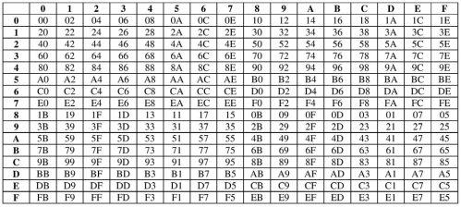
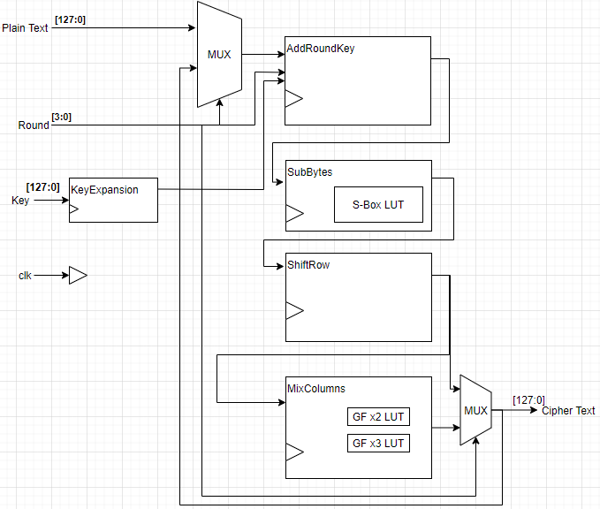
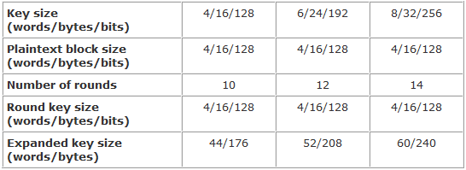
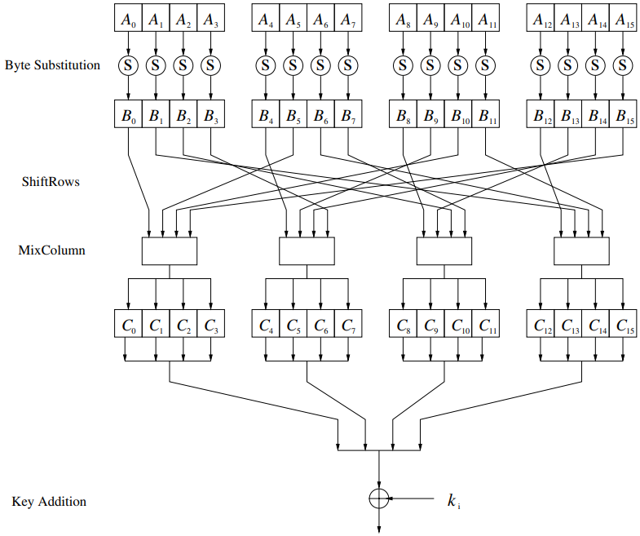
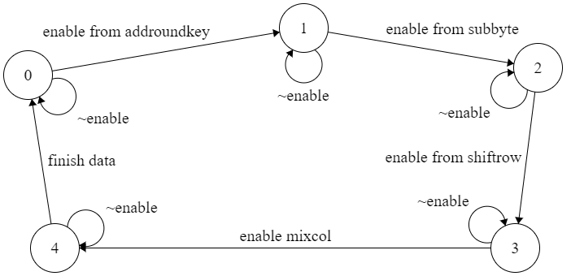
Efficient Hardware Implementation of AES
Department of
Electronics & Communication Engineering
Name: Sachleen S. Chani Mentor: Dr. Vijaypal Singh Rathor
Roll No. : 101506143
Abstract
Hardware implementation of cryptographic algorithms is inherently more secure.
An effective way to implement the AES algorithm in FPGA is explored in this project.
Higher speeds and lesser area could be achieved by designing the SubBytes and MixColumns layers as a Look Up Tables (LUTs) and ROMs.
Look Up Tables and ROM Implementation
Implementation utilizes LUTs (ROM) for the S-box SubBytes layer, multiplication in MixColumns layer [2].
This reduces the computation cost otherwise needed for matrix multiplication in Galois field GF(2⁸).
Introduction
To securely transmit data, cryptography is used. There are two types of cryptographic systems: Symmetric and Asymmetric.
Symmetric cypher algorithms use identical keys for the sender and the receiver.
Rijndael algorithm , which is a symmetric, block cryptosystem, was chosen as the Advanced Encryption Standard (AES) by the NIST on 2nd Oct 2000.
Hardware implementation provides greater speeds and higher reliability with large amount of data [1].
Galois Multiplication by 2 LUT
Verilog Implementation
Advanced Encryption Standard
AES algorithm is very robust because of the different key lengths, which results in AES-128, AES-192 and AES-256 format encryption for a 128-bit (16 word) block data.
For this project, the implementation is using a key length of 128 bits.
The Key is expanded into 44-word key.
AES Parameters
AES round description
SubBytes uses a LUT to substitute input 8-bits.
ShiftRows rotates the rows of the 16-byte block through a fixed pattern.
In the MixColumns layer multiplication of the block data is performed in Galois field GF(2⁸).
Top Level block diagram
This is a Moore FSM; the states depend on the internal enable.
This implementation represents only first round for the AES. FSM stays in a state until the calculation of the state is not finished.
AES State diagram
AES Round Functions
References
[1] P. S. Abhijith, M. Srivastava, A. Mishra, M. Goswami, and B. R. Singh, "High performance hardware implementation of AES using minimal resources," pp. 338-343, 2013, doi: 10.1109/ISSP.2013.6526931.
[2] W. McLoone and J. V. McCanny, "Rijndael FPGA implementation utilizing look-up tables," vol. 34, pp. 349-360, 2001, doi: 10.1109/SIPS.2001.957363.

