Slide 1
Efficient Hardware Implementation of Advanced Encryption Standard (AES)
By: Sachleen S. Chani

Slide 2
Contents
Introduction
Why FPGAs?
Advanced Encryption Standard Algorithm
Proposed Design
Implementation and Simulation results
Conclusion and further scope
Notes:
-- the need and importance of encryption
-- the proposed design to solve the problem
-- simulation results

Slide 3
1. Introduction
With most data being shared and stored electronically we need a secure method to handle the data.
To not create a bottleneck on the network speeds, algorithms must at least have equivalent speeds to data transmission speeds.
Efficient implementation of Rijndael algorithm (AES-128) is explored in this project.
The proposed design reduces the area used by 62% while achieving the throughput speed 0.974 Gbps. The power consumption is relatively lower as compared to at 0.33W [2].
The implementation is done on Xilinx Virtex-7 XC7VX690T FPGA and the simulation and synthesis has been run using Xilinx Vivado Design Suit 2020.2
Notes:
-- security and secure way to send data
-- various cryptographic algos
-- need an efficient way to encrypt
-- AES-128 implemented
-- solved the problem by reduced resources used on-board + low power consumption

Slide 4
2. Why FPGAs?
Implementation on a FPGA gives flexibility and reliability compared to the software implementation.
Another advantage of using FPGA over software is the algorithm agility.
There are various hardware implementation to meet numerous application requirements, which all can be easily implemented on an FPGA.
Implementations in [10], [12] and [14] were able to a achieve 20-30 Gbps by using loop unrolling and pipelining.
The approach taken in [4] demonstrated a 73.7 Gbps.
A compact, low-cost approach is investigated in [13] which uses an inexpensive Spartan II FPGA .
Although software implementation gives ease of use and upgradability, flexibility, but there are downsides to it as well such as limited physical security.
Notes:
-- fpgas give reliable way to implement the encryption and decryption.
-- physical security, even if the OS is compromised, the data may still be secure.
-- FPGAs chosen as they give the agility to modify the algorithm
-- hardware implementation can give high speeds
--- and even low speeds for reduced implementation costs for the needs

Slide 5
3. Advanced Encryption Standard Algorithm
AES has a 128-bit block size with 128, 192 and 256-bit key sizes chosen independently. Accordingly, the number of rounds are 10, 12 and 14, respectively.
In this implementation AES-128 is used.
Each round has 4 operations :
SubBytes
ShiftRows
MixColumns
AddRoundkey.
The 128-bit(4-word) key is expanded to 44-word key through Key Expansion process.
The plaintext input is arranged in 4x4 16-byte matrix called State Matrix.
AES encryption block diagram [5]
Notes:
-- robust with diff bit lengths
-- how many rounds and round operations
-- key expansion

Slide 6
a) SubBytes operation
The SubBytes layer adds non-linearity in the cipher making it tougher for cryptanalysis.
This operation takes each 1-byte value from the state matrix and substitutes it with another 1-byte value using the S-box.
First 4 bits tells the row, and the last 4 bits tells the column.
S-box: Substitution values in base 16 [9]

Slide 7
b) ShiftRows operation
ShiftRows operation shifts each byte in a row cyclically to the left by a certain amount.
The first row remains unchanged
The second is shifted to the left by an offset of 1 byte
Third row is shifted left by 2 bytes.
The fourth row is shifted by an offset of 3 bytes to the left.
No hardware area used as the input wires are mapped to the output wires after the offset.
a) before ShiftRows function, b) after ShiftRows

Slide 8
c) MixColumns operation
Vector multiplication of each column of state matrix to a 4x4 fixed matrix.
Each individual multiplication and addition is performed in the GF(2⁸).
C₀ = {02}.B₀ + {03}.B₅ + {01}.B₁₀ + {01}.B₁₅
Multiplication by two means bitwise left shift followed by a conditional XOR if the MSB is high before the shift.
MixColumns multiplication for each column [5]

Slide 9
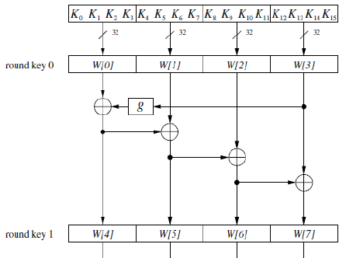
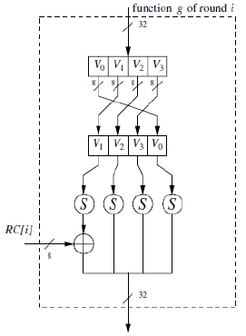
d) AddRoundkey operation and Key Expansion
A bitwise exclusive-OR (XOR) operation is performed between the output state matrix from the MixColumns function and the round key obtained from key expansion operation.
The key expansion operation expands the given 128bit key to 44-word key. Each of the 4-word is used in each round operation.
The g() function has the following operations:
RotWord
SubBytes
RCon
The round constant value varies from round to round, but it is always an element of the Galois field GF(2⁸).
AES key expansion [5]

Slide 10
4. Proposed Design
Two operations in the AES algorithm, SubBytes and MixColumns are expansive transformations in terms of computational resources [11].
The SubBytes operation is already optimized in most of the AES implementations by using a look-up table rather than computing the inverse and vector addition in GF(2⁸).
In this project the MixColumns operation is optimized for efficient performance.
The Proposed design implementation is aimed at reducing the area and increasing the speed by using LUTs and ROMs.
The resource area and computational time decreases significantly [7].
Mixcolumns block diagram
Notes:
-- computation resource expensive operations mixcolumn and subbytes= inverse + vector add
-- proposed design of LUTs
-- reduced computation
-- time and area saved

Slide 11
Instead of computing the multiplication in GF(2⁸) by 2 and 3, Look-up Tables (LUTs) are used.
The values are mapped exactly like it’s done for S-boxes. Each LUT ROM has address lines and data lines of size 8-bits
{02}35 = 6A
{03}F5 = 04
Galois Multiplication LUT for multiply by 2 [7]
Galois Multiplication LUT for multiply by 3 [7]
Notes:
--look up value instead of computing
-- elaborate on the example

Slide 12
To optimize the key expansion, it is implemented as a ROM.
All the round keys are computed at the start of the encryption process.
Whole 44-word key is stored in a 11x1 ROMs each having a size of 128-bits.
This further reduced the complexities provided by on-the-fly key generation [2].
The implementation of the encryption algorithm is done using a FSM.
Each round operation implemented in a separate module.
State0 – Add first round key
State1 – SubBytes
State2 – ShiftRows
State3 – MixColumns
State4 – AddRoundkey
State5 – Complete
AES encryption FSM
Notes:
-- key expansion computed as a ROM before encryption start
-- no on-the-fly key computation
-- FSM used and each states meaning

Slide 13
5. Implementation and Simulation Results
The target Device is Virtex-7 XC7VX690TFFG1761-1.
The proposed algorithm is simulated and synthesized using the Xilinx Vivado Design Suit 2020.2.
All the individual operations were coded in separate modules and tested for their correct functionality.
The ‘ready’ signal goes from low to high when the encryption process is complete.
‘en’ signal enables the encryption module.
Encryption simulation result waveform
Notes:
--board used and software
-- sim results
-- sim goes through FSM

Slide 14
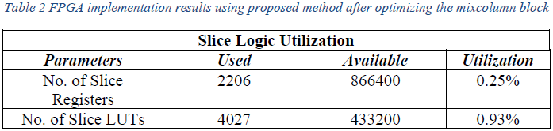
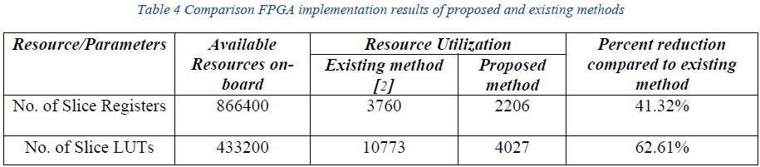
Table 2 shows the results after the synthesis of the design on the target board.
The area utilization is 0.93% (<1%).
There is a reduction of area used by 62.61% by the implementation of LUTs and ROMs for MixColumns and Key Expansion operations compared to [2].
Maximum path delay is 4.380 ns, the maximum frequency is 228.31 MHz
The throughput achieved is 0.974 Gbps
Power consumption of the design is 0.33W
Result comparison between proposed method and existing method [2]
Notes:
-- talk about the results
-- compare with the paper cited
--how results better

Slide 15
6. Conclusion and further scope
In this project, effective hardware implementation of AES-128 encryption is presented.
The implementation was done on XC7VX690T chipset, of Xilinx Virtex-7 family FPGA.
It is well designed to meet the requirements of efficient design. Look-up table (LUT) based approach saves processing time and reduces the complex architecture.
With the SubBytes and MixColumns operations as LUTs, the throughput of 0.974 Gbps was achieved, which is comparable to [2] AES-128 throughput.
The resource utilization is 0.93% (<1%) with the power consumption of 0.33W
The overall design is found to have good efficiency in terms of power, area, and throughput.
This implementation can be incorporated in larger designs due to its small resource utilization.
The design can be further improved in performance by using parallel processes and pipelining.
Notes:
-- reiterate the problem
-- mention the result of only 1% resource utilization
0.97 Gbps throughput
and low power
--the design can include larger designs
-- design improved by using parallel prcesses and pipelining

Slide 16
References
[1] I. Verbauwhede, P. Schaumont, and H. Kuo, "Design and performance testing of a 2.29-GB/s Rijndael processor," IEEE Journal of Solid-State Circuits, vol. 38, no. 3, pp. 569-572, 2003, doi: 10.1109/JSSC.2002.808300.
[2] N. S. S. Srinivas and M. Akramuddin, "FPGA based hardware implementation of AES Rijndael algorithm for Encryption and Decryption," in 2016 International Conference on Electrical, Electronics, and Optimization Techniques (ICEEOT), 3-5 March 2016 2016, pp. 1769-1776, doi: 10.1109/ICEEOT.2016.7754990.
[3] P. V. S. Shastry, A. Agnihotri, D. Kachhwaha, J. Singh, and M. S. Sutaone, "A combinational logic implementation of S-box of AES," in 2011 IEEE 54th International Midwest Symposium on Circuits and Systems (MWSCAS), 7-10 Aug. 2011 2011, pp. 1-4, doi: 10.1109/MWSCAS.2011.6026559.
[4] S. Qu, G. Shou, Y. Hu, Z. Guo, and Z. Qian, "High Throughput, Pipelined Implementation of AES on FPGA," in 2009 International Symposium on Information Engineering and Electronic Commerce, 16-17 May 2009 2009, pp. 542-545, doi: 10.1109/IEEC.2009.120.
[5] C. Paar and J. Pelzl, Understanding Cryptography: A Textbook for Students and Practitioners. 2010.
[6] D. Mukhopadhyay and D. RoyChowdhury, "An efficient end to end design of Rijndael cryptosystem in 0.18 /spl mu/ CMOS," in 18th International Conference on VLSI Design held jointly with 4th International Conference on Embedded Systems Design, 3-7 Jan. 2005 2005, pp. 405-410, doi: 10.1109/ICVD.2005.49.
[7] W. McLoone and J. V. McCanny, "Rijndael FPGA implementation utilizing look-up tables," vol. 34, pp. 349-360, 2001, doi: 10.1109/SIPS.2001.957363.
[8] B. Liu and B. M. Baas, "Parallel AES Encryption Engines for Many-Core Processor Arrays," IEEE Transactions on Computers, vol. 62, no. 3, pp. 536-547, 2013, doi: 10.1109/TC.2011.251.
[9] N. James et al., "Advanced Encryption Standard (AES)," (in - en), Journal of Research of the National Institute of Standards and Technology, vol. 106, 3, pp. 511-577, 2001.
[10] A. Hodjat and I. Verbauwhede, "A 21.54 Gbits/s fully pipelined AES processor on FPGA," in 12th Annual IEEE Symposium on Field-Programmable Custom Computing Machines, 20-23 April 2004 2004, pp. 308-309, doi: 10.1109/FCCM.2004.1.
[11] R. Doud, "Hardware crypto solutions Boost VPN," Electron Eng. Times, pp. 57-64, 1999.
[12] J. Criado, M. A. Vega-Rodríguez, J. Sánchez-Pérez, and J. A. Gomez-Pulido, "A new methodology to implement the AES algorithm using partial and dynamic reconfiguration," Integration, vol. 43, pp. 72-80, 01/31 2010, doi: 10.1016/j.vlsi.2009.05.003.
[13] P. Chodowiec and K. Gaj, Very compact FPGA implementation of the AES algorithm. 2003, pp. 319-333.
[14] C. Chi-Jeng, H. Chi-Wu, C. Kuo-Huang, C. Yi-Cheng, and H. Chung-Cheng, "High throughput 32-bit AES implementation in FPGA," in APCCAS 2008 - 2008 IEEE Asia Pacific Conference on Circuits and Systems, 30 Nov.-3 Dec. 2008 2008, pp. 1806-1809, doi: 10.1109/APCCAS.2008.4746393.
[15] P. S. Abhijith, M. Srivastava, A. Mishra, M. Goswami, and B. R. Singh, "High performance hardware implementation of AES using minimal resources," pp. 338-343, 2013, doi: 10.1109/ISSP.2013.6526931.

Slide 17
Thank You

