Slide 1
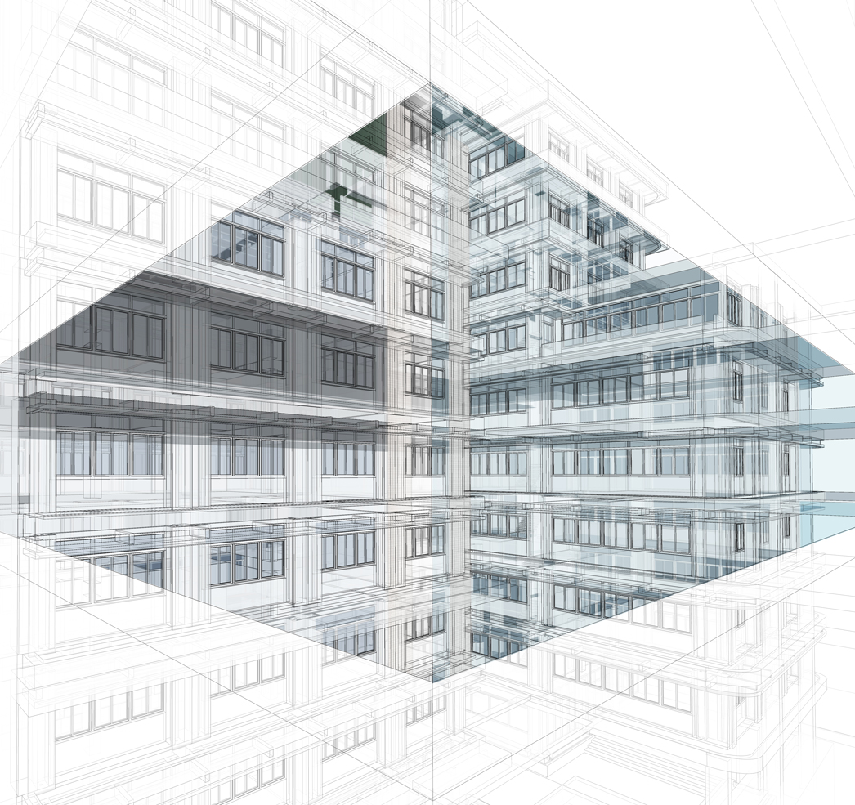
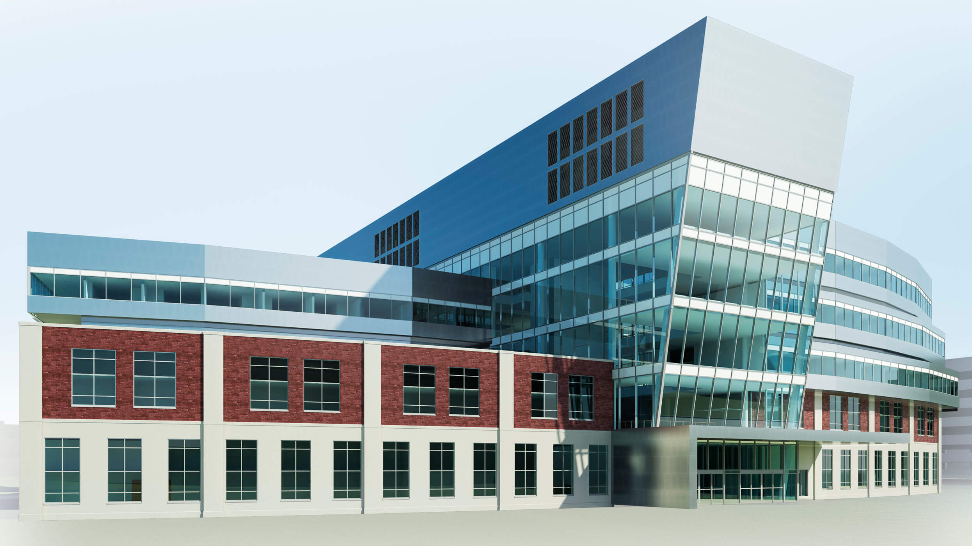
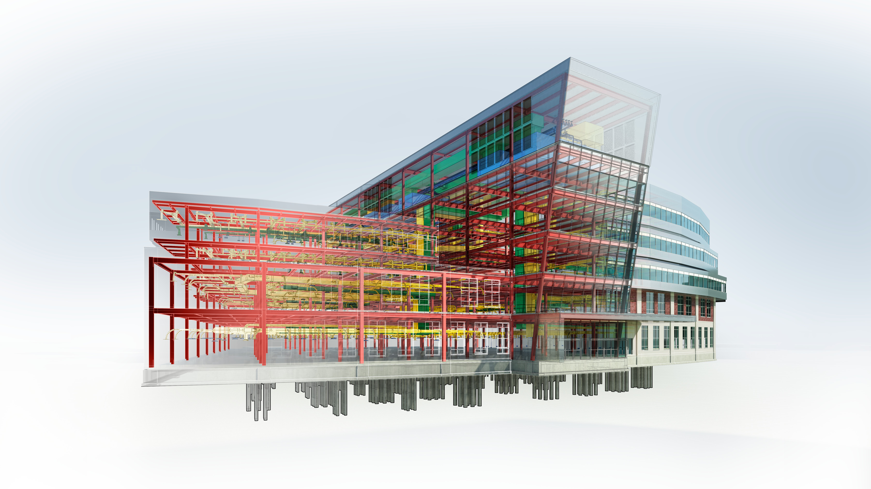
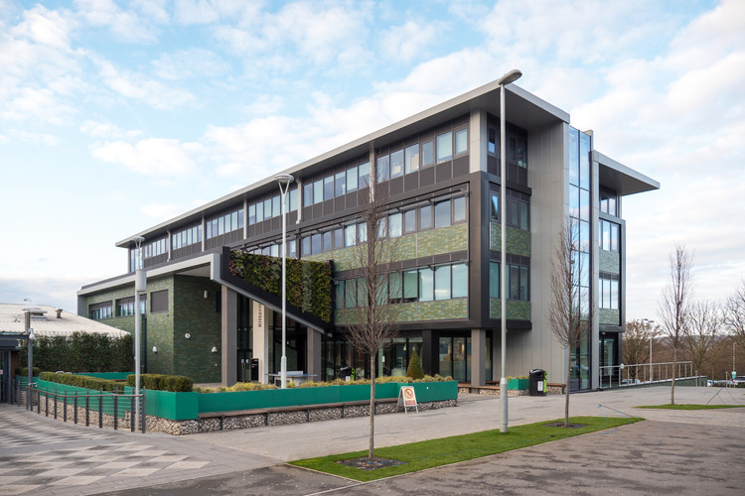
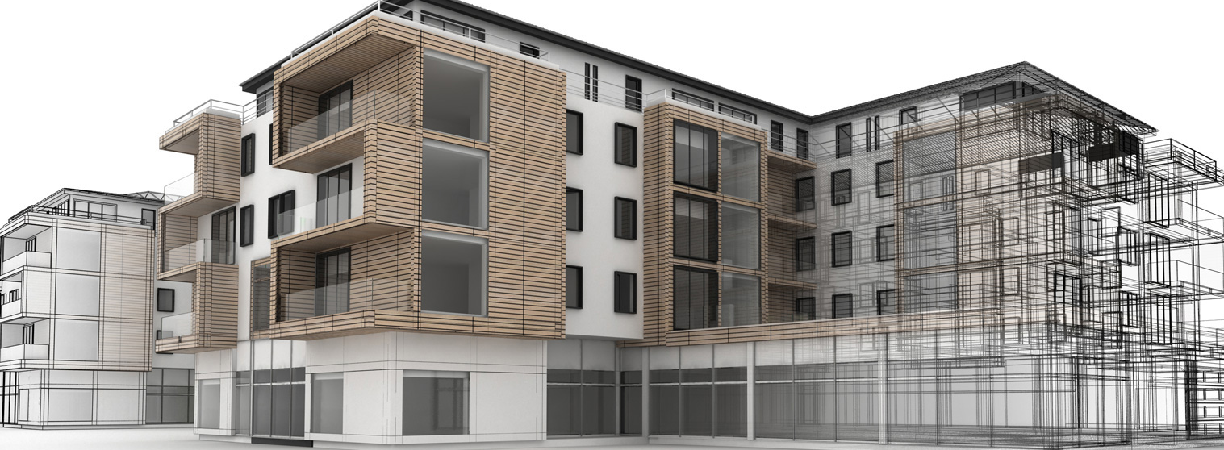
BIM
BUILDING INFORMATION
MODELLING

Slide 2
BENEFITS
COST
RETURN ON INVESTMENT (ROI)
AREAS TO BE COVERED:
COST- BENEFITS ANALYSIS
Case Study from BIM Practiser
PROJECT
FOCUS AREA:
ORGANIZATION

Slide 3
vs
PROJECT
ORGANIZATION
10 CASE STUDY
5 years of ROI
Through different constructionstage
ROI = Net Revenue – Operating Cost
Design
Development
Pre-design
Schematic
Design
Construction
Document
Post
Construction
Construction

Slide 4
Establish Criteria
Test criteria
Evaluate
Validation
COST
Operation
Initial
Maintenance
BENEFITS
Cost
Productivity
Quality
Communication
&
Coordination
Time

Slide 5
 | Evaluation Method | Remarks
Initial Stage
Hardware Supplies | No(s) of hardware x unit costs | - Depends on vendor - Quantity of hardware purchase
Desktops | No(s) of desktop x unit costs | - Depends on vendor - Quantity of desktop purchase
Software supplies and purchasing | No(s) of software x unit costs | - costs of software - years of licensing
Workplace installation |  | - new setup of workplace
Telecommunication equipment purchasing |  | - telephone lines, WIFI installation, television/screen
Cost of management and staff dealing with procurement | No(s) of staff x monthly basis
Cost of start-up personnel (BIM user)
- BIM Manager | No(s) of staff x monthly basis
- BIM Coordinator | No(s) of staff x monthly basis
- BIM Modeller | No(s) of staff x monthly basis

Slide 6
 | Evaluation Method | Remarks
Operation Stage
Consulting costs |  | - consult with experience BIM user/company
Cost of communications equipment installation (telephone lines, data lines, etc.) |  | - lump sum value for communication costs
Cost of personnel searches and hiring activities
Cost of personnel (BIM user)
- BIM Manager | No(s) of staff x monthly basis | - including increments/year
- BIM Coordinator | No(s) of staff x monthly basis
- BIM Modeller | No(s) of staff x monthly basis
Cost for interacting with users during development

Slide 7
Con’t..
Cost for staff training | No(s) of staff x training costs
Rental costs | Costs per month | Office rental costs
Depreciation costs on hardware | Cost of hardware x 60% depreciation | - based on 60% Depreciation Rates for Financial Year 2017-18 & Assessment Year 2018-19
Depreciation costs on software | Cost of software x 60% depreciation
Software licensing | Cost of license x number of software | - based on annum licensing
Server Upgrading |  | - lump sum

Slide 8
 | Evaluation Method | Remarks
Maintenance Stage
Workplace upgrading |  | - lump sum value for upgrading workplace
Cost of BIM software upgrading to fit current technology and version
System maintenance costs – hardware | No(s) of hardware x Hardware maintenance costs
System maintenance costs – software | No(s) of software x Software maintenance costs
System maintenance costs – server |  | - lump sum for server maintenance

Slide 9
BIM BENEFITS
Please fill in the rank in Google Forms.
https://docs.google.com/forms/d/e/1FAIpQLSdOJQfY0NwvIXA7oe2raCRGxkq_JZe6KkX3rYhkugqsz_LtEQ/viewform
Possibility of all parties to perform checks directly on the 3D model, which can shorten the lead times
BIM reduces the abstraction and integrates the multiple disciplines, including design and documentation
Accelerate the project design faster than conventional process
Feasibility study and conceptual design benefits which include enhanced processes and reduction in unnecessary time required
The time needed to change plans can be potentially reduced and the value of space could be improved by optimization
Time

Slide 10
Cost Estimating Features
Avoid project delay and construction cost overrun
Extraction of bill of quantities for cost estimation
Performing checks directly on the 3D model, remove the costs of printing documents and/or electronic sharing of multiple 2D drawing files
Cost estimation accuracy compared to traditional estimates
Cost
Conceptual design stage, quantity take-offs can be fully automated, saving much of the effort required for preparation of tender documents
Improved procurement process with increased accuracy in automated quantity take-off process
Perform a variety of complementary tasks, including energy or environmental analysis, visualization, construction simulation, and improving the accuracy of documentation
Improves the productivity of design documentation
Enhanced 3D coordination
Productivity

Slide 11
Quality
Improved quality of design and documentation (accuracy and reliability of documents)
Automated updates of plans once families are accurately set-up
Enhanced visualization of project
Early Detection of Problems/Reduce Errors through Virtual design and construction by using BIM
Avoid data or information lost
Supports the concept of integrated project delivery through integrate people, systems, and business structures and practices into a collaborative process
Allowing all design team members (owners, architects, engineers, contractors, subcontractors, and suppliers) to collaborate more accurately and efficiently
Conflict, interference, and collision detection
Provides greater potential for early collaboration and information sharing than traditional methods
Minimized risk of discrepancies between plan, section and elevation
Communication
&
Coordination

Slide 12
References
1. https://www.bankbazaar.com/tax/depreciation-rates-for-ay-2015-2016.html?ck=Y%2BziX71XnZjIM9ZwEflsyDYlRL7gaN4W0xhuJSr9Iq7aMYwRm2IPACTQB2XBBtGG&rc=1

