Slide 1
KPI P2-055
PRODUCTIVITY
KPI DESCRIPTION Report on construction manpower supply and demand, published annually from Q4 2017 onwards
INITIATIVE P2 - Enhance control and balance of workforce supply
SUB-INITIATIVE P2a - Implement regular industry manpower planning
SPONSOR En Megat Kamil Azmi Megat Rus Kamarani
OWNER Ahmad Ridzuan Ismail
OIC Nurul Hidayah Abdul Ghani
KPI LEADER CIDB
ANNUAL TARGET
2016 Weightage : 10% | 2017 Weightage : 50% | 2018 Weightage : 20% | 2019 Weightage : 10% | 2020 Weightage : 10%
10% of Manpower Study draft completed by Q4 2016 | Manpower Study finalised and published by Q4 2017 | Presentation on manpower study to related agencies and manpower projection 2017 by Q1 2018 Analysis report and manpower status 2017 by Q2 2018 Manpower projection 2018 published by Q4 2018 | Analysis report and manpower status 2018 by Q2 2019 Manpower projection 2020 published by Q4 2019 | Analysis report and manpower status 2019 by Q2 2020 Manpower projection 2021 published by Q4 2020
PROGRESS REPORT UNTIL Q3 2018
This KPI is under the purview of IWG9.
UPM Consultancy & Services Sdn Bhd was appointed in 2016 to conduct the manpower study. The ‘Kajian Pengurusan Modal Insan Dalam Industri Pembinaan Di Malaysia’ was published on 26 Dec 2017. Recommendation as a result of the findings under this study is useful for multiple agencies with interest such as the Ministry of human Resource (MOHR), Ministry of Home Affairs (MOHA), Majlis Amanah Rakyat (MARA) and others.
This is the summary of the manpower study:
Objektif kajian:
Mengkaji permintaan dan penawaran terhadap personel pembinaan di Malaysia
Mengkaji strategi dan amalan terbaik di negara lain : (United Kingdom, United Arab Emirates (UAE), Singapura, Jerman dan Australia)
Mencadangkan strategi yang sewajarnya dalam merasionalisasikan personel tempatan dan asing
Menghasilkan model dan kaedah unjuran terhadap penawaran dan permintaan pekerja binaan
Menganggarkan ketidakcukupan keperluan personel dalam industri pembinaan sehingga 2030.
Penemuan:
Construction Personnel Modelling System (CoPMos) telah dibangunkan bagi menghasilkan unjuran permintaan dan penawaran personel binaan di Malaysia sehingga tahun 2020. Model ini boleh digunakan bermula 2018. CopMos juga boleh digunapakai sehingga tahun 2030 dengan input parameter tahunan terkini.
Dashboard Penanda Aras dengan negara maju telah dibangunkan bagi mengenalpasti amalan terbaik dalam pengurusan tenaga kerja dalam industri pembinaan.
Human Capital Management Model (HCMM) dibangunkan bagi mengenalpasti penawaran personel tempatan sebagai pilihan utama sebelum kemasukan pekerja asing dibuat. Sebarang kekurangan akan menjadi asas kepada pembangunan modul latihan oleh institusi TVET.
Manpower Master Plan akan dikeluarkan secara tahunan bagi digunakan oleh kerajaan dan industri dalam merancang pembangunan tenaga kerja.
Blueprint keperluan personel dalam sektor pembinaan akan dikeluarkan secara tahunan berdasarkan kategori MASCO 4-digit.
Presentation of Study to Related Agencies
KSU Kementerian Kerja Raya on 7 February 2018.
TWG3/P on 6 March 2018
Jawatankuasa Kerja Dasar, KKR on 10 April 2018
UPMCS appointed Pn Satariah Awang Kecik as the ‘proof reader’ from 11 Jan – 17 Jan 2017 as per commented during CITP-IWG9/P2 meeting on 26 Dec 2018 to review the entire report.
Draft analysis report and manpower status 2017 has been presented to GM BPPB on 27 June 2018.
The final draft of analysis report and manpower status 2017 has been submitted on 2 July 2018.
Analysis report and manpower status 2017 was presented to SO on 6 August 2018.

Slide 2
KPI P2-055
PRODUCTIVITY
KPI DESCRIPTION Report on construction manpower supply and demand, published annually from Q4 2017 onwards
INITIATIVE P2 - Enhance control and balance of workforce supply
SUB-INITIATIVE P2a - Implement regular industry manpower planning
SPONSOR En Megat Kamil Azmi Megat Rus Kamarani
OWNER Ahmad Ridzuan Ismail
OIC Nurul Hidayah Abdul Ghani
KPI LEADER CIDB
ANNUAL TARGET
2016 Weightage : 10% | 2017 Weightage : 50% | 2018 Weightage : 20% | 2019 Weightage : 10% | 2020 Weightage : 10%
10% of Manpower Study draft completed by Q4 2016 | Manpower Study finalised and published by Q4 2017 | Presentation on manpower study to related agencies and manpower projection 2017 by Q1 2018 Analysis report and manpower status 2017 by Q2 2018 Manpower projection 2018 published by Q4 2018 | Analysis report and manpower status 2018 by Q2 2019 Manpower projection 2020 published by Q4 2019 | Analysis report and manpower status 2019 by Q2 2020 Manpower projection 2021 published by Q4 2020
PROGRESS REPORT UNTIL Q3 2018 (con’t)
This KPI is under the purview of IWG9.
Meeting with IBS unit on the impact of IBS on manpower supply on 16 March 2018.
Draft analysis report and manpower status 2017 has been presented to GM BPPB on 27 June 2018.
The final draft of analysis report and manpower status 2017 has been submitted on 2 July 2018.
Analysis report and manpower status 2017 has been presented to SO on 6 August 2018.

Slide 3
KPI P2-056
PRODUCTIVITY
KPI DESCRIPTION All qualified skilled workers and supervisory personnel accredited from Q4 2016 onwards
INITIATIVE P2 - Enhance control and balance of workforce supply
SUB-INITIATIVE P2a - Implement regular industry manpower planning
SPONSOR En Megat Kamil Azmi Megat Rus Kamarani
OWNER Ahmad Ridzuan Ismail
OIC Nurul Hidayah Abdul Ghani
KPI LEADER CIDB
ANNUAL TARGET
2016 Weightage : 20% | 2017 Weightage : 20% | 2018 Weightage : 20% | 2019 Weightage : 20% | 2020 Weightage : 20%
Schedule 3 of Act 520 on skills trades reviewed and gazzeted by Q3 2016 | 100% of 2017 application by assessed skilled workers and supervisory personnel accredited and registered | 2017 Data analytics on accredited skilled workers and supervisory personnel produced by Q1 2018 100% of 2018 application by assessed skilled workers and supervisory personnel accredited and registered | 2018 Data analytics on accredited skilled workers and supervisory personnel produced by Q1 2019 100% of 2019 application by assessed skilled workers and supervisory personnel accredited and registered | 2019 Data analytics on accredited skilled workers and supervisory personnel produced by Q1 2020 100% of 2020 application by assessed skilled workers and supervisory personnel accredited and registered
PROGRESS REPORT UNTIL Q3 2018
This KPI is under the purview of IWG9.
Mandatory accreditation of 59 trades of skilled workers and supervisory personnel under CIDB Act 520 Amended 2011 came into force on 1 June 2016. The Amended Schedule 3 of Act 520 currently have only 25 trades of skilled workers and supervisory personnel gazetted on 10 February 2017.
Until December 2017, 100% of 89,256 (66,024 + 23,232) application received from assessed skilled workers and supervisory personnel were accredited and registered by CIDB.
Data 2017 (until Dec 2017)
The table below shows the total number of construction personnel listed by CIDB under the 6 categories of workers as of December 2017. For the purpose of this KPI, only category 2 and category 5 is relevant.
KATEGORI | TEMPATAN | ASING | JUMLAH
1. PEKERJA BINAAN AM | 281,326 | 89,377 | 370,703
2. PEKERJA BINAAN MAHIR | 63,671 | 2,353 | 66,024
3. PELATIH BINAAN | 78,316 | 18 | 78,334
4. PENGURUS PROJEK BINAAN | 66,101 | 1,862 | 67,963
5. PENYELIA BINAAN | 22,986 | 246 | 23,232
6. PERSONEL PENTADBIRAN | 93,848 | 1,921 | 95,405
TOTAL: | 605,884 | 95,777 | 701,661

Slide 4
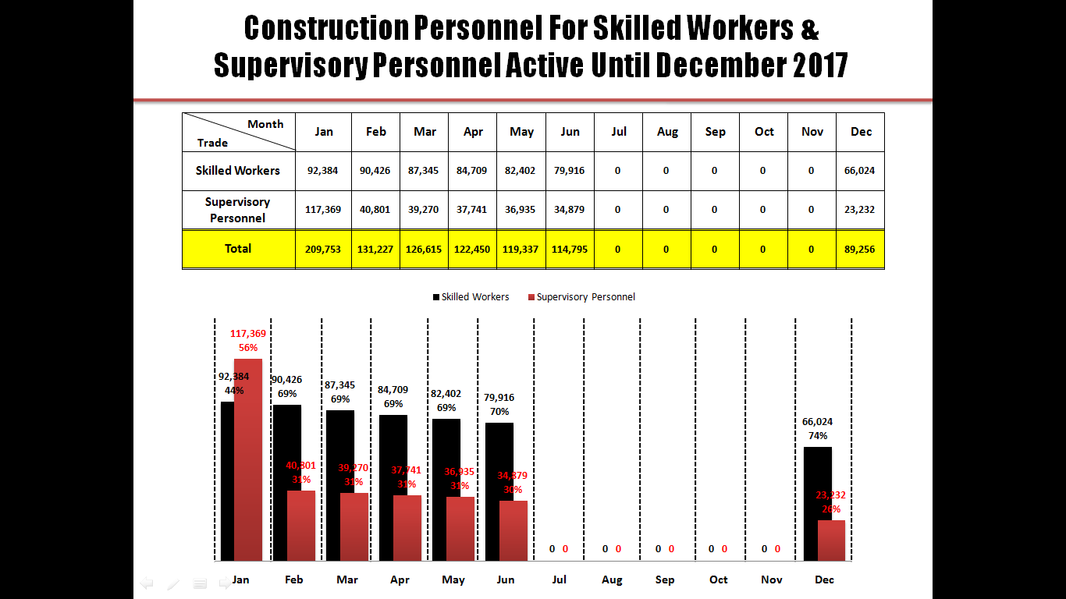
KPI P2-056
PRODUCTIVITY
KPI DESCRIPTION All qualified skilled workers and supervisory personnel accredited from Q4 2016 onwards
INITIATIVE P2 - Enhance control and balance of workforce supply
SUB-INITIATIVE P2a - Implement regular industry manpower planning
SPONSOR En Megat Kamil Azmi Megat Rus Kamarani
OWNER Ahmad Ridzuan Ismail
OIC Nurul Hidayah Abdul Ghani
KPI LEADER CIDB
ANNUAL TARGET
2016 Weightage : 20% | 2017 Weightage : 20% | 2018 Weightage : 20% | 2019 Weightage : 20% | 2020 Weightage : 20%
Schedule 3 of Act 520 on skills trades reviewed and gazzeted by Q3 2016 | 100% of 2017 application by assessed skilled workers and supervisory personnel accredited and registered | 2017 Data analytics on accredited skilled workers and supervisory personnel produced by Q1 2018 100% of 2018 application by assessed skilled workers and supervisory personnel accredited and registered | 2018 Data analytics on accredited skilled workers and supervisory personnel produced by Q1 2019 100% of 2019 application by assessed skilled workers and supervisory personnel accredited and registered | 2019 Data analytics on accredited skilled workers and supervisory personnel produced by Q1 2020 100% of 2020 application by assessed skilled workers and supervisory personnel accredited and registered
PROGRESS REPORT UNTIL Q3 2018 (con’t)
Data Analytic 2017
The graph below shows the trend of skilled worker and supervisory personnel accredited and registered by CIDB from January until December 2017.
Data collection from July to November 2017 was not available due to data cleaning from SMB system to CIMS.

Slide 5
KPI P2-056
PRODUCTIVITY
KPI DESCRIPTION All qualified skilled workers and supervisory personnel accredited from Q4 2016 onwards
INITIATIVE P2 - Enhance control and balance of workforce supply
SUB-INITIATIVE P2a - Implement regular industry manpower planning
SPONSOR En Megat Kamil Azmi Megat Rus Kamarani
OWNER Ahmad Ridzuan Ismail
OIC Nurul Hidayah Abdul Ghani
KPI LEADER CIDB
ANNUAL TARGET
2016 Weightage : 20% | 2017 Weightage : 20% | 2018 Weightage : 20% | 2019 Weightage : 20% | 2020 Weightage : 20%
Schedule 3 of Act 520 on skills trades reviewed and gazzeted by Q3 2016 | 100% of 2017 application by assessed skilled workers and supervisory personnel accredited and registered | 2017 Data analytics on accredited skilled workers and supervisory personnel produced by Q1 2018 100% of 2018 application by assessed skilled workers and supervisory personnel accredited and registered | 2018 Data analytics on accredited skilled workers and supervisory personnel produced by Q1 2019 100% of 2019 application by assessed skilled workers and supervisory personnel accredited and registered | 2019 Data analytics on accredited skilled workers and supervisory personnel produced by Q1 2020 100% of 2020 application by assessed skilled workers and supervisory personnel accredited and registered
PROGRESS REPORT UNTIL Q3 2018 (con’t)
Data 2018 (Until June 2018)
The table below shows the total number of construction personnel listed by CIDB under the 6 categories of workers as of June 2018. For the purpose of this KPI, only category 2 and category 5 is relevant.
Data 2018 (Until September 2018)
The table below shows the total number of construction personnel listed by CIDB under the 6 categories of workers as of June 2018. For the purpose of this KPI, only category 2 and category 5 is relevant.
KATEGORI | TEMPATAN | ASING | JUMLAH
1. PEKERJA BINAAN AM | 327,910 | 105,783 | 433,693
2. PEKERJA BINAAN MAHIR | 69,169 | 3,517 | 72,686
3. PELATIH BINAAN | 81,234 | 14 | 81,248
4. PENGURUS PROJEK BINAAN | 82,199 | 3,063 | 85,262
5. PENYELIA BINAAN | 19,955 | 303 | 20,258
6. PERSONEL PENTADBIRAN | 96,531 | 3,391 | 99,922
TOTAL: | 676,998 | 116,071 | 793,069
KATEGORI | TEMPATAN | ASING | JUMLAH
1. PEKERJA BINAAN AM | 349,943 | 112,292 | 462,235
2. PEKERJA BINAAN MAHIR | 71,574 | 3,535 | 75,109
3. PELATIH BINAAN | 80,908 | 13 | 80,921
4. PENGURUS PROJEK BINAAN | 89,145 | 3,463 | 92,608
5. PENYELIA BINAAN | 18,577 | 266 | 18,843
6. PERSONEL PENTADBIRAN | 96,378 | 3,645 | 100,023
TOTAL: | 706,525 | 123,214 | 829,739

Slide 6
KPI P2-057
PRODUCTIVITY
KPI DESCRIPTION Tiered-visa programme implemented by Q1 2019
INITIATIVE P2 - Enhance control and balance of workforce supply
SUB-INITIATIVE P2b - Introduce mechanisms to raise skills mix for intake of foreign workers
SPONSOR En Megat Kamil Azmi Megat Rus Kamarani
OWNER Ahmad Ridzuan Ismail
OIC Nurul Hidayah Abdul Ghani
KPI LEADER CIDB
ANNUAL TARGET
2016 | 2017 | 2018 Weightage : 60% | 2019 Weightage : 40% | 2020
 |  | New policy on tiered–visa approved by JKKPA-PATI by Q4 2018 | Tiered visa implemented for construction workers beginning Q1 2019
Note: 2016 - 2017
Subject to manpower study and policy approval by JKKPA-PATI
PROGRESS REPORT UNTIL Q3 2018
This KPI is under the purview of IWG9.
New Policy On Tiered–Visa
JKKPA-PATI approved the same programme of Tiered Visa programme that presented by ILMIA, KSM as known as Multi-Tier Levy on 17 August 2017 chaired by Deputy Prime Minister. The Multi-Tier Levy covers all sectors in Malaysia including construction sector.
UNIMAS was appointed by ILMIA to conduct a study on “Developing Multi-Tier Levy: Malaysian Case Study” for all sectors in Malaysia including construction sector.
The multi-tier levy study inception report was approved by the Technical Committee chaired by ILMIA on 2 March 2018.
Development of multi-tier levy workshop was conducted on 8 March 2018 with ILMIA and related agencies.
The multi-tier levy study interim report was approved by the committee chaired by ILMIA on 19 March 2018.
The mechanism of multi-tier levy has been presented to KKR on 6 April 2018.
Workshop focusing on construction industry has been conducted on 9 – 11 April 2018.
4 Townhall has been conducted as per below:
North: 16 July 2018
South: 9 July 2018
Center: 10 July 2018
East: 18 July 2018

Slide 7
KPI P2-058
PRODUCTIVITY
KPI DESCRIPTION Proportion of skilled : unskilled foreign labour improved from 5 : 95 to 15 : 85 by Q4 2020
INITIATIVE P2 - Enhance control and balance of workforce supply
SUB-INITIATIVE P2b - Introduce mechanisms to raise skills mix for intake of foreign workers
SPONSOR En Megat Kamil Azmi Megat Rus Kamarani
OWNER Ahmad Ridzuan Ismail
OIC Nurul Hidayah Abdul Ghani
KPI LEADER CIDB
ANNUAL TARGET
2016 | 2017 | 2018 Weightage : 30% | 2019 Weightage : 30% | 2020 Weightage : 40%
 |  | New policy on proportion of skilled (7%): unskilled (93%)foreign labour implemented by KDN | New policy on proportion of skilled (10%): unskilled (90%)foreign labour implemented by KDN | New policy on proportion of skilled (15%): unskilled (85%)foreign labour implemented by KDN
Note: 2016 - 2017
Subject to manpower study and policy approval by JKKPA-PATI
PROGRESS REPORT UNTIL Q3 2018
Subject to completion of Manpower study under KPI No.55 in 2017
New Policy On Proportion of Skilled : Unskilled Foreign Labour
The proportion of skilled:unskilled foreign labour is included in Multi-tier Levy programmme which approved by JKKA-PATI on 17 August 2017 chaired by Deputy Prime Minister. The Multi-Tier Levy covers all sectors in Malaysia including construction sector.

