Slide 1



PRODUCTIVITY OF BUILDING INFORMATION MODELLING (BIM)
RESEARCH TITLE: COST BENEFIT ANALYSIS (CBA) OF BUILDING INFORMATION MODELLING (BIM) IN THE MALAYSIA CONSTRUCTION INDUSTRY

Slide 2

Presentation Outlines
RESEARCH OBJECTIVES & METHODOLOGY
EXPECTED FINDINGS
INTRODUCTION
INTRODUCTION
BIM allows all the parties involved in construction projects to work together in a collaborative platform during the project lifecycle. The value of BIM throughout construction project life-cycle (from design to operation and maintenance phase) is often measured by benefit and ratio of return to investment, or ROI.
Benefits of organization
COST-BENEFIT ANALYSIS (CBA)
BIM
impact
OF
Overall costs
Return of Investment (ROI)

Slide 3
INTRODUCTION
The value of BIM throughout construction project life-cycle (from design to operation and maintenance phase) is often measured by benefit and ratio of return to investment, or ROI. Difficulties in measuring all these factors reveal the need for a value chain approach that accounts for the project lifecycle. Currently, there is limited evidence of consistent recorded data of BIM internal and external company best practices between projects, industry, nations and governments. This research project aims to develop a framework that able to prove value, returns and assessment methods surrounding the technological, processes and investment required to adopt BIM.
Needs of CBA of BIM study:
• BIM investment need to be assessed in different stages of the project lifecycle that encompass design; preparation; construction; and operation and maintenance.
• None discuss accurate measurement and proper indicators for BIM investment assessment during each project phase that are pertinent to different stakeholders.

Slide 4
BACKGROUND
The first section will explain how BIM adoption will affect the supply chain. This section highlights roles and responsibilities of supply chain members in implementing BIM. Understand the implications relative to measuring the return associated to organisation level adoption and project based implementation of BIM will be discussed in Section 2. Section 3 explains value of BIM throughout construction project life-cycle, from design until operation and maintenance stage. Section 4 explain the proposed methodology of conducting the study. This section explains in detail how both qualitative and quantitative approach will be analyzed and provide evidence on the: required early investment; perceived benefits; the impact of BIM in project; and business drivers in implementing BIM in Malaysia.

Slide 5
THE ORGANIZATIONAL AND PROJECT BASED PERSPECTIVE ON BIM
The organisation changes in implementing BIM will affect the business process, technologies and peoples work practices (Arayici, Khosrowshahi, Ponting, & Mihindu, 2009). Organisational change is important process behind BIM adoption and implementation effort. It is important for the participating organisations to understand the business requirements which the BIM processes are expected to address (Azhar, 2011). However, there is a need for the organisation to understand perceived value of BIM before making further investments into BIM.
As the organisation implements BIM, decision-makers and end users need a benchmark to understand the value of BIM for their organisations. Beyond simply keeping up with industry trends, the organisations will look for repeatable business value from their investment in the technology. The payoff could come in the form of improved staff productivity, increased profits or new business opportunities for the company. But internal business benefits aren’t gained overnight. With experience, users begin to see how BIM can offer considerable value to their companies (Young Jr., Jones, Bernstein, & Gudgel, 2009).

Slide 6
PROJECT BASED PERSPECTIVE ON BIM
The previous research has indicated BIM technology able to improve productivity (cost and time) (Abdirad, 2017); reduce waste (Li et al., 2014) through the optimization of construction design, the management of construction assets, the minimization of unnecessary waste, and others. BIM allows all the parties involved in construction projects (e.g., government agencies, owners, designers, construction managers, supervisors, operation mangers, project users, etc.) to work together in a collaborative platform during the project lifecycle. Users can reap various benefits of BIM throughout the project lifecycle. However, BIM benefits will be different and bring more value in some phases than others.
Phase of project | Benefits
Pre-design | Feasibility study and conceptual design benefits which include enhanced processes and reduction in unnecessary time required. Schematic model design prior to detailed building model development allows for enhanced evaluation for increased buildability and performance Incorporate BIM with client’s requirements, established budgetary need and constraints.
Schematic design | Improve communication and more collaborative work among members of supply chain. Earlier and more accurate visualizations of Design with 3D model Automated corrections (low-level) when design changes are made Earlier collaborate and simultaneous work by multiple design disciplines

Slide 7
PROJECT BASED PERSPECTIVE ON BIM
Phase of project | Benefits
Design development | The design capabilities of BIM are among its most obvious and immediately understood aspects, particularly as more detailed models are created. Solution based value engineering with accurate definitions of early estimates, disruption avoidance. Increased accuracy and consistency – of 2D drawings – from early stages and at any stage of the design production phase Linking of building model to energy analysis tools (early) to improve energy efficiency and sustainability
Construction Documents | BIM pays off as designs become rich with data. With the addition of specifications for contractors, BIM aids in improving communication between the design world and the building team. Enhances coordination of design disciplines, time savings, improved understanding and building systems. Synchronization of design and construction planning can be done using tools like simulation of construction processes to reveal sources of potential problems. Enhance synchronization of procurement with design as well as construction through the generation of 3D models Extraction of bill of quantities for cost estimation Design intent checks using 3D visualizations as well as quantification of the space areas
Construction | BIM can save time and money—a benefit that becomes clear during construction. For example, reducing systems clashes can help budget and schedule. Clash detection allows for discovery of design errors as well as omissions before actual construction Cross system updates enable quicker reaction to design problems or site issues

Slide 8
PROJECT BASED PERSPECTIVE ON BIM
Phase of project | Benefits
Fabrication | Accuracy is critical for fabrication, and a data-rich BIM model can have a positive impact. By using BIM, many fabricators can extract data rather than draw specifications that feed directly into their existing systems. BIM model as well as objects and families can be utilized as basis for fabricated components Reduction of wastages and better implementation of lean construction techniques
Post-construction | Model provides a source of information for building systems for better operations and facilities management. As-built spaces and systems utilised as a starting point for maintenance and operations, as well as a database for possible future retrofits.

Slide 9
RESEARCH OBJECTIVES
To measure Cost-Benefit Analysis (CBA) of Building Information Modelling (BIM) for Project Based
Pre-Design
Schematic
Design
Design
Development
Construction
Document
Construction
Fabrication
Post-Construction
BIM’s Software and hardware cost
Drawing coordination
RFI
Construction wastage
As Built drawing
Design changes
Bill of quantities
?
What parameter/tools can be used to measure the productivity at each stages?

Slide 10
METHODOLOGY
Working Group
BIM Report
Consists of CREAM’s researcher, industrial player who experts in BIM and expertise in BIM’s productivity
Questionnaire
A report on BIM’s productivity as research outcome will be produced for wide implementation of BIM in Malaysia.
Questionnaire on BIM’s productivity based on selected parameters were used to measure CBA of BIM.

Slide 11
EXPECTED FINDINGS
Cost Benefits Analysis of BIM’s implementation through productivity (for each construction stages)
How the productivity can be evaluate in term of monetary value?
Example:
Clash detection in construction stages:
Construction drawing x ManPower Rate per Hour = Monetary value (RM)
→ output = Cost Benefit Analysis
Conventional Method vs BIM
- time taken to design
Normal CAD method (30 days)
Using BIM (15 days)
Time and Cost Reduction

Slide 12
DESIGN MANAGEMENT
Project Timeline
Traditional Design, Bid and Build
Draw for Interpretation
Intepret & Redraw
Verify
Fabricate
Assemble
Coordination Risk
Design and Build (adopting collaborative BIM)
Draw for Fabrication
Verify
Fabricate
Assemble
Coordination Risk
Collaborative and integrated team (Fully collaborative BIM)
Time and Cost Reduction
Model for understanding
Model for coordination
Coordination Risk
Fabricate
Assemble

Slide 13
Labour Productivity
Material Efficiency
Software, Hardware & Training
Construction Drawing
Project
Management
Conventional vs BIM
Cost of BIM implementation
Drawing integration and detection of clashes

Slide 14
Labour Productivity
Material Efficiency
Conventional
Conventional
Prefabrication (IBS)
Prefabrication (IBS)
Increase labour productivity (Repetitive and reduce number of workers)
Waste reduction, reduce rework
BIM
BIM
Clashes (Resolved and reduce potential of RFIs)
Rework down between 50 – 95% (Source: DPR construction)
Labour productivity up 4-28% (Source: DPR construction)
EARLY COST
Software Cost, Upgrading of Hardware, Staff Training
Software, Hardware & Training

Slide 15
Construction Drawing
BIM saves 10% of contract value through clash
detection
10%
RFIs on BIM projects were decreased from 50% to 100%
50%
Drawing coordination through multiple discipline can save time and cost
The design process has been estimated as 10% faster and 80% more accurate than the traditional designing method (I. Czmoch & A.Pękala, 2014)
10%

Slide 16
COST BENEFIT ANALYSIS
Cost-Benefits Analysis (CBA) is one the traditional approach used in construction business for early-phase decision making (Belay et al., 2016) . The analysis will provide the crucial economy information regarding the overall project costs and the benefits gains from the project. The main ideas in measuring and evaluating the analysis is to change the estimations of benefits into monetary value. In general, a project value consists of two main cost; monetary cost and non-monetary cost. Monetary cost can be defined as costs that is directly imposed during the whole project life cycle while non-monetary cost can be defined as costs that are being absorbed through the project such as cultural and social cost. Monetary costs includes the initial, continuing and rehabilitation cost throughout the project (Shabrin & Kashem, 2017). In measuring the whole structure of CBA, the main component included in the structure must be well understand. Monetary and value is two main component which affect the analysis of cost-benefits. Productivity is one of the main factors that contributed to value component. The implementation of BIM in construction industry is expected to increased the productivity whereby it generates and manages building and information data using three-dimensional (3D) and real time condition in both design and construction (Enegbuma, Aliagha, & Ali, 2014).

Slide 17
COST BENEFIT ANALYSIS
There are some opinion regarding the usage of BIM at different project levels such as pre-design, design, construction and post construction process. Schultz et al. (2013) discussed on the implementation of BIM at different levels depending on each company. The perspective of BIM’s implementation differs on each individual as it is implemented at early design stages rather than during construction and post construction. However, a strong evidence behind the implementation is it induced collaboration between parties and assisting in better project delivery if it is implemented properly. Productivity of BIM is one of the key factors that contributed to CBA of BIM.

Slide 18
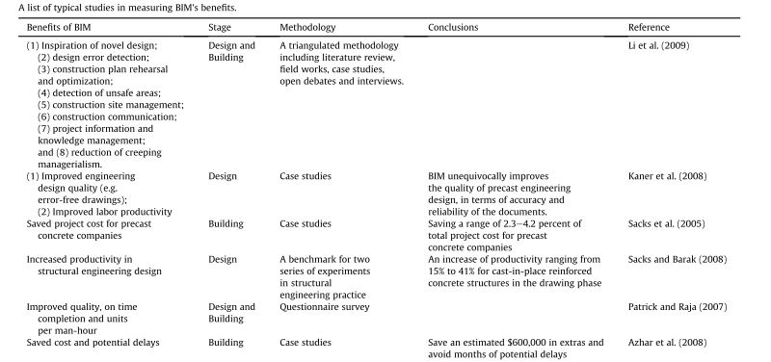
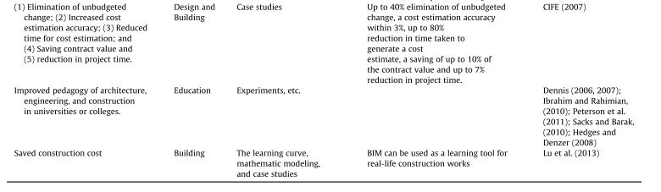

Slide 19
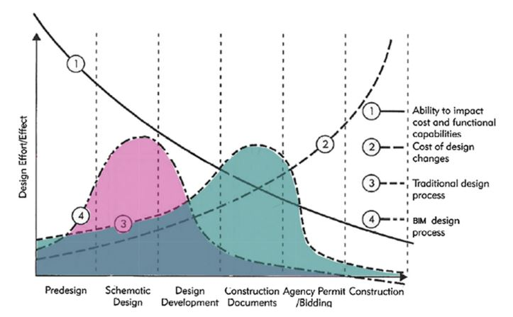
COST BENEFIT ANALYSIS
The time-effort distribution curve shows the overall cost-benefit analysis of BIM implementation in construction. Traditional AEC process is shown through the area enclosed by Curve 3. The area enclosed by Curve 4, the horizontal axis and the vertical axis represent the overall effort in undertaking the project with BIM implemented. Subtraction of the two areas represents the saved effort contributed by BIM implementation.
Cost Benefits Analysis = Monetary
+ Productivity Value
Monetary comes from clash reports where each of the clash will directly impose cost on the project. The cost for each clashes were different and these cost contribute to CBA of the project.
Productivity Value contains several parameter such as labor productivity (eg: cost of BIM’s training and BIM modeller) and material productivity (eg: cost of buying and upgrading BIM software and IT facilities, BIM licensing)

Slide 20
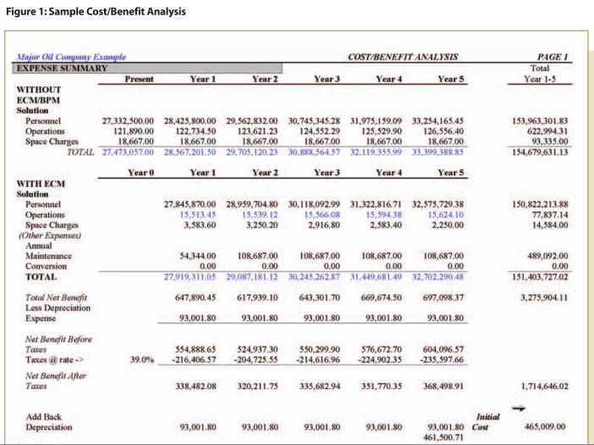
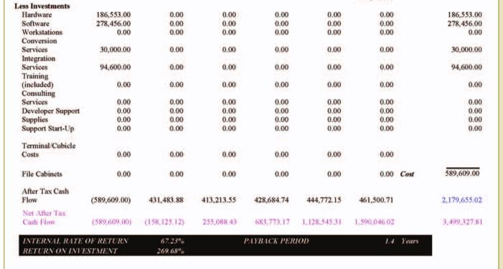
Sample of Cost Benefits Analysis

Slide 21
Kajian literatur
Laporan, jurnal, dokumen, kajian kes dan maklumat lain yang berkenaan
Pembangunan rangka kerja (Framework) bagi mengukur dan menganalisis kos faedah bagi penggunaan BIM secara keseluruhan
Membangunkan item dalam rangka kerja (Metric & benchmark) untuk meniliai analisis kos faedah secara menyeluruh.
Menguji kebolehpakaian rangka kerja
Questionnaire on Productivity based on selected parameter
Clash report from BIM
Membentangkan dan membincangkan rangka kerja dan kaedah yang digunapakai untuk pengumpulan maklumat
Bengkel dan perbincangan
Kajian kes bagi pengumpulan maklumat
Menjalankan kajian kes bagi pengumpulan maklumat maklumat
Bengkel dan perbincangan
Membentangkan penemuan kajian dan mengesahkan kandungan laporan bersama bersama pemain industri dan jawatankuasa kerja BIM-CIDB
Laporan Kajian Analisis Kos Faedah Bagi Penggunaan Pemodelan Maklumat Bangunan (BIM) Dalam Industri Pembinaan di Malaysia

Slide 23
REFERENCES
Abdirad, H. (2017). Metric-based BIM implementation assessment: a review of research and practice. Architectural Engineering and Design Management, 13(1), 52–78. https://doi.org/10.1080/17452007.2016.1183474
Arayici, Y., Khosrowshahi, F., Ponting, A. M., & Mihindu, S. (2009). Towards Implementation of Building Information Modelling in the Construction Industry.
Arop, N. H. M. (2001). It and Productivity in Malaysia: Firm Level Evidence. Universiti Malaya.
Azhar, S. (2011). Building information modeling (BIM): Trends, benefits, risks, and challenges for the AEC industry. Leadership and Management in Engineering, 11, 241–252.
Belay, A. M., Torp, O., Thodesen, C., & Odeck, J. (2016). A framework for Organizing a Resilient Cost Benefit Analysis for Construction Projects. Procedia Engineering, 145(1877), 1169–1176. https://doi.org/10.1016/j.proeng.2016.04.151
Briscoe, G., & Dainty, A. (2005). Construction supply chain integration: an elusive goal? Supply Chain Management: An International Journal, 10(4), 319–326. https://doi.org/10.1108/13598540510612794
CIDB Malaysia. (2015). Construction Industry Transformation Programme 2016-2020. https://doi.org/10.1007/s13398-014-0173-7.2
CIDB Malaysia. (2016). BIM Guide Malaysia.
Dainty, A. R. J., Millett, S. J., & Briscoe, G. H. (2001). New perspectives on construction supply chain integration. Supply Chain Management: An International Journal, 6(4), 163–173. https://doi.org/10.1108/13598540110402700
Eleni Papadonikolaki, R. V. and H. W. (2015). Supply chain integration with BIM: a graph-based model. Structural Survey. https://doi.org/10.1108/MBE-09-2016-0047
Enegbuma, W. I., Aliagha, G. U., & Ali, K. N. (2014). Preliminary building information modelling adoption model in Malaysia. Construction Innovation, 14(4), 408–432. https://doi.org/10.1108/CI-01-2014-0012
Forbes, L. H., & Ahmad, S. M. (2011). Modern Construction: Lean Project Delivery and Integrated Practices. Boca Raton, United States of America: Taylor and Francis Group, LLC. https://doi.org/10.1515/9783990434550
Jupp, J. (2013). Bim Investment: Understanding Value , Return and Models of Assessment. Proceedings: 38th AUBEA International Conference Webiste, 2013, 1–10. Retrieved from https://www.library.auckland.ac.nz/external/finalproceeding/Files/Papers/46530Final00075.pdf
Li, J., Hou, L., Wang, X., Wang, J., Guo, J., Zhang, S., & Jiao, Y. (2014). A project-based quantification of BIM benefits. International Journal of Advanced Robotic Systems, 11(1), 1–13. https://doi.org/10.5772/58448
London, K., Kenley, R., & Agapiou, A. (1998). Theoretical supply chain network modelling in the building industry. 14th Annual ARCOM Conference, 2(September), 9–11.

Slide 24
REFERENCES
Madanayake, U. (2012). Value of Adopting Building Information Modelling ( Bim ) To the Supply Chain in Construction Industry, 1–25.
Malaysia Productivity Corporation. (2016). Productivity Report 2015/2016.
O’Brien, W. J., London, K., & Vrijhoef, R. (2002). Construction Supply Chain Modeling: a Research Review and Interdisciplinary Research Agenda. Iglc10, (April 2014), 129–148.
Pagh, D. M. L. M. C. C. J. D. (n.d.). Supply Chain Management: Implementation Issues and Research Oppurtunities.
Papadonikolaki, E., Vrijhoef, R., & Wamelink, J. W. F. (2015). A BIM-based supply chain model for AEC, 149, 181–193. https://doi.org/10.2495/BIM150161
Schultz, A., Essiet, M., Souza, D., Kapogiannis, G., & Les Ruddock. (2013). The Economics of BIM and added Value of BIM to Construction Sector and Society. International Council for Research and Innovation in Building and Construction, (August). Retrieved from https://www.researchgate.net/publication/274310089_The_Economics_of_BIM_and_added_Value_of_BIM_to_Construction_Sector_and_Society
Sebastian, R. (2011). Changing roles of the clients, architects and contractors through BIM. Engineering, Construction and Architectural Management, 18(2), 176–187. https://doi.org/10.1108/09699981111111148
Shabrin, N., & Kashem, S. B. A. (2017). A Comprehensive Cost Benefit Analysis of Green Building. Proceedings of 94th The IIER International Conference, Dhaka, Bangladesh, 1st-2nd February 2017, (February).
Soroor, J., Tarokh, M. J., & Shemshadi, A. (2009). Theoretical and practical study of supply chain coordination. Journal of Business & Industrial Marketing, 24(2), 131–142. https://doi.org/10.1108/08858620910931749
Succar, B. (2009). Automation in Construction Building information modelling framework : A research and delivery foundation for industry stakeholders. Automation in Construction, 18(3), 357–375. https://doi.org/10.1016/j.autcon.2008.10.003
Vaidyanathan, K., & Howell, G. (2007). Construction Supply Chain Maturity Model – Conceptual Framework, (July), 170–180.
Winch, G. M. (2010). Managing Construction Projects (2nd edition). Construction Management and Economics, 28(July 2013), 1115–1116. https://doi.org/10.1080/01446193.2010.513397
Young Jr., N. W. ., Jones, S. A., Bernstein, H. M., & Gudgel, J. E. (2009). SmartMarket Report. McGraw Hill Construction - SmartMarket Report Construction, 1–52.
Zeng, N., König, M., & Xu, B. (2015). Supply Chain Modeling for BIM-oriented Construction Schedule Management : CODP-based Classification Approach. Proc. of the 32nd CIB W78 Conference 2015, 27th-29th October 2015, Eindhoven, The Netherlands, (August), 800–809.

