Slide 1
Elastic ELKS
Martin B. K. Grønholdt - mart80c7@edu.eal.dk
Michal Stanislaw Skorczewski - mich74p0@edu.eal.dk
Mikkel Juel Johansen - mikk4972@edu.eal.dk

Slide 2
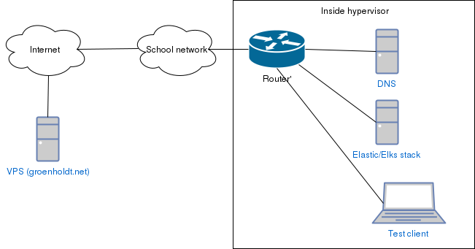
Design

Slide 3
The grand scheme
Religion?
God ?
Chinanet ?
How many roads must a man walk down?
WE DON’T KNOW.

Slide 4
The plan I
Introduction to ansible – Install dnsmasq
Setup MacBook
  Chose distribution
  VMWare
  Git client
Virtual Machines
  Dnsmasq – Ansible
  Elastic/ELKS stack – Ansible
  Client - Ansible
  Connections
  NTP

Slide 5
The plan II
Virtual Private Server
  Tinc connection
  Remote logging configuration
Elastic/ELKS stack
  Determine importent log data
  Log saparation/grouping
  Chose data for charts/graphs
Remote access to MacBook internal network
  Possible?
  How?
  Talk to mon.

Slide 6
Compulsory element?
There is a compulsory element of presenting to the class. This must include:
A presentation
  what is done
  how you have implemeted the points above
  How it integrated with the chinanet system
A working proof-of-concept
How to reproduce it. (https://github.com/deadbok/eal_itsec_elastic_elks)

