Slide 1

Elastic Stack
Martin Grønholdt
Michał Skórczewski
Mikkel Juel Johansen
https://github.com/deadbok/eal_itsec_elastic_elks

Slide 2
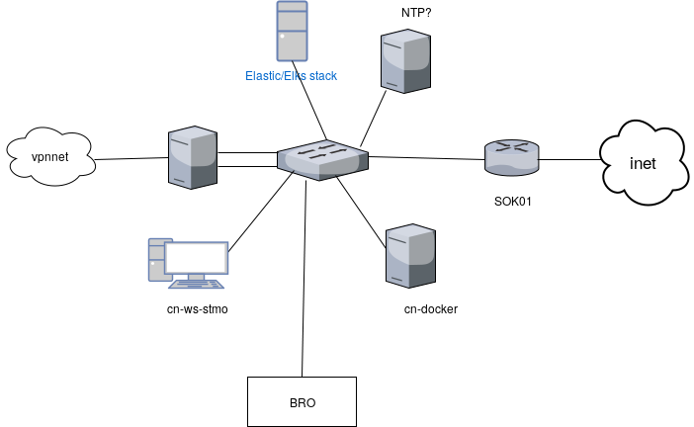
Implementation in China net

Slide 3
Roles in the Elasic Stack
Logstash
Collect and transform data
Elasticsearch
Search, analytics, and storage
Kibana
Web interface visualising data from Elasticsearch

Slide 4
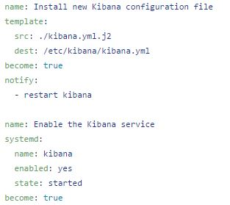
Ansible
Used for deploying easily and consistently
Roles to configure syslog to send information to ELK system
Central management of configurations

Slide 5
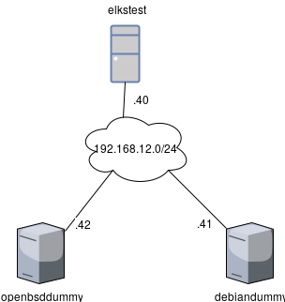
Testing network

Slide 6



Management

Slide 7

Live demo

