Slide 1
Elastic ELKS
Martin B. K. Grønholdt - mart80c7@edu.eal.dk
Michal Stanislaw Skorczewski - mich74p0@edu.eal.dk
Mikkel Juel Johansen - mikk4972@edu.eal.dk

Slide 2
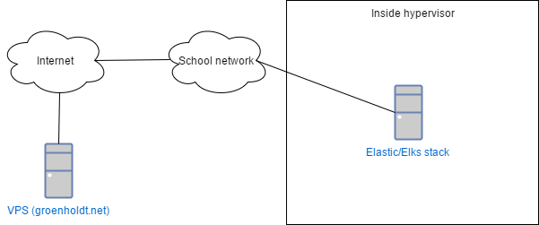
Design

Slide 3
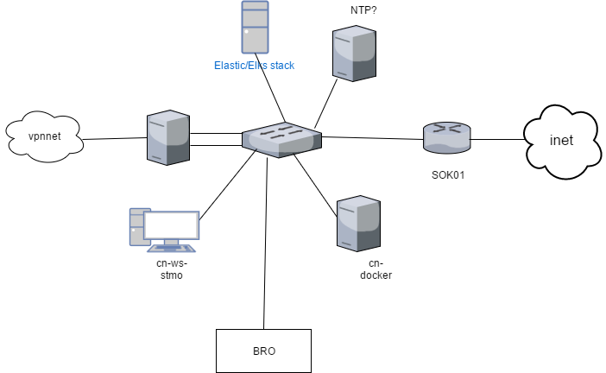
The grand scheme

Slide 4
The plan
Make ansible script to install remote logging
TBD

Slide 5
How to reproduce it
https://github.com/deadbok/eal_itsec_elastic_elks

