Slide 1


FINAL PRESENTATION ITT2 PROJECT NETWORK
Group 7:
Martin Grønholdt
Michał Skórczewski

Slide 2
Project plan

Slide 3
Responsibilities
Vlan Implementation | Michal Skorczewski
Vlan Trunking (802.1q) | Michal Skorczewski
Vlan L3- Interface | Michal Skorczewski
Vurtual Routers | Michal Skorczewski
Ethernet OAM | Michal Skorczewski
Troubleshooting & Monitoring | Michal Skorczewski
Ipv6 | Martin Gronholdt
OSPF | Martin Gronholdt
IS-IS | Martin Gronholdt
Route Re-distribution OSPF/IS-IS | Martin Gronholdt
BGP | Michal Skorczewski
Router Redistribution BGP/OSPF | Michal Skorczewski
Routing Policies | Michal Skorczewski
Route Redistribution | Martin Gronholdt
RE/PFE | Michal Skorczewski
Firewall Filters | Martin Gronholdt
CoS | Michal Skorczewski

Slide 4
Martin’s chapters
IPv6
OSPF
IS-IS
Route Redistribution OSPF-ISIS
Route Redistribution
Firewall Filters

Slide 5
Michał’s Chapters
Vlan Implementation
Vlan Trunking (802.1q)
Vlan L3- Interface
Vurtual Routers
Ethernet OAM
Troubleshooting & Monitoring
BGP
Route Redistribution BGP-OSPF
Routing Policies
RE/PFE
Class of Service

Slide 6
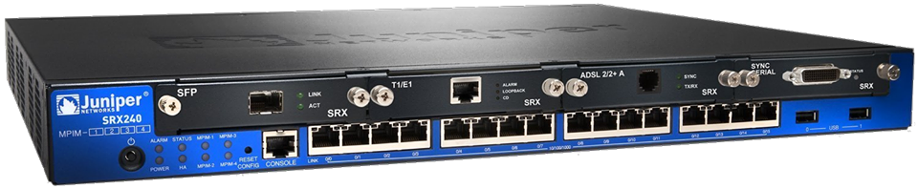
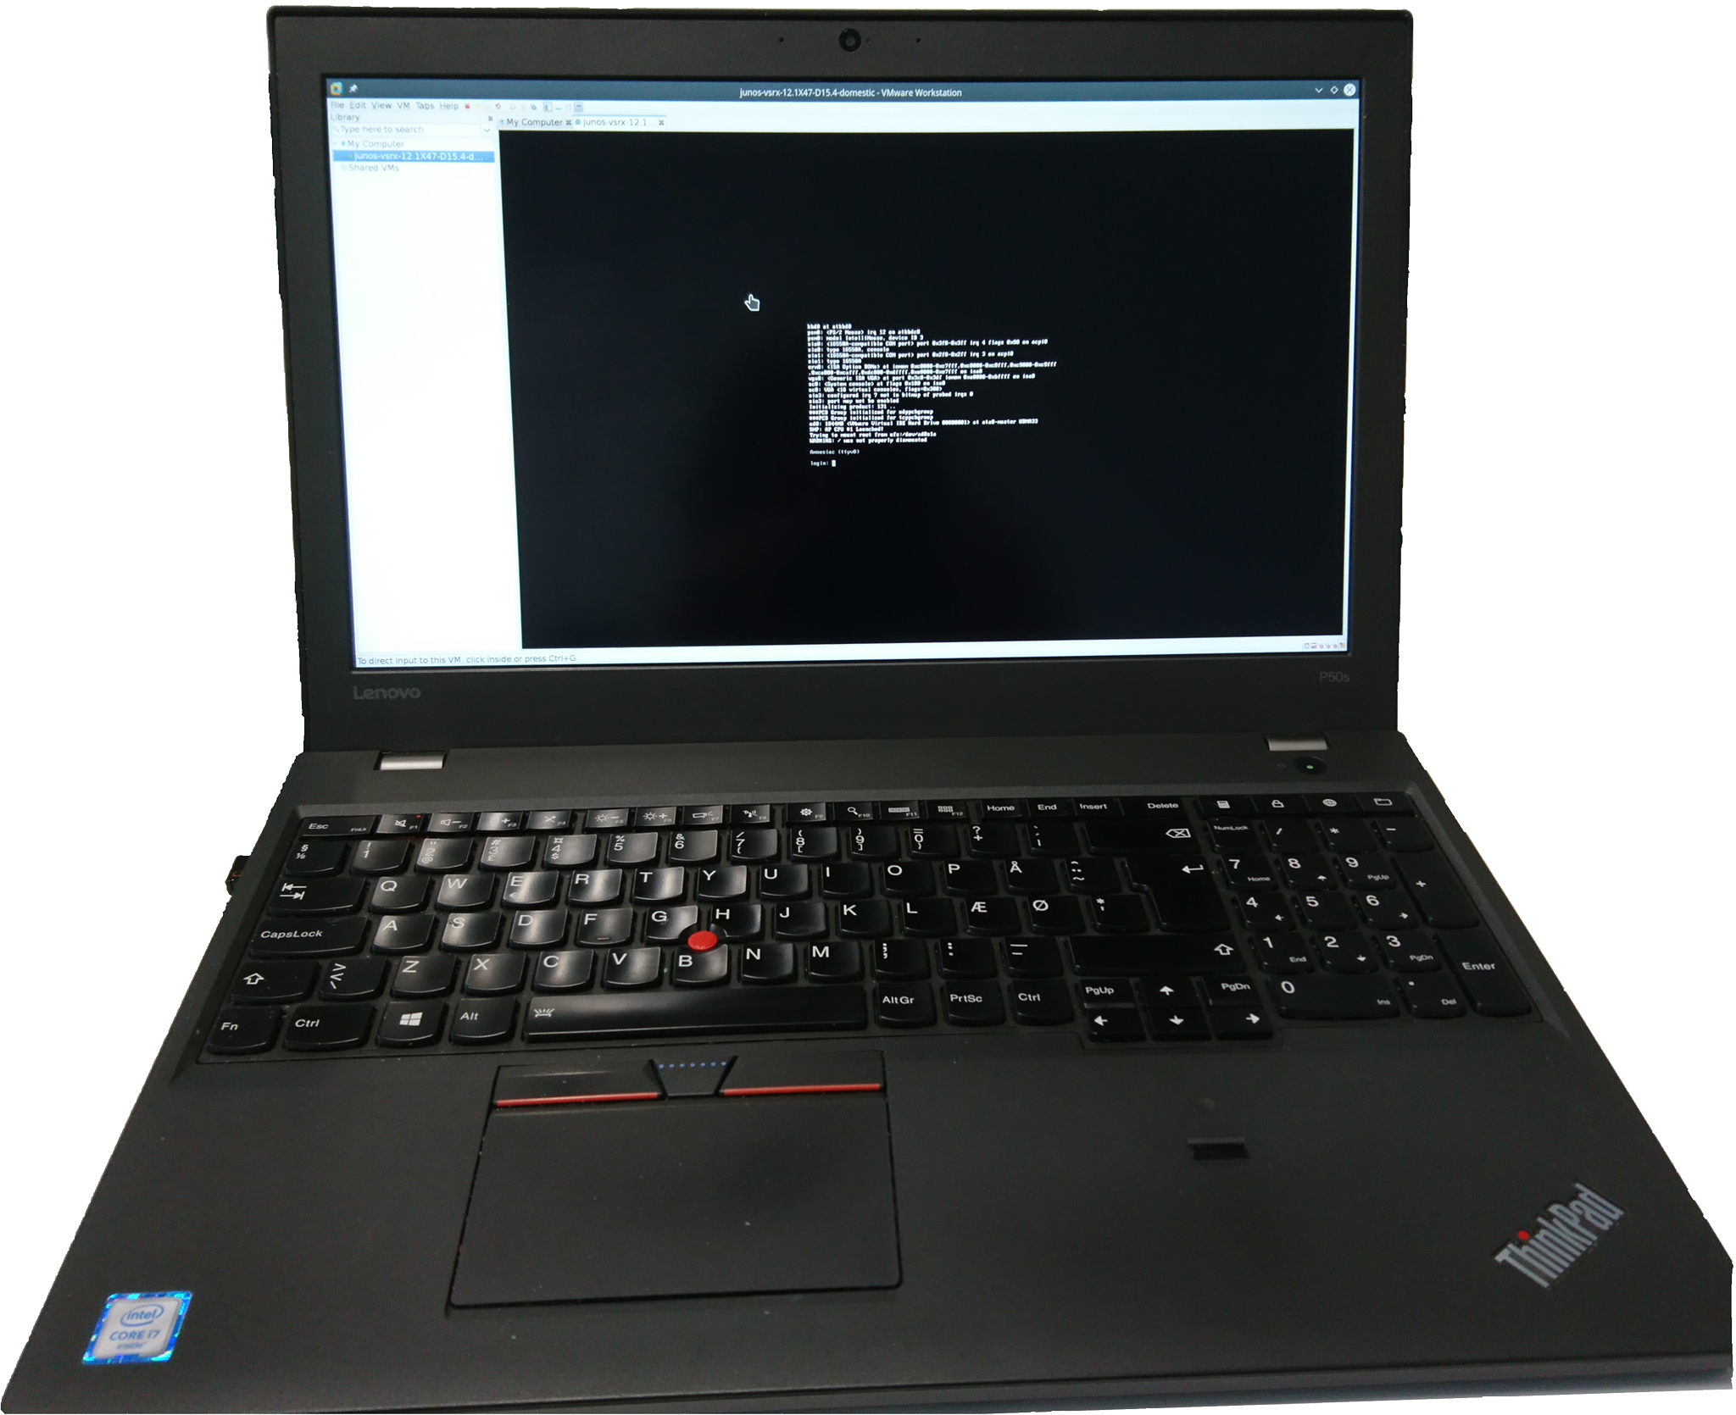
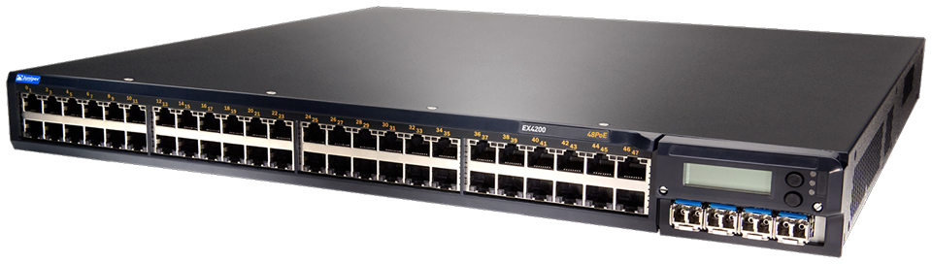
Juniper devices used during the project

Slide 7
Ipv6
Fixed header size (40 bytes)
128 bit - 2001:0DB8:0000:0000:00C0:FEFE:BADA:5500
Unicast – One interface
Anycast – Multiple interfaces delivered to one interface
Multicast –
Leading zeroes can be skipped.
  2001:DB8:0:0:C0:FEFE:BADA:5500
A double colon can replace a string of consecutive zeroes in multiple address block, but only once.
  2001:DB8::C0:FEFE:BADA:5500

Slide 8
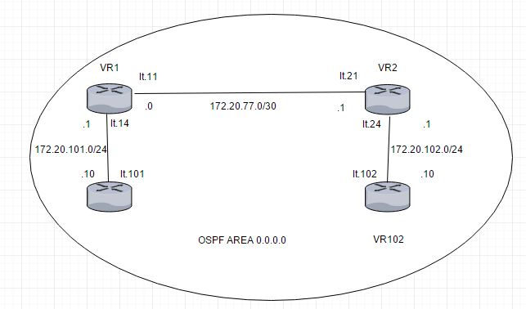
OSPF
OSPF is short for
Open Shortest Path First
Interior gateway protocol
Uses areas to group networks
logically (area 0 is the backbone)
Version 3 adds support for IPv6

Slide 9
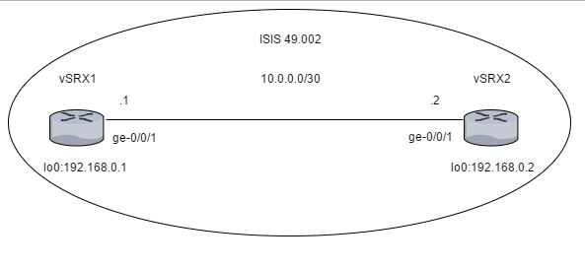
Is-IS
IS-IS is an interior gateway protocol
Layer 2, does not use IP
Extensible through TLVs
Supports IPv6
Logically divided using levels

Slide 10
Route Re-Distribution (OSPF/IS-IS)
Routes from OSPF into IS-IS
Policy statements
Export statements in the routing protocols.

Slide 11
Firewall Filters
Stateless - Cannot interpret traffic patterns or data flows
Restrict traffic based on its source, protocol, and application.
Limit the traffic rate of.
Process fragmented packages by configuring the filter to support this.

