Slide 1


FINAL PRESENTATION ITT2 PROJECT NETWORK
Group 7: Martin Grønholdt
Michał Skórczewski

Slide 2
Project plan

Slide 3
responsibilities
Vlan Implementation | Michal Skorczewski
Vlan Trunking (802.1q) | Michal Skorczewski
Vlan L3- Interface | Michal Skorczewski
Vurtual Routers | Michal Skorczewski
Ethernet OAM | Michal Skorczewski
Troubleshooting & Monitoring | Michal Skorczewski
Ipv6 | Martin Gronholdt
OSPF | Martin Gronholdt
IS-IS | Martin Gronholdt
Route Re-distribution OSPF/IS-IS | Martin Gronholdt
BGP | Michal Skorczewski
Router Redistribution BGP/OSPF | Michal Skorczewski
Routing Policies | Michal Skorczewski
Route Redistribution | Martin Gronholdt
RE/PFE | Michal Skorczewski
Firewall Filters | Martin Gronholdt
CoS | Michal Skorczewski

Slide 4
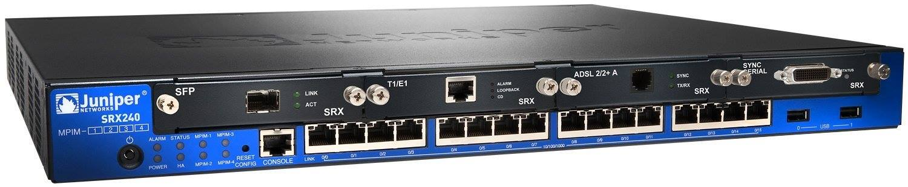
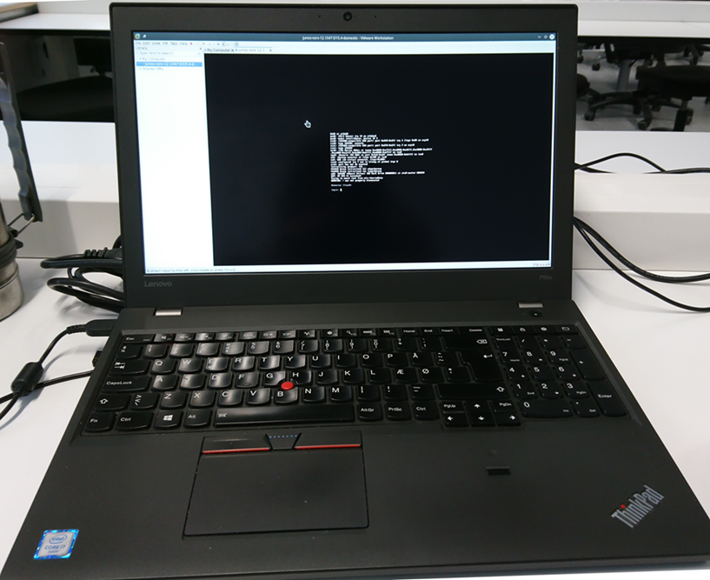
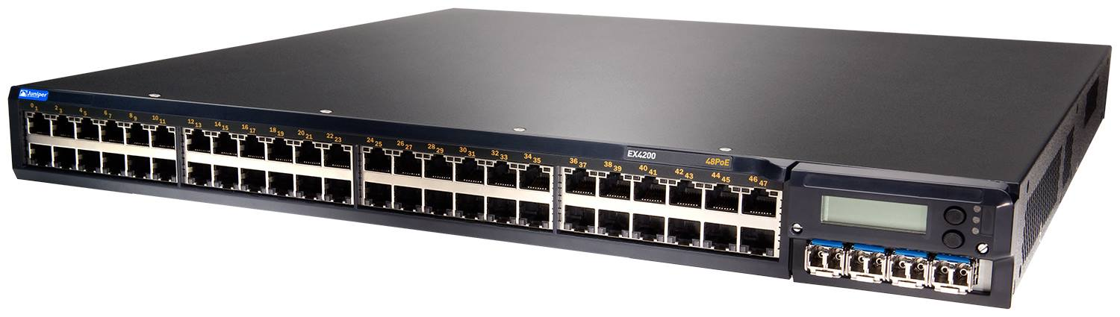
Juniper devices used during the project

Slide 5

Juniper certification

