Slide 1


FINAL PRESENTATION ITT2 PROJECT NETWORK
Group 7:
Martin Grønholdt
Michał Skórczewski

Slide 2
Project plan

Slide 3
Responsibilities
Vlan Implementation | Michal Skorczewski
Vlan Trunking (802.1q) | Michal Skorczewski
Vlan L3- Interface | Michal Skorczewski
Vurtual Routers | Michal Skorczewski
Ethernet OAM | Michal Skorczewski
Troubleshooting & Monitoring | Michal Skorczewski
Ipv6 | Martin Gronholdt
OSPF | Martin Gronholdt
IS-IS | Martin Gronholdt
Route Re-distribution OSPF/IS-IS | Martin Gronholdt
BGP | Michal Skorczewski
Router Redistribution BGP/OSPF | Michal Skorczewski
Routing Policies | Michal Skorczewski
Route Redistribution | Martin Gronholdt
RE/PFE | Michal Skorczewski
Firewall Filters | Martin Gronholdt
CoS | Michal Skorczewski

Slide 4
Martin’s chapters
IPv6
OSPF
IS-IS
Route Redistribution OSPF-ISIS
Route Redistribution
Firewall Filters

Slide 5
Michał’s Chapters
Vlan Implementation
Vlan Trunking (802.1q)
Vlan L3- Interface
Vurtual Routers
Ethernet OAM
Troubleshooting & Monitoring
BGP
Route Redistribution BGP-OSPF
Routing Policies
RE/PFE
Class of Service

Slide 6
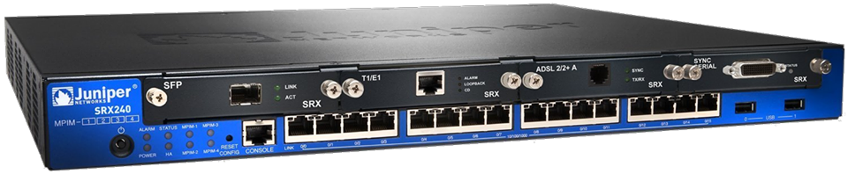
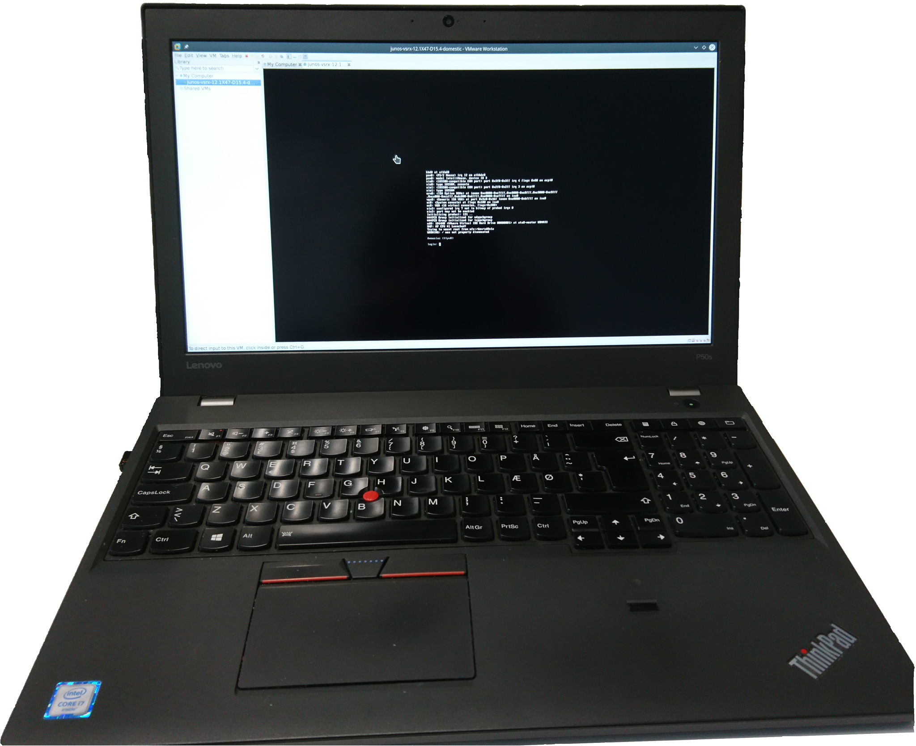
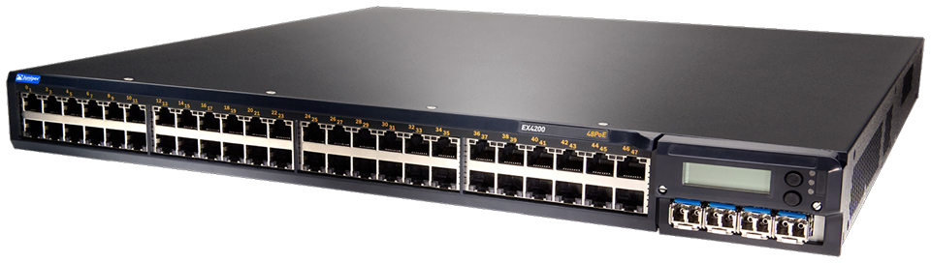
Juniper devices used during the project

