Slide 1


FINAL PRESENTATION ITT2 PROJECT NETWORK
Group 7:
Martin Grønholdt
Michał Skórczewski

Slide 2
Project plan

Slide 3
Responsibilities
Vlan Implementation | Michal Skorczewski
Vlan Trunking (802.1q) | Michal Skorczewski
Vlan L3- Interface | Michal Skorczewski
Vurtual Routers | Michal Skorczewski
Ethernet OAM | Michal Skorczewski
Troubleshooting & Monitoring | Michal Skorczewski
Ipv6 | Martin Gronholdt
OSPF | Martin Gronholdt
IS-IS | Martin Gronholdt
Route Re-distribution OSPF/IS-IS | Martin Gronholdt
BGP | Michal Skorczewski
Router Redistribution BGP/OSPF | Michal Skorczewski
Routing Policies | Michal Skorczewski
Route Redistribution | Martin Gronholdt
RE/PFE | Michal Skorczewski
Firewall Filters | Martin Gronholdt
CoS | Michal Skorczewski

Slide 4
Martin’s chapters
IPv6
OSPF
IS-IS
Route Redistribution OSPF-ISIS
Route Redistribution
Firewall Filters

Slide 5
Michał’s Chapters
Vlan Implementation
Vlan Trunking (802.1q)
Vlan L3- Interface
Vurtual Routers
Ethernet OAM
Troubleshooting & Monitoring
BGP
Route Redistribution BGP-OSPF
Routing Policies
RE/PFE
Class of Service

Slide 6


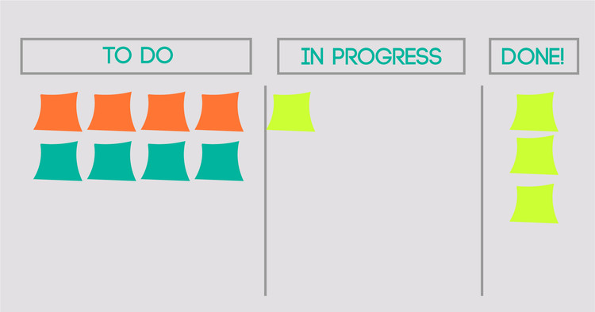

Project management

Slide 7
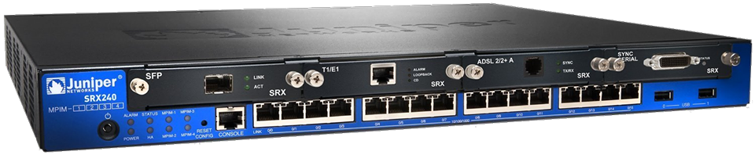
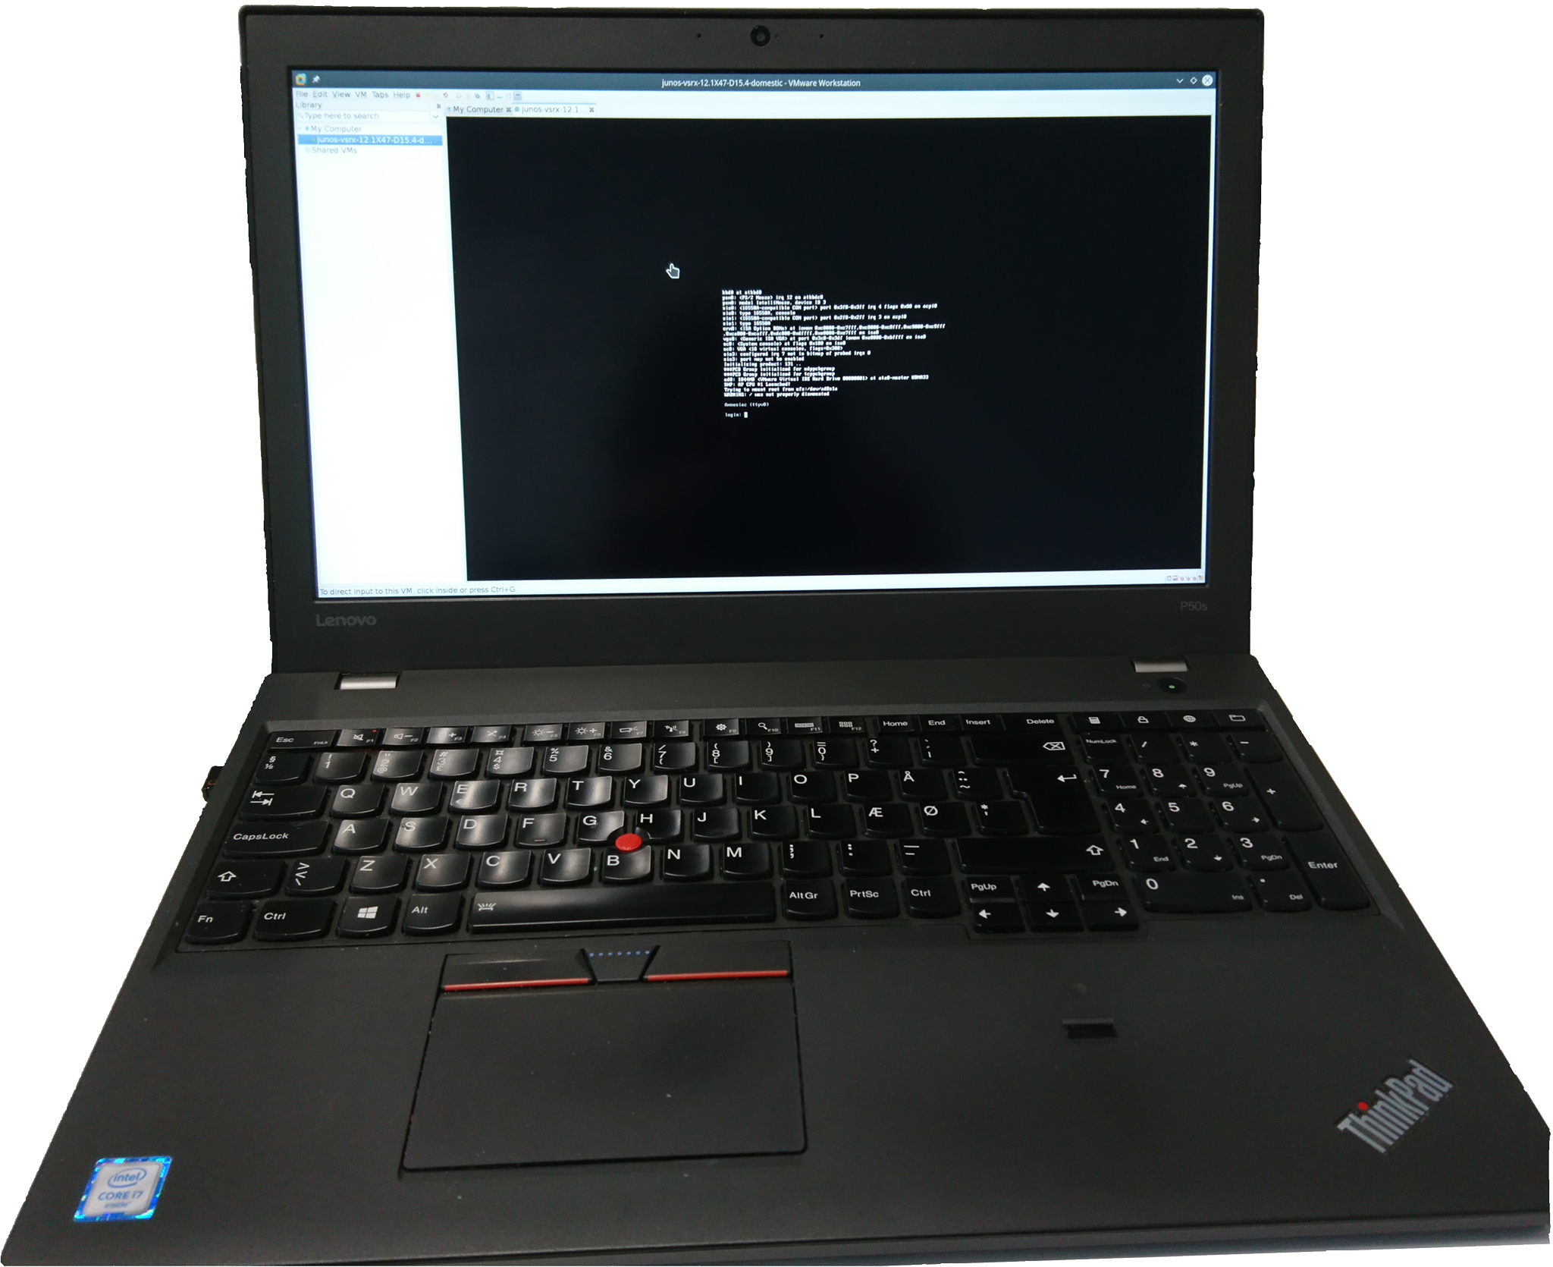
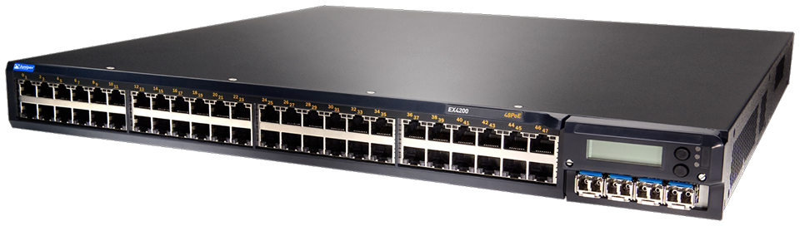
Juniper devices used during the project

Slide 8
Martin b. K. Grønholdt
PROJECT NETWORK
FINAL PRESENTATION
ITT2

Slide 9
Ipv6
Fixed header size (40 bytes)
128 bit - 2001:0DB8:0000:0000:00C0:FEFE:BADA:5500
Unicast – One interface
Anycast – Multiple interfaces delivered to one interface
Multicast –
Leading zeroes can be skipped.
  2001:DB8:0:0:C0:FEFE:BADA:5500
A double colon can replace a string of consecutive zeroes in multiple address block, but only once.
  2001:DB8::C0:FEFE:BADA:5500

Slide 10
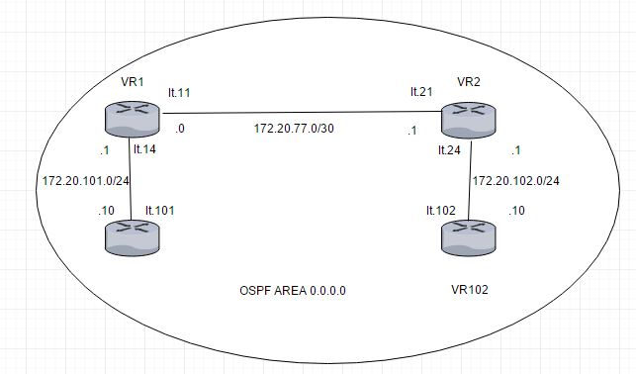
OSPF
OSPF is short for
Open Shortest Path First
Interior gateway protocol
Uses areas to group networks
logically (area 0 is the backbone)
Version 3 adds support for IPv6

Slide 11
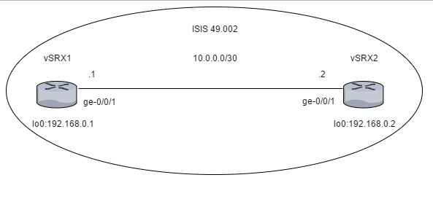
Is-IS
IS-IS is an interior gateway protocol
Layer 2, does not use IP
Extensible through TLVs
Supports IPv6
Logically divided using levels

Slide 12
Route Re-Distribution (OSPF/IS-IS)
Routes from OSPF into IS-IS
Policy statements
Export statements in the routing protocols.

Slide 13
Firewall Filters
Stateless - Cannot interpret traffic patterns or data flows
Restrict traffic based on its source, protocol, and application.
Limit the traffic rate of.
Process fragmented packages by configuring the filter to support this.

Slide 14
Michał Skórczewski
PROJECT NETWORK
FINAL PRESENTATION
ITT2

Slide 15
My Responsibilities
Ethernet l2&l3 Switching
Intermediate routing
SEcurity
VLAN Implementation
VLAN Trunking
VLAN L3-interface
Virtual Routers
Ethernet OAM
Toubleshooting&Monitoring
BGP
Route Redistribution – BGP/OSPF
Routing Policies
RE/PFE
CoS

Slide 16
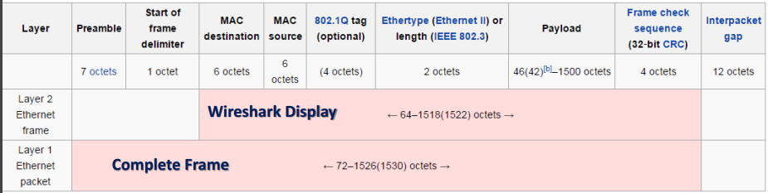
ETHERNET
Created for SMALL networks
Defined in IEEE 802.3 specification
Ethernet packet (on physical link) trasports an Ethernet frame

Slide 17
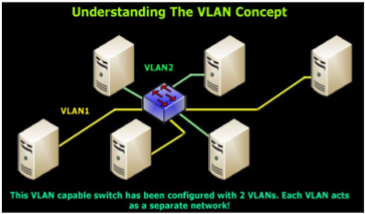
VLAN
IEEE 802.1D-2004 – concept of bridging
IEEE 802.1Q – standard defining VLANS.
Each VLAN is identified by a unique 802.1Q ID
Implementation

Slide 18
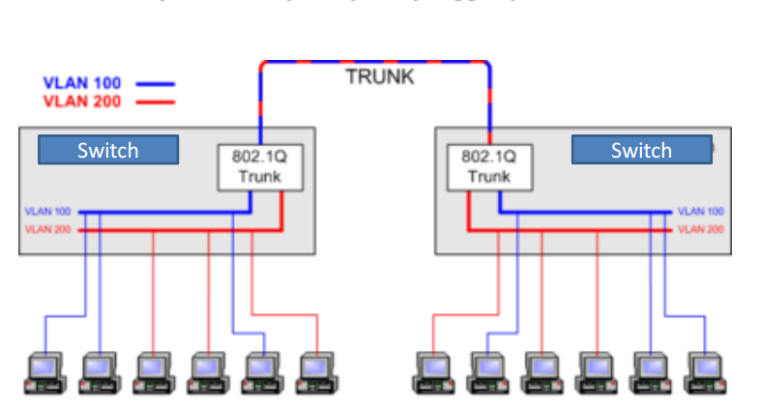
TRUNKING

Slide 19
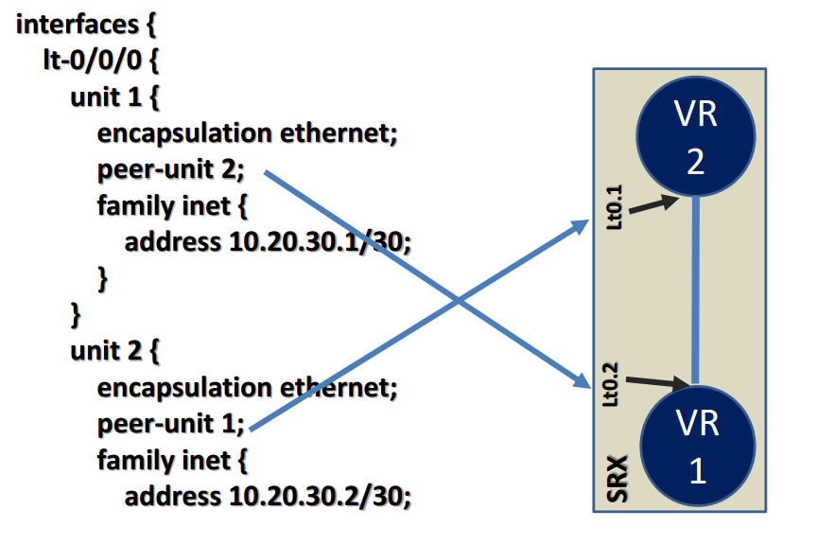
Virtual routers & Logical tunnels
VR can act like a „normal”, physical router.
In VR it is possible to create physical or logical connection between instances

Slide 20
ETHERNET OAM
Features:
-discovery
-link monitoring
-remote fault detection
-remote loopback

Slide 21

Troubleshooting and monitoring
It is possible to check alarms, port numbers, temperatures, serial numbers of parts and other things.
Besides to troubleshooting Juniper allows us to monitor traffic

Slide 22
Border Gateway protocol (bgp)
Uses TCP connection between the routers
Autonomous systems
BGP routing information includes the complete route to each destination
BGP uses peering
There are 2 levels of peering (peer and client)
4 types of messages

Slide 23
BGP MODES
iBGP
Devices are fully meshed
Group internal-peers
Route Reflector
eBGP
External devices have BGP peer sesion to another AS
Group external

Slide 24
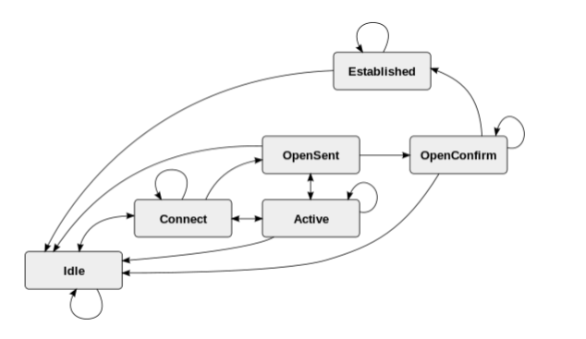
Finite state machine

Slide 25
Problems with bgp
iBGP scalability
Instability
Routing table growth
Load balancing problem
Security issues

Slide 26
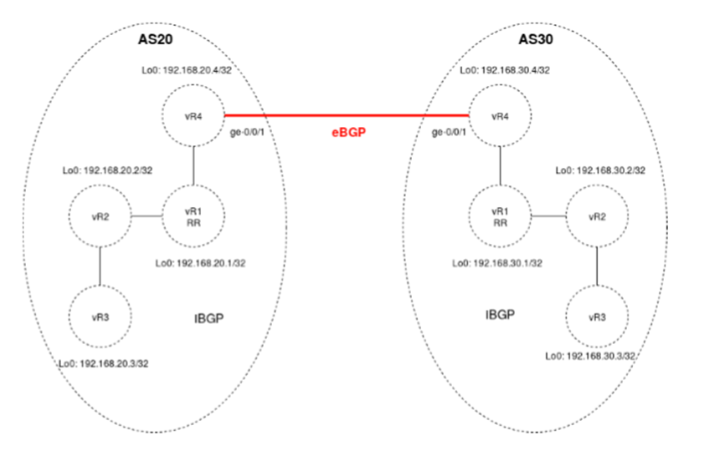
Route redistribution bgp/ospf

Slide 27
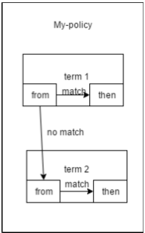
Routing policies
Control the flow of routing information be tweenrouting processes
Software evaluates terms until it reaches
a terminating action

Slide 28
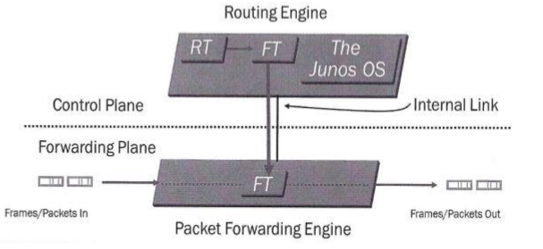
RE/PFE

Slide 29
Class of service
Classification of traffic
Meeting a network performance requirements.
Forwarding classes
Loss priority
Deployment models
Policers
Scheduling
Queue Priority

