Slide 1


FINAL PRESENTATION ITT2 PROJECT NETWORK
Group 7:
Martin Grønholdt
Michał Skórczewski

Slide 2
Project plan

Slide 3
Responsibilities
Vlan Implementation | Michal Skorczewski
Vlan Trunking (802.1q) | Michal Skorczewski
Vlan L3- Interface | Michal Skorczewski
Vurtual Routers | Michal Skorczewski
Ethernet OAM | Michal Skorczewski
Troubleshooting & Monitoring | Michal Skorczewski
Ipv6 | Martin Gronholdt
OSPF | Martin Gronholdt
IS-IS | Martin Gronholdt
Route Re-distribution OSPF/IS-IS | Martin Gronholdt
BGP | Michal Skorczewski
Router Redistribution BGP/OSPF | Michal Skorczewski
Routing Policies | Michal Skorczewski
Route Redistribution | Martin Gronholdt
RE/PFE | Michal Skorczewski
Firewall Filters | Martin Gronholdt
CoS | Michal Skorczewski

Slide 4
Martin’s chapters
IPv6
OSPF
IS-IS
Route Redistribution OSPF-ISIS
Route Redistribution
Firewall Filters

Slide 5
Michał’s Chapters
Ethernet
Vlan Trunking (802.1q)
Vurtual Routers
Logical Tunnels
Troubleshooting & Monitoring
BGP
BGP-OSPF
RE/PFE

Slide 6


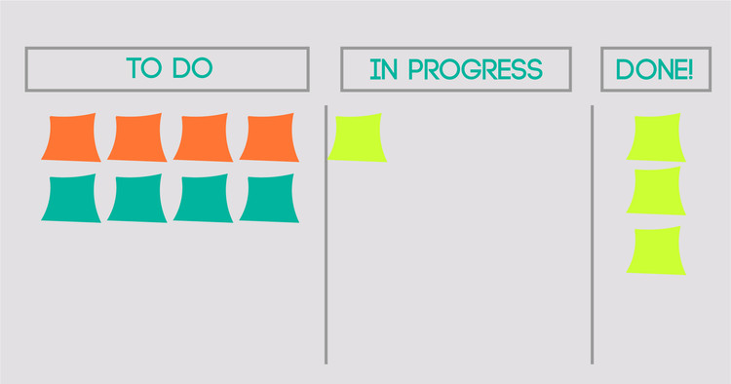

Project management

Slide 7
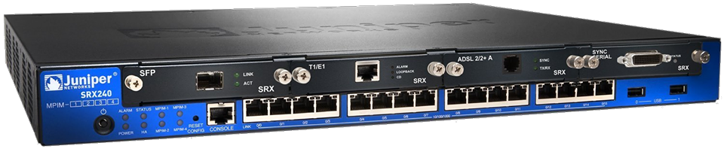
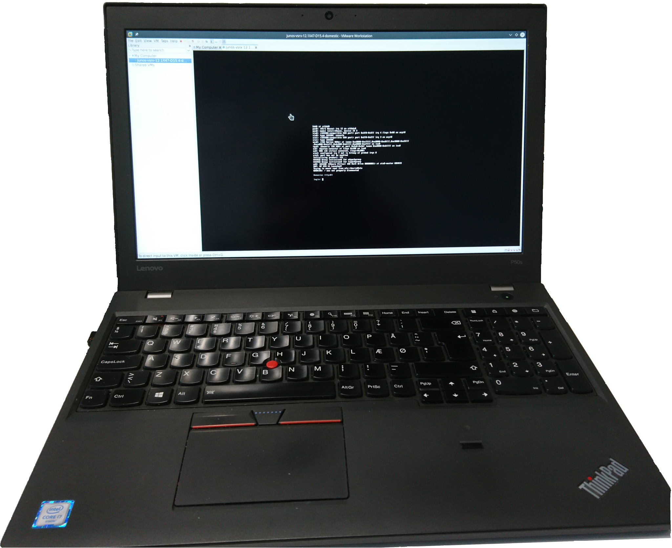
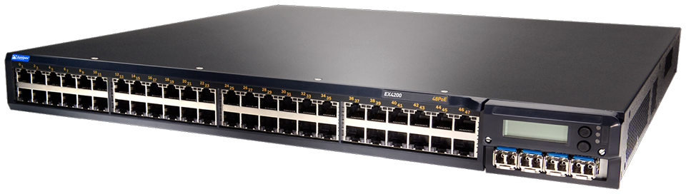
Juniper devices used during the project

Slide 8
Martin b. K. Grønholdt
PROJECT NETWORK
FINAL PRESENTATION
ITT2

Slide 9
Ipv4 and IPV6
4 bit | 4 bit | 4 bit | 4 bit | 4 bit | 4 bit | 4 bit | 4 bit
Version | IHL | DSCP (6 bit) & ECN (2 bit) |  | Total length
Identification |  |  |  | Flags (3 bit) | Fragmentet Offset (13 bits)
TTL |  | Protocol |  | Header Checksum
Source address
Destination address
Options (if IHL > 5)
4 bit | 4 bit | 4 bit | 4 bit | 4 bit | 4 bit | 4 bit | 4 bit
Version | Traffic class |  | Flow label
Payload length |  |  |  | Next header |  | Hop limit
Source address (128 bit)
Destination address (128 bit)

Slide 10
IPv6
40 bytes fixed header
128 bit - 2001:0DB8:0000:0000:00C0:FEFE:BADA:5500
Unicast – One interface
Anycast – Multiple interfaces delivered to one interface
Multicast – Multiple interfaces processed by all interfaces
Leading zeroes can be skipped.
  2001:DB8:0:0:C0:FEFE:BADA:5500
A double colon can replace a string of consecutive zeroes in multiple address block, but only once.
  2001:DB8::C0:FEFE:BADA:5500

Slide 11
IPv6 Special addresses
::/128 - Unspecified address - IPv4 0.0.0.0/32 address.
::/0 - Default route address - IPv4 0.0.0.0/0 in IPv4.
::1/128 - The loopback address. – IPv4 127.0.0.1
FE80::/10 - Link-local address – IPv4 169.254.0.0./16
FC00::/7 - Unique local addresses – IPv4 10.0.0.0/8, 172.16.0.0/12 and 192.168.0.0/16
IPv6 and IPv6 interoperation
  ::FFFF:0:0/96
  64:FF9B::/96
  2001::/32
  2002::/16
2001:db8::/32 - This prefix is used in documentation.
0100::/64 - This prefix is used for discarding traffic
FF0X:: - Multicast address

Slide 12
OSPF
OSPF is short for Open Shortest Path First
Interior gateway protocol
Uses areas to group networks logically (area 0 is the backbone)
Version 3 adds support for IPv6
Dijkstra's algorithm

Slide 13
Is-IS
IS-IS is an interior gateway protocol
Layer 2, does not use IP
Extensible through TLVs
Supports IPv6
Logically divided using levels

Slide 14
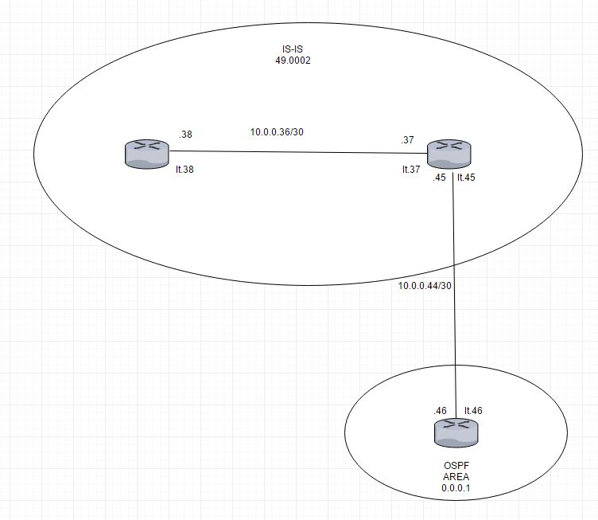
Route Re-Distribution (OSPF/IS-IS)
Policy statements
Export statements in the routing protocols.
Example: routes from OSPF into IS-IS

Slide 15
Firewall Filters
Stateless - Cannot interpret traffic patterns or data flows
Restrict traffic based on its source, protocol, and application.
Limit the traffic rate of.
Process fragmented packages by configuring the filter to support this.

Slide 16
Michał Skórczewski
PROJECT NETWORK
FINAL PRESENTATION
ITT2

Slide 17
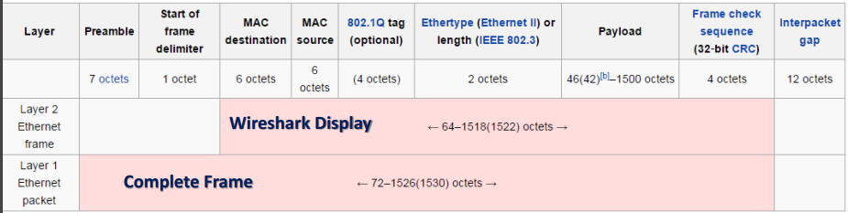
ETHERNET
Created for SMALL networks
Defined in IEEE 802.3 specification
Ethernet packet (on physical link) trasports an Ethernet frame

Slide 18
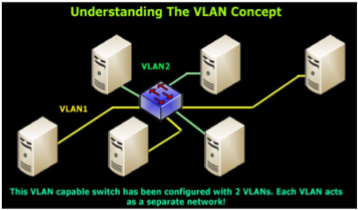
VLAN
IEEE 802.1D-2004 – concept of bridging
IEEE 802.1Q – standard defining VLANS.
Each VLAN is identified by a unique 802.1Q

Slide 19
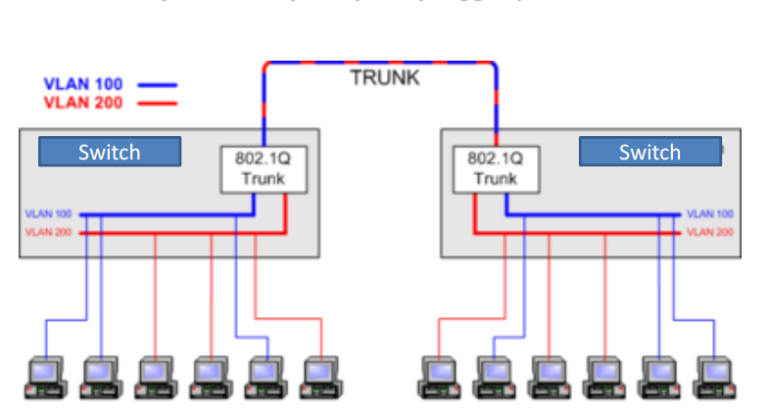
TRUNKING

Slide 20
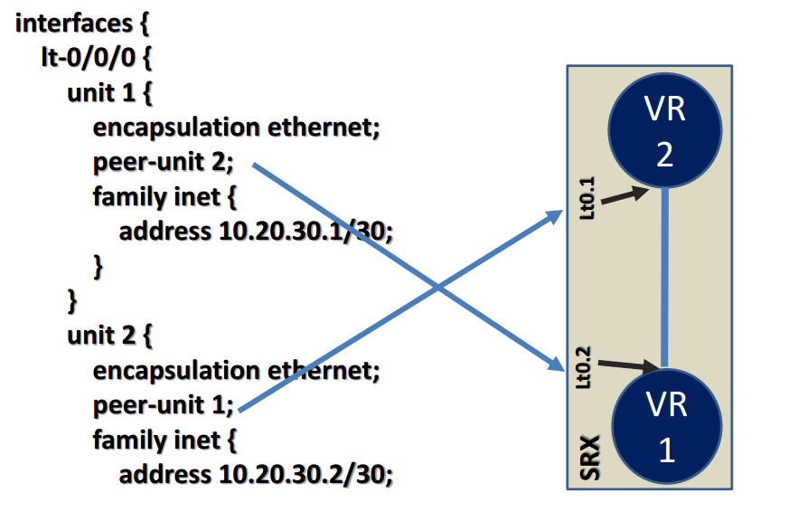
Virtual routers & Logical tunnels
VR can act like a „normal”, physical router.
In VR it is possible to create physical or logical connection between instances

Slide 21

Troubleshooting and monitoring
It is possible to check alarms, port numbers, temperatures, serial numbers of parts and other things.
Besides to troubleshooting Juniper allows us to monitor traffic

Slide 22
Border Gateway protocol (bgp)
Uses TCP connection between the routers
Autonomous systems
BGP routing information includes the complete route to each destination
BGP uses peering
There are 2 levels of peering (peer and client)
4 types of messages

Slide 23
BGP MODES
iBGP
Devices are fully meshed
Group internal-peers
Route Reflector
eBGP
External devices have BGP peer sesion to another AS
Group external

Slide 24
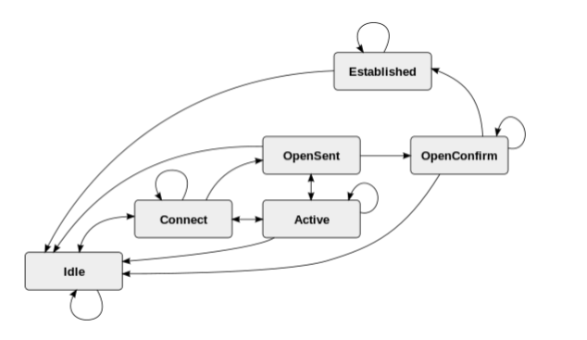
Finite state machine

Slide 25
Problems with bgp
iBGP scalability
Instability
Routing table growth
Load balancing problem
Security issues

Slide 26
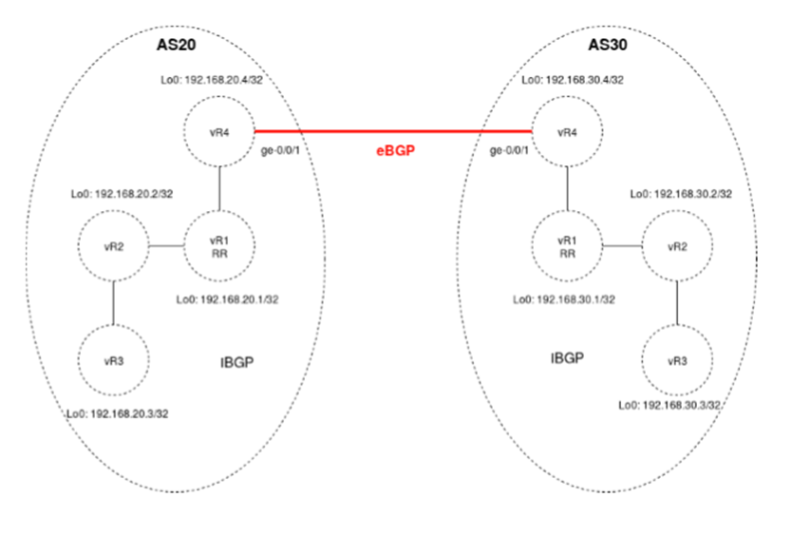
Route redistribution bgp/ospf

Slide 27
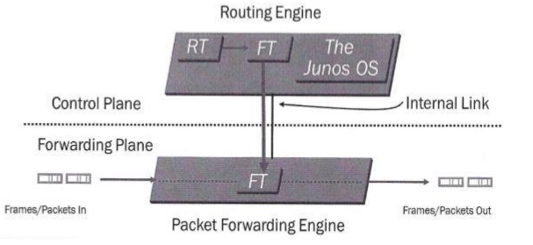
RE/PFE

