Slide 1
Presentation
Martin Grønholdt
Michał Skórczewski
Fríði Mellemgaard

Slide 2

Topology & Purpose

Slide 3
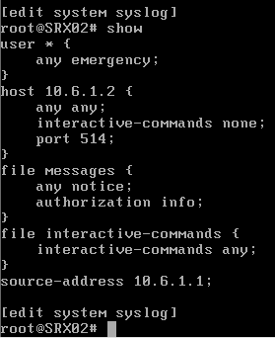
SRX Config

Slide 4
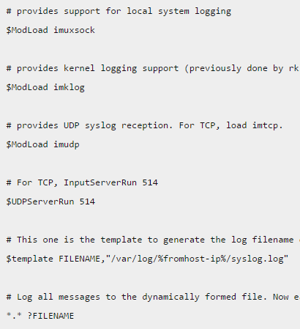
Debian Conf
/etc/rsyslog.conf

Slide 5
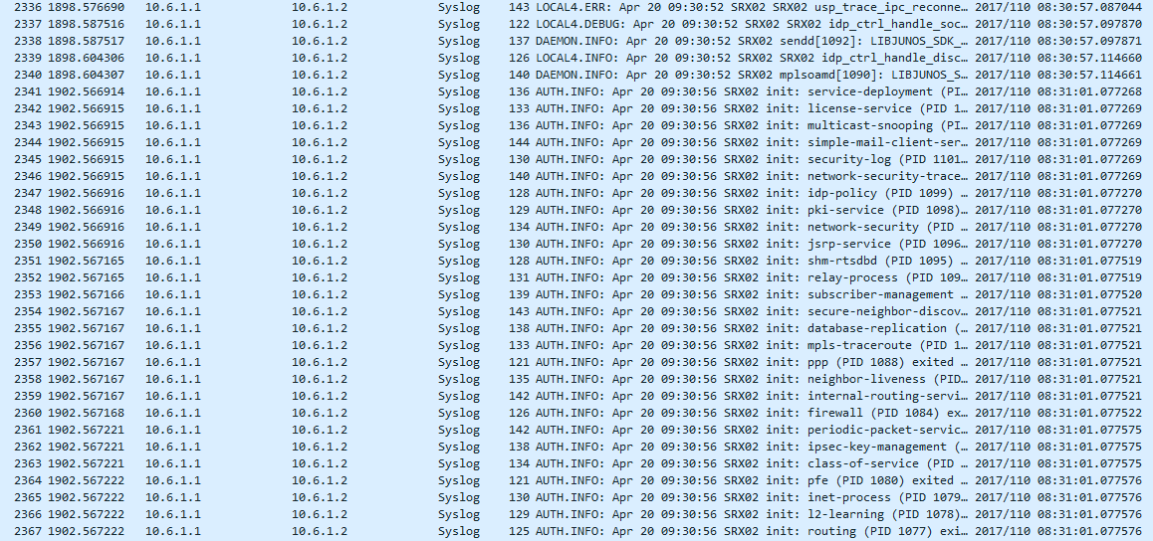
Wireshark

Slide 6
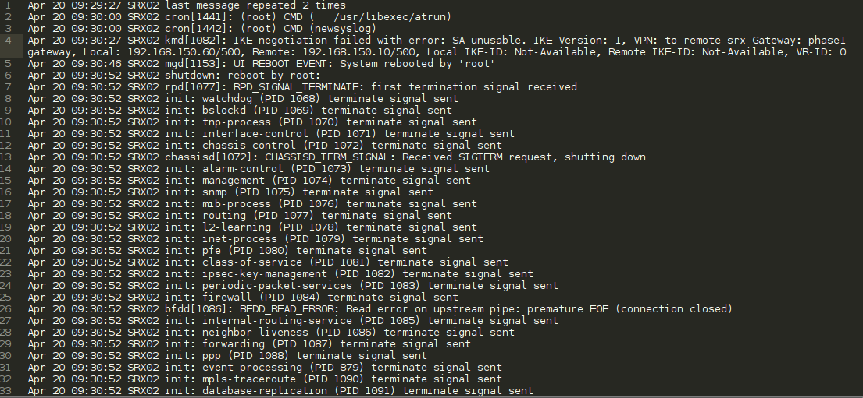
Log file

