Slide 1
Elastic Stack
Martin B. K. Grønholdt, Fríði Árnmar Mellemgaard, Michal Stanislaw Skorczewski
Resources for this presentation are available here:
https://github.com/deadbok/it_sec_w16

Slide 2
Roles in the stack
Logstash
  Collect and transform data
Elasticsearch
  Search, analytics, and storage
Kibana
  Advanced web interface visualising data from Elasticsearch

Slide 3
Installation steps
Install OpenJDK JRE 8
  Add jessie-backports repository
  Install OpenJDK JRE 8
Install the Elastic stack
  Add the Elastic repository
  Install Elasticsearch
  Install Logstash
  Install Kibana
  Configure

Slide 4

Automation
Use ansible for deploying

Slide 5

Obligatory diagram
Syslog
Elastic stack goes here

Slide 6
Elastic stack configuration
Configure syslog to output JSON (01-json-template.conf)
Send this to Logstash (60-output.conf)
Configure Logstash to receive, unify, and pass the information to Elasticsearch (rsyslog-pipeline.conf)
Network configuration of Elasticsearch, Kibana, and Logstash

Slide 7
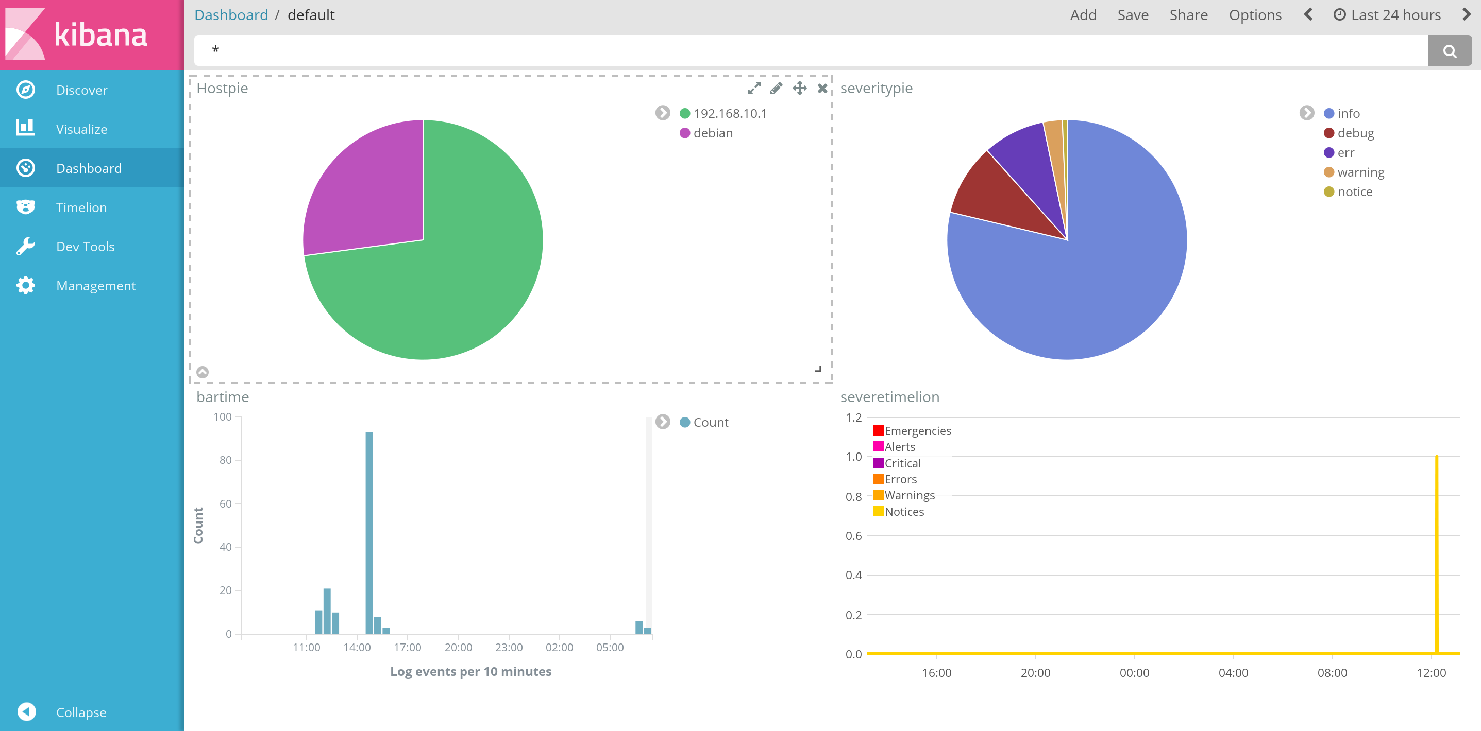
Kibana - Dashboard

Slide 8
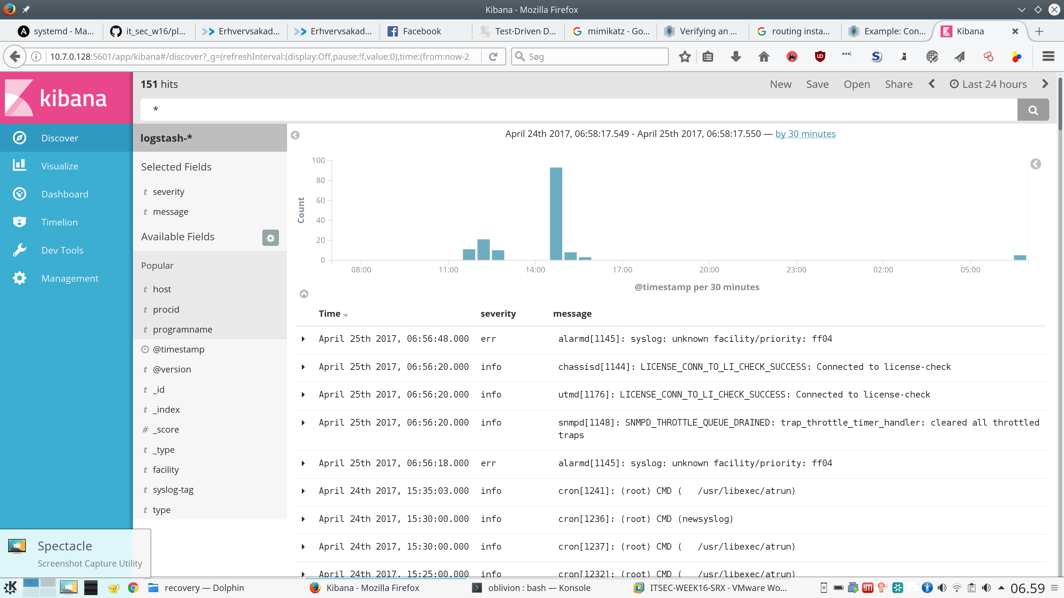
Kibana - Discover

Slide 9
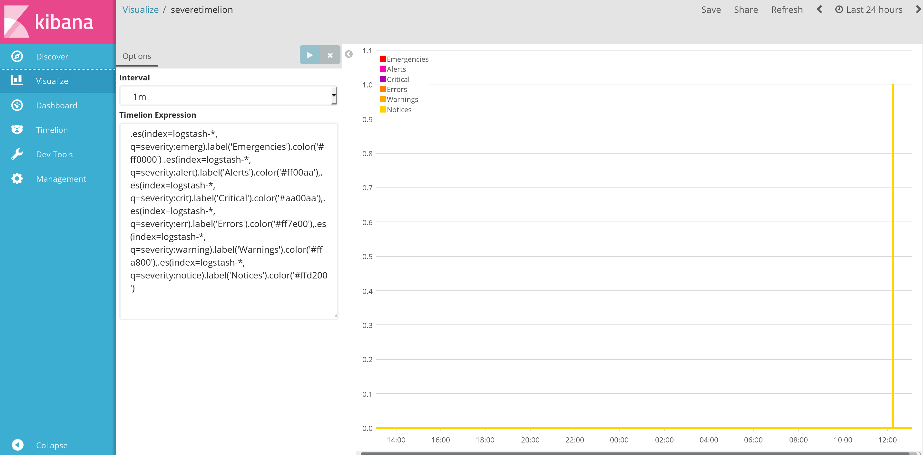
Kibana - Visualize

