Slide 1
Juniper log grabber
Martin Grønholdt, Rickie Ljungberg, Kasper Soelberg

Slide 2
Overview

Slide 3
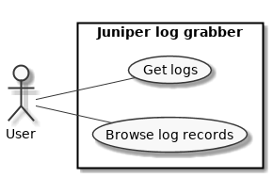
Use case

Slide 4
GUI mock up

Slide 5
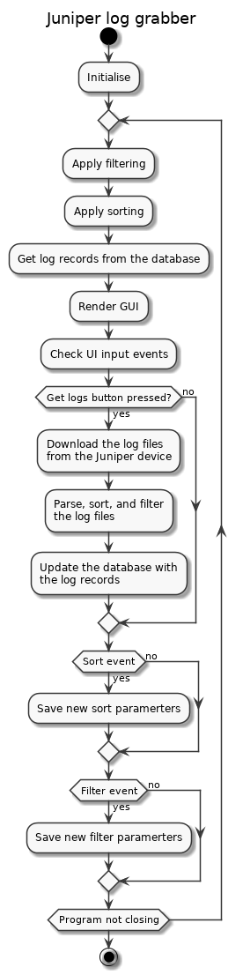
Program flow

Slide 6
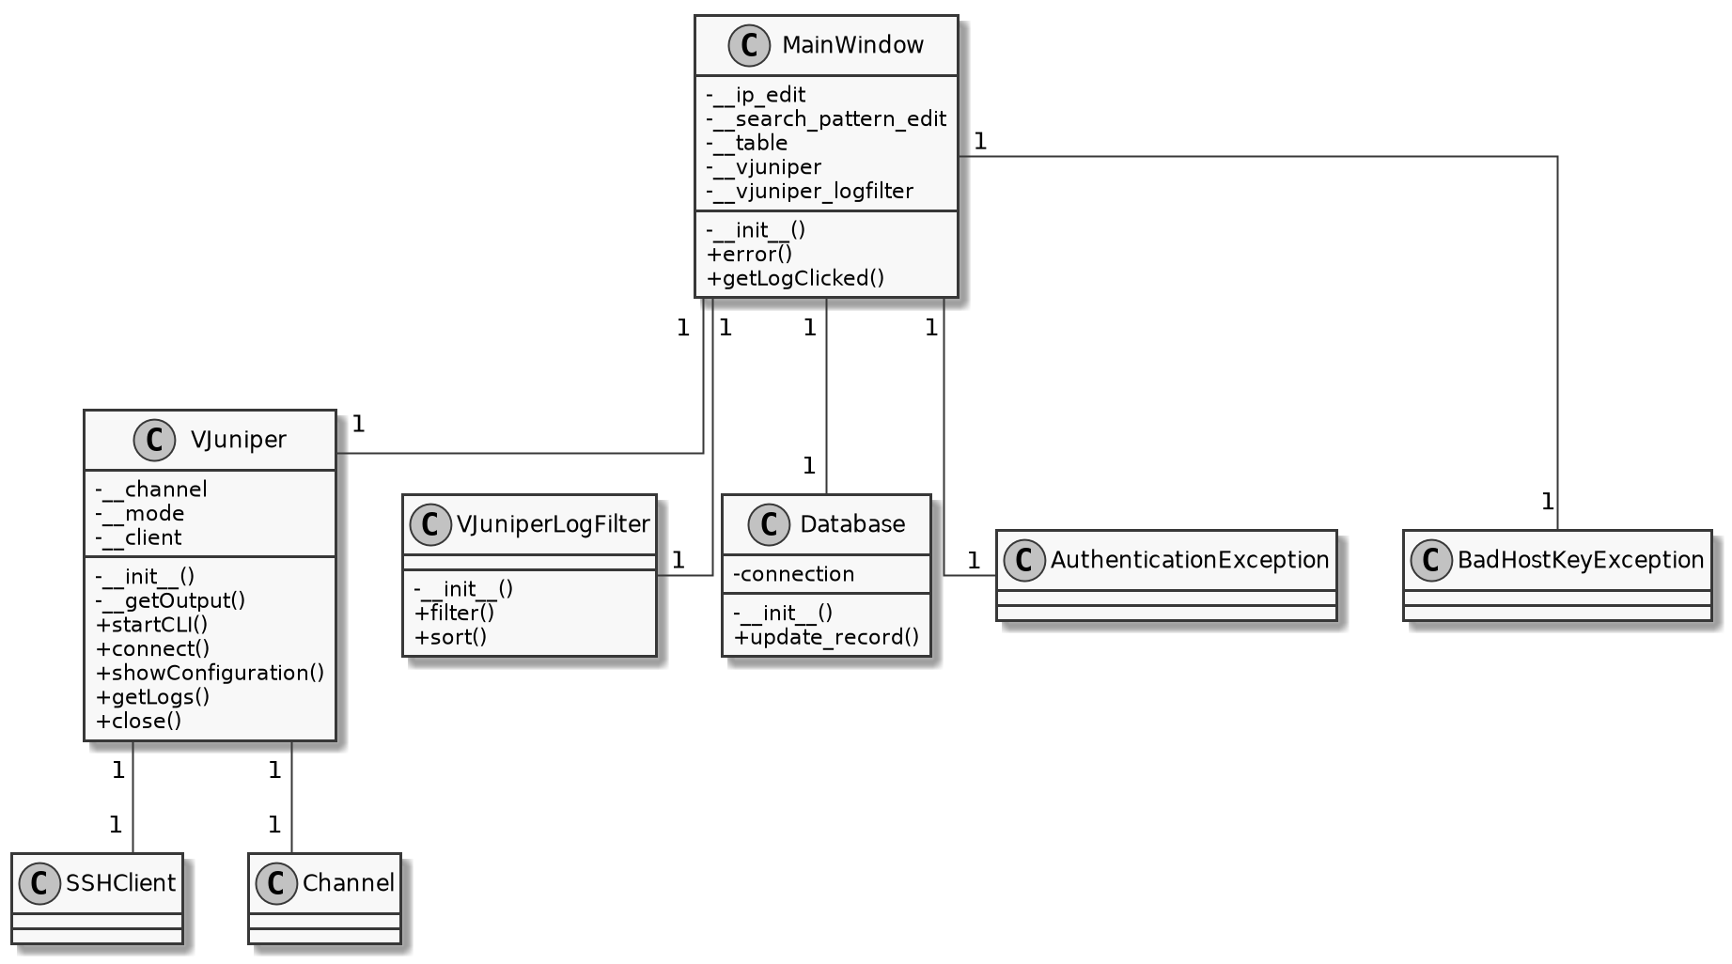
Class diagram (draft)

