Slide 1
vSphere 6.5 changes from 6.0
Authors:
Fríði Mellemgaard - frid4436@edu.eal.dk
Michal Skorczewski - mich74p0@edu.eal.dk
Martin Grønholdt - mart80c7@edu.eal.dk

Slide 2
Lots
Changes are generally aimed at managing larger installations
  Most of this has not been tested due to lack of hardware and resources for using these features
For further information read about all changes at:
  http://www.vmware.com/go/vsphere65whatsnew

Slide 3
User interface options
vCenter Client (deprecated)
  Windows only
ESXi Web Interface
vCenter Server 6.5
  Targets deployments with 100+ VMs
  Enables vSphere Web Client
  Windows Server
    Needs Windows Server installation with 8GB RAM.
vCenter Server Appliance
  Ready made Linux Appliance
  Has system requirements like the Windows Server version.

Slide 4
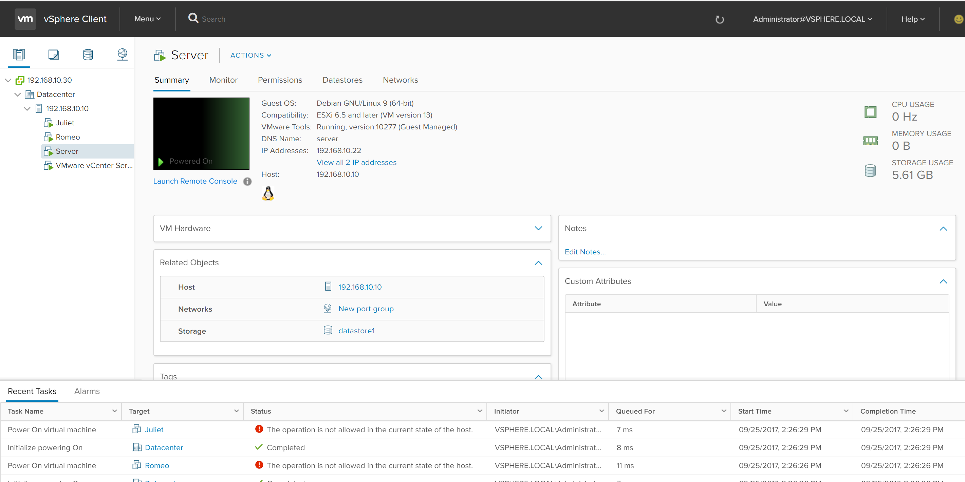
VMware vCenter Server
vCenter HTML5 interface

Slide 5
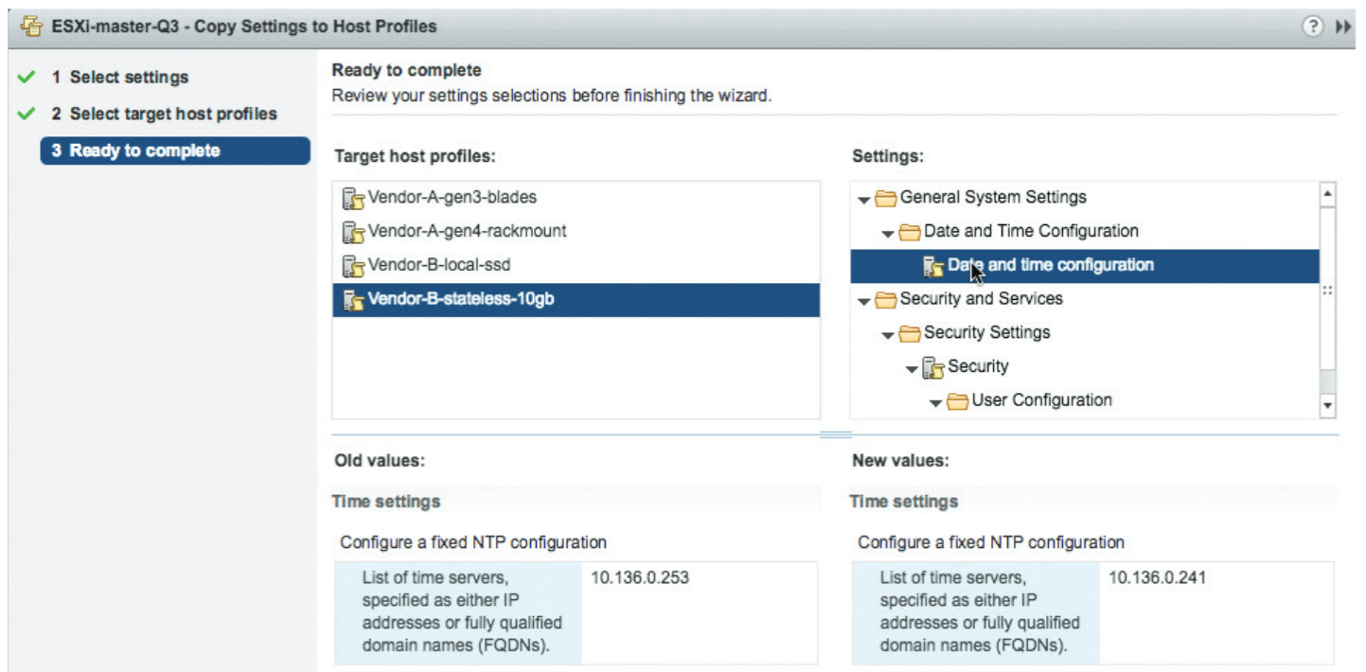
Host management
Host profiles view

Slide 6
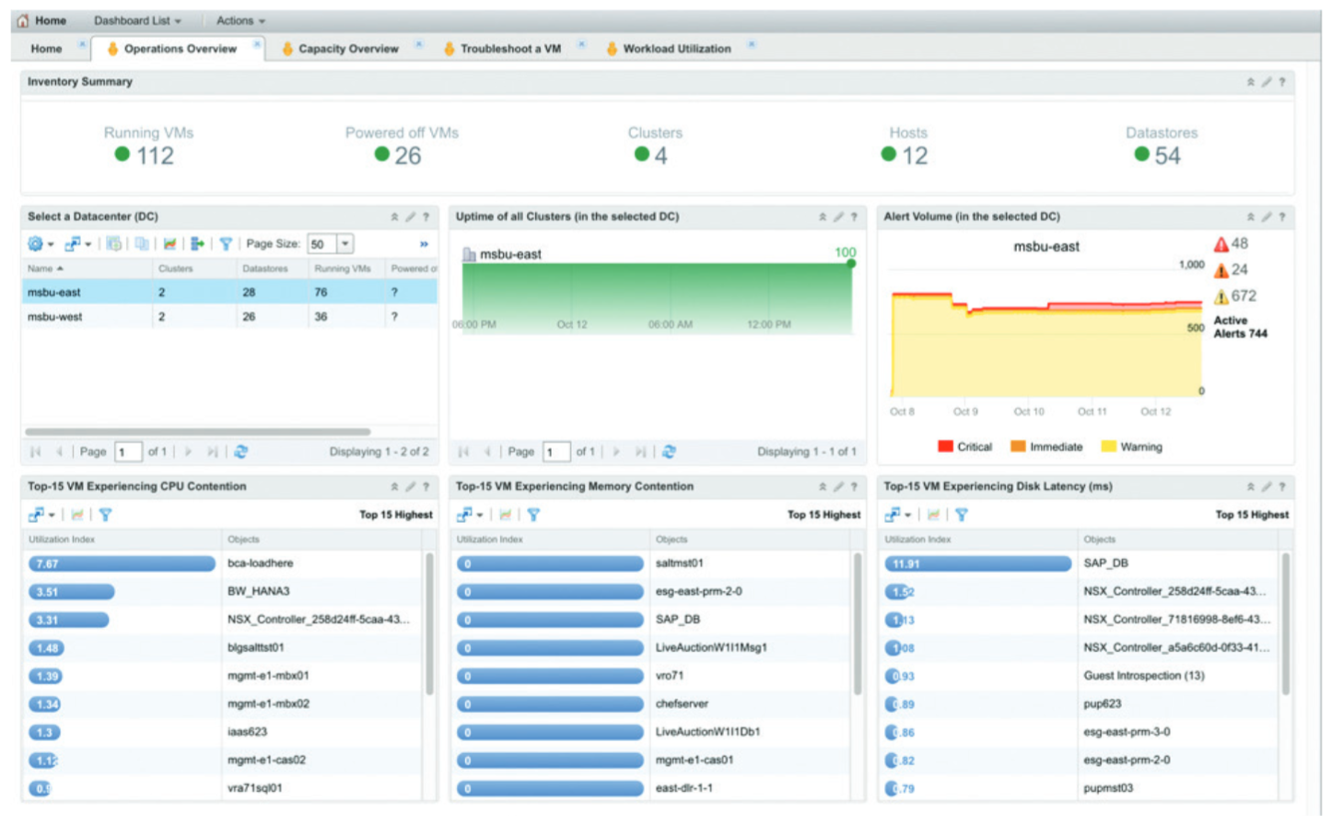
Operations Management
vRealize dashboard

Slide 7
Something new
Web Client (HTML 5)
Cross-Cloud vMotion
Rest API
vCenter HA
vCenter Native Backup

Slide 8
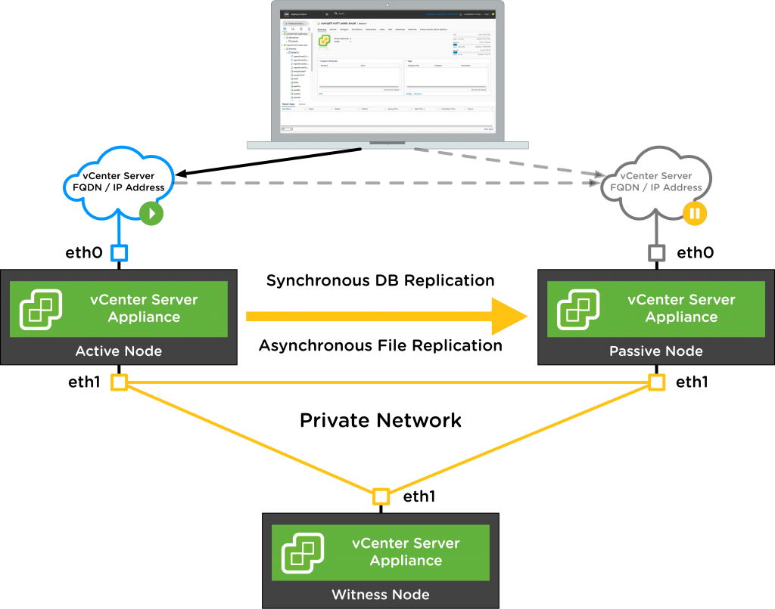
vCenter HA

Slide 9
Some differences
vRAM 4TB -> 6TB per VM
CPUs 480 -> 576 per VM
1000 hosts -> 2000 hosts
10000 VMs -> 25000 VMs

Slide 10
Security
Virtual Machine Encryption
Encrypted vMotion
vSphere Integrated Containers

Slide 11

Questions?

