Slide 1

Automation using Selenium
Advanced Level Real-Time Training in SELENIUM Testing Tool with Complete Project Support.
Glister Technologies Solutions

Slide 2

Content of Selenium
Introduction to Testing
Test - Automation Introduction
Test-Automation Strategy
Java Concepts , Core Java
Overview of Selenium Components
Selenium IDE & RC
Selenium Web driver 2.0
Selenium Grid
Object Identification
XPATH, Object Locators
HTML,XML,CSS
JUnit - Framework
TestNG - Framework
Selenium - Maven
Selenium using Mobile
Emulator & Simulator
Selenium Automation for Android & IOS
Real – Time Projects – Best Practise
Continues Project Support.

Slide 3
Approach & Importance in Test-Automation
Record & Play back it’s not a Complete Automation Testing.
Automation Strategy & Framework is important in Test-Automation Projects.
Our Automation Training Provided by Test- Architect.
Customized Based Training using Various Real Time – APPS.
End to End Framework based Training with Real time Scenarios.
Long Term Project Support with opportunity to become as a associate with our testing team.

Slide 4

Automation Introduction
Automation is the integration of testing tools into the test environment in such a manner that the test execution, logging, and comparison of results are done with little human intervention.
A testing tool is a software application which helps automate the testing process. But the testing tool is not the complete answer for automation.

Slide 5

Process of Automation
Unstable software: If the software is still under development and undergoing many changes automation testing will not be that effective.
Once in a blue moon test scripts: Do not automate test scripts which will be run once in a while.
Code and document review: Do not try to automate code and document reviews; they will just cause trouble.

Slide 6
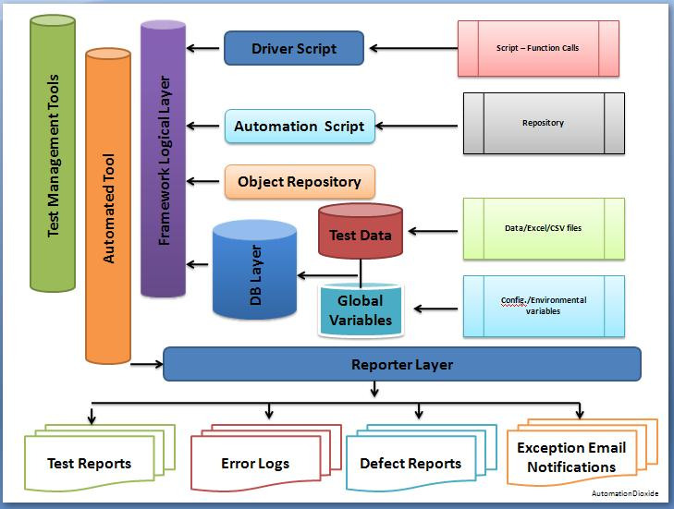

Slide 7

Features of Automation
Testing workbenches provide a range of tools to reduce the time required and total testing costs.
Systems such as Junit support the automatic execution of tests.
Most testing workbenches are open systems because testing needs are organisation-specific.
They are sometimes difficult to integrate with closed design and analysis workbenches.

Slide 8

Advantages of Automation Testing
Automated testing is cheaper.
Automated testing is faster.
Automated testing is more reliable.
Automated testing reduces human and technical risks.
Automated testing is more powerful and versatile.

Slide 9

Overview of Supported Technologies
Java
JavaScript
HTML
CSS
Ant
XML
Locators

Slide 10

Java Concepts
Java is:
  platform independent programming language
  similar to C++ in syntax
  similar to Smalltalk in mental paradigm
Pros: also ubiquitous to net
Cons: interpreted, and still under development (moving target)

Slide 11
Java Features
Java has some interesting features:
  automatic type checking,
  automatic garbage collection,
  simplifies pointers; no directly accessible pointer to memory,
  simplified network access,
  multi-threading!

Slide 12
Java Security
Pointer denial - reduces chances of virulent programs corrupting host,
Applets even more restricted -
  May not
    run local executables,
    Read or write to local file system,
    Communicate with any server other than the originating server.

Slide 13
How it works…!
Compile-time Environment
Compile-time Environment
Class Loader
Bytecode
Verifier
Java Class
Libraries
Java
Source
(.java)
Java
Interpreter
Just in Time
Compiler
Java
Bytecodes
move locally
or through
network
Java
Virtual
machine
Java
Compiler
Runtime System
Java
Bytecode
(.class )
Operating System
Hardware

Slide 14
Object-Oriented
Java supports OOD
  Polymorphism
  Inheritance
  Encapsulation
Java programs contain nothing but definitions and instantiations of classes
  Everything is encapsulated in a class!

Slide 15
Java Advantages
Portable - Write Once, Run Anywhere
Security has been well thought through
Robust memory management
Designed for network programming
Multi-threaded (multiple simultaneous tasks)
Dynamic & extensible (loads of libraries)
  Classes stored in separate files
  Loaded only when needed

Slide 16
JavaScript
Browsers have limited functionality
  Text,
  images
  tables
  frames
JavaScript allows for interactivity
Browser/page manipulation
  Reacting to user actions
A type of programming language
  Easy to learn
  Developed by Netscape

Slide 17
Example Statements
<script language="JavaScript">
window.prompt('Enter your name:','');
</script>
<form>
<input type="button" Value="Press" onClick="window.alert('Hello');">
</form>

Slide 18
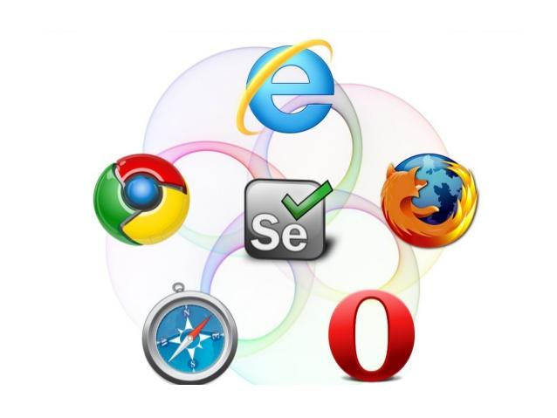
Selenium Introduction
Test tool for web applications
Runs in any mainstream browser
Supports tests in many languages
Selenium(pure HTML, no backend required)
Java, C#, Perl, Python, Ruby
Record/playback (Selenium IDE)
Open Source with corporate backing
Lives at selenium.openqa.org

Slide 19

What is Selenium?
Selenium automates browsers. Selenium has the support of some of the largest browser vendors who have taken (or are taking) steps to make Selenium a native part of their browser.
It is also the core technology in countless other browser automation tools, APIs and frameworks.

Slide 20
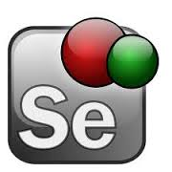
Why selenium?
Selenium is probably the best option for automated testing of Websites today.
It is becoming increasingly popular and it is the first choice of automation testers as well as organizations for automating the testing of Web-based applications for both the GUI as well as the functionality.
Selenium can also be used as a unit testing tool for JavaScript

Slide 21
You can use opensource.Selenium tool selenium IDE is a plugin to firefox to record and playback tests (like WinRunner, QTP).
You can then export the recorded test in most language e.g. html, Java , .net , perl , ruby etc. The exported test can be run in any browser and any platform using “selenium remote control”.

Slide 22
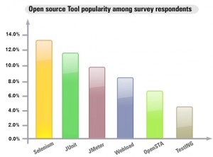
The following graph shows the popularity of Selenium along with other open source automation testing tools.

Slide 23
Advantages of Selenium
Free!
Can test across multiple browsers
Mimics actual user experience
Ajax / CSS support
Use language of choice
Large user community
Great tools: CubicTest, Grid, HRMES

Slide 24

Overview of Selenium Components
Selenium IDE - Plugin to Firefox to record and play test in firefox and also export tests in different languages.
Selenium RC- Allows playing of exported test in different platform/OS.
Selenium Grid -Allows to control lots of selenium machines.
Selenium Web driver 2.0-Driving a browser natively as a user would either locally or on a remote machine using the Selenium Server it marks a leap forward in terms of browser automation.

Slide 25
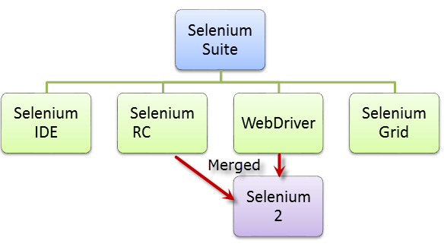

Slide 26
Selenium IDE
Easy record and playback.
Intelligent field selection will use IDs, names, or XPath as needed.
Autocomplete for all common Selenium commands.
Walk through tests.
Debug and set breakpoints.
Save tests as HTML, Ruby scripts, or any other format. Support for Selenium user-extensions.js file.
Option to automatically assert the title of every page.

Slide 27
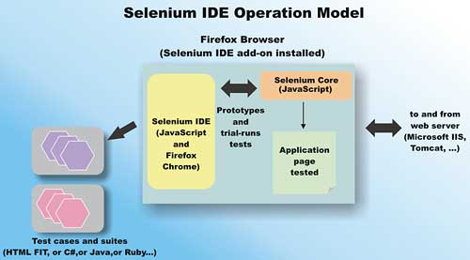
Setup:
Open selenium IDE
Go to Options -->Options
Select WebDriver Tab
Check the Enable WebDriver Play back check box
In text box type firefox or internet explorer or chrome Click OK
Record a test case in Selenium IDE

Slide 28
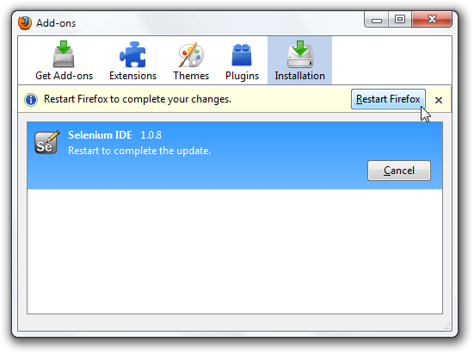
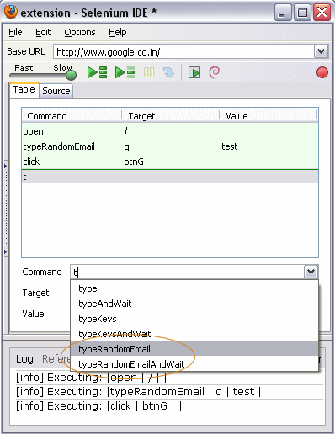

Slide 29
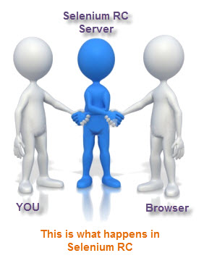
Selenium RC
Selenium Remote Control (RC) is a server, written in Java, that accepts commands for the browser via HTTP.
RC makes it possible to write automated tests for a web application in any programming language, which allows for better integration of Selenium in existing unit test frameworks.
To make writing tests easier, Selenium project currently provides client drivers for PHP, Python, Ruby, .NET, Perl and Java. The Java driver can also be used with JavaScript (via the Rhino engine).

Slide 30
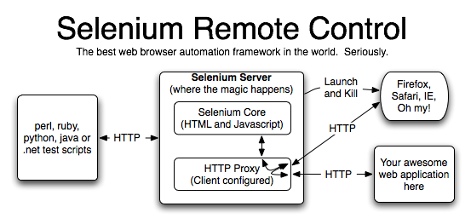
A new instance of selenium RC server is needed to launch html test case - which means that the port should be different for each parallel run.
However, for Java/PHP test case only one Selenium RC instance needs to be running continuously.

Slide 31
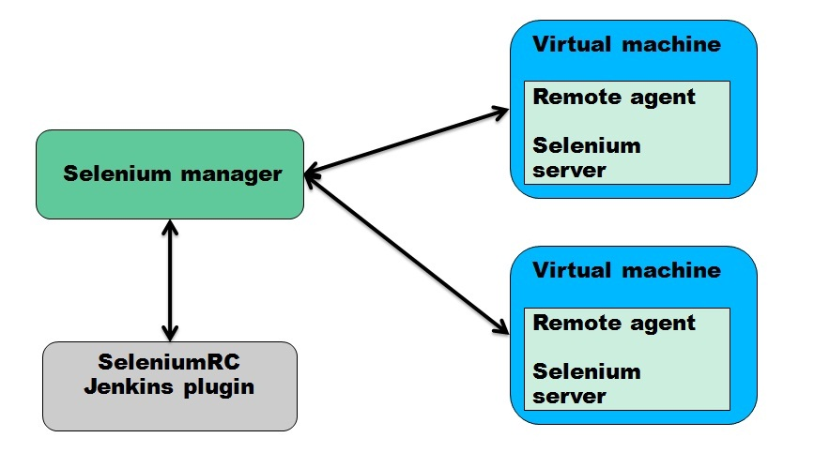

Slide 32
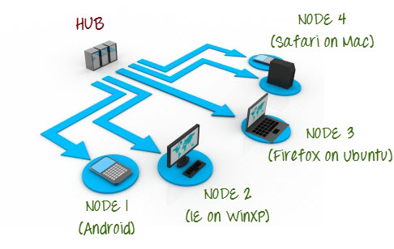
Selenium Grid
Selenium-Grid allows you run your tests on different machines against different browsers in parallel.
That is, running multiple tests at the same time against different machines running different browsers and the operating systems.
Essentially, Selenium-Grid support distributed test execution.
It allows for running your tests in a distributed test execution environment.

Slide 33
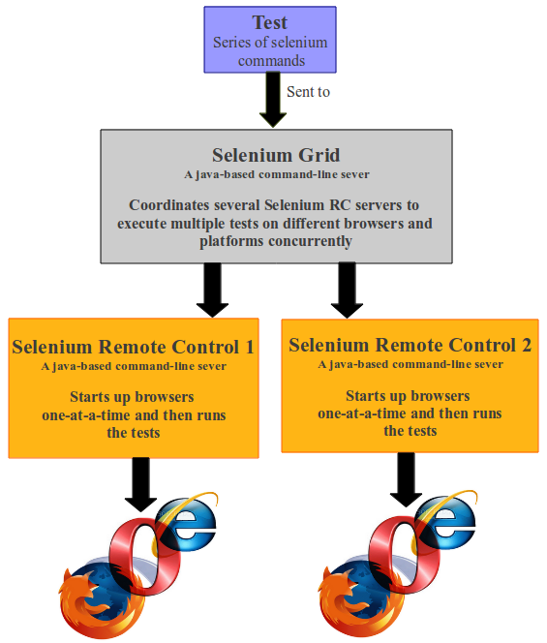
Generally speaking, there’s two reasons why you might want to use Selenium-Grid.
To run your tests against multiple browsers, multiple versions of browser, and browsers running on different operating systems.
To reduce the time it takes for the test suite to complete a test pass.

Slide 34
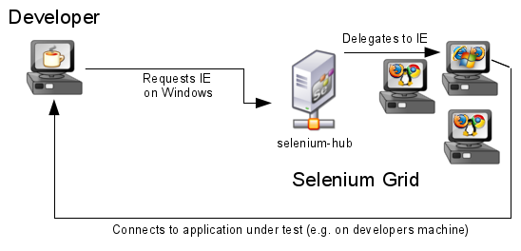

Slide 35
Selenium-Grid 2.0
Selenium-Grid 2.0 is the latest release as of the writing of this document (5/26/2012).
It is quite different from version 1 of Selenium-Grid. In 2.0 Selenium-Grid was merged with the Selenium-RC server.
Now, you only need to download a single .jar file to get the remote Selenium-RC-Server and Selenium-Grid all in one package.
Selenium-Grid 1.0
Version 1 was the first general release of Selenium-Grid.
If you are new to Selenium-Grid you should use version 2. It’s been updated and has new features, and supports Selenium-Web driver. Legacy test systems may still be using version

Slide 36
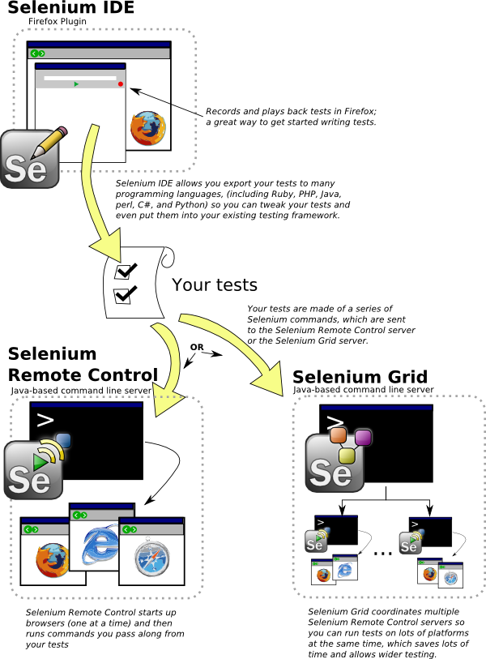
Selenium IDE-RC-Grid

Slide 37
Selenium Web driver
Selenium Web Driver is the successor to Selenium RC.
Selenium Web Driver accepts commands (sent in Selenese, or via a Client API) and sends them to a browser.
This is implemented through a browser-specific browser driver, which sends commands to a browser, and retrieves results.
Most browser drivers actually launch and access a browser application (such as Firefox or Internet Explorer); there is also an HtmlUnit browser driver, which simulates a browser using HtmlUnit.

Slide 38
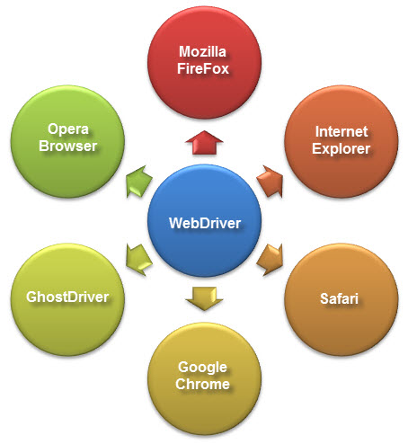
Unlike in Selenium 1, where the Selenium RC server was necessary to run tests, Selenium Web Driver does not need a special server to execute tests.
Instead, the Web Driver directly starts a browser instance and controls it. However, Selenium Grid can be used with Web Driver to execute tests on remote systems.

Slide 39
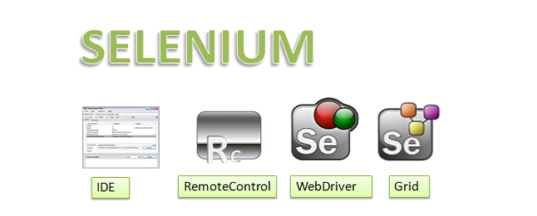

Slide 40
Selenium IDE | Selenium RC | Webdriver
Works only on mozilla | Works on almost all browsers.Does not work on latest version of firefox/IE | Works on latest versions of almost all browsers - Firefox, IE(6,7,8), OPera, Chrome
Record and run tool | No Record and run | No Record and run
No server required to start | Server is required to start | No server required to start
Core engine is Javascript based | Core engine is Javascript based | Interacts natively with browser application
Very simple to use. | Its a simple and small API | Complex and a bit large API as compared to RC
Not at all object oriented | Less Object orinted API | Purely Object oriented API
Cannot move mouse with it | Cannot move mouse with it | Can move mouse cursor
Full xpaths have to be appended with 'xapth=\\' syntax | Full xpaths have to be appended with 'xapth=\\' syntax | No need to append 'xpath=\\'

Slide 42
Object Identification
To identify the objects such as Links, Buttons, Edit boxes, Drop downs, etc on the application Selenium uses a concept called “Locators”.
There are around 8 different types of locators.
Out of them, explaining only four as they are widely used while automating the test cases using Selenium.
id = id – By default Selenium IDE takes “id” as Locator
Every Web Page will be having some HTML Source code. This can be viewed using “View –> Page Source / View source” on the browser. In the following picture we can see “id” attribute of a HTML tag is used as a locator to identify an object.

Slide 43
JUnit
JUnit is a framework for writing unit tests
  A unit test is a test of a single class
    A test case is a single test of a single method
    A test suite is a collection of test cases
Unit testing is particularly important when software requirements change frequently
  Code often has to be refactored to incorporate the changes
  Unit testing helps ensure that the refactored code continues to work

Slide 44
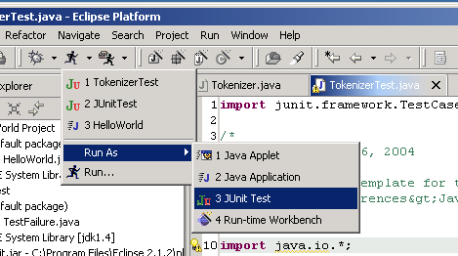
JUnit is a unit testing framework for the Java programming language.
JUnit has been important in the development of test-driven development, and is one of a family of unit testing frameworks collectively known as xUnit that originated with JUnit.
Second, use this pulldown menu
First, select a Test class
Third, Run As → JUnit

Slide 45


The Testing Problems
Should write
Do
programmers
few
Why?
I am so busy
It is difficult

Slide 46
TestNG
Automated testing framework
NG = Next Generation
Similar to JUnit (especially JUnit 4)
Not a JUnit extension (but inspired by JUnit)
Designed to be better than JUnit, especially when testing integrated classes
Created by Dr. Cédric Beust (of Google)
Open source (http://testng.org)

Slide 47
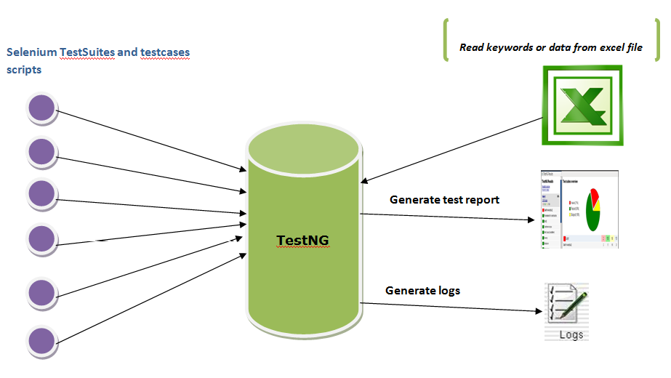

Slide 48
Locators
Element Locators
ID: id=foo
Name: name=foo
First ID, then name: identifier=foo
DOM: document.forms[‘myform’].myDropdown
XPath: xpath=//table[@id='table1']//tr[4]/td[2]
Link Text: link=sometext
CSS Selector: css=a[href=“#id3”]
Sensible defaults, e.g. xpath if starts with //
selenium.click("btnG");

Slide 49
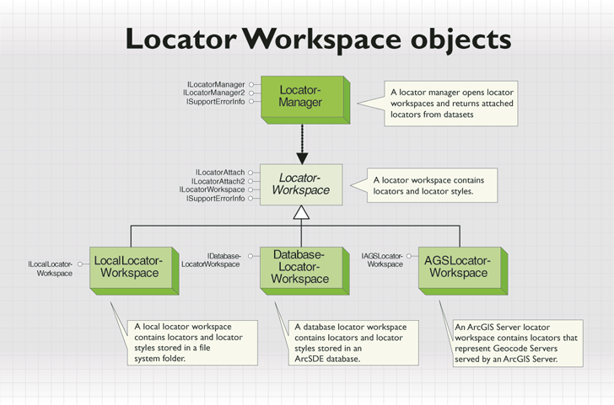

Slide 50
Element Filters
Element filters can be used with a locator to refine a list of candidate elements. They are currently used only in the 'name' element-locator.
Filters look much like locators, ie.
filterType=argument Supported element-filters are:
value=value Pattern
Matches elements based on their values. This is particularly useful for refining a list of similarly-named toggle-buttons . index=index
Selects a single element based on its position in the list (offset from zero).

Slide 51
String-match Patterns
Various Pattern syntaxes are available for matching string values:
glob: pattern: Match a string against a "glob" (aka "wildmat") pattern. "Glob" is a kind of limited regular-expression syntax typically used in command-line shells. In a glob pattern, "*" represents any sequence of characters, and "?" represents any single character. Glob patterns match against the entire string.
regexp: regexp: Match a string using a regular-expression. The full power of JavaScript regular-expressions is available.
exact: string: Match a string exactly, verbatim, without any of that fancy wildcard stuff.
If no pattern prefix is specified, Selenium assumes that it's a "glob" pattern.

Slide 52
Selenium-Maven
If you're using Maven, you will find all Selenium Maven artifacts directly in the central Maven repository here: http://repo1.maven.org/maven2/org/seleniumhq/selenium/
In order to start using Default Selenium or one of the new Web Driver implementations in your Maven project, just add the following dependency to your pom.xml:
<dependency> <groupId>org.seleniumhq.selenium</groupId> <artifactId>selenium-java</artifactId> <version>2.37.1</version> </dependency>
Note: Before version 2.0rc3 the artifact was named selenium-remote-control.

Slide 53
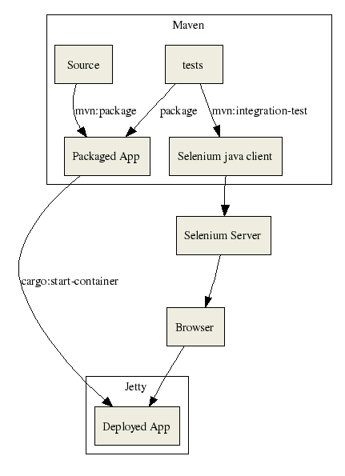
Overview of Selenium Maven artifacts

Slide 54


Selenium using Mobiles
Types of Mobile Testing
Emulator
Real device(tethered to workstation)
Real device in a real location on a real network

Slide 55
Selenium Automation for Android & IOS
The Android Driver uses the RemoteWeb-Driver.
The client side is your test code(Java code).
The server side is an application that gets installed on the android emulator or device.(android-server.apk)
The client and the server communicate using the Wire Protocol which consists of REST requests JSON and HTTP.
The application executes the tests in the context of an Android Web View.

Slide 56
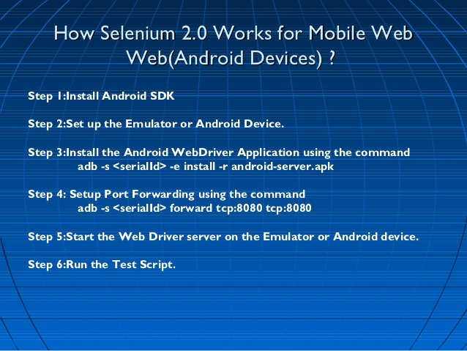

Slide 57
UNPACK
~/android_sdk
UPDATE
$ cd~/andriod_sdk/tools
$ ./android update sdk
CREATE AVD
$ ./android create avd \
-n my_android \
-t 8 \
-c 100M
START EMULATOR
$ ./emulator -avd my_android \
-no-audio \
-no-boot- anim \
-scale .8 &

Slide 58
INSTALL SELENIUM APK
$ cd~/android_sdk/platform-tools/
$ ./adb -e install \
-r ~/selenium/android/prebuilt/android-server.apk
PORT FORWARDING
$ ./adb forward tcp:8080 tcp:8080
LAUNCH APP
$ adb –s shell am start –n\
org.openga.selenium.android.app/
org.openga.selenium.android.app.Mainactivity

Slide 59
Sample Codings of Selenium
driver. get("http://www.google.com"); To open an application
driver.findElement(By.id("passwd-id")); Finding Element using Id
driver.findElement(By.name("passwd")); Finding Element using Name
driver.findElement(By. Xpath("//input[@id=’passwd-id’]")); Finding Element using Xpath
element.sendKeys("some text"); To type some data
element. clear(); clear the contents of a text ﬁeld or text area
driver.findElement(By. Xpath("//select")); Selecting the value
findElement(By.id("submit")).click(); To click on Any button/Link

Slide 60
driver.switchTo().window("window Name"); Moving from one window to another window
driver.switchTo().frame("frame Name"); swing from frame to frame (or into iframes)
driver.switchTo().frame("frameName.0.child"); to access sub frames by separating the path with a dot, and you can specify the frame by its index too.
driver.switchTo().alert(); Handling Alerts
driver. Navigate().to("http://www.example.com"); To Navigate Particular URL
driver. Navigate().forward(); To Navigate Forward
driver. Navigate().back(); To Navigate Backward
driver. close() Closes the current window

Slide 61
driver. Quit() Quits the driver and closes every associated window.
driver.switch_to_alert() Switches focus to an alert on the page.
driver. Refresh() Refreshes the current page
driver.get_screenshot_as_file('/Screenshots/foo.png') The full path you wish to save your screenshot to
driver.get_screenshot_as_base64() Gets the screenshot of the current window as a base64 encoded string
select.findElements(By.tagName("option")); Selecting the value
select.deselectAll(); This will deselect all OPTIONs from the ﬁrst SELECT on the page
select.selectByVisibleText("Edam"); select the OPTION with the displayed text of “Edam”

Slide 62
Reach Us
Email: info@thecreatingexperts.com
Web: www.thecreatingexperts.com
Powered By
Glister Tech – www.glistertech.com

