Slide 1

Introduction to Microcontrollers Fall Term, 2021
Professor Allan Douglas

Slide 2
Lab Work
Hopefully, everyone has their lab materials by now.
Lab#1 has been posted on Canvas
Due next week on the day we normally meet by midnight.

Slide 3
Lecture Outline
Arduino Integrated Development Environment (IDE)
Compiling and downloading code
Programming in Arduino "C"
Data Types and Variables
setup() and loop()
Programming Structures (conditional statements, loops, functions)
Operators
Arduino Libraries
Including Libraries
Example “Sketches”
Optiboot Bootloader
WinAVR Tools
avr-gcc, advdude

Slide 4
EE333 Software
Required
Arduino 1.8.13 Integrated Development Environment (IDE)
Arduino sketch development, serial comms, and download
https://www.arduino.cc/en/main/software
Optional
Atmel Studio IDE (optional)
Complete IDE for all Amtel products
http://www.atmel.com/microsite/atmel_studio6/
WinAVR 2010_01_10 (optional)
C compiler, linker, file conversion, programming tools
http://sourceforge.net/projects/winavr/files/

Slide 5
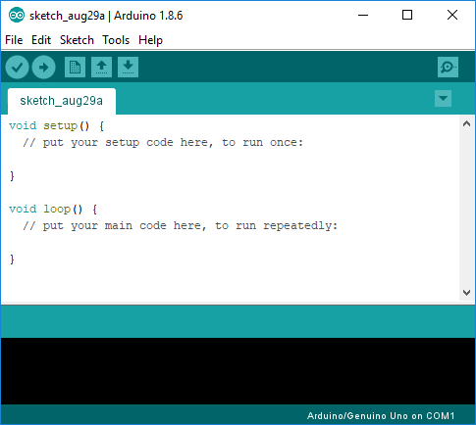
Arduino Integrated Development Environment (IDE)
Compile
Compile & Upload
Slides show version 1.8.6.
Version 1.8.13 should
look very similar.
Arduino Code
Comm Port

Slide 6
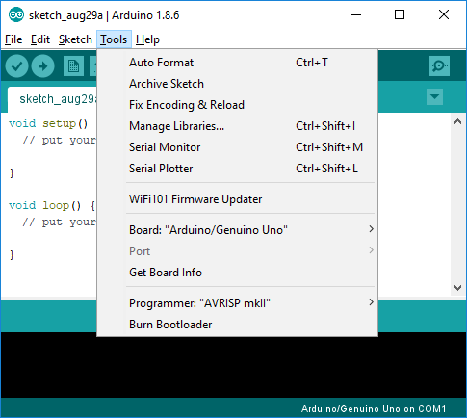
Arduino Integrated Development Environment (IDE)
Set target board
Set comm port

Slide 7
Programming the ATmega 328P (Arduino)
The Arduino language is based on C/C++.
Your compiled Arduino code (sketch) automatically links to the AVR Libc library and allows the use of any AVR functions.
Programming Language Topics
Data Types and Variables
setup() and loop()
Programming Structures control program flow
(statements, logic conditions, loops, functions)
Operators
Programming Language Reference
https://www.arduino.cc/en/Reference/HomePage

Slide 8
Arduino setup() and loop()
setup() and loop() are required in every Arduino sketch.
setup() runs the code between {} once after the microcontroller reset is de-asserted.
loop() continues executing the code between {} forever.

Slide 9
Arduino “C” Language Reference
https://www.arduino.cc/en/Reference/HomePage
Data Types
Data Type Conversions
Structure
Control Structures
Operators
Arithmetic
Comparison
Boolean
Bitwise
Functions
Digital I/O
Time
Math/Trig
Communication
Serial

Slide 10
Data Types

Slide 11
Data Type Conversions
Make sure that data types match when performing mathematical operations.
Casting Functions (convert one data type to another)
Char()
Byte()
Int()
Word()
Long()
Float()
https://www.arduino.cc/en/Reference/HomePage

Slide 12
Program Structures: If
If statements test a logic condition. If the logical condition evaluates true, the code that follows is executed.
if (x > 120) digitalWrite(LEDpin, HIGH);
if (x > 120)
digitalWrite(LEDpin, HIGH);
if (x > 120){ digitalWrite(LEDpin, HIGH); }
if (x > 120) {
digitalWrite(LEDpin1, HIGH);
digitalWrite(LEDpin2, HIGH);
} // all are correct
if (someVariable > 50)
{
// do something here
}

Slide 13
Program Structures: If/Else
You may cascade if statements using else if additional tests are required, or if you need to handle cases when the if condition evaluates to false.
if (pinFiveInput < 500)
{
// action A
}
else
{
// action B
}
if (pinFiveInput < 500)
{
// do Thing A
}
else if (pinFiveInput >= 1000)
{
// do Thing B
}
else
{
// do Thing C
}

Slide 14
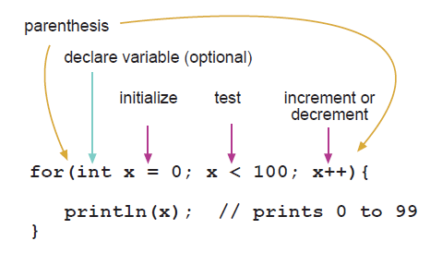
Program Structures: For Loops
For statements are used to repeat a block of statements enclosed in curly braces. An incrementing counter is usually used to control the number of iterations in the loop.
The for statement is useful for any repetitive operation, and is often used in combination with arrays to operate on collections of data.
// Dim an LED using a PWM pin
int PWMpin = 10; // LED in series with 470 ohm resistor on pin 10
void setup()
{
// no setup needed
}
void loop()
{
for (int i=0; i <= 255; i++){
analogWrite(PWMpin, i);
delay(10);
}
}

Slide 15
Program Structures: While Loops
While loops will loop continuously, and infinitely, until the logical condition inside the parenthesis becomes false.
Something must change the tested variable, or the while loop will never exit. This condition could be internal (ex. an incremented variable exceeds a limit), or an external condition (ex. an external sensor input signal goes to a logic high state).
var = 0;
while(var < 200){
// do something repetitive 200 times
var++;
}

Slide 16
Program Structures: Do/While
The do loop works in the same manner as the while loop, with the exception that the logical condition is tested at the end of the loop.
The do loop will always execute at least once.
do
{
// statement block
} while (logical condition);
do
{
delay(50); // wait for sensors to stabilize
x = readSensors(); // check the sensors
} while (x < 100);

Slide 17
Program Structures: Switch/Case
Like if statements, switch...case controls the flow of programs by allowing programmers to specify different code that should be executed in various conditions.
switch (var) {
case 1:
{
//do something when var equals 1
int a = 0;
.......
.......
}
break;
default:
// if nothing else matches, do the default
// default is optional
break;
}
switch (var) {
case 1:
//do something when var equals 1
break;
case 2:
//do something when var equals 2
break;
default:
// if nothing else matches, do the default
// default is optional
break;
}
Break ends each case.

Slide 18
Program Structures: Break
Break is used to exit from a do, for, or while loop, bypassing the normal loop condition. It is also used to exit from a switch statement.
for (x = 0; x < 255; x ++)
{
analogWrite(PWMpin, x);
sens = analogRead(sensorPin);
if (sens > threshold){ // bail out on sensor detect
x = 0;
break;
}
delay(50);
}
Terminate the for loop

Slide 19
Program Structures: Operators
Arithmetic Operators
= (assignment operator)
+ (addition)
- (subtraction)
* (multiplication)
/ (division)
% (modulo)
Comparison Operators (used in if statements and for/while/do loops)
== (equal to)
!= (not equal to)
< (less than)
> (greater than)
<= (less than or equal to)
>= (greater than or equal to)

Slide 20
Program Structures: Operators
Boolean Operators (used in if statements and for/while/do loops)
&& (and)
|| (or)
! (not)
Bitwise Operators (used to manipulate bits in a data type)
& (bitwise and)
| (bitwise or)
^ (bitwise xor)
~ (bitwise not)
<< (bitshift left)
>> (bitshift right)

Slide 21
Program Structures: Operators
Compound Operators
++ (increment)
-- (decrement)
+= (compound addition)
-= (compound subtraction)
*= (compound multiplication)
/= (compound division)
%= (compound modulo)
&= (compound bitwise and)
|= (compound bitwise or)

Slide 22
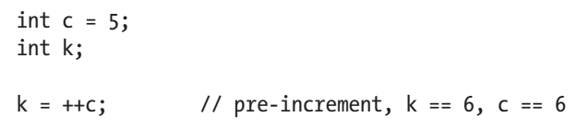
Compound Operator Examples
Pre-increment
++ counter;
Post-increment
counter++;
Often used for loops
count = count + 1; // these have the same effect
count++;

Slide 23
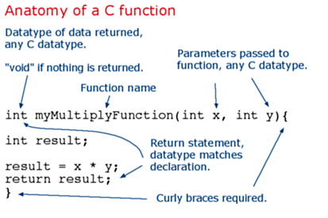
Program Structures: Functions
Segmenting code into functions allows a programmer to create modular pieces of code that perform a defined task and then return to the area of code from which the function was "called". The typical case for creating a function is when one needs to perform the same action multiple times in a program.

Slide 24
Program Structures: Functions
To "call" our simple multiply function, we pass it parameters of the datatype that it is expecting:
void loop(){ int i = 2; int j = 3; int k; k = myMultiplyFunction(i, j); // k now contains 6 }
Our function needs to be declared outside any other function, so "myMultiplyFunction()" can go either above or below the "loop()" function.

Slide 25
Program Structures: Functions
The entire sketch would then look like this:
void setup(){ Serial.begin(9600); } void loop() { int i = 2; int j = 3; int k; k = myMultiplyFunction(i, j); // k now contains 6 Serial.println(k); delay(500); } int myMultiplyFunction(int x, int y){ int result; result = x * y; return result; }

Slide 26
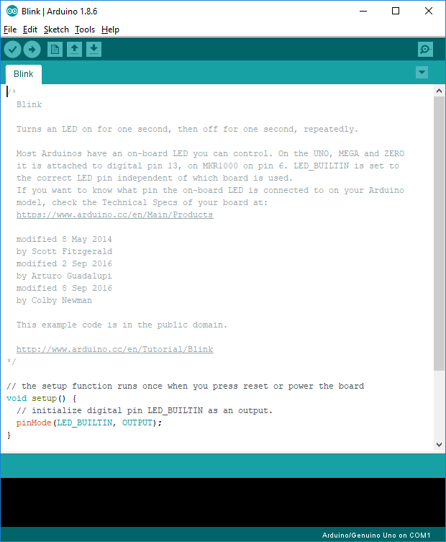
Comments
Comments are ignored by the compiler. They are used to help explain details of the code for the reader.
Multi-line comments
/*
This is a
multi-line
comment
*/
Single-line comment
// This is a comment
Your code should be fully
commented for EE333.

Slide 27
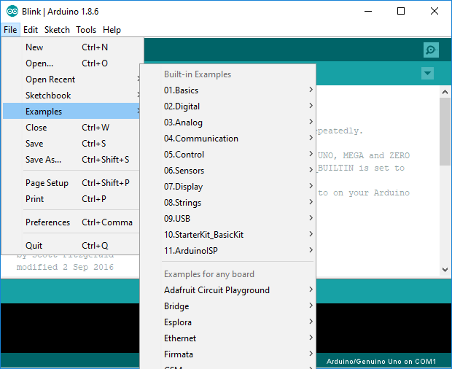
Example Arduino Sketches
There is a huge
collection of example
sketches available
for reference.

Slide 28
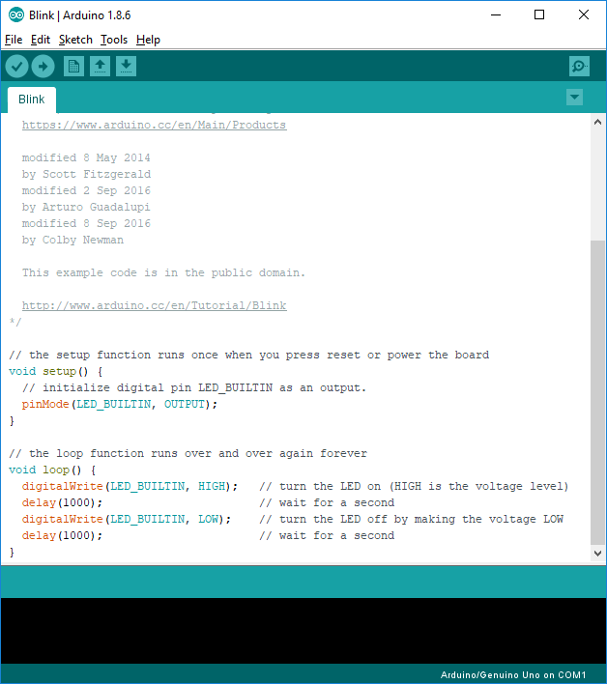
Blink sketch
pinMode()
digitalWrite()
delay()

Slide 29
pinMode() function
Description
Configures the specified pin to behave either as an input or an output. See the description of digital pins for details on the functionality of the pins.
As of Arduino 1.0.1, it is possible to enable the internal pullup resistors with the mode INPUT_PULLUP. Additionally, the INPUT mode explicitly disables the internal pullups.
Syntax
pinMode(pin, mode)
Parameters
pin: the number of the pin whose mode you wish to set
mode: INPUT, OUTPUT, or INPUT_PULLUP. (see the digital pins page for a more complete description of the functionality.)
Returns
None

Slide 30
digitalWrite() function
Description
Write a HIGH or a LOW value to a digital pin.
If the pin has been configured as an OUTPUT with pinMode(), its voltage will be set to the corresponding value: 5V (or 3.3V on 3.3V boards) for HIGH, 0V (ground) for LOW.
If the pin is configured as an INPUT, digitalWrite() will enable (HIGH) or disable (LOW) the internal pullup on the input pin. It is recommended to set the pinMode() to INPUT_PULLUP to enable the internal pull-up resistor. See the digital pins tutorial for more information.
NOTE: If you do not set the pinMode() to OUTPUT, and connect an LED to a pin, when calling digitalWrite(HIGH), the LED may appear dim. Without explicitly setting pinMode(), digitalWrite() will have enabled the internal pull-up resistor, which acts like a large current-limiting resistor.
Syntax
digitalWrite(pin, value)
Parameters
pin: the pin number
value: HIGH or LOW
Returns
none

Slide 31
delay() function
Description
Pauses the program for the amount of time (in miliseconds) specified as parameter.
Syntax
delay(ms)
Parameters
ms: the number of milliseconds to pause (unsigned long)
Returns
nothing

Slide 32
Arduino Bootloader
Microcontrollers are usually programmed through a programmer unless you have a piece of firmware in your microcontroller that allows installing new firmware using an external programmer. This is called a bootloader.
Optiboot is installed on Arduinos when purchased.
This allows you to load programs over USB rather than an Atmel external programmer.
The bootloader is executed when power is applied or reset is asserted.
It provides basic serial communication with the microcontroller and that ability to read/write flash memory.

Slide 33
Optiboot
Optiboot is an easy to install upgrade to the Arduino bootloader within Arduino boards. It provides the following features:
Allows larger sketches. Optiboot is a quarter of the size of the default bootloader, freeing 1.5k of extra space.
Makes your sketches upload faster. Optiboot operates at higher baud rates and has streamlined programming.
Adaboot performance improvements. Optiboot runs your sketches sooner, with no watchdog issues.
Compatible with 168 and 328 Arduinos including Lilypad, Pro, Nano
Believed to work with ATmega1280 ("Mega"), ATmega644 ("Sanguino"), and ATmega1284.
Optiboot is now installed by default on the Arduino Uno. It can be installed on all older mega8, 168 or 328 based Arduinos.
otpiboot_atmega328.hex is 1467 bytes.

Slide 34
Optiboot Basic Operation
On reset, Optiboot starts and reads the reset reason from MCUSR. For any cause other than "external reset", the application is started immediately. Otherwise, optiboot attempts to download new application software:
The "start LED" is flashed to indicate that optiboot is running. (which pin is used, and how many times it flashes, is configurable.)
The (configurable) UART is configured and the WDT is enabled with a 1s timeout.
Optiboot attempts to read commands from the (configurable) serial port. Valid characters will cause the WDT to be reset, and the application flash area to be programmed.
With no valid UART traffic, or after programming, the WDT is allowed to expire, causing the chip to reset.
Since the WDT reset is NOT an 'external reset', the application is started as in (1) - the AVR at the time the application is run has all IO registers except MCUSR and SP in their pristine, reset, state.

Slide 35
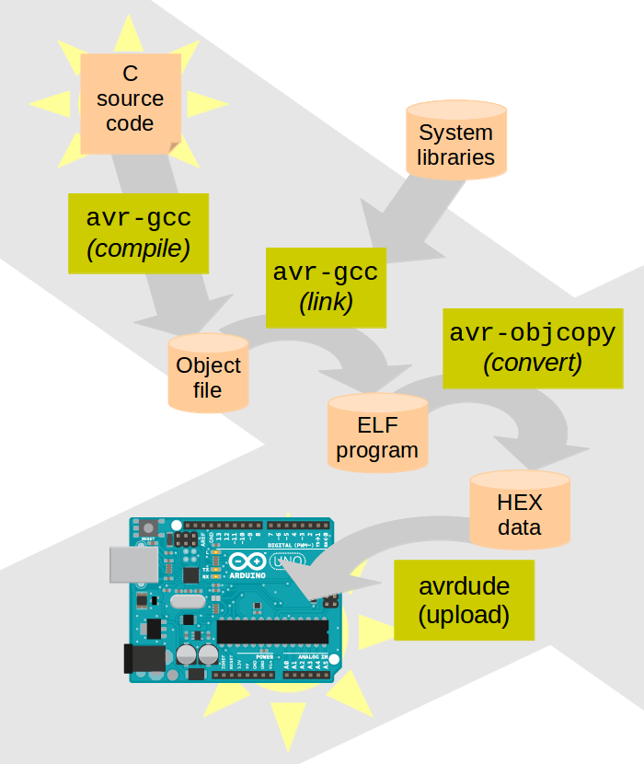
Programming in Pure C
This example requires that WinAVR is installed on your PC.
To check this, open a Command Console and type:
which avr-gcc.exe
If avr-gcc.exe cannot be found, install WinAVR from the following website.
http://sourceforge.net/projects/winavr/files/
https://balau82.wordpress.com/2011/03/29/programming-arduino-uno-in-pure-c/

Slide 36
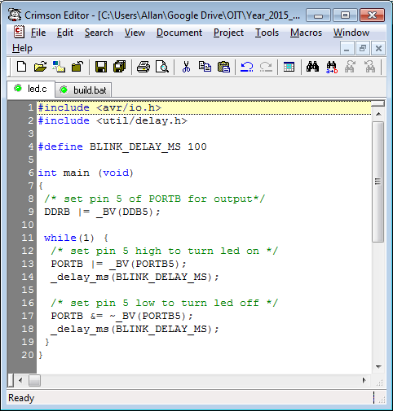
Blink Sketch in Pure C
The _BV() is defined in hardware/tools/avr/avr/include/avr/sfr_defs.h, as shown below.
#define _BV(bit) (1 << (bit))
The _BV() is a macro that shifts 1 to left by the specified number. For example _BV(5) would be 0b00100000.

Slide 37
WinAVR
WinAVRTM (pronounced "whenever") is a suite of executable, open source software development tools for the Atmel AVR series of RISC microprocessors hosted on the Windows platform. It includes the GNU GCC compiler for C and C++.
http://sourceforge.net/projects/winavr/
Toolset includes:
avr-gcc (compiler/linker)
avrdude (programmer)
avr-gdb (debugger)

Slide 38
AVRDUDE
AVRDUDE is an utility to download/upload/manipulate the ROM and EEPROM contents of AVR microcontrollers using the in-system programming technique (ISP).
A program for download/uploading AVR microcontroller flash and eeprom.
It was written by Brian S. Dean. Now open source.
Documentation can be downloaded from the download area.

Slide 39
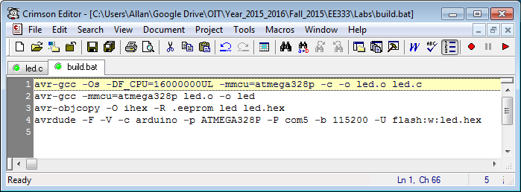
Compiling/Linking/Programming
The first command line takes the C source file and compiles it into an object file. The options tell the compiler to optimize for code size, what is the clock frequency (it’s useful for delay functions for example) and which is the processor for which to compile code.
The second commands links the object file together with system libraries (that are linked implicitly as needed) into an ELF program.
The third command converts the ELF program into an IHEX file.
The fourth command uploads the IHEX data ito the Atmega chip embedded flash, and the options tells avrdude program to communicate using the Arduino serial protocol, through a particular serial port which is the PC virtual comm port com5, and to use 115200bps as the data rate.

Slide 40
AVRDUDE Output
avrdude: AVR device initialized and ready to accept instructions
Reading | ################################################## | 100% 0.02s
avrdude: Device signature = 0x1e950f
avrdude: NOTE: FLASH memory has been specified, an erase cycle will be performed
To disable this feature, specify the -D option.
avrdude: erasing chip
avrdude: reading input file "led.hex"
avrdude: input file led.hex auto detected as Intel Hex
avrdude: writing flash (172 bytes):
Writing | ################################################## | 100% 0.03s
avrdude: 172 bytes of flash written
avrdude: safemode: Fuses OK
avrdude done. Thank you.

Slide 41
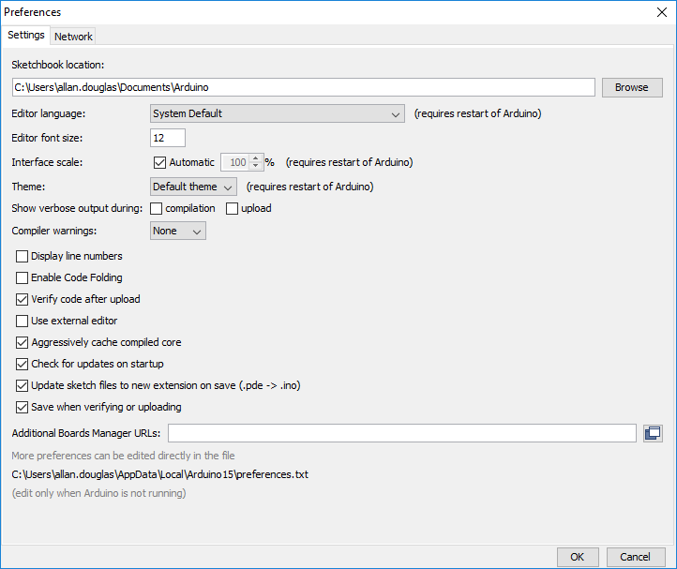
AVRDUDE Output
To see the AVRDUDE output with the Arduino IDE, click Tools -> Preferences, then check these two boxes.

