Slide 1

Introduction to Microcontrollers Fall Term, 2021
Professor Allan Douglas

Slide 2
Lecture Outline
Assembly Language Programming
Development tools
In-System Programmers (ISPs)
Debuggers
Assembly Language Instructions and Op Codes
Analysis of “Blink” in assembly language
Extra Credit Lab

Slide 3
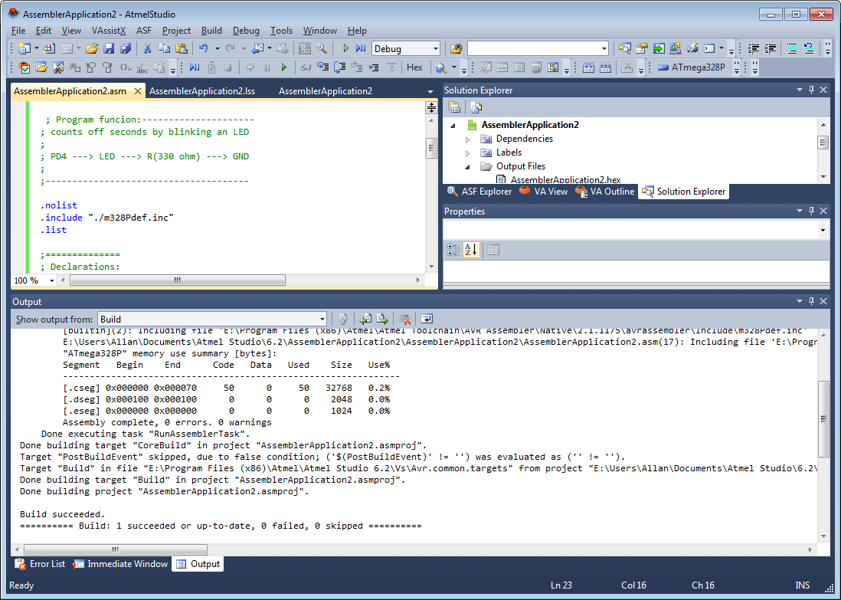
Atmel Studio
Atmel Studio is an Integrated Development Environment (IDE) for developing projects for any Atmel microcontroller.
You can develop code in C, C++, or assembly.
You can download code to a board using an In-System Programmer and you can use a Debugger to validate your application.
http://www.atmel.com/microsite/atmel-studio/

Slide 4

In-System Programmer (ISP)
Programs both flash and EEPROM
Supports fuses and lock bit programming
Upgradeable for future device support
Supports target voltages from 1.8V to 5.5V
Adjustable ISP programming speed (50Hz to 8MHz SCK frequency)
USB 2.0 compliant (full speed, 12Mbps)
Powered from USB, does not require external power supply
Target interface protection
Short-circuit protection

Slide 5
In-System Programmer (ISP)
ISP Connector
The programmer uses SPI
to communicate with the
microcontroller.

Slide 6
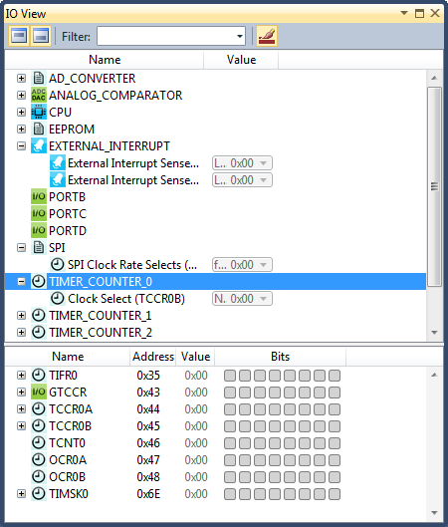
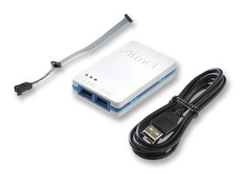
Debuggers
These devices allow developers to:
Download their applications to Flash memory
Modify internal EEPROM and Fuses
Set Breakpoints in their code
Single step during code execution
Watch internal variables
Examine memory
Examine peripheral settings and status

Slide 7
AVR Central Processing Unit
Review
16-bit wide
Flash memory

Slide 8
AVR General Purpose Working Registers
Review

Slide 9
Assembly Language Programming
When you develop code in C or C++ (Arduino sketches), the compiler converts your code to machine language. When you develop code in assembly language, an assembler converts your code to machine language. The machine language executable file is written to Flash.
After reset, the microcontroller CPU executes these machine language instructions.
In some situations, controlling the exact execution time of your application is critical. Programming directly in assembly language programming (low-level instructions) allows the developer precise control of execution.
Developers can write their entire application in assembly language or embed assembly language within their C or C++ code.
Converting assembly code to a .hex file with machine code requires an assembler. Atmel studio includes an assembler called avrasm2.exe.

Slide 10
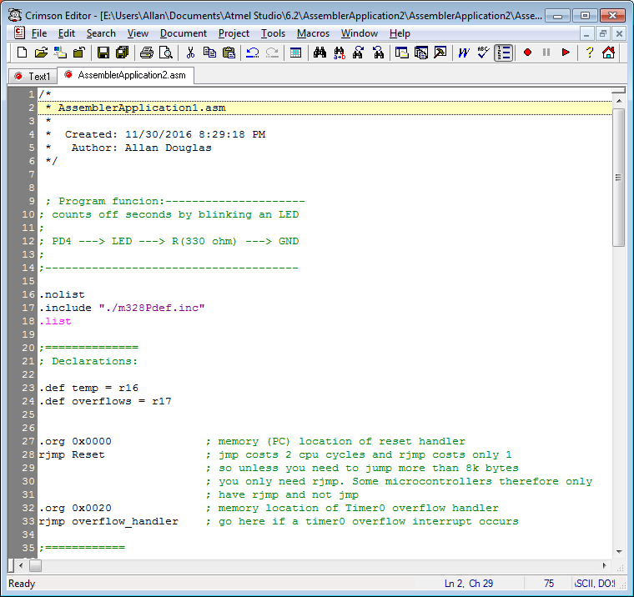
“Blink” in Assembly Code
Comments start with a semicolon.
Commands that start with a period
are assembler directives.
The NOLIST directive tells the Assembler to turn listfile generation OFF. The Assembler normally generates a listfile, which is a combination of assembly source code, addresses, and opcodes. Listfile generation is turned on by default, but can be disabled by using this directive. The directive can also be used together with the LIST directive in order to only generate listfile of selected parts of an assembly source file.
http://www.instructables.com/id/Command-Line-Assembly-Language-Programming-for-Ard-2/step3/Blinkasm/

Slide 11
“Blink” in Assembly Code
The DEF directive allows the registers to be referred to through symbols. A defined symbol can be used in the rest of the program to refer to the register it is assigned to. A register can have several symbolic names attached to it. A symbol can be redefined later in the program.
The ORG directive sets the location counter to an absolute value. The value to set is given as a parameter. If an ORG directive is given within a Data Segment, then it is the SRAM location counter which is set, if the directive is given within a Code Segment, then it is the Program memory counter which is set and if the directive is given within an EEPROM Segment, it is the EEPROM location counter which is set.

Slide 12
Links for Assembly Language Programming
Assembler Directives
https://www.microchip.com/webdoc/GUID-E06F3258-483F-4A7B-B1F8-69933E029363/index.html
Assembly Language Instruction Set
https://www.microchip.com/webdoc/avrassembler/avrassembler.wb_instruction_list.html

Slide 13
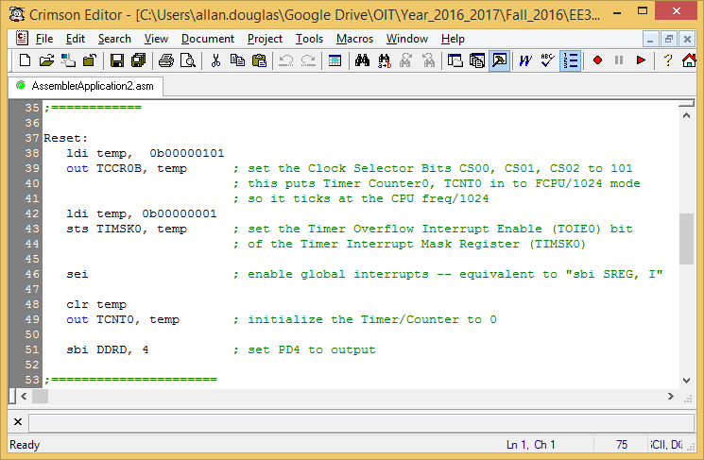
“Blink” in Assembly Code
ldi - Load Immediate
out - Store register to IO Location
sts - Store Direct to Data Space
sei - Enable Interrupts
clr - Clear Register
sbi - Set Bit in I/O Register

Slide 14
“Blink” in Assembly Code

Slide 15
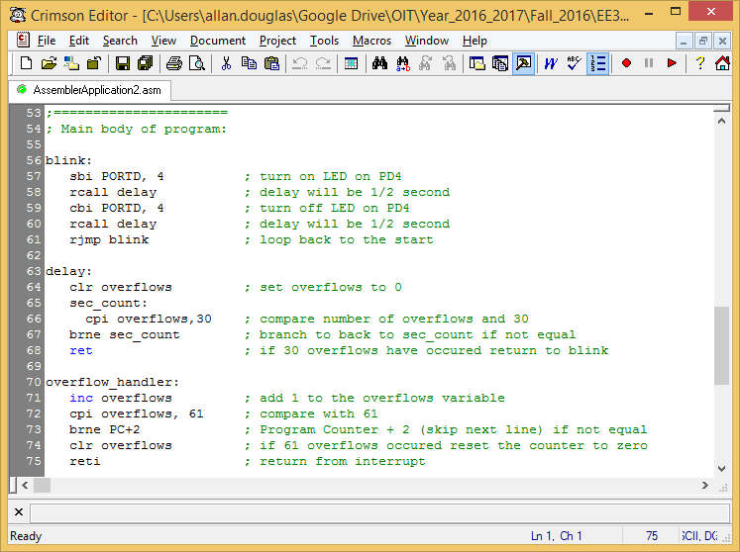
“Blink” in Assembly Code
sbi – Set Bit in I/O Register
rcall – Relative Call to Subroutine
Labels
cbi – Clear Bit in I/O Register
rjmp – Relative Jump
clr – Clear Register
cpi – Compare with Immediate
brne – Branch if Not Equal
ret – Return from Subroutine
reti – Return from Interrupt
inc – Increment
Timer0 prescaler is set to 16MHz/1024 = 15.624 KHz
Timer0 will overflow once every = 256/15624Hz = 16.384ms
30 overflows = 30 x 16.384ms = 0.49152 seconds
60 overflows = ~1 second

Slide 16
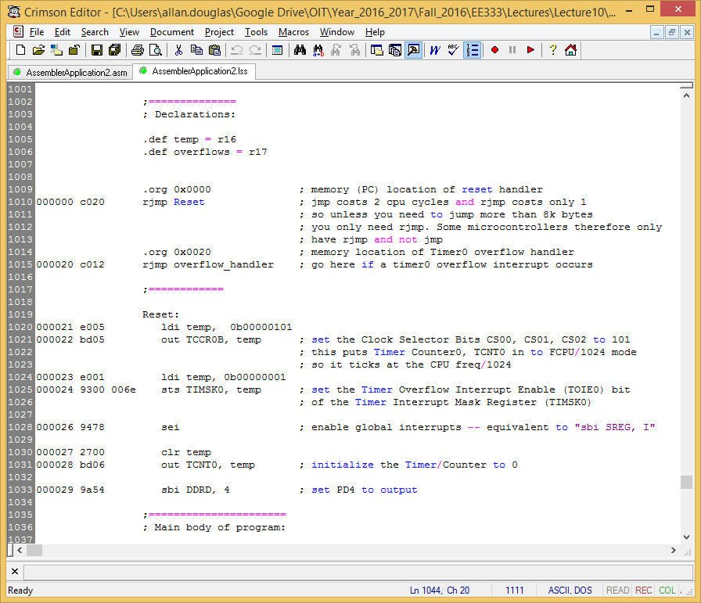
.list Command Generates a Listfile
Flash Address
16-bit Op Code
32-bit Op Code

Slide 17
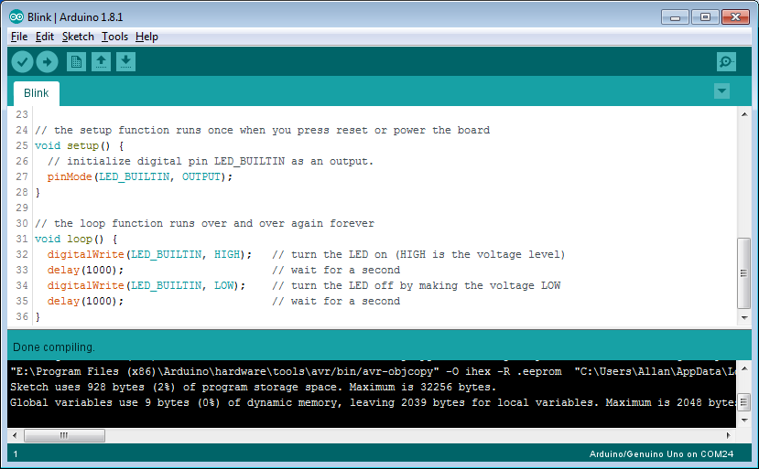
Size of Blink as a Sketch
928 bytes

Slide 18
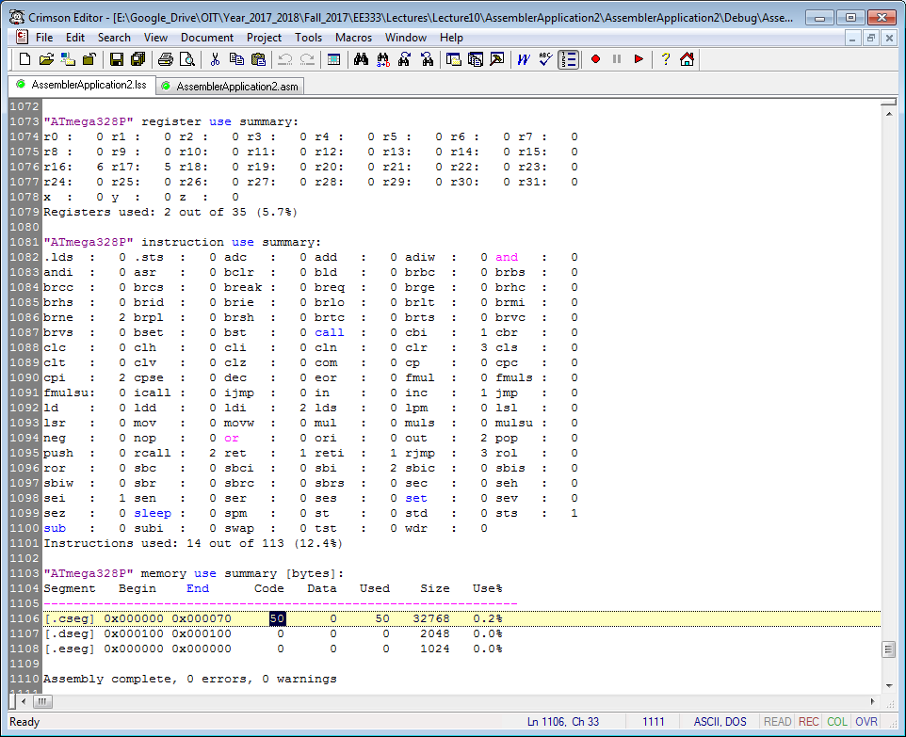
Size of Blink in Assembly
50 bytes

Slide 19
Advantages and Disadvantages
C/C++
Assembly
Human readable code
Rapid development
Barely human readable
Very fast execution time
Precise timing control
Small executable code size
To gain the “best of both worlds” embed assembly language in your C/C++ for functions
that require the advantages of assembly code.

Slide 20
Extra Credit Lab
Implement “Blink” in assembly language.
The code is available on Canvas. File name is AssemblerApplication2.asm.
Send an ASCII character to the serial monitor/terminal with assembly language.
Research code examples online
Write a normal Lab Report
Include screenshots, pictures, or short videos to demonstrate your functional code.
This lab is worth 50 points (normal labs are worth 100 points).
Due by midnight the last day of class this term (this Friday night).

Slide 21

Thank You
Thank you for taking EE333.
I hope that you learned a great deal about the capabilities of microcontrollers this term.
I look forward to seeing all of you in EE335 next term!

