Slide 1

Introduction to Microcontrollers Fall Term, 2021
Professor Allan Douglas

Slide 2
Schedule/Labs
Lab#1
Due tonight by midnight.
Lab#2 has been posted on Canvas.

Slide 3
Lecture Outline
Microcontroller Registers
Programming Microcontrollers
Atmel AVR Microcontroller Registers
Basic Serial Communication
General Purpose I/O
Microcontroller Ports and Registers
Inter-Integrated Circuit Communications (I²C)
Serial Peripheral Interface (SPI)
RS-232(USART)
Lab#2
Lab Grading Rubric

Slide 4
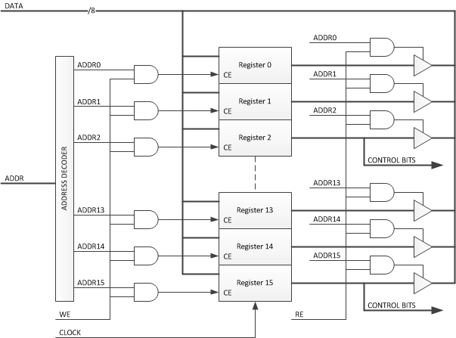
Microcontroller Registers

Slide 5
General Purpose Digital I/O
ESD protection
diodes.

Slide 6
General Purpose Digital I/O
Tri-State Buffer
Enable In Out
0 0 Z
0 1 Z
1 0 0
1 1 1
Direction
Port
Tri-State Buffer
Transmission Gate
Pin
If SLEEP is high, the input is “disconnected”
and the Schmitt Trigger input is clamped to
ground.

Slide 7
I/O Port Control Registers
See the register summary in the ATMega328p datasheet on Canvas.

Slide 8
Port Pin Configurations
Each port pin consists of three register bits: DDR, PORT, and PIN.
PORT
DIRECTION
PIN

Slide 9
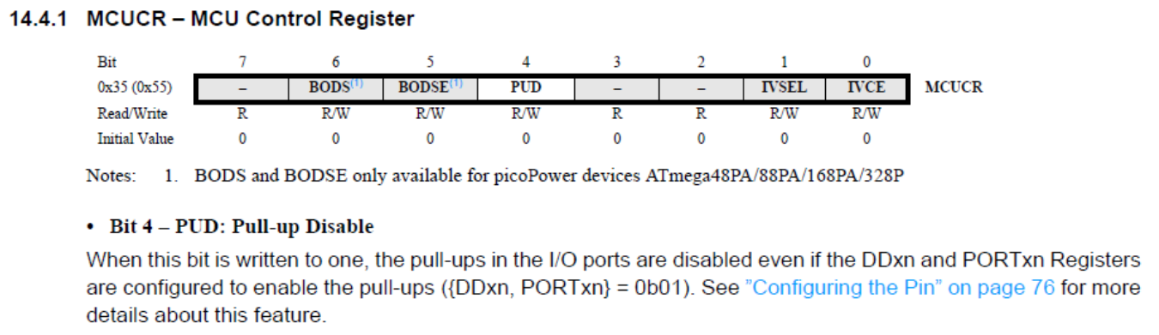
Configuring Pins

Slide 10
Read/Modify/Write (RMW)
So how do you change one bit in an 8-bit register?
Read the current register value (all eight bits)
Modify the current value with bitwise operations
Current_Value = 1001_0011
Modified_Value = Current_Value | 0000_1000. This sets bit 3. Modified_Value = 1001_1011
Current_Value = 1001_0011
Modified_Value = Current_Value & 1111_1110. This clears bit 0. Modified_Value = 1001_0010
Write the modified value back to the register

Slide 11
Programming Microcontrollers
Arduino C “Sketches”
Very high-level programming.
Use of very high-level libraries to simplify code.
Specific to the Arduino family of AVR microcontrollers.
Requires a compiler/linker (avr-gcc).
C/C++
High-level programming with library use.
More general-purpose code that can be ported to other microcontrollers.
Requires a compiler/linker (avr-gcc).
Assembly Language Programming
Low-Level programming.
Specific to a particular microcontroller.
Direct manipulation of internal registers, memory, and the Arithmetic Logic Unit (ALU).
Provides precise control over program execution time.

Slide 12
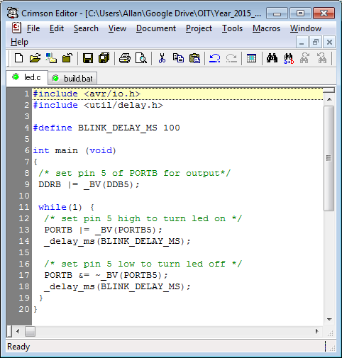
Blink Sketch in Pure C

Slide 13
Libraries/Macros/Definitions
#include <avr/io.h>
This header file includes the appropriate IO definitions for the device that has been specified by the -mmcu= compiler command-line switch.
Remember the C compiler command line…
avr-gcc -Os -DF_CPU=16000000UL -mmcu=atmega328p -c -o led.o led.c
Let’s review io.h
#if defined (__AVR_ATmega328P__) || defined (__AVR_ATmega328__)
# include <avr/iom328p.h>
What does including iom328p.h do?

Slide 14
iom328p.h
Let’s examine iom328p.h
define PINB _SFR_IO8(0x03)
#define PINB0 0
#define PINB1 1
#define PINB2 2
#define PINB3 3
#define PINB4 4
#define PINB5 5
#define PINB6 6
#define PINB7 7
#define DDRB _SFR_IO8(0x04)
#define DDB0 0
#define DDB1 1
#define DDB2 2
#define DDB3 3
#define DDB4 4
#define DDB5 5
#define DDB6 6
#define DDB7 7
#define PORTB _SFR_IO8(0x05)
#define PORTB0 0
#define PORTB1 1
#define PORTB2 2
#define PORTB3 3
#define PORTB4 4
#define PORTB5 5
#define PORTB6 6
#define PORTB7 7
These definitions can now be used in your code so that
you don’t need to remember the actual numbers and addresses.

Slide 15
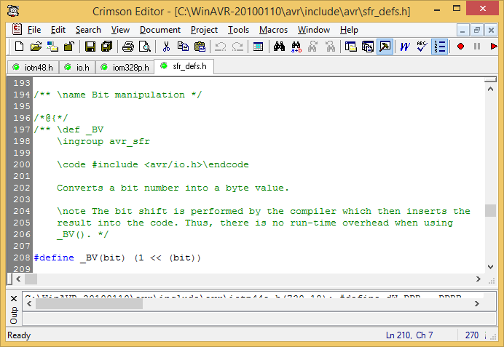
_BV Macro

Slide 16
Back to C code
/* set pin 5 of PORTB for output*/
DDRB |= _BV(DDB5);
What does this do?
Macro substitution ….
DDRB |= (1 << (DDB5))
DDB5 = 5
DDRB |= (1<<5);
DDRB |= 00010000;
DDRB = DDRB | 00010000; -- This is a bitwise OR function
This means…
read the value in the DDRB register (address 0x04)
OR that value with 00010000 in binary (set by #5)
Write the result back to DDRB (address 0x04)
This is typically called a “read-modify-write”

Slide 17
Result
The code “sets” this bit to a 1. This pin is now and output.
None of the other bits in the DDRB register were changed.

Slide 18
pinMode() function
Description
Configures the specified pin to behave either as an input or an output. See the description of digital pins for details on the functionality of the pins.
As of Arduino 1.0.1, it is possible to enable the internal pullup resistors with the mode INPUT_PULLUP. Additionally, the INPUT mode explicitly disables the internal pullups.
Syntax
pinMode(pin, mode)
Parameters
pin: the number of the pin whose mode you wish to set
mode: INPUT, OUTPUT, or INPUT_PULLUP. (see the digital pins page for a more complete description of the functionality.)
Returns
None
The pinmode() function in the Arduino library conceals all of this complication from the programmer.

Slide 19
digitalWrite() function
Description
Write a HIGH or a LOW value to a digital pin.
If the pin has been configured as an OUTPUT with pinMode(), its voltage will be set to the corresponding value: 5V (or 3.3V on 3.3V boards) for HIGH, 0V (ground) for LOW.
If the pin is configured as an INPUT, digitalWrite() will enable (HIGH) or disable (LOW) the internal pullup on the input pin. It is recommended to set the pinMode() to INPUT_PULLUP to enable the internal pull-up resistor. See the digital pins tutorial for more information.
NOTE: If you do not set the pinMode() to OUTPUT, and connect an LED to a pin, when calling digitalWrite(HIGH), the LED may appear dim. Without explicitly setting pinMode(), digitalWrite() will have enabled the internal pull-up resistor, which acts like a large current-limiting resistor.
Syntax
digitalWrite(pin, value)
Parameters
pin: the pin number
value: HIGH or LOW
Returns
none

Slide 20
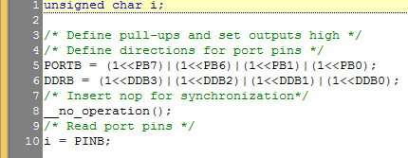
Another Example with C
C Code
Port B pin 7 (01 = input P-U)
Port B pin 6 (01 = input P-U)
Port B pin 5 (00 = input)
Port B pin 4 (00 = input)
Port B pin 3 (10 = output low)
Port B pin 2 (10 = output low)
Port B pin 1 (11 = output high)
Port B pin 0 (11 = output high)

Slide 21
AVR General Purpose Working Registers

Slide 22
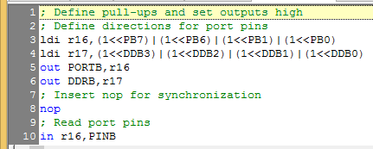
Same Example with Assembly
ldi = Load immediate
out = Out port
in = In port
nop = No operation

Slide 23
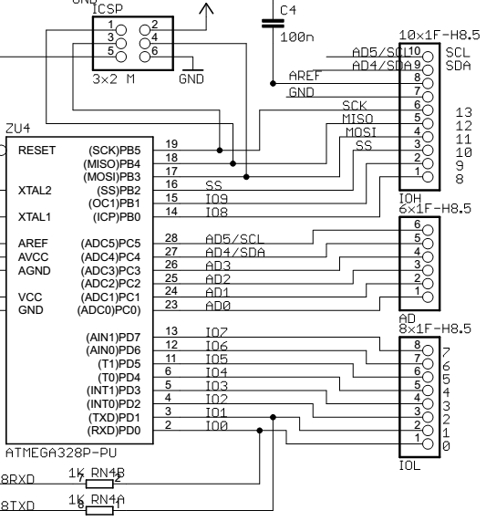
Arduino Digital Pins
I²C Pins (SCL/SDA)
SPI Pins
(SCK/MISO/MOSI/SS)
Port B
I²C Pins (SCL/SDA)
Port C
Port D
General Purpose
Digital I/O

Slide 24
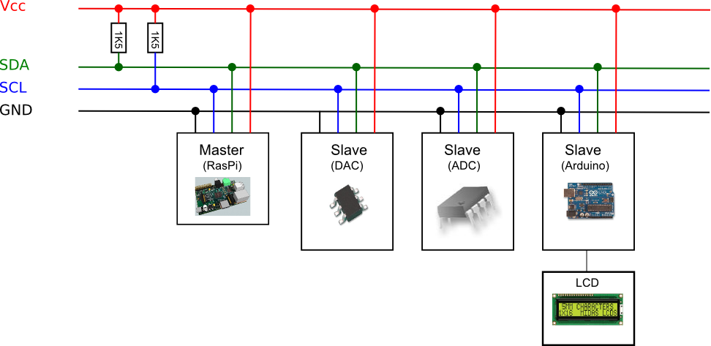
I²C Serial Communications
I²C is Inter-Integrated Circuit Communications
pronounced I squared C or I two C
Sometimes called two-wire interface (TWI).
Originally developed by Philips (now NXP Semiconductors).
All pin connections are Open-Collector (only 0 or tri-state)
http://www.nxp.com/documents/user_manual/UM10204.pdf
Pull-Up Resistors
Each slave device has a unique address
http://quick2wire.com/articles/i2c-and-spi/

Slide 25
I²C Serial Communications
I²C can be used to connect up to 127 nodes (slaves).
The bus requires two data wires, known as SDA (data) and SCL (clock).
I2C can be used to control a very wide range of devices:
Digital-to-analog converters (DACs)
Analog-to-digital converters (ADCs)
LCD displays
OLED Screens
Keyboards
Motor drivers
LED drivers
Memory chips and cards (EEPROM, RAM, FERAM, Flash)
Bus expanders/extenders (chips with 8 or 16 I/O pins controllable via I²C)
Other microcontrollers
Lab#2

Slide 26
I²C Serial Communications
The original standard specified a standard clock rate of 100KHz. Most I2C chips and micro-controllers can support this. (100Kbps max speed)
Later updates to the standard introduced a fast speed of 400KHz (400 Kbps max speed) and high speed of 1.7 or 3.4 MHz.
The Arduino can support standard and fast speeds
Each bus requires pull-ups

Slide 27
I²C Data Transfer Timing
Start and Stop
Conditions
Slave
Slave
Typical Transaction

Slide 28
Arduino Wire Library
https://www.arduino.cc/en/Reference/Wire
Functions
begin()
requestFrom()
beginTransmission()
endTransmission()
write()
available()
read()
onReceive()
onRequest()

Slide 29
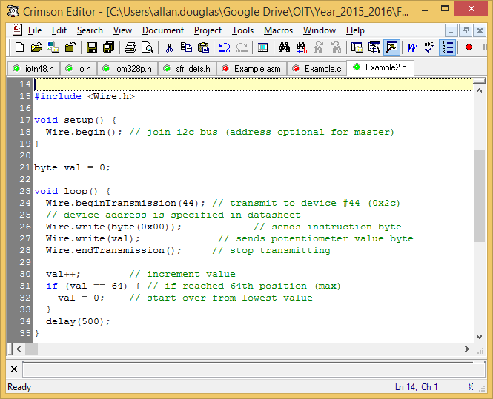
I²C Digital Potentiometer Example
Include wire.h
Defines all the wire functions.
Wire.begin()
Join the I2C bus as a master or slave
Specify an address parameter for slave connection.
Wire.beginTransmission(44)
Write I²C Address
Wire.write()
Write I2C Slave Sub-Address
Wire.write()
Write I2C Slave Data
Wire.endTransmittion()
Complete the transaction

Slide 30
AVR Two-Wire Interface (TWI) Module
Addresses start at 0xBD

Slide 31
Two-Wire Interface (TWI) Module

Slide 32
Arduino Digital Pins
I²C Pins (SCL/SDA)
SPI Pins
(SCK/MISO/MOSI/SS)
Port B
I²C Pins (SCL/SDA)
Port C
Port D
General Purpose
Digital I/O

Slide 33
SPI Serial Communications
SPI stands for Serial Peripheral Interface.
Originally developed by Motorola (now Freescale).
SPI is much simpler than I2C.
Master and slave are linked by three data wires, usually called MISO, (Master in, Slave out), MOSI (Master out, Slave in) and MCLK.
Many SPI-enabled ICs and Microcontrollers can cope with data rates of over 10MHz, so transfer is much faster than with I2C.
The downside is that SPI normally has no addressing capability; instead, devices are selected by means of a Chip Select signal which the master can use to enable one slave out of several connected to the SPI bus. If more than one slave exists, one chip select line is required per device, which can use precious GPIO lines on the Master.

Slide 34
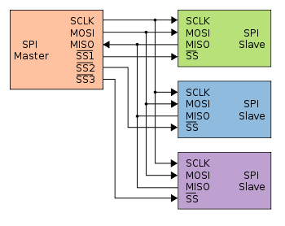
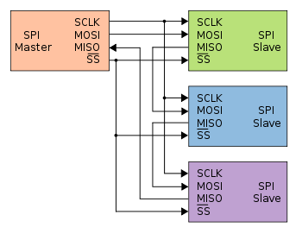
SPI Serial Communications
Typical SPI bus: master and three independent slaves
Daisy-chained SPI bus: master and cooperative slaves
https://en.wikipedia.org/wiki/Serial_Peripheral_Interface_Bus

Slide 35
AVR Serial Peripheral Interface (SPI) Module
Addresses start at 0x4E

Slide 36
SPI Modes
Controlled by CPOL and CPHA registers

Slide 37
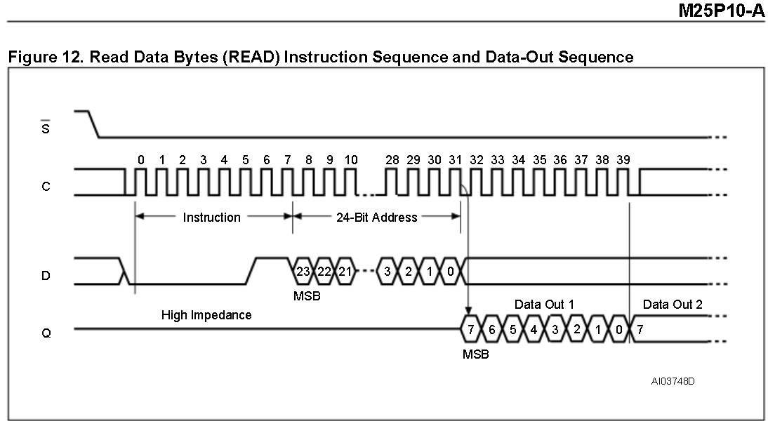
SPI Timing Example
Micron Serial EEPROM

Slide 38
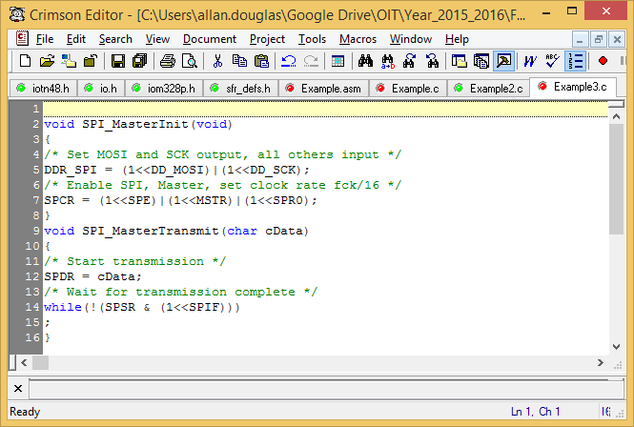
SPI Master in C
The following code examples show how to initialize the SPI as a Master and how to perform a simple transmission. DDR_SPI in the examples must be replaced by the actual Data Direction Register controlling the SPI pins. DD_MOSI, DD_MISO and DD_SCK must be replaced by the actual data direction bits for these pins. E.g. if MOSI is placed on pin PB5, replace DD_MOSI with DDB5 and DDR_SPI with DDRB.

Slide 39
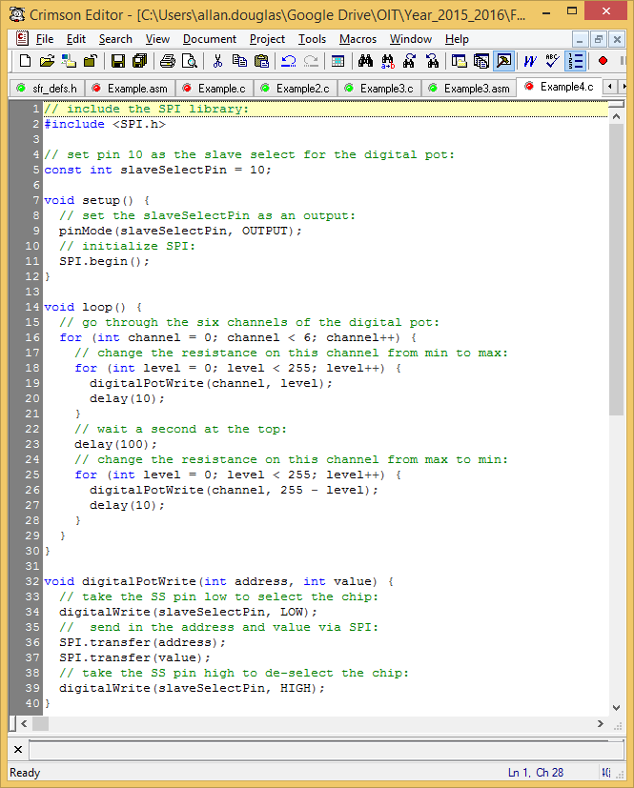
SPI Digital Potentiometer Example
Arduino Code
Include SPI library
Assert Chip Select
Send Address and Data
De-Assert Chip Select

Slide 40
Arduino Digital Pins
I²C Pins (SCL/SDA)
SPI Pins
(SCK/MISO/MOSI/SS)
Port B
I²C Pins (SCL/SDA)
Port C
Port D
General Purpose
Digital I/O
Serial USART (RX/TX)

Slide 41
Serial USART Communications
AVR Microcontroller has a USART peripheral
USART = Universal Sync/Async Receiver/Transmitter
USART is controlled with registers starting at address 0xC0
Frame Format
User needs to configure Baud Rate, # of Data Bits, Parity, # of Stop Bits

Slide 42
USART Block Diagram

Slide 43
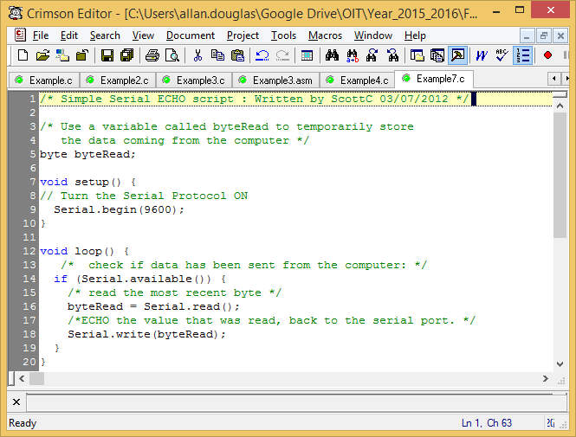
Serial Communications Echo
Set serial port for 9600 Baud
Wait for a byte to arrive (indicated by UCSRn bit)
Read the byte from UDRn
Send the byte to UDRn

Slide 44
Review of Lab#2
Lab#2 has been posted on Canvas.
Let’s review the Lab Description document…

Slide 45
Lab Grading Rubric
Category | % Possible | Description of Criteria
Presentation/Clarity | 10 | Neatly formatted presentation of material Clear sentences with coherent flow Readable and properly labeled figures/tables
Introduction | 5 | Purpose and overall objective(s) stated
Procedure/Results | 70 | Procedure clearly described Code provided and commented when appropriate All required work from checklist included and discussed All included figures/tables referenced in text
Summary/Conclusion | 15 | Experience and challenges discussed Understanding of material demonstrated
Total | 100

Slide 46
Lab Grading Rubric
Note: Write for an audience that is not familiar with your specific lab instructions. Clearly state your objectives, procedures and results. Do not simply copy questions from the lab assignment and write in your answers.
T.A. schedule and contact information:
By Appointment
Icek.warnecke@oit.edu

