Slide 1

Introduction to Microcontrollers Fall Term, 2021
Professor Allan Douglas

Slide 2
Schedule/Labs
Lab#3
Due tonight by midnight.
Lab#4 has been posted on Canvas.
Due 11/9 by midnight.

Slide 3
Lecture Outline
Lab Reports
Interrupts
Interrupt Unit
Internal vs. External Interrupts
Interrupt Service Routines
Timer/Counters
Resources available in ATMega 328P
Control Registers
Prescaling
Use Cases
Lab#4
Overview

Slide 4
Lab Report Rubric
Category | % Possible | Description of Criteria
Presentation/Clarity | 10 | Neatly formatted presentation of material Clear sentences with coherent flow Readable and properly labeled figures/tables
Introduction | 5 | Purpose and overall objective(s) stated
Procedure/Results | 70 | Procedure clearly described Code provided and commented when appropriate All required work from checklist included and discussed All included figures/tables referenced in text
Summary/Conclusion | 15 | Experience and challenges discussed Understanding of material demonstrated
Total | 100

Slide 5
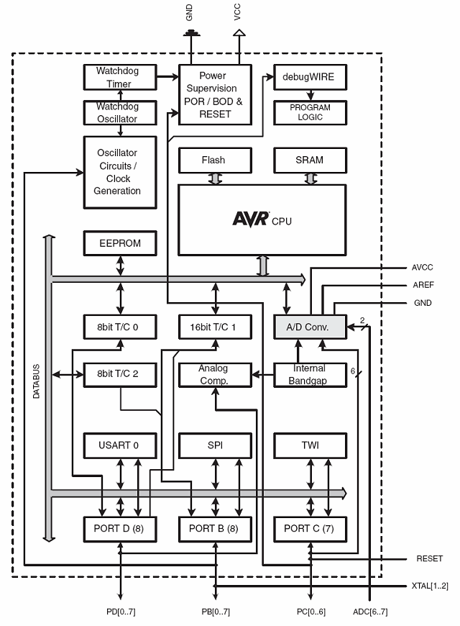
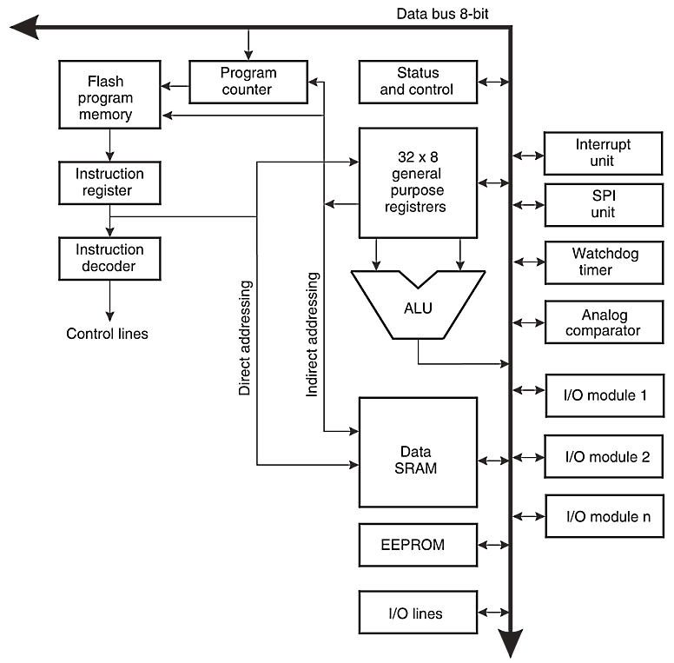
Atmega328P Block Diagrams
32kBytes
ATmega328P Data Sheet, downloaded from http://www.atmel.com

Slide 6
Interrupt versus Polling
Setup()
Loop()
Command
Command
Command
Command
Command
Interrupt Service Routine (ISR)
Interrupt Command
Interrupt Command
Interrupt Command
Interrupt
Event

Slide 7
AVR 328P Interrupts
1 Reset
2 External Interrupt Request 0 (pin D2) (INT0_vect)
3 External Interrupt Request 1 (pin D3) (INT1_vect)
4 Pin Change Interrupt Request 0 (pins D8 to D13) (PCINT0_vect)
5 Pin Change Interrupt Request 1 (pins A0 to A5) (PCINT1_vect)
6 Pin Change Interrupt Request 2 (pins D0 to D7) (PCINT2_vect)
7 Watchdog Time-out Interrupt (WDT_vect)
8 Timer/Counter2 Compare Match A (TIMER2_COMPA_vect)
9 Timer/Counter2 Compare Match B (TIMER2_COMPB_vect)
10 Timer/Counter2 Overflow (TIMER2_OVF_vect)
11 Timer/Counter1 Capture Event (TIMER1_CAPT_vect)
12 Timer/Counter1 Compare Match A (TIMER1_COMPA_vect)
13 Timer/Counter1 Compare Match B (TIMER1_COMPB_vect)
14 Timer/Counter1 Overflow (TIMER1_OVF_vect)
15 Timer/Counter0 Compare Match A (TIMER0_COMPA_vect)
16 Timer/Counter0 Compare Match B (TIMER0_COMPB_vect)
17 Timer/Counter0 Overflow (TIMER0_OVF_vect)
18 SPI Serial Transfer Complete (SPI_STC_vect)
19 USART Rx Complete (USART_RX_vect)
20 USART, Data Register Empty (USART_UDRE_vect)
21 USART, Tx Complete (USART_TX_vect)
22 ADC Conversion Complete (ADC_vect)
23 EEPROM Ready (EE_READY_vect)
24 Analog Comparator (ANALOG_COMP_vect)
25 2-wire Serial Interface (I2C) (TWI_vect)
26 Store Program Memory Ready (SPM_READY_vect)
(VALUE) is the name of the interrupt vector.

Slide 8
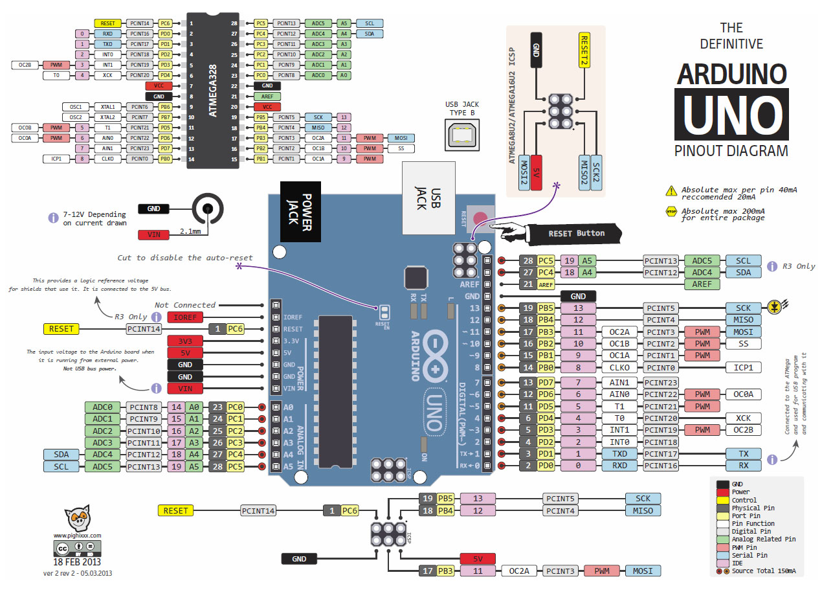
Arduino Pinout & External Interrupts
External
Interrupts

Slide 9
AVR 328P External Interrupts

Slide 10
AVR 328P External Interrupts
ISR = Interrupt Service Routine
This is a function that is automatically called when an interrupt occurs.

Slide 11
Arduino Commands to Handle Interrupts
interrupts() : global interrupt enable
noInterrupts() : global interrupt disable
attachInterrupt() : Associate an external interrupt with an ISR
detachInterrupt() : Disconnect the ISR
When an interrupt occurs, a flag in the interrupt flag register (TIFRx) is set.
This flag is automatically cleared when entering the ISR.
https://arduino-info.wikispaces.com/Timers-Arduino

Slide 12
Interrupt Service Routines (ISRs)
Interrupt reference links:
http://gammon.com.au/interrupts
http://letsmakerobots.com/content/arduino-101-timers-and-interrupts
When writing an Interrupt Service Routine (ISR):
Keep it short
Don't use delay ()
Don’t include serial prints statements (these functions are very slow)
Make variables shared with the main code volatile
Don't try to turn disable interrupts in an ISR
Volatile variable declaration forces the compiler to re-read the value when used because an external source (ISR) may have changed the value of the variable.

Slide 13
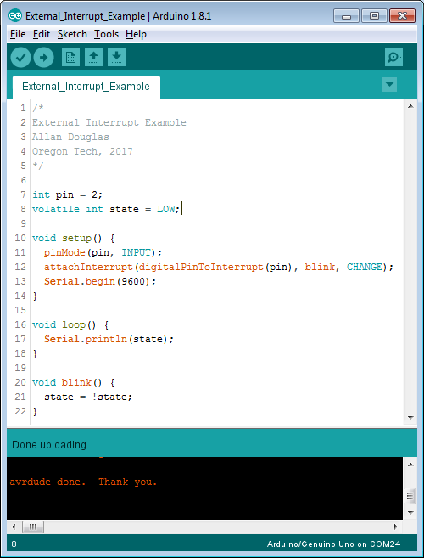
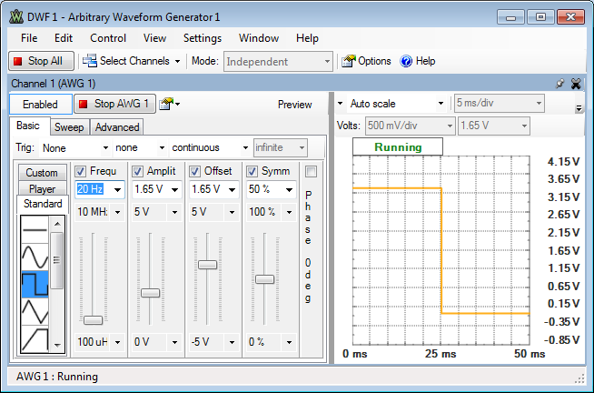
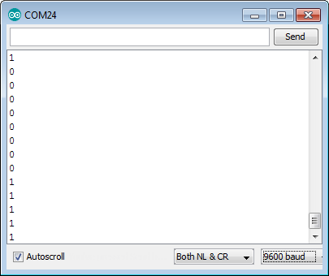
ISR Example Code
Volatile
20Hz
ISR

Slide 14
Microcontroller Counter/Timers
Many applications need to count events or generate time delays.
The ATmega 328P has the following hardware resources:
Timer/Counter0: 8-bits (max. count is 255)
This Timer is used for the Arduino delay(), millis(), and micros() functions.
Timer/Counter1: 16-bits (max. count is 65535)
Timer/Counter2: 8-bits (max. count is 255)
This timer is almost identical to Timer0 except that Timer2 can be used as a real time counter with an additional external 32.768kHz crystal.
There are also a few differences in their control registers.
Timers can be configured in different modes:
Normal mode.
PWM mode. (Pulse width modulation mode.): the OCxy outputs are used to generate PWM signals.
CTC mode. Clear timer on compare match. When the timer counter reaches the compare match register, the timer will be cleared.
PWM, phase correct mode.
Fast PWM mode.

Slide 15
8-bit Counter/Timer0/2
8-bit counter
Prescaler
8-bit register
8-bit register
5 Registers to control and interface with the timer.
8-bit register
8-bit register

Slide 16
External Timer Inputs
To Counter clock enable
Logic Synchronizer
These inputs can be used to count external events (edges)

Slide 17
Timer/Counter0 Control Registers
TCNT0: 8-bit up/down, loadable counter with reset.
TCCR0A: Control Register A (compare and mode bits)
TCCR0B: Control Register B (prescaler and mode bits)
OCR0A: Output Compare Register A
OCR0B: Output Compare Register B
TIMSK0 - Timer/Counter Interrupt Mask Register. To enable/disable timer interrupts.
TIFR0 - Timer/Counter Interrupt Flag Register. Indicates a pending timer interrupt.

Slide 18
Timer Interrupts
Timer Overflow: Timer overflow means the timer has reached is limit value. When a timer overflow interrupt occurs, the timer overflow bit TOVx will be set in the interrupt flag register TIFRx. When the timer overflow interrupt enable bit TOIEx in the interrupt mask register TIMSKx is set, the timer overflow interrupt service routine ISR(TIMERx_OVF_vect) will be called.
Output Compare Match: When a output compare match interrupt occurs, the OCFxy flag will be set in the interrupt flag register TIFRx . When the output compare interrupt enable bit OCIExy in the interrupt mask register TIMSKx is set, the output compare match interrupt service ISR(TIMERx_COMPy_vect) routine will be called.

Slide 19
Timer/Counter0 Interrupt Flags

Slide 20
Timer/Counter0 Interrupt Mask

Slide 21
Controlling Timer0
Control of Mode. OC0A/B toggle,
set, or clear on match.
Control of counting sequence,
maximum counter value, type of waveform generation (PWM).
Force Output Compare
Control of Prescaler

Slide 22
Timer Interrupts
Timer Overflow: Timer overflow means the timer has reached is limit value. When a timer overflow interrupt occurs, the timer overflow bit TOVx will be set in the interrupt flag register TIFRx. When the timer overflow interrupt enable bit TOIEx in the interrupt mask register TIMSKx is set, the timer overflow interrupt service routine ISR(TIMERx_OVF_vect) will be called.
Output Compare Match: When an output compare match interrupt occurs, the OCFxy flag will be set in the interrupt flag register TIFRx . When the output compare interrupt enable bit OCIExy in the interrupt mask register TIMSKx is set, the output compare match interrupt service ISR(TIMERx_COMPy_vect) routine will be called.
Timer Input Capture (only supported on Timer1): When a timer input capture interrupt occurs, the input capture flag bit ICF1 will be set in the interrupt flag register TIFR1. When the input capture interrupt enable bit ICIE1 in the interrupt mask register TIMSK1 is set, the timer input capture interrupt service routine ISR(TIMER1_CAPT_vect) will be called.

Slide 23
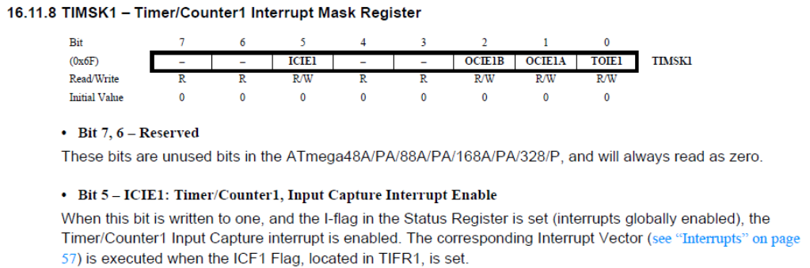
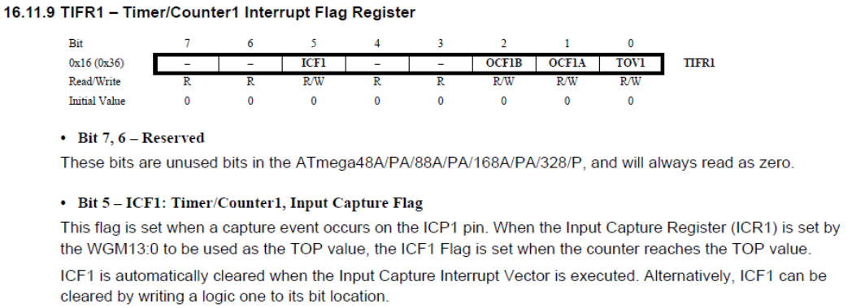
Timer1 Input Capture Registers

Slide 24
Timer Prescaler
16 MHz
External
pins.
0
7
0
7

Slide 25
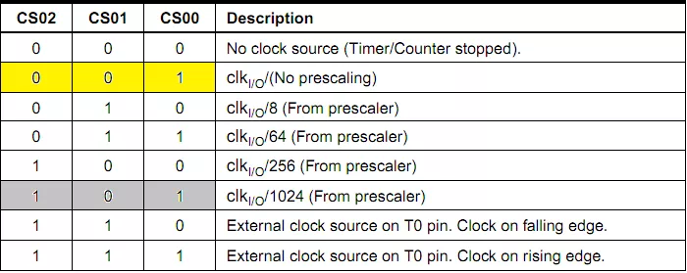
Timer0 Prescaler Control Bits
Prescaling allows you to control the time between counter increments.
You can increase the time between counter overflow events, but the time steps become more coarse.

Slide 26
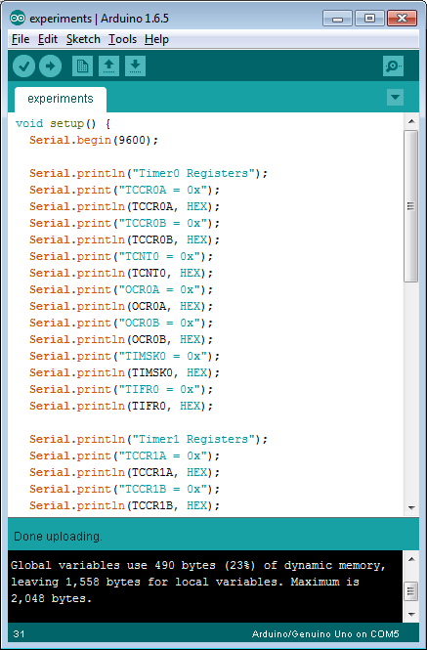
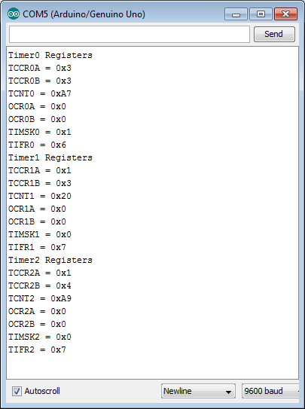
Examine the Timer Registers

Slide 27
A Closer Look at Timer0
TCCR0B = 0x3
CS01 and CS00 are set
Prescaler = 64
Microcontroller clock rate is 16MHz
Counter increments once every 64*T = 64/16MHz = 4us
Counter will count to 256*4us = 1.024ms
millis() - Returns the number of milliseconds since the program started
(unsigned long = 32 bits)
The number of milliseconds since the Arduino board began running the current program. This number will overflow (go back to zero), after approximately 50 days.
2^32-1 = 4,294,967,295 * 1.024ms = 439,8046s = 50.903316 days
micros() - Returns the number of microseconds since the Arduino board began running the current program. This number will overflow (go back to zero), after approximately 70 minutes.

Slide 28
16-bit Counter/Timer1
T1
16-bit counter
16-bits
16-bits

Slide 29
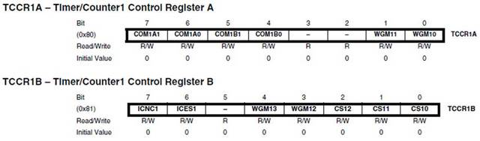
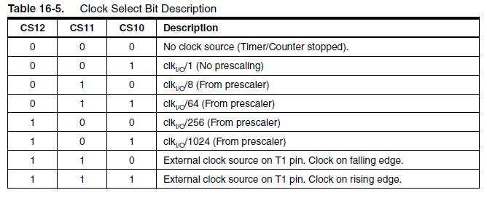
Timer/Counter1 Control Registers

Slide 30
Timer/Counter1 Count Register

Slide 31
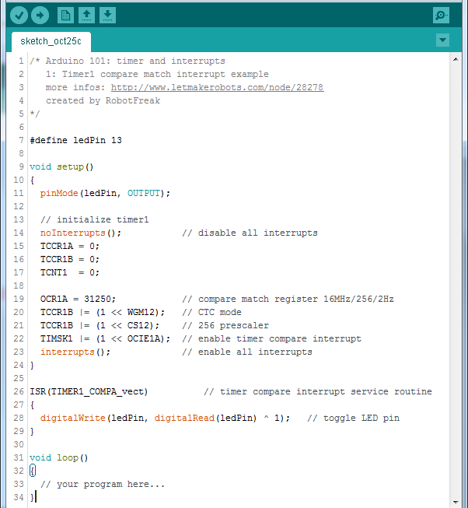
Timer1 Registers
File: iom328p.h
#define TCCR1A _SFR_MEM8(0x80)
#define WGM10 0
#define WGM11 1
#define COM1B0 4
#define COM1B1 5
#define COM1A0 6
#define COM1A1 7
#define TCCR1B _SFR_MEM8(0x81)
#define CS10 0
#define CS11 1
#define CS12 2
#define WGM12 3
#define WGM13 4
#define ICES1 6
#define ICNC1 7
#define TIMSK1 _SFR_MEM8(0x6F)
#define TOIE1 0
#define OCIE1A 1
#define OCIE1B 2
#define ICIE1 5
Alternative method to write your ISR. Use this technique for Lab#4.
See slide 7
Bitwise xor

Slide 32
Enabling Interrupt Masks
When working with interrupts as shown in the previous slide, make sure that you enable the interrupt mask register as follows:
EIMSK |= (1 << INT0); // Turns on INT0

Slide 33
What does this code do?
Count up to 31,250
Prescaler = 256, so T = 256/16MHz = 16us
So, ledPin high time = 31,250 * 16us = 0.5 seconds
Timer1 is 16-bits

Slide 34
Excellent Reference on Timers
A copy of an article from Nuts & Volts magazine has been uploaded on Canvas (Week#5).
The file is called TimersArticle.pdf
I encourage everyone to read it.

Slide 35
Lab#4
Part 1: Interrupt Speed Test
Connect the function generator to an interrupt input on the Arduino and write a sketch to respond to external interrupts. Determine mazimum rate possible for handling interrupts.
Part 2: Measuring Pulse Duration
Measure the duration of a function generator pulse using the micros() function and interrupts. Then you will repeat the process with a timer.
Let’s review the Lab#4 assignment document.

