Slide 1

Introduction to Microcontrollers Fall Term, 2021
Professor Allan Douglas

Slide 2
Schedule/Labs
Lab#4
Due by midnight.
Lab#5 will be posted on Canvas.
Due 11/16 by midnight

Slide 3
Lecture Outline
Pulse Width Modulation (PWM)
PWM Concepts
Arduino PWM
Timer Control/Compare Registers
Timer Modes
Clear Timer on Compare Match (CTC) Mode
Fast PWM Mode
Phase-Correct PWM Mode
Pre-Scaler
Lab#5
Overview

Slide 4
What is Pulse Width Modulation?
Pulse-width modulation (PWM) is a modulation technique used to encode a message into a pulsing signal. Although this modulation technique can be used to encode information for transmission, its main use is to allow the control of the power supplied to electrical devices, especially to inertial loads such as motors.
The term duty cycle describes the proportion of 'on' time to the regular interval or 'period' of time.
A low duty cycle corresponds to low power, because the power is off for most of the time.
Duty cycle is expressed in percent, 100% being fully on.
The main advantage of PWM is that power loss in the switching devices is very low.
When a switch is off there is practically no current.
When it is on and power is being transferred to the load, there is almost no voltage drop across the switch.
Power loss, being the product of voltage and current, is thus in both cases close to zero.
PWM also works well with digital controls, which, because of their on/off nature, can easily set the needed duty cycle.
https://en.wikipedia.org/wiki/Pulse-width_modulation

Slide 5
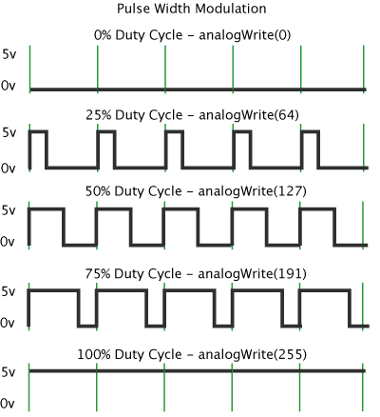
Examples of Duty Cycle
Signal On-Time/Period expressed as a percentage
Arduino uses the analogWrite() function to control duty cycle.

Slide 6
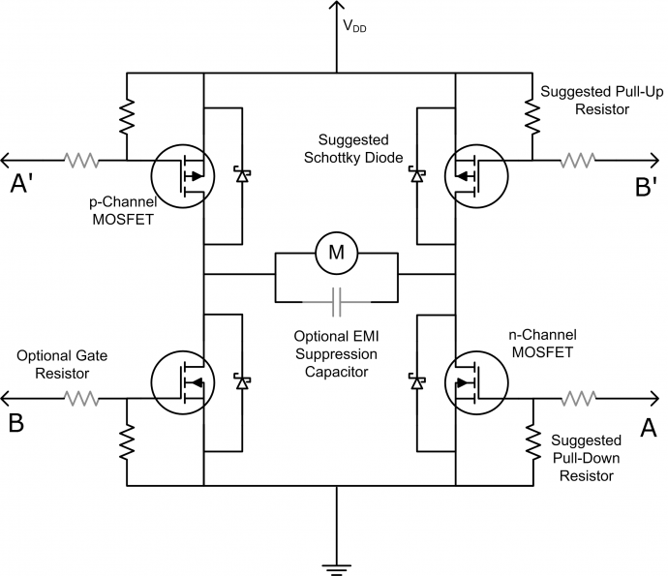
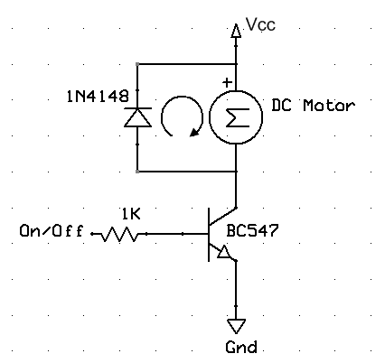
DC Motor Drive
Simple Motor Drive Circuit
H-Bridge Motor Drive Circuit

Slide 7
Arduino PWM Control
analogWrite()
Description: Writes an analog value (PWM wave) to a pin. After a call to analogWrite(), the pin will generate a steady square wave of the specified duty cycle until the next call to analogWrite() (or a call to digitalRead() or digitalWrite() on the same pin).
The default frequency of the PWM signal on most pins is approximately 490 Hz. On the Uno and similar boards, pins 5 and 6 have a frequency of approximately 980 Hz.
On most Arduino boards (those with the ATmega168 or ATmega328), this function works on pins 3, 5, 6, 9, 10, and 11. On the Arduino Mega, it works on pins 2 - 13 and 44 - 46.
You do not need to call pinMode() to set the pin as an output before calling analogWrite().
The analogWrite() function has nothing to do with the analog pins or the analogRead() function.
Syntax: analogWrite(pin, value)
Parameters
pin: the pin to write to.
value: the duty cycle: between 0 (always off) and 255 (always on).

Slide 8
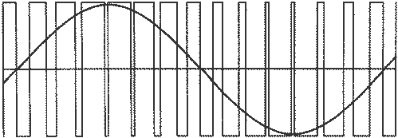
Pulse Width Modulation
Duty Cycle=255
How do we generate this?
Duty Cycle=0
double t = 0.0;
void loop()
{
OCR0A = (unsigned int)(127.0*sin(t*2.0*PI)+128.0);
delay(100);
t = t + 0.1;
Serial.println(OCR0A);
}
http://electronics.stackexchange.com/questions/191742/how-is-a-pwm-signal-converted-to-sine-using-a-transformer

Slide 9
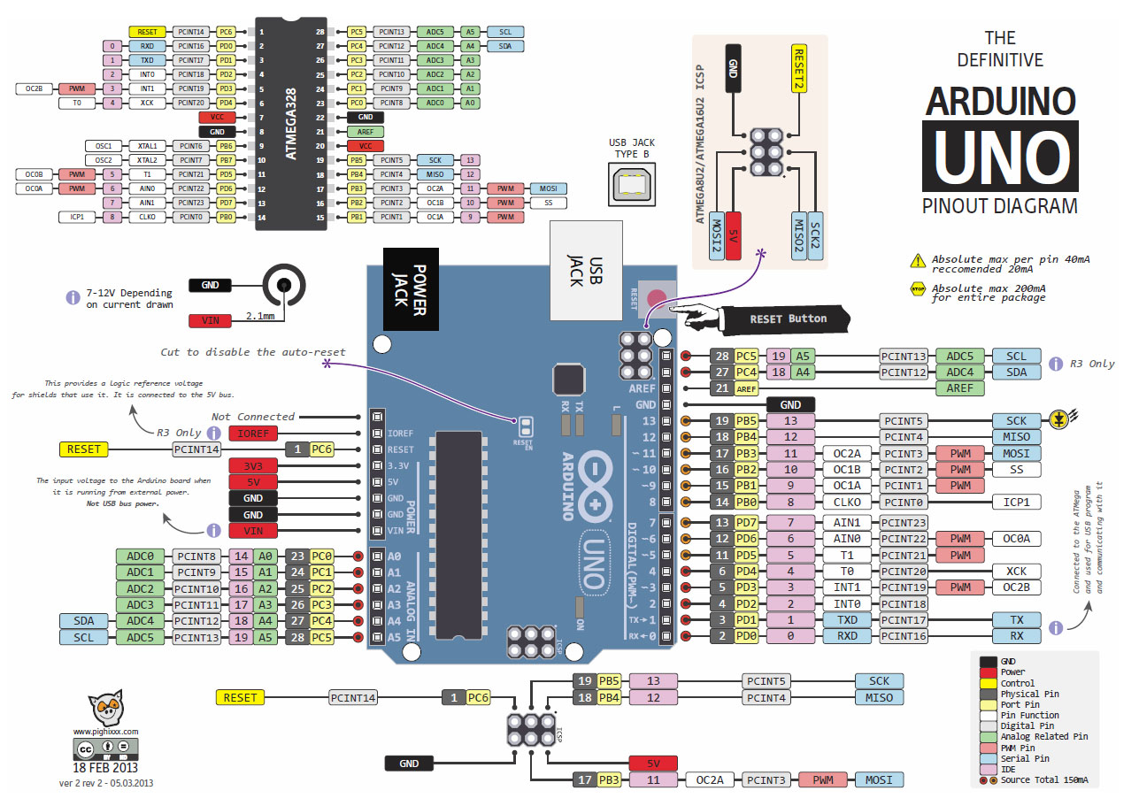
Atmega328P Pinout
Pins 3, 5, 6, 9, 10, and 11

Slide 10
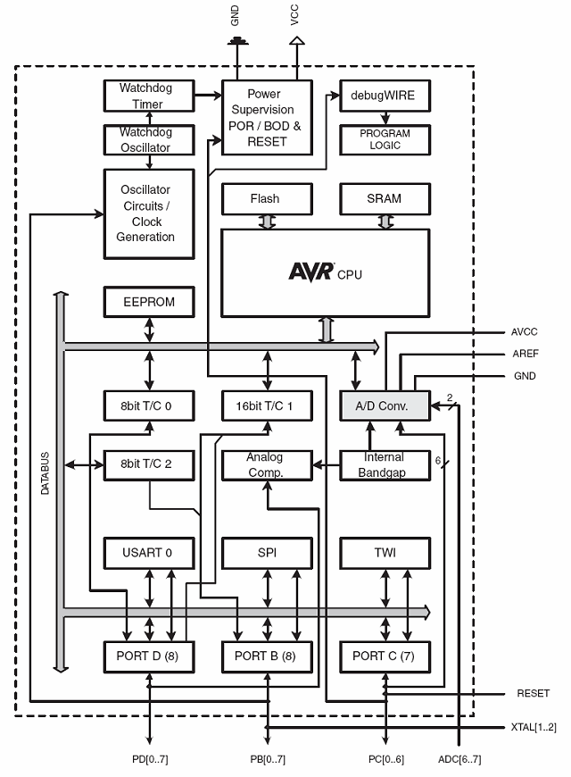
Atmega328P Block Diagram
32kBytes
Each of the Timer/Counter modules can be used to generate PWM signals.
ATmega328P Data Sheet, downloaded from http://www.atmel.com

Slide 11
8-bit Timer/Counter 0/2
Timer Overflow Interrupt
8-bit counter
Prescaler
Output Compare Match Interrupt
PWM Output
8-bit register
Output Compare Match Interrupt
PWM Output
8-bit register
5 Registers to control and interface with the timer.
8-bit register
8-bit register

Slide 12
16-bit Counter/Timer 1
Timer Overflow Interrupt
16-bit counter
Output Compare Match Interrupt
PWM Output
16-bits
Output Compare Match Interrupt
PWM Output
16-bits

Slide 13
Microcontroller Timers
Many applications need to count events or generate time delays.
The ATmega 328P has the following hardware resources:
Timer/Counter0: 8-bits (max. count is 255)
This Timer is used for the Arduino delay(), millis(), and micros() functions.
Timer/Counter1: 16-bits (max. count is 65535)
Timer/Counter2: 8-bits (max. count is 255)
This timer is almost identical to Timer0 except that Timer2 can be used as a real time counter with an additional external 32.768kHz crystal.
There are also a few differences in their control registers.
Timers can be configured in different modes:
Normal mode.
PWM mode. (Pulse width modulation mode.): the OCxy outputs are used to generate PWM signals.
CTC mode. Clear timer on compare match. When the timer counter reaches the compare match register, the timer will be cleared.
PWM, phase correct mode.
Fast PWM mode.

Slide 14
Waveform Generation
Timer 0/2
3 WGM Bits

Slide 15
Waveform Generation
Timer 1
4 WGM Bits

Slide 16
Normal Mode

Slide 17
Clear Timer on Compare Match (CTC) Mode

Slide 18
Timer Interrupts
Timer Overflow: Timer overflow means the timer has reached is limit value. When a timer overflow interrupt occurs, the timer overflow bit TOVx will be set in the interrupt flag register TIFRx. When the timer overflow interrupt enable bit TOIEx in the interrupt mask register TIMSKx is set, the timer overflow interrupt service routine ISR(TIMERx_OVF_vect) will be called.
Output Compare Match: When a output compare match interrupt occurs, the OCFxy flag will be set in the interrupt flag register TIFRx . When the output compare interrupt enable bit OCIExy in the interrupt mask register TIMSKx is set, the output compare match interrupt service ISR(TIMERx_COMPy_vect) routine will be called.
Timer Input Capture: When a timer input capture interrupt occurs, the input capture flag bit ICFx will be set in the interrupt flag register TIFRx. When the input capture interrupt enable bit ICIEx in the interrupt mask register TIMSKx is set, the timer input capture interrupt service routine ISR(TIMERx_CAPT_vect) will be called.

Slide 19
Clear Timer on Compare Match (CTC) Mode
In Clear Timer on Compare or CTC mode, the OCR0A Register is used to manipulate the counter resolution.
In CTC mode the counter is cleared to zero when the counter value (TCNT0) matches the OCR0A.
The OCR0A defines the top value for the counter, hence also its resolution. This mode allows greater control of the compare match output frequency.
Changed OCRA0

Slide 20
Clear Timer on Compare Match (CTC) Mode
An interrupt can be generated each time the counter value reaches the TOP value by using the OCF0A Flag.
If the interrupt is enabled, the interrupt handler routine can be used for updating the TOP value.
However, changing TOP to a value close to BOTTOM when the counter is running with none or a low pre-scaler value must be done with care since the CTC mode does not have the double buffering feature.
If the new value written to OCR0A is lower than the current value of TCNT0, the counter will miss the compare match.
The counter will then have to count to its maximum value (0xFF) and wrap around starting at 0x00 before the compare match can occur.

Slide 21
Timer Output Compare Unit

Slide 22
Timer 0 -Output Compare Registers

Slide 23
Timer1 – Output Control Registers
Nuts and Volts, Nov. 2015

Slide 24
Fast PWM Mode
The Fast PWM mode provides a high frequency PWM waveform generation option.
Fast PWM differs from the other PWM options by its single-slope operation. The counter counts from BOTTOM to TOP then restarts from BOTTOM. TOP is defined as 0xFF when WGM2:0 = 3, and OCR0A when WGM2:0 = 7.
The operating frequency of the Fast PWM mode can be twice as high as the Phase Correct PWM mode that use dual-slope operation.
This high frequency makes the fast PWM mode well suited for power regulation, rectification, and DAC applications.

Slide 25
Fast PWM Mode

Slide 26
Phase Correct PWM Mode
The phase correct PWM mode provides a high-resolution phase correct PWM waveform generation option.
The phase correct PWM mode is based on a dual-slope operation.
The counter counts repeatedly from BOTTOM to TOP and then from TOP to BOTTOM. TOP is defined as 0xFF when WGM2:0 = 1, and OCR0A when WGM2:0 = 5.
The dual-slope operation has lower maximum operation frequency than single slope operation.
However, due to the symmetric feature of the dual-slope PWM modes, these modes are preferred for motor control applications.

Slide 27
Phase Correct PWM Mode

Slide 28
Timer Pre-Scaler
16 MHz
External
pins.
0
7
0
7

Slide 29
Prescaler

Slide 30
Pre-Scaler Control Bits
Pre-Scaling allows you to control the time between counter increments.
You can increase the time between counter overflow events, but the time steps become coarser.

Slide 31
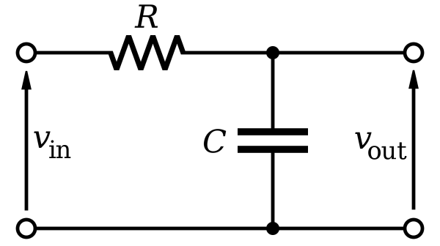
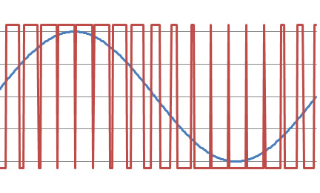
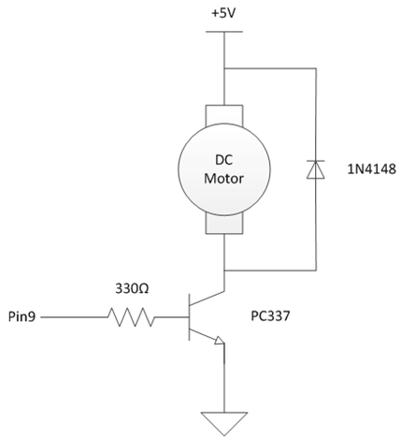
Lab#5
Part 1: PWM - Variable DC Voltage
Part 2: PWM - Variable LED Intensity
Video recording required
Part 3: PWM – Variable DC Motor Speed
Video recording required
255
0

Slide 32
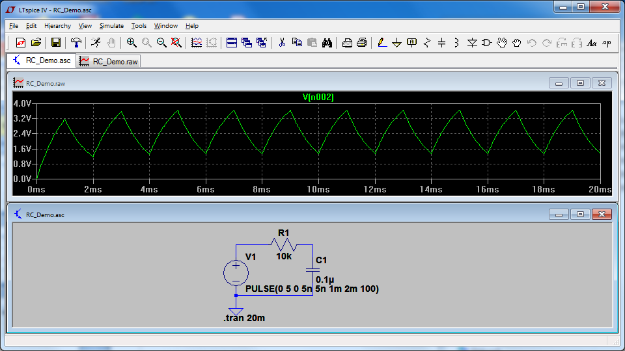
Lab#5 Simulation

