Slide 1

Introduction to Microcontrollers Fall Term, 2021
Professor Allan Douglas

Slide 2
Schedule/Labs
Lab#5
Due by midnight.
Lab#6 has been posted on Canvas.
Due 11/23 by midnight

Slide 3
Lecture Outline
Analog Comparators
Comparator Concepts
Atmega328P Analog Comparator
Control Registers
Interrupts
Arduino Commands
Analog to Digital Converter (ADC)
ADC Concepts
Successive Approximation, Resolution/Accuracy
Atmega328P Analog to Digital Converter
Bandgap Reference
Control Registers
Acquisition Time/Sampling Rate Limitations
Interrupts
Arduino Commands
Lab#6

Slide 4

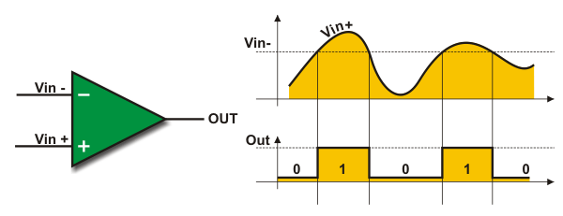
Analog Comparators
Analog Comparator is a module that compares two analog input voltages and outputs a signal level indicating which of the inputs is greater or lesser.
An analog comparator is basically an amplifier (op-amp) without feedback and thus has very high gain.
http://embedded-lab.com/blog/?p=10522

Slide 5
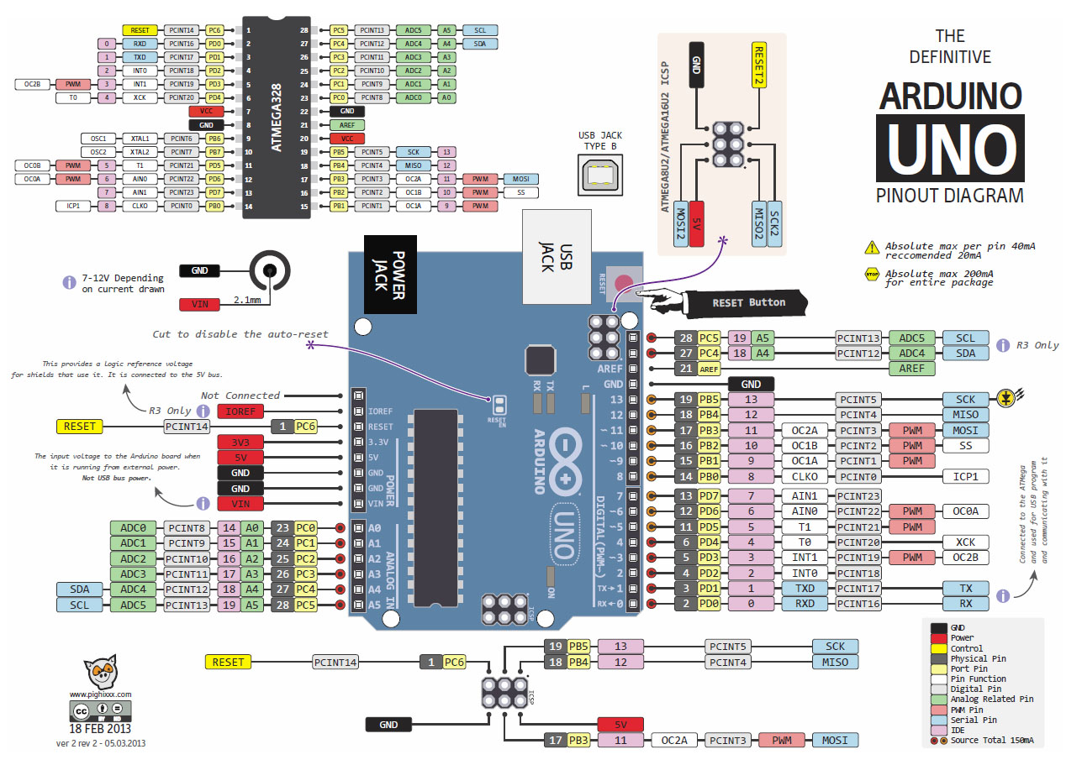
Atmega328P Pinout
Analog
Comparator
Inputs
Analog
Converter
Inputs

Slide 6
Analog Comparator
The Analog Comparator compares the input values on the positive pin AIN0 and negative pin AIN1.
When the voltage on the positive pin AIN0 is higher than the voltage on the negative pin AIN1, the Analog Comparator output, ACO, is set.
The comparator’s output can be set to trigger the Timer/Counter1 Input Capture function.
In addition, the comparator can trigger a separate interrupt, exclusive to the Analog Comparator.
The user can select Interrupt triggering on comparator output rise, fall or toggle.
Transmission
Gate

Slide 7
Comparator Control Registers

Slide 8
Comparator Control Registers

Slide 9
Comparator Control Registers

Slide 10
Analog to Digital Converters (ADCs)
Everything in the physical world is analog.
We use a transducer (sensor) to convert physical quantities to an electrical signal (voltage or current).
ADCs are used to convert an analog voltage or current into a digital representation for processing.
Some physical quantities what we may want to measure are:
Voltage, current, power, magnetic field strength
Temperature, wind pressure, air pressure, humidity, flow rate
Velocity, angular velocity, acceleration
Light intensity
Transducer Types
Electromagnetic, electrochemical, electromechanical, electroacoustic, photoelectric, electrostatic, thermoelectric, radio acoustic
https://en.wikipedia.org/wiki/Pulse-width_modulation

Slide 11
ADC Devices
Resolution
ADCs have n-bit resolution, where n can be 8, 10, 12, 16 or even 24 bits.
For a 10-bit ADC, the sampled values will be between 0-1023
Reference Voltage
ADCs require a precise reference voltage.
The ATmega328P has 3 different references available.
Conversion Time
The conversion time depends on the technique used for conversion.
The ATmega328P uses a technique called successive approximation.

Slide 12
Analog-to-Digital Converter Block Diagram
The ATmega328P has a 10-bit ADC
The ADC has a MUX to select 1 of 8 different inputs.
The DIP package version of the chip only supports 6 inputs.
The UNO only supports 6 inputs even if you have the SMT component.
The ADC contains a Sample and Hold circuit which ensures that the input voltage to the ADC is held at a constant level during conversion.

Slide 13
Voltage Reference Options
Fixed Bandgap Voltage Reference
A bandgap voltage reference is a temperature independent voltage reference circuit widely used in integrated circuits.
It produces a constant voltage regardless of power supply variations, temperature changes and circuit loading from a device.
Internal 1.1V Reference
The internal 1.1V reference is generated from the internal bandgap reference (VBG) through an internal amplifier.
External A_{VCC} Reference
The ADC has a separate analog supply voltage pin, AVCC.
AVCC must not differ more than ±0.3V from VCC.
The voltage reference may be externally decoupled at the AREF pin by a capacitor for better noise performance.
External A_{REF} Reference
Externally provided by the PCB designer.

Slide 14
Arduino UNO Schematic
External
Reference
A_{VCC} is +5V
Analog
Inputs
Analog
Comparator
Inputs

Slide 15
Successive Approximation
The ADC converts an analog input voltage to a 10-bit digital value through successive approximation.
The minimum value represents GND and the maximum value represents the voltage on the AREF pin minus 1 LSB.
To perform a conversion the microcontroller performs the following steps:
Set an internal voltage (Digital to Analog Converter - DAC)
Compares internal voltage to the held sample
Adjust the internal voltage
Repeat steps 1-3 until the difference is minimized
This process is iterative, so it takes 13 prescaled clock cycles to complete.
First conversion requires 25 prescaled clock cycles (initialization)
Subsequent conversions take 13 prescaled clock cycles

Slide 16
Internal Temperature Sensor
Process variation causes the output voltage from the temperature sensor to vary from one chip to another.
To enable more accurate results, the temperature measurement can be calibrated in the application software.
This software calibration requires that a calibration value is measured and stored in EEPROM for each chip.

Slide 17
ADC Control Registers

Slide 18
ADC Control Registers

Slide 19
ADC Control Registers
Not available in Arduino UNO
Not available in Arduino UNO
Not available in Arduino UNO

Slide 20
ADC Control Registers

Slide 21
ADC Control Registers

Slide 22
ADC Control Registers
Note: The maximum conversion rate is 200kHz for an Atmega328P.

Slide 23
ADC Control Registers
The ADC has 10-bit resolution.

Slide 24
ADC Control Registers

Slide 25
ADC Control Registers

Slide 26
ADC Control Registers

Slide 27
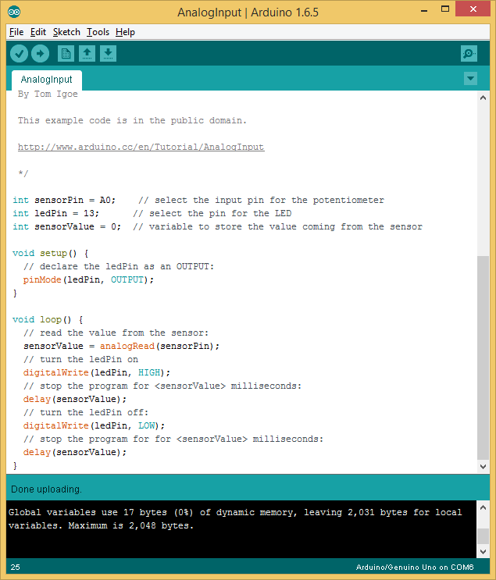
Arduino Example #1
Read from ADC with MUX
set to pin A0.
analogRead(pinNumber);

Slide 28
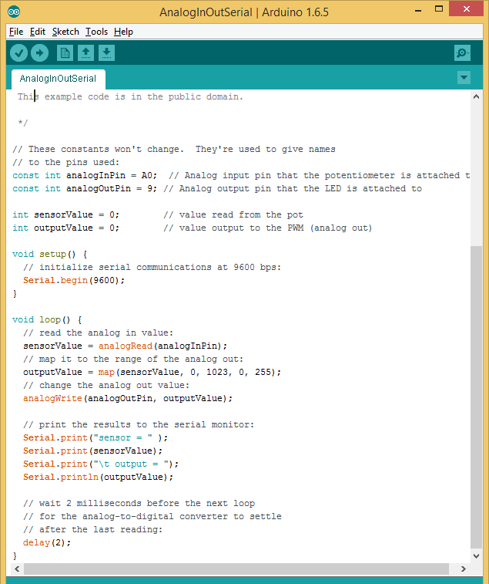
Arduino Example#2
Reads an analog input pin
Maps the result to a range from 0 to 255
Uses the result to set the pulse width modulation (PWM) of an output pin.
Prints the results to the serial monitor.
ADC for analogRead()
PWM duty cycle
for analogWrite()

Slide 29
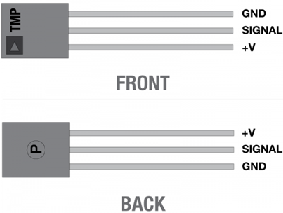
Lab#6
Part 1: DC Voltage Measurement
Write an Arduino sketch to measure the ADC0 input, scale your ADC measurement so that full range corresponds to 5V (set your reference to Vcc), and display the voltage on your LCD and on the Serial Monitor. Determine how many digits you should display beyond the decimal point based on the ADC accuracy.
Part 2: AC Voltage Measurement
Write an Arduino sketch to measure the ADC1 input. Connect a function generator to your microcontroller ADC1 input. Setup the function generator to generate a 10Hz sine wave with an amplitude of 2.5V with a +2.5V offset. Set your sampling rate to 125kHz and use Free Running mode. Write your code to determine the minimum voltage, the maximum voltage, and the period. Display your results on the Serial Monitor every second. This is challenging.
Part 3: Temperature Measurement
Write a sketch to measure two temperatures per second. You may use the delay() function for this. Your sketch should set the ADC input MUX to the internal temperature reference, start a measurement, and wait for the conversion complete interrupt. Then read the ADC data registers, set the ADC input MUX to the pin ADC0 (external temperature sensor), start a measurement, and wait for the conversion complete interrupt.
Now, convert both temperatures to degrees C. Determine how many digits you should display beyond the decimal point based on the ADC accuracy. Display both measurements on the Serial Monitor.

