Slide 1

Introduction to Microcontrollers Fall Term, 2021
Professor Allan Douglas

Slide 2
Schedule/Labs
Lab#6
Due by midnight.
Lab#7 has been posted on Canvas.
Due 11/30 by midnight

Slide 3
Lecture Outline
IR Remote Transmission and Reception
IR Concepts
IR Components
IR Remote Library
Pulse Code Modulation
Lab#7

Slide 4
IR Communications Concepts
IR remote control systems utilize Pulse Code Modulation (PCM), where the modulating carrier frequency typically resides in the range 30kHz to 58kHz.
Modulation means turning the IRLED on and off rapidly in bursts of the carrier frequency.
The receiver is tuned to this carrier frequency, ensuring that it receives only the signal required. It then uses this frequency to demodulate the signal.
When the IRLED is not emitting light, the transmitter is in the OFF state, which in terms of the signal is referred to as a 'space'. During IRLED activity, where the light is emitted in pulsed fashion at the carrier frequency, the transmitter is in the ON state, which is referred to as a pulse or 'mark'.
At the receiver, a 'space' is output as a High, while a mark is output as a Low.
These spaces and marks are not the '0's and '1's of the command being transmitted, however. The actual data to be sent from the controller is encoded. The method of encoding used determines how to represent the '1's and '0's in terms of the marks and spaces.
http://techdocs.altium.com/display/FPGA/Infrared+Communication+Concepts

Slide 5
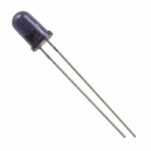
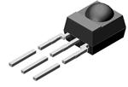
IR Communications Components
IR LED
IR Sensor

Slide 6
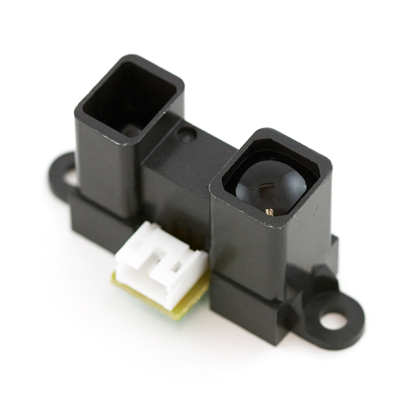
IR Applications
IR Communications
TVs, BlueRay Players, Stereos
Universal Remotes
Presence Sensing
Robot collision detection
Reflective sensors for hand dryers, towel or soap dispensers, water faucets, toilet flush
Vending machine fall detection
Security and pet gates
Person or object vicinity activation

Slide 7
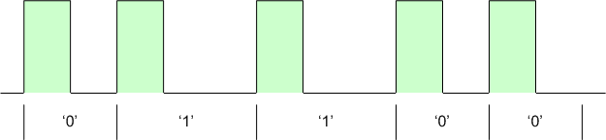
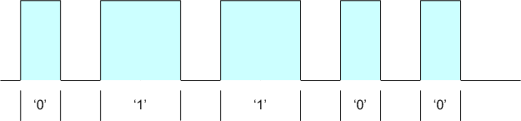
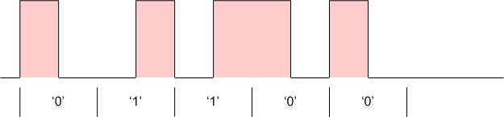
Encoding
The following three methods of encoding are typically used in IR remote control systems.
Pulse Distance Encoding
Pulse Length Encoding
Manchester Encoding
38.222kHz pulses

Slide 8
IR Arduino Library
Thanks to Ken Shirriff
http://www.righto.com/2009/08/multi-protocol-infrared-remote-library.html
This IR remote library lets you both send and receive IR remote codes in multiple protocols.
It supports NEC, Sony SIRC, Philips RC5, Philips RC6, and raw protocols.
If you want additional protocols, they are straightforward to add.
The library can even be used to record codes from your remote and re-transmit them, as a minimal universal remote.
Installation
1. Navigate to the [Releases](https://github.com/z3t0/Arduino-IRremote/releases) page.
2. Download the latest release.
3. Extract the zip file
4. Move the "IRremote" folder that has been extracted to your libraries directory.
5. Make sure to delete Arduino_Root/libraries/RobotIRremote. Where Arduino_Root refers to the install directory of Arduino. The library RobotIRremote has similar definitions to IRremote and causes errors if both are installed.

Slide 9
NEC IR Remote Protocol
Modulation frequency is 38.222kHz
The NEC IR transmission protocol uses pulse distance encoding of the message bits.
Each pulse burst (mark – RC transmitter ON) is 562.5µs in length, at a carrier frequency of 38kHz (26.3µs).
Logical bits are transmitted as follows:
Logical '0' – a 562.5µs pulse burst followed by a 562.5µs space, with a total transmit time of 1.125ms
Logical '1' – a 562.5µs pulse burst followed by a 1.6875ms space, with a total transmit time of 2.25ms
http://techdocs.altium.com/display/FPGA/NEC+Infrared+Transmission+Protocol

Slide 10
NEC IR Remote Protocol
When a key is pressed on the remote controller, the message transmitted consists of the following, in order:
a 9ms leading pulse burst (16 times the pulse burst length used for a logical data bit)
a 4.5ms space
the 8-bit address for the receiving device
the 8-bit logical inverse of the address
the 8-bit command
the 8-bit logical inverse of the command
a final 562.5µs pulse burst to signify the end of message transmission.
The four bytes of data bits are each sent least significant bit first.

Slide 11
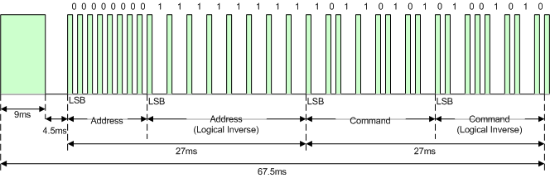
NEC IR Remote Protocol
The format of an NEC IR transmission frame, for an address of 00h (00000000b) and a command of ADh (10101101b).
Notice that it takes:
27ms to transmit both the 16 bits for the address (address + inverse) and the 16 bits for the command (command + inverse). This comes from each of the 16 bit blocks ultimately containing eight '0's and eight '1's - giving (8 * 1.125ms) + (8 * 2.25ms).
67.5ms to fully transmit the message frame (discounting the final 562.5µs pulse burst that signifies the end of message).

Slide 12
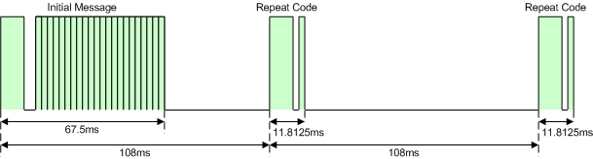
NEC IR Remote Protocol
REPEAT CODES
If the key on the remote controller is continually depressed, a repeat code will be issued, typically around 40ms after the pulse burst that signified the end of the message. A repeat code will continue to be sent out at 108ms intervals, until the key is finally released.
The repeat code consists of the following, in order:
a 9ms leading pulse burst
a 2.25ms space
a 562.5µs pulse burst to mark the end of the space (and hence end of the transmitted repeat code).
This figure illustrates the transmission of two repeat codes after an initial message frame is sent.

Slide 13
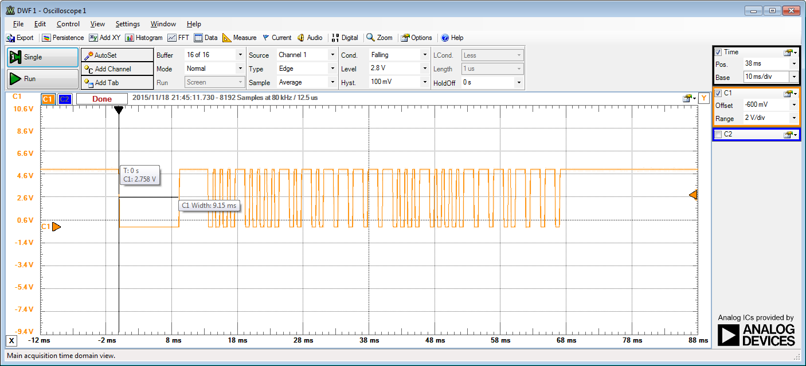
Real Example: Address/Command
This is the On/Off button from a Frigidaire AC unit.
0001_0000_1010_1111_1000_1000_0111_0111 = 0x10AF8877
Signal is inverted
~9ms

Slide 14
IRrecvDumpV2
Serial Monitor Output
Encoding : NEC
Code : 10AF8877 (32 bits)
Timing[67]:
+9000, -4350 + 650, - 450 + 700, - 450 + 650, - 450
+ 650, -1550 + 650, - 500 + 650, - 450 + 650, - 450
+ 650, - 450 + 700, -1550 + 600, - 500 + 650, -1550
+ 650, - 450 + 700, -1550 + 600, -1600 + 650, -1600
+ 600, -1600 + 650, -1600 + 600, - 500 + 650, - 450
+ 700, - 400 + 700, -1550 + 600, - 500 + 650, - 450
+ 700, - 400 + 700, - 400 + 700, -1550 + 600, -1600
+ 650, -1600 + 650, - 450 + 700, -1550 + 600, -1600
+ 650, -1550 + 650
unsigned int rawData[67] = {9000,4350, 650,450, 700,450, 650,450, 650,1550, 650,500, 650,450, 650,450, 650,450, 700,1550, 600,500, 650,1550, 650,450, 700,1550, 600,1600, 650,1600, 600,1600, 650,1600, 600,500, 650,450, 700,400, 700,1550, 600,500, 650,450, 700,400, 700,400, 700,1550, 600,1600, 650,1600, 650,450, 700,1550, 600,1600, 650,1550, 650}; // NEC 10AF8877
unsigned int data = 0x10AF8877;

Slide 15
Extended NEC Protocol
The first two bytes are not bitwise inverses. Why is this?
The NEC protocol has been so widely used that all possible addresses were used up.
By sacrificing the address redundancy, the address range was extended from 256 possible values to approximately 65536 different values.
This way the address range was extended from 8 bits to 16 bits without changing any other property of the protocol.
By extending the address range this way the total message time is no longer constant.

Slide 16
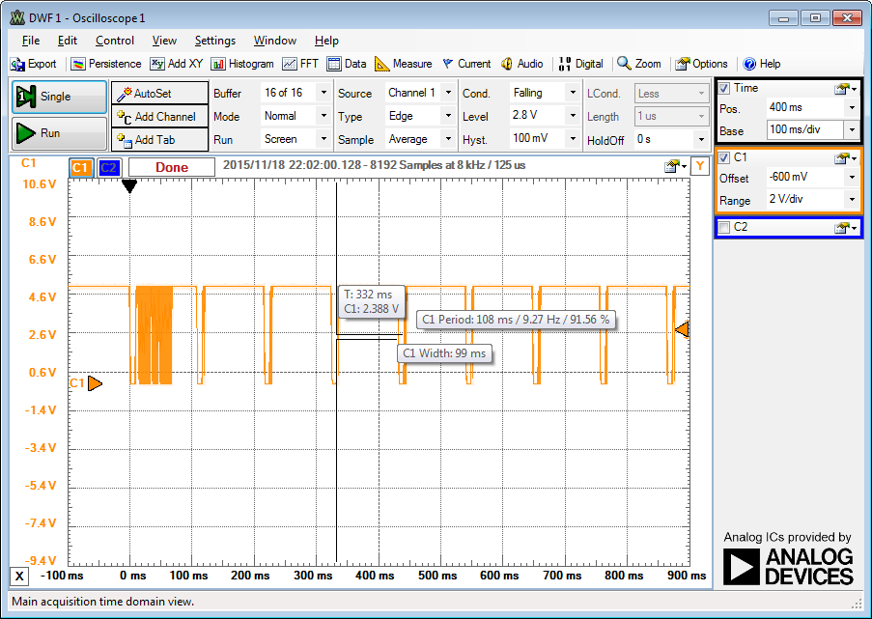
Real Example: Repeat Codes
On/Off button from a Frigidaire AC unit held down.
108ms period

Slide 17
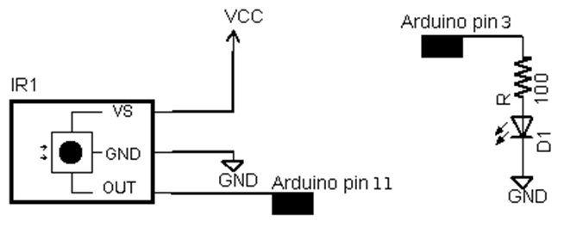
Lab#7
Part 1: IR Communications
Part 2: Arduino Communications with IR
Two microcontrollers communicating with IR signals.
Use your Arduino board and the breadboard microcontroller you built in Lab#1.
IR Receiver Diode
LED - Infrared 950nm

