Slide 1
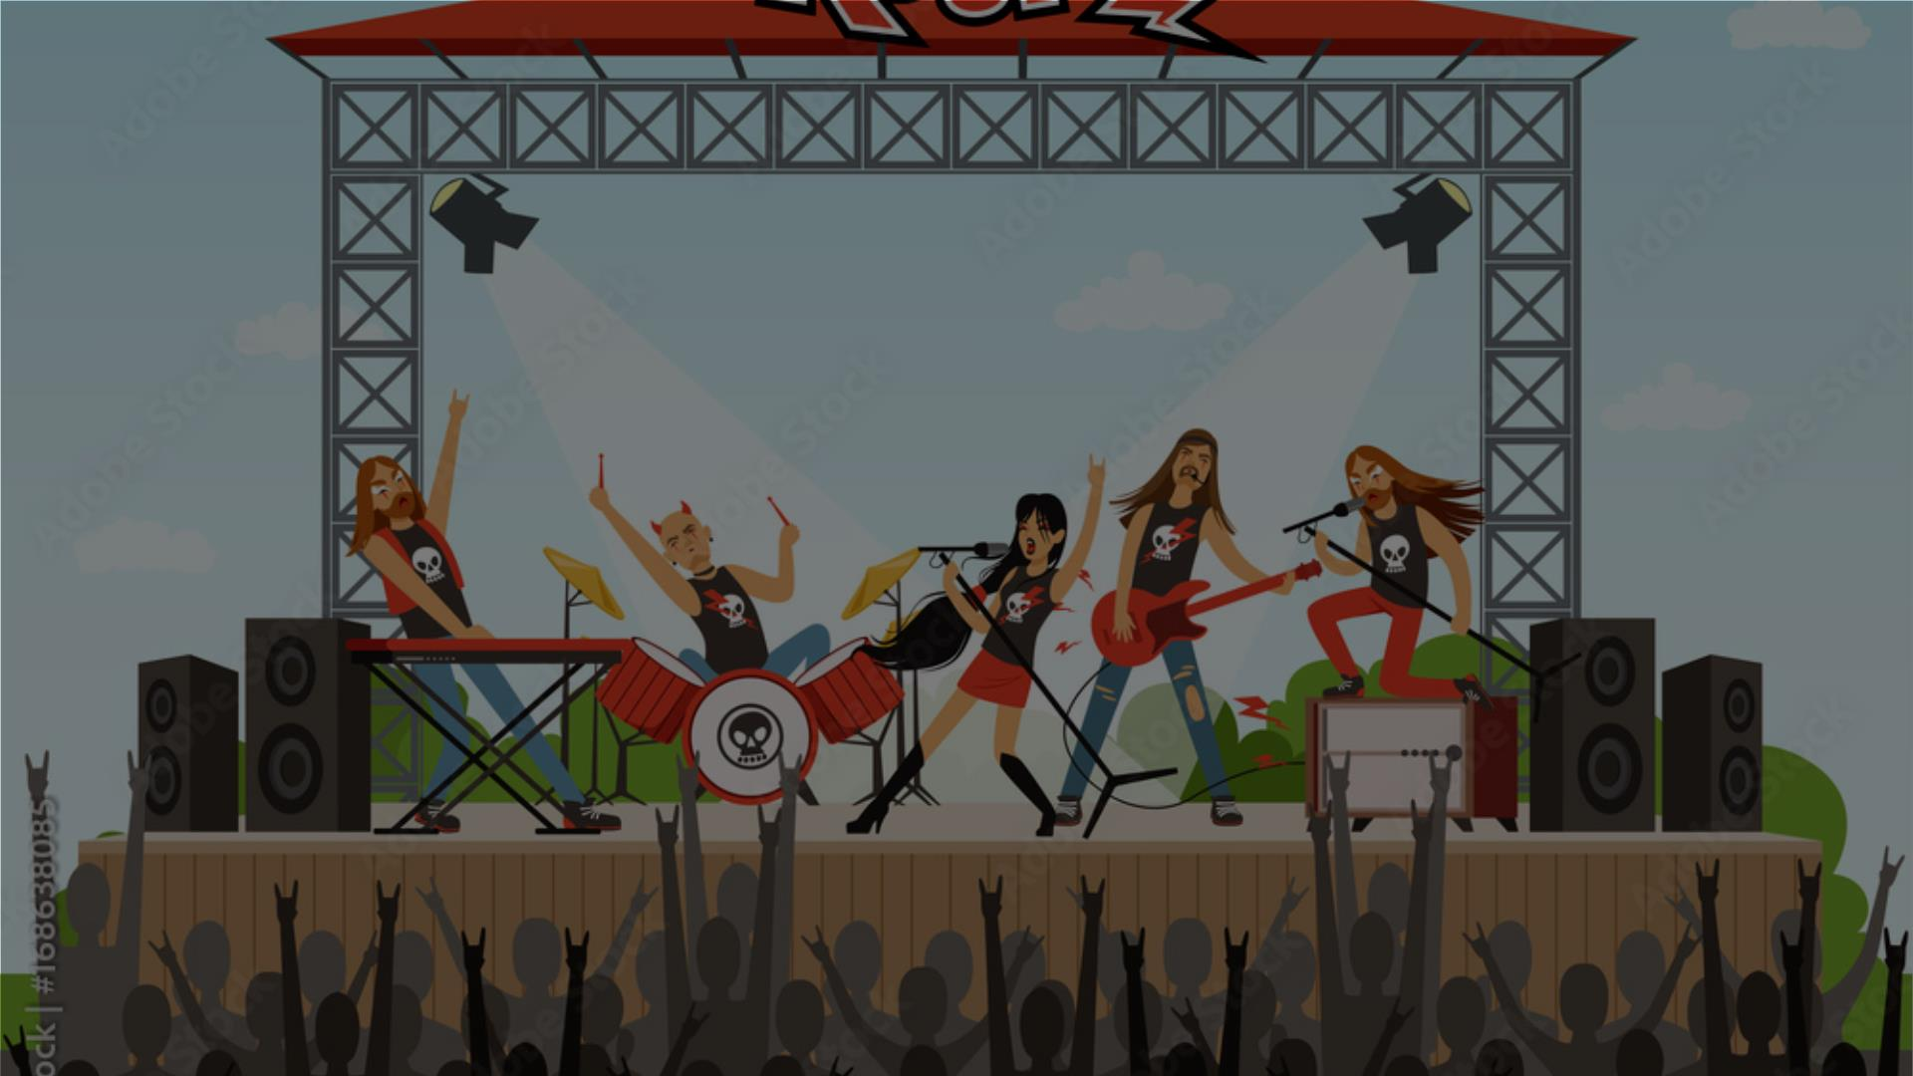
Global Concert Tour Strategy
for Neon Bison
Data-Driven Insights for Optimal Touring
Rajdeep Ray

Slide 2
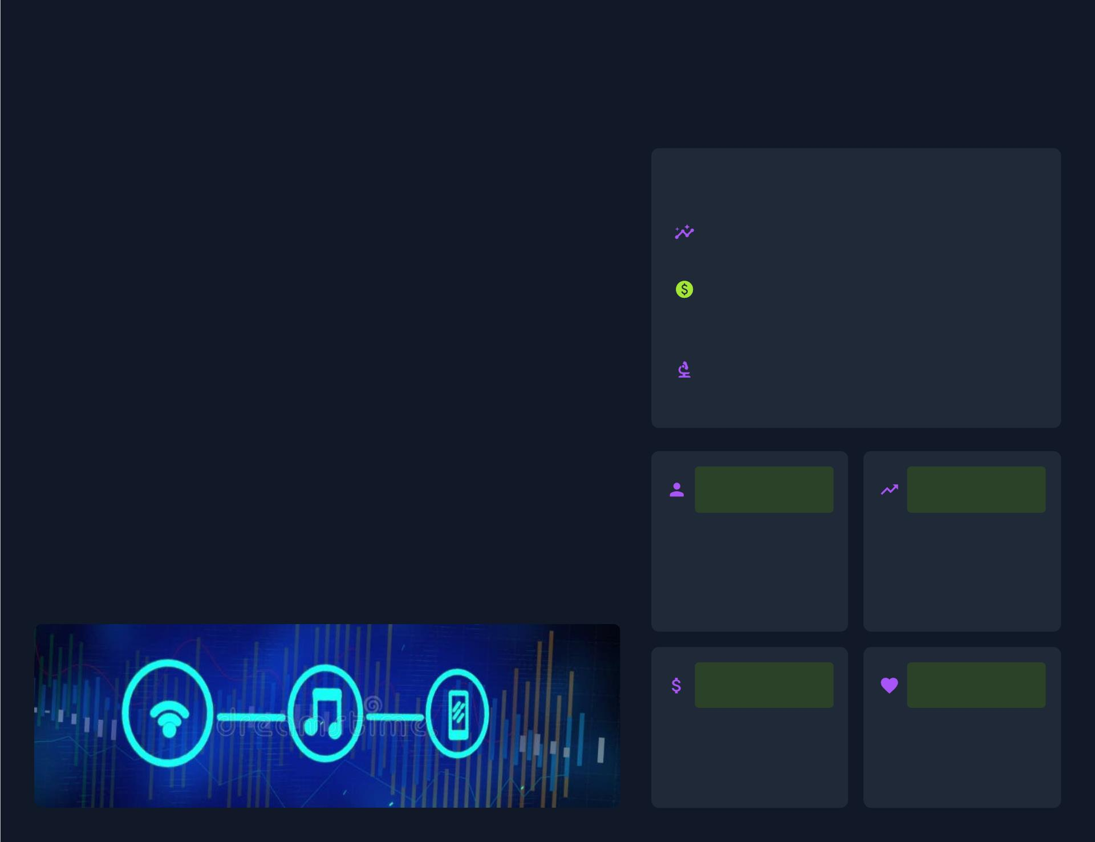
Project Overview: Data-Driven Tour
Planning
Leveraging Data for Strategic Tour
Decisions
Core Objectives
The music industry has undergone a signiﬁcant transformation, with music
consumption shifting online, generating large amounts of digital data. Data
analytics has become a cornerstone of success, empowering stakeholders
to make informed decisions, optimize strategies, and drive growth.
Leveraging music store data for
strategic tour decisions.
Primary Goal: Optimize tour
eﬀectiveness, proﬁtability, and
entertainment.
A data scientist in this ﬁeld collects raw data from various online sources,
derives insights using techniques like sentiment analysis and machine
learning, and creates products for analyzing an artist's popularity, fans, and
press mentions. This project simulates a real-world music business scenario
to apply these principles.
Simulating a real-world music
business scenario.
Music analytics is more powerful than ever, telling artists when and what to
release, where and how to promote, and how to engage their audience
eﬀectively.
Audience
Preferences
Predictive
Analytics
Understanding audience
behavior through data
helps tailor content and
marketing for stronger
fan connections.
Forecasting trends,
guiding releases, and
staying ahead of the
curve.
Revenue
Fan
Optimization
Engagement
Analyzing royalties,
licensing, and sales to
identify new income
opportunities.
Using data to
personalize experiences
and deepen loyalty.
Source: A Data Scientist in the Music Industry | Music Analytics: The Ultimate Guide | Music Data Analysis: Strategies for Success | Dashboard Music Stock Illustrations

Slide 3
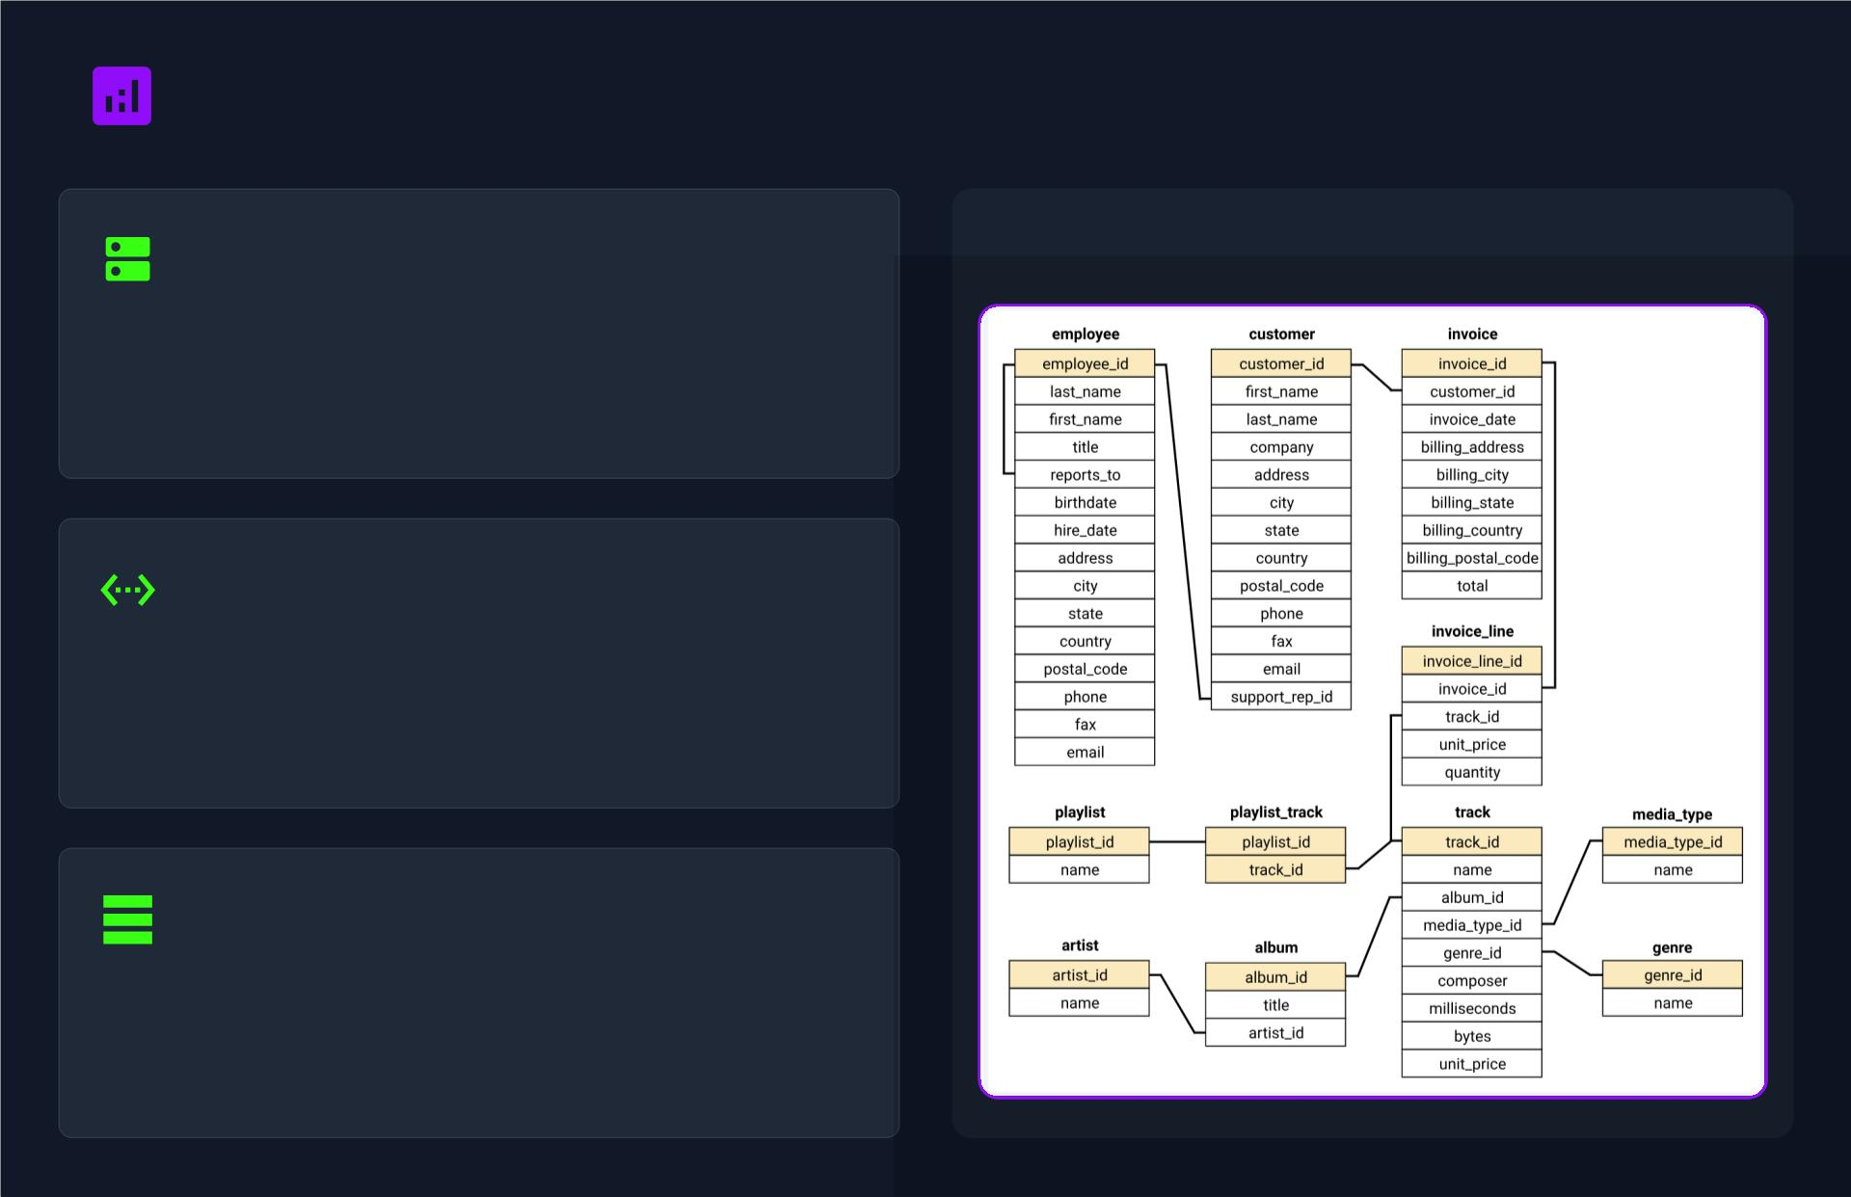
Data Sources & Analytical Approach
Database Foundation
Entity-Relationship Diagram
Our analysis is powered by a PostgreSQL relational
database, ensuring data integrity and eﬃcient querying
for complex analytical tasks.
Automated Workﬂow
Data ingestion is automated using Python and
SQLAlchemy, creating a reliable and repeatable data
pipeline for seamless analysis.
Key Data Tables
The schema includes core tables like Customer, Invoice,
Track, Album, Artist, and Genre to capture a holistic
view of the music ecosystem.
Reference: Data Analytics Consulting Powerpoint Presentation Template ... - Etsy

Slide 4
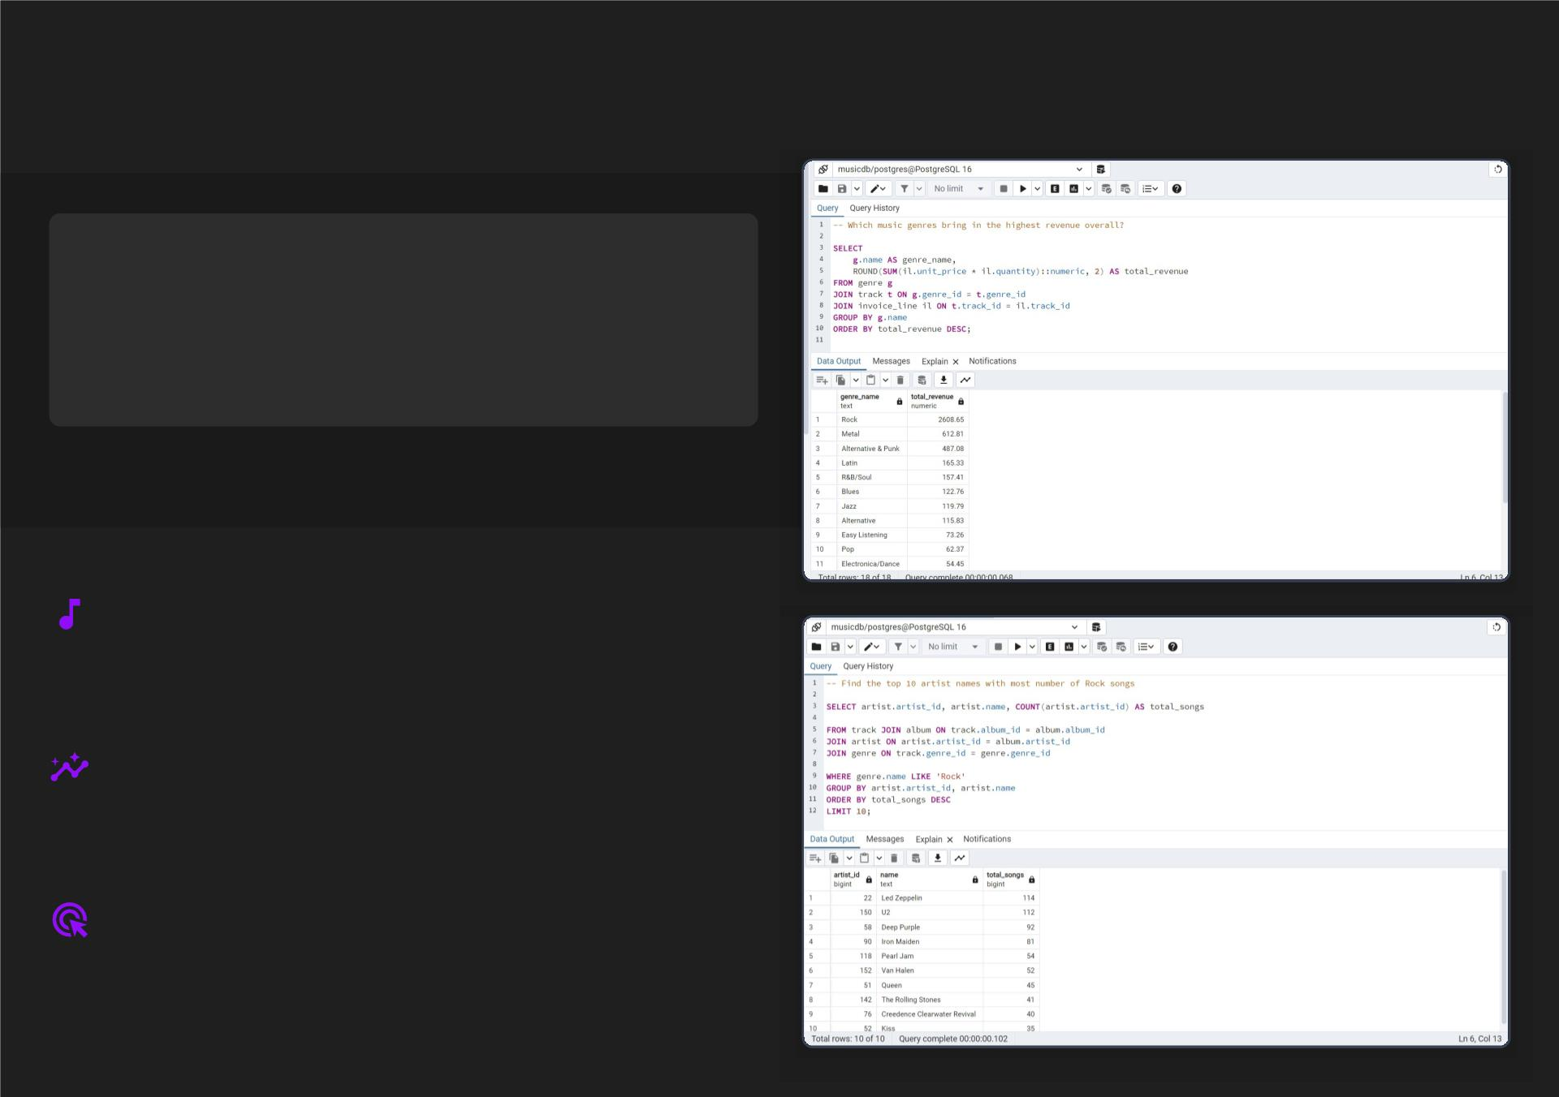
Rock Reigns: The Leading Genre
MARKET DOMINANCE
Rock Leads All Genres
In both sales volume and total revenue contribution.
Unpacking Rock's Enduring
Appeal
Rock music consistently demonstrates unparalleled
market leadership, surpassing all other genres in both
sales volume and overall revenue generation, indicating a
robust and highly engaged consumer base.
The genre's success is attributed to high customer
engagement and purchase frequency. Loyal fans invest in
albums, merchandise, and tickets, fostering a vibrant
ecosystem that makes tours highly proﬁtable.
This market dynamic allows for targeted marketing and
optimized tour routing, ensuring Neon Bison can capitalize
on the genre's inherent strength and dedicated fanbase.
Source: Music Analytics: The Ultimate Guide for Artists in 2025 - Pitch-Us, Music Data Analysis: Strategies for Success - Yellowbrick

Slide 5
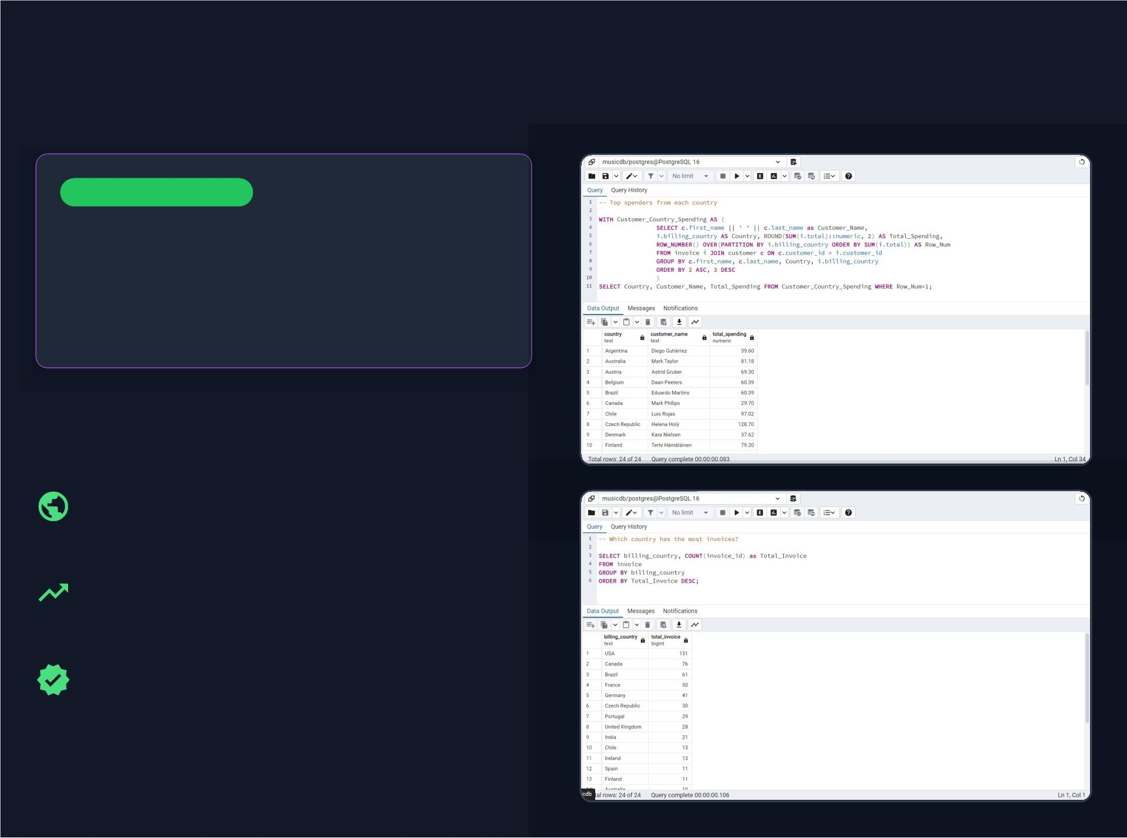
High-Value Markets: USA, Canada,
Brazil & Germany
Market Concentration
Signiﬁcant Revenue
Generation
Focus on key regions for maximum impact and
proﬁtability.
Strategic Market
Prioritization
USA and Canada are primary targets, identiﬁed as the
most active and highest-spending customer bases,
ensuring strong ticket and merchandise revenue.
Brazil and Germany represent strong secondary
markets. Their growing customer bases show promising
potential for substantial future revenue generation.
This focus is justiﬁed by signiﬁcant revenue generation
and high customer concentration, allowing for optimized
tour routing and targeted marketing.
Source: Music Analytics: The Ultimate Guide for Artists in 2025 - Pitch-Us
Source: Music Data Analysis: Strategies for Success - Yellowbrick

Slide 6
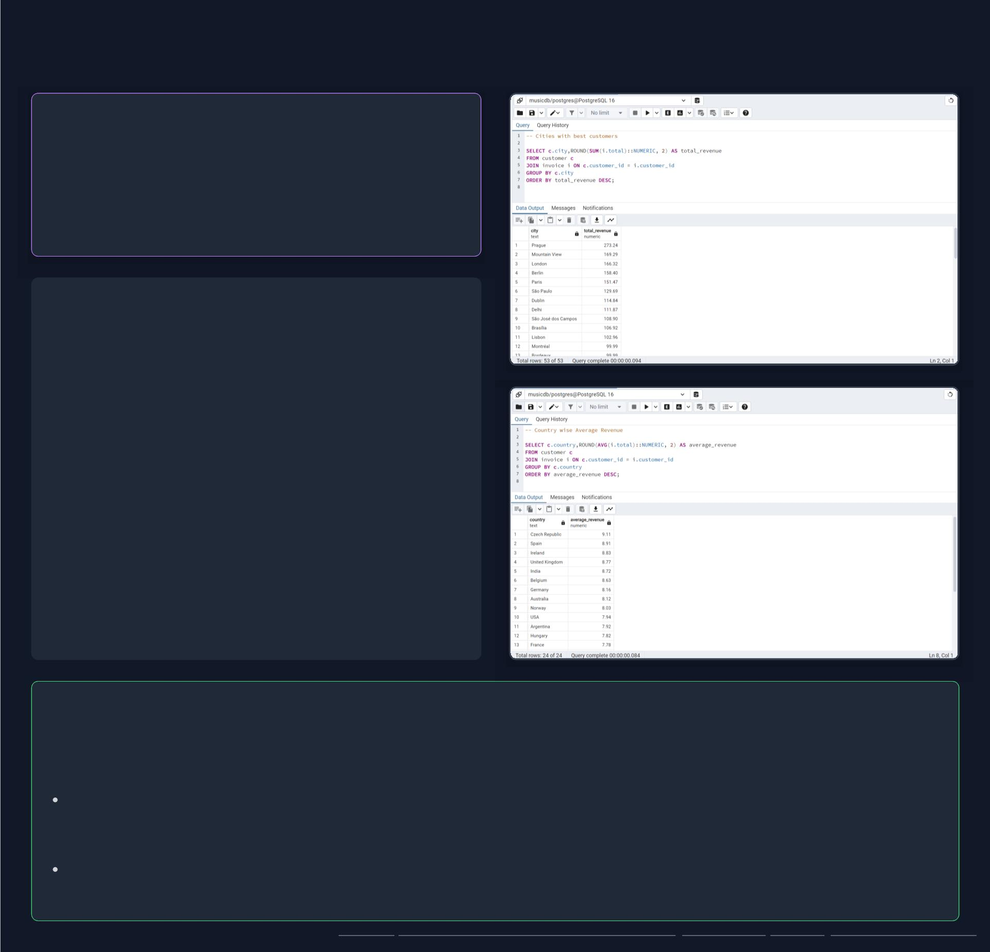
Uncovering High-Engagement Cities
Engagement Hotspots
High Average Spend Per
Customer
Beyond population size, focus on customer value.
Identifying Pockets of Deep
Engagement
While overall market size is important, our analysis
reveals speciﬁc cities that demonstrate exceptionally high
average spend per customer. Cities like São Paulo,
Edmonton, and Prague stand out, indicating a deeper
level of engagement and loyalty from their customer
base, despite potentially smaller populations.
This metric is crucial for identifying 'super-fans' and highly
dedicated audiences. These cities represent concentrated
pockets of high-value customers who are more likely to
invest signiﬁcantly in music, merchandise, and live
experiences.
Strategic Implications: Targeted Opportunities
The presence of high average spend per customer in these cities justiﬁes a tailored approach to tour planning and fan
engagement.
Opportunities for Exclusive Events: These locations are ideal for hosting exclusive fan events, VIP experiences, or
smaller, intimate shows that cater directly to highly engaged audiences, fostering stronger loyalty and generating premium
revenue.
Pilot Programs for New Oﬀerings: High-engagement cities can serve as excellent test markets for new merchandise,
fan club initiatives, or interactive experiences, leveraging the strong connection with the local fanbase.
Source: Music Analytics: The Ultimate Guide for Artists in 2025 - Pitch-Us, Music Data Analysis: Strategies for Success - Yellowbrick

Slide 7
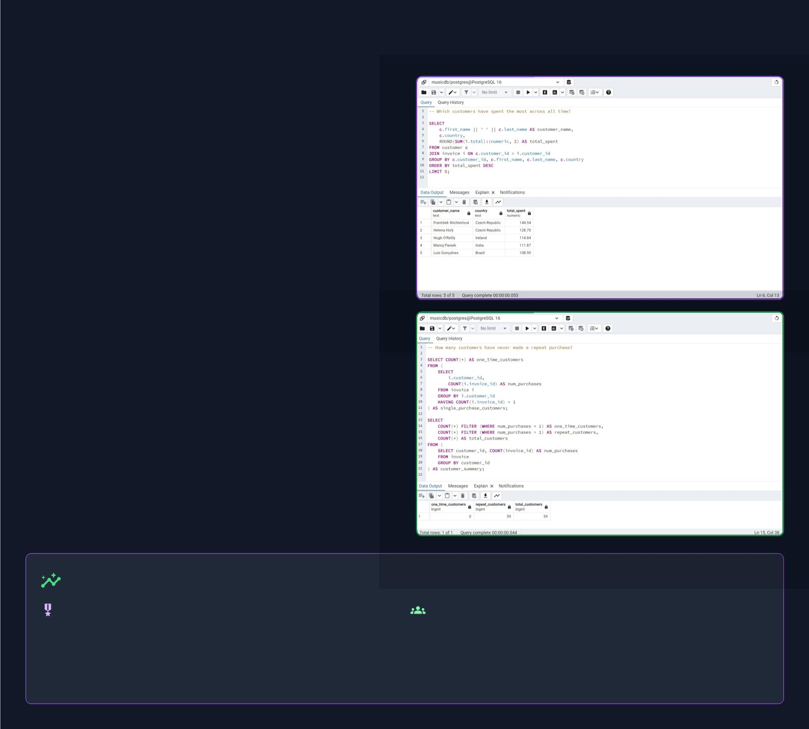
Identifying & Engaging Top Spenders
Beyond Frequency:
Uncovering True Value
Our analysis reveals a crucial insight: not all high-value
customers are frequent purchasers. We've identiﬁed
outlier high-spenders like František Wichterlová
and Luis Rojas who, despite moderate purchase
frequency, contribute signiﬁcantly to overall revenue.
These individuals represent a distinct segment of highly
valuable fans.
Conversely, while Rock buyers tend to be repeat
purchasers, their individual transaction values might be
lower than these outliers. This highlights the importanc
of segmenting our audience not just by purchase
volume, but by total lifetime value.
Understanding these diﬀerent customer behaviors allow
us to tailor our engagement strategies. High-frequency,
moderate-spend customers beneﬁt from consistent
engagement, while high-spend, lower-frequency outlier
require personalized incentives.
Strategic Imperative: Personalize
For Outlier High-Spenders:
For Repeat Rock Buyers:
Implement exclusive, high-tier loyalty beneﬁts, early access to Reinforce loyalty through tiered rewards, fan club
premium content, and direct, personalized communication to
acknowledge their signiﬁcant contribution.
memberships, and consistent engagement. Focus on
community building and exclusive content relevant to their
genre preference.
Source: Music Analytics: The Ultimate Guide for Artists in 2025 - Pitch-Us, Music Data Analysis: Strategies for Success - Yellowbrick

Slide 8
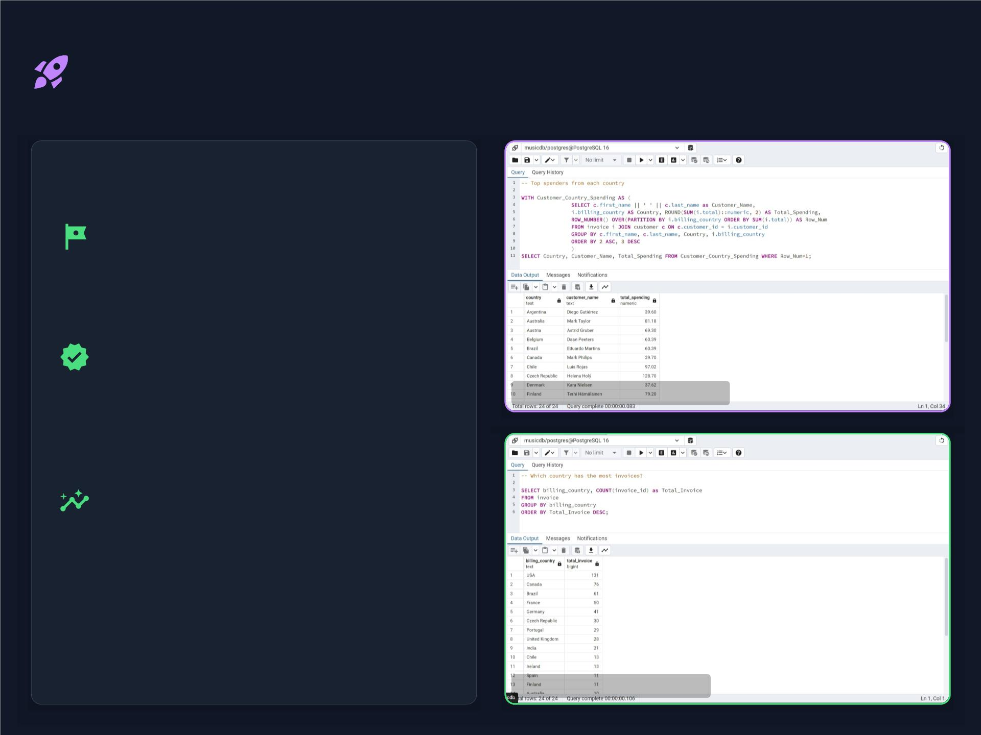
Recommendation 1: Tour Launch
Strategy
Recommendation
Focus on cities like New York, Chicago,
and Toronto for the initial tour launch.
Justiﬁcation
This strategy combines strong purchase volumes
with consistent customer engagement, ensuring a
robust and proﬁtable start to the tour.
Evidence: To p Spending Countries
Supporting Insights
North America oﬀers a strong starting point due
to high activity and signiﬁcant revenue potential
(Strategic Insight 1), validated by data on top
spenders and invoice volumes.
Evidence: High Invoice Volume
Source: Music Analytics: The Ultimate Guide for Artists in 2025 - Pitch-Us, Music Data Analysis: Strategies for Success - Yellowbrick

Slide 9
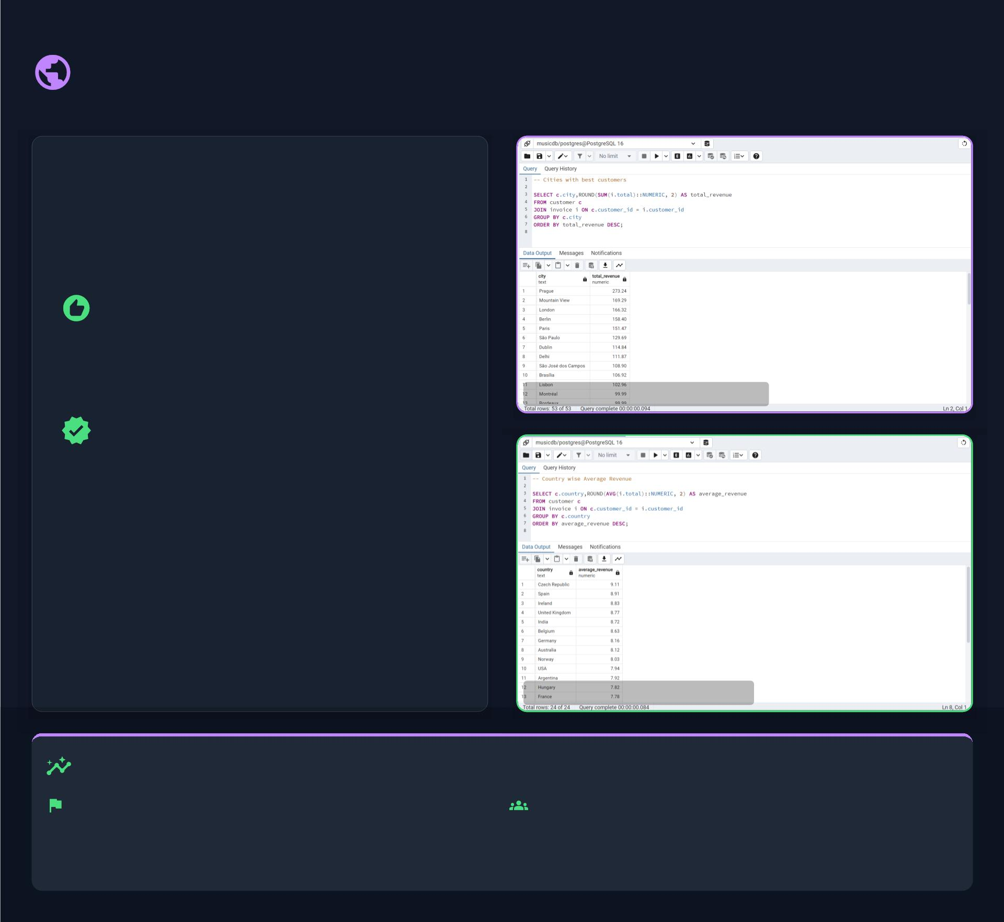
Recommendation 2: Market
Expansion
Recommendation
Expand the tour to include São Paulo,
Brasília, Prague, and Berlin.
Evidence: High-Value Customer Cities
Justiﬁcation
These cities demonstrate strong average spend
per customer and cater to niche but highly
proﬁtable audiences, maximizing revenue
potential.
Evidence: Strong Average Revenue
Data-Backed Expansion Opportunities
Valuable Secondary Markets: Analysis shows Brazil and
Germany (Strategic Insight 2) have growing customer
bases with signiﬁcant revenue potential, making them
ideal for a second tour phase.
Niche European Audiences: Cities like Prague and Berlin
(Strategic Insight 3) show exceptionally high average
spend, indicating highly engaged and valuable fan
segments perfect for targeted events.
Source: Music Analytics: The Ultimate Guide for Artists in 2025 - Pitch-Us, Music Data Analysis: Strategies for Success - Yellowbrick

Slide 10
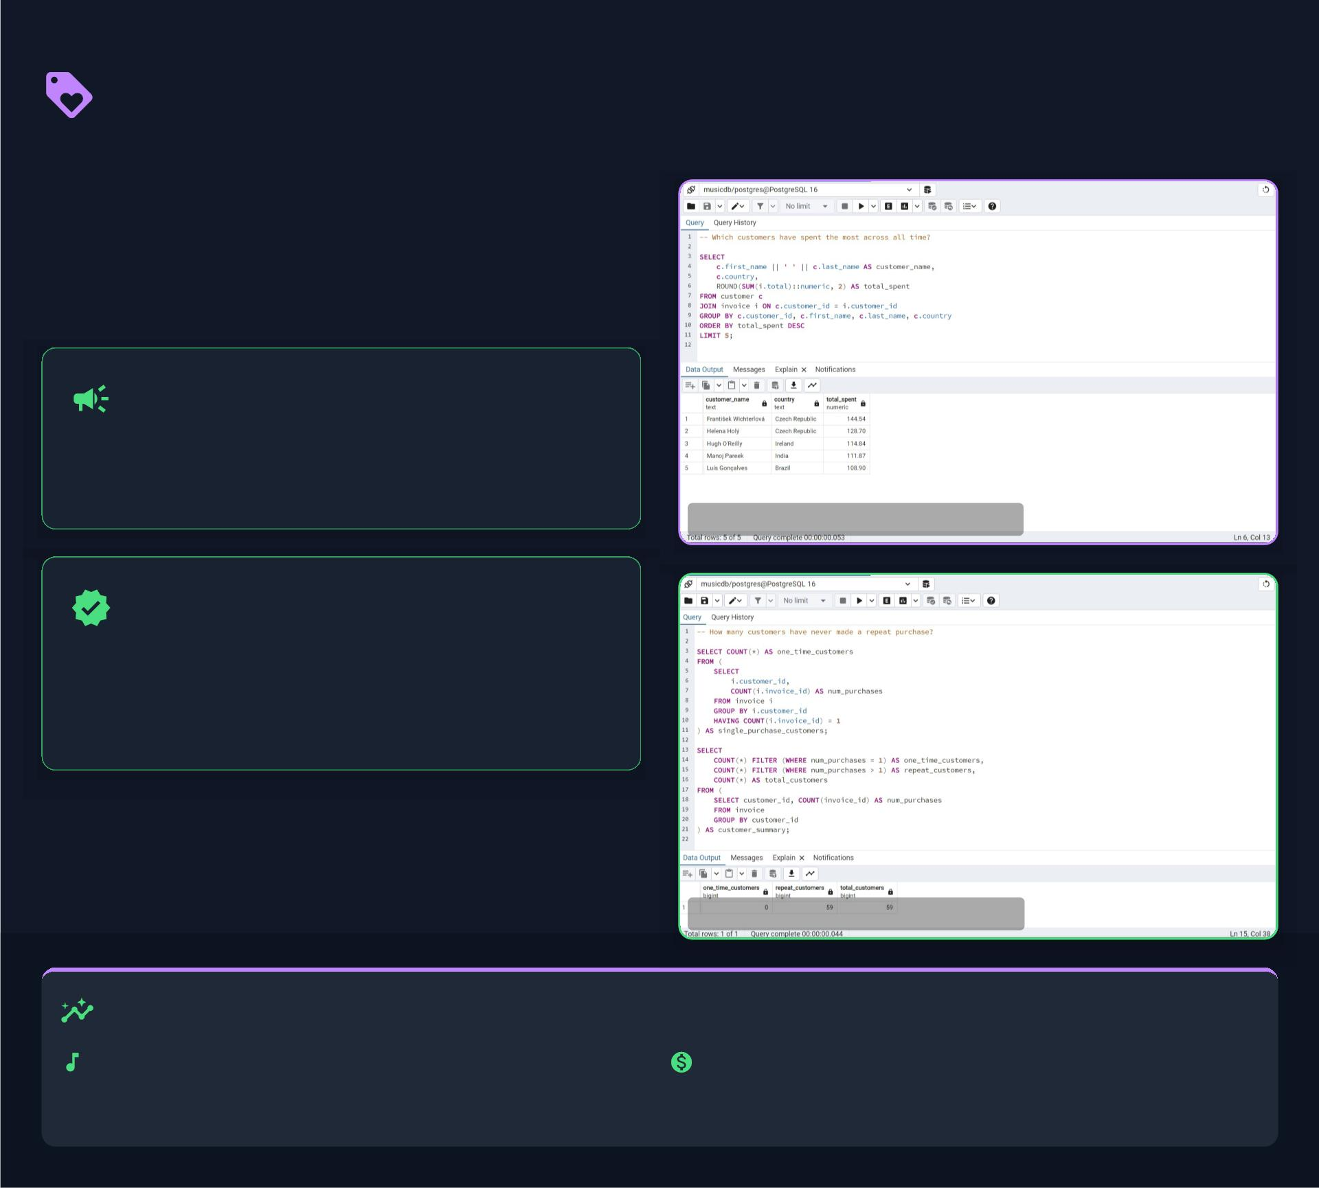
Recommendation 3: Fan
Engagement
Recommendation
Create tailored digital campaigns and
tiered loyalty programs.
Evidence: Identify High-Value Spenders
Justiﬁcation
Boost anticipation before tour dates, recognize and
reward the most loyal fans, and create powerful
incentives for repeat purchases.
Evidence: Encourage Repeat Purchases
Supporting Insights
Rock Genre Loyalty (Insight 5): The dedicated fanbase
for Rock music provides a solid foundation for strategies
aimed at retaining returning customers.
High-Value Spenders (Insight 7): Top-spending
customers require personalized incentives to feel valued
and maintain their high level of investment.
Source: Music Analytics: The Ultimate Guide for Artists in 2025 - Pitch-Us, Music Data Analysis: Strategies for Success - Yellowbrick

Slide 11

Conclusion: Data-Driven Success
Key Takeaways & Future Vision
Actionable
Insights
Scalable Growth
Future-Prooﬁng
This provides a scalable
Future considerations to enhance
strategy:
Structured SQL analytics
translates raw data into actionable
business decisions. Our
methodology for eﬀective tour
planning, fan targeting, and
revenue growth. By continuously
analyzing data, Neon Bison can
adapt to evolving market trends
and optimize its strategies for
sustained success in the dynamic
music industry.
Integrate social media data
to track virality and audience
sentiment.
methodology has demonstrated
how detailed analysis of customer
behavior, genre popularity, and
geographical spending patterns
can directly inform strategic
choices for tour planning and fan
engagement.
Implement real-time sales
tracking for agile adjustments
during tours.
Source: Music Analytics: The Ultimate Guide for Artists in 2025 - Pitch-Us, Using Data Visualization for Content Marketing | DBS Interactive

Slide 12

Technical Skills Demonstrated
SQL Skills
Conceptual Foundations
Multi-table joins using INNER JOIN, LEFT JOIN
Applied core DBMS (Database Management
Aggregation and ﬁltering using GROUP BY, HAVING
System) principles to model relationships across tables
Window functions such as ROW_NUMBER, RANK for
advanced analytics
Common Table Expressions (CTEs) for modular and
readable queries
Query optimization, sorting, and formatting of outputs
for clarity
AI Tools
Database &
Used 'ChatGPT' to design and optimize SQL queries
Programming
Used 'Agnes AI' for making presentations
Generated initial visualizations & documentation with
AI suggestions
Used 'Jupyter Notebook' and 'Python' to automate
bulk data loading into 'PostgreSQL'
Used ORM libraries like 'SQL Alchemy' for for faster
data loading
Set up and analyzed datasets within a locally hosted
database

Slide 13
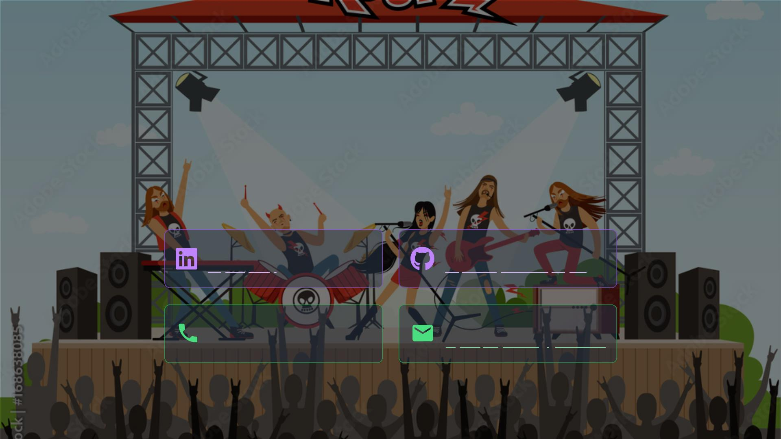
Thank You!
Questions & Discussion
Contact with me:
LinkedIn
GitHub
Rajdeep Ray
Repository for this project
Phone
Email
+91 7076918307
rajdeepray.c48.it@gmail.com

