Slide 1

Data Analytics Project with Excel
Call Center Performance Analysis
by Rajdeep Ray
Image from: Call Center Background Images - Free Download on Freepik

Slide 2

Understanding the Data: Call Records
A Foundation for Operational
Insights
This slide provides a foundational understanding of the data
underpinning our analysis, oﬀering a direct snapshot of our FY
2023 call center operations. This comprehensive dataset is
crucial for evaluating performance and driving strategic
improvements.
Our analysis is built upon a robust dataset of 1,000 individual
call logs, with each entry meticulously capturing a single
customer interaction. This detailed collection forms the core of
our insights into customer engagements.
Key Data Points Captured:
•
•
•
•
Call Duration: The length of each customer service
interaction.
Purchase Amount: The monetary value of any transaction
completed during the call.
Representative ID: A unique identiﬁer for the customer
service agent handling the interaction.
Satisfaction Rating: Customer feedback on a 1-5 scale,
providing a direct measure of service quality.
This foundational dataset is invaluable for extracting rich,
actionable insights. It empowers decision-makers with the
information needed to enhance daily operations, pinpoint areas
for improvement, and ultimately boost both customer
satisfaction and overall call center eﬃciency.
Source: Image from: Data Collection Spreadsheet - Stock Photo

Slide 3
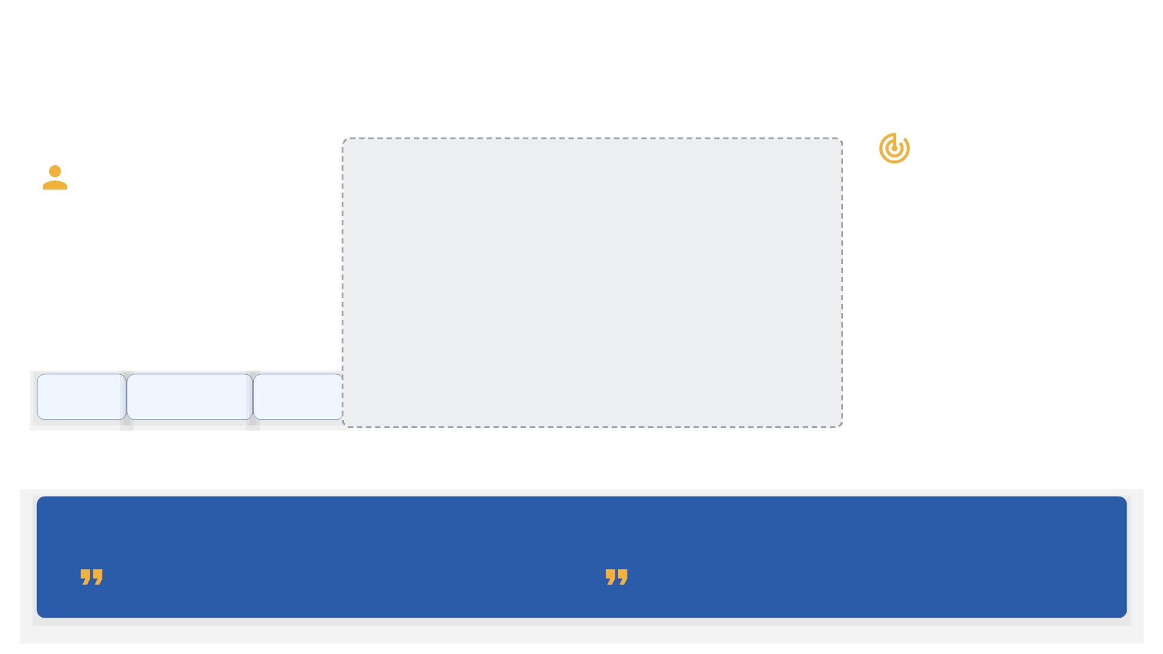
Understanding the Data: Customer Demographics
Targeted
Enriching
Proﬁles
Insights
These attributes enable highly
targeted analysis and
personalized marketing
strategies that resonate with
customers.
Our dataset is enriched with key
customer demographics to
provide a holistic view of our
user base.
[Screenshot of Customer Demographics Data
Table]
Connecting proﬁles with call
data unlocks a deeper, more
nuanced understanding of
customer behavior.
Age
Gender
City
AMPLIFY YOUR STRATEGY WITH DEMOGRAPHIC INSIGHTS!
"Empowering decision-makers with the insights they need to
enhance performance and customer satisfaction."
"Helps businesses make data-driven decisions to improve
customer experience and reduce churn."
Source: Quotes from: LinkedIn post by Purna Duggirala

Slide 4

Data's Strategic Value
From raw calls to real decisions: The data serves as a backbone for action.
Tracking Representative Efficiency
Monitor individual and team performance to identify top performers and coaching opportunities.
Analyzing Customer Satisfaction
Dive into satisfaction ratings to understand customer sentiment and improve service quality.
Identifying Call Handling Patterns
Uncover trends by time, day, and city to optimize staffing and resource allocation.
Enabling Personalized Marketing
Leverage customer attributes for targeted campaigns and improved engagement.
Bridging customer experience with overall business strategy.

Slide 5
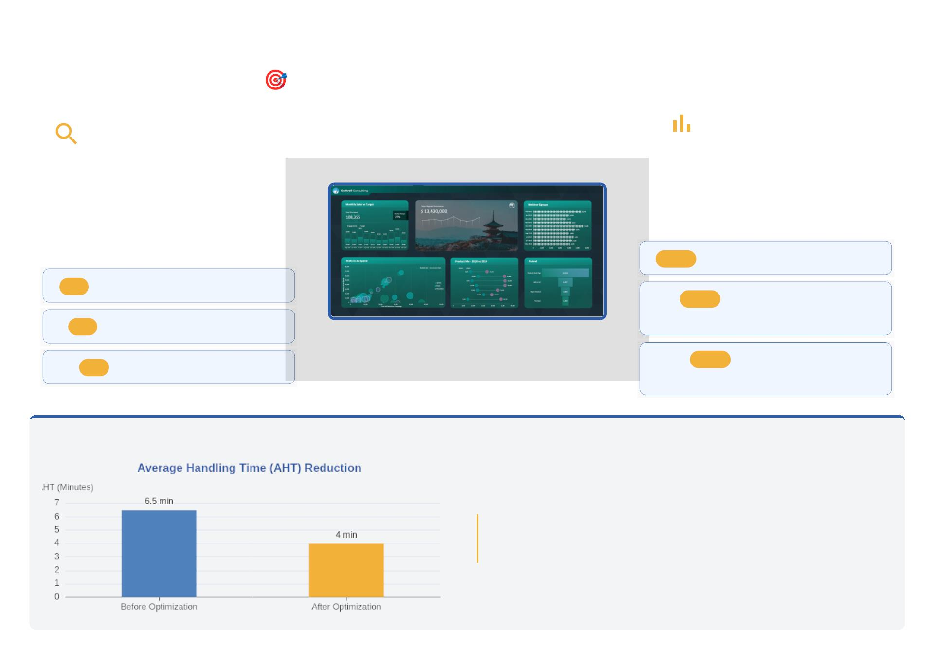

Core Business Objective
Improve overall call center performance.
Data-Driven Strategy
Pinpointing Inefficiencies
The insights derived from our data are pivotal for
informing strategic decisions across critical
business functions. This ensures that every
action is grounded in evidence, maximizing
impact and minimizing risk.
Achieving peak performance begins with a
forensic examination of current operations. By
leveraging detailed call center analytics, we can
meticulously identify friction points and
inefficiencies that hinder agent productivity and
customer satisfaction.
AREA
Sales Strategy Optimization
KPI
Average Handling Time (AHT)
AREA
Staffing & Resource
Allocation
KPI
First Call Resolution (FCR)
Agent Occupancy Rate
AREA
Support Process
Enhancement
KPI
OPTIMIZE PERFORMANCE THROUGH DATA-DRIVEN INSIGHTS!
"By utilizing a performance dashboard, call center managers can visualize
crucial metrics such as average handling time and customer satisfaction
scores, which can lead to more informed decision-making."
Source: Image from 5 of my favorite Excel dashboard examples; Quote from Essential Call Center Performance Dashboard Excel Guide - Insight7

Slide 6
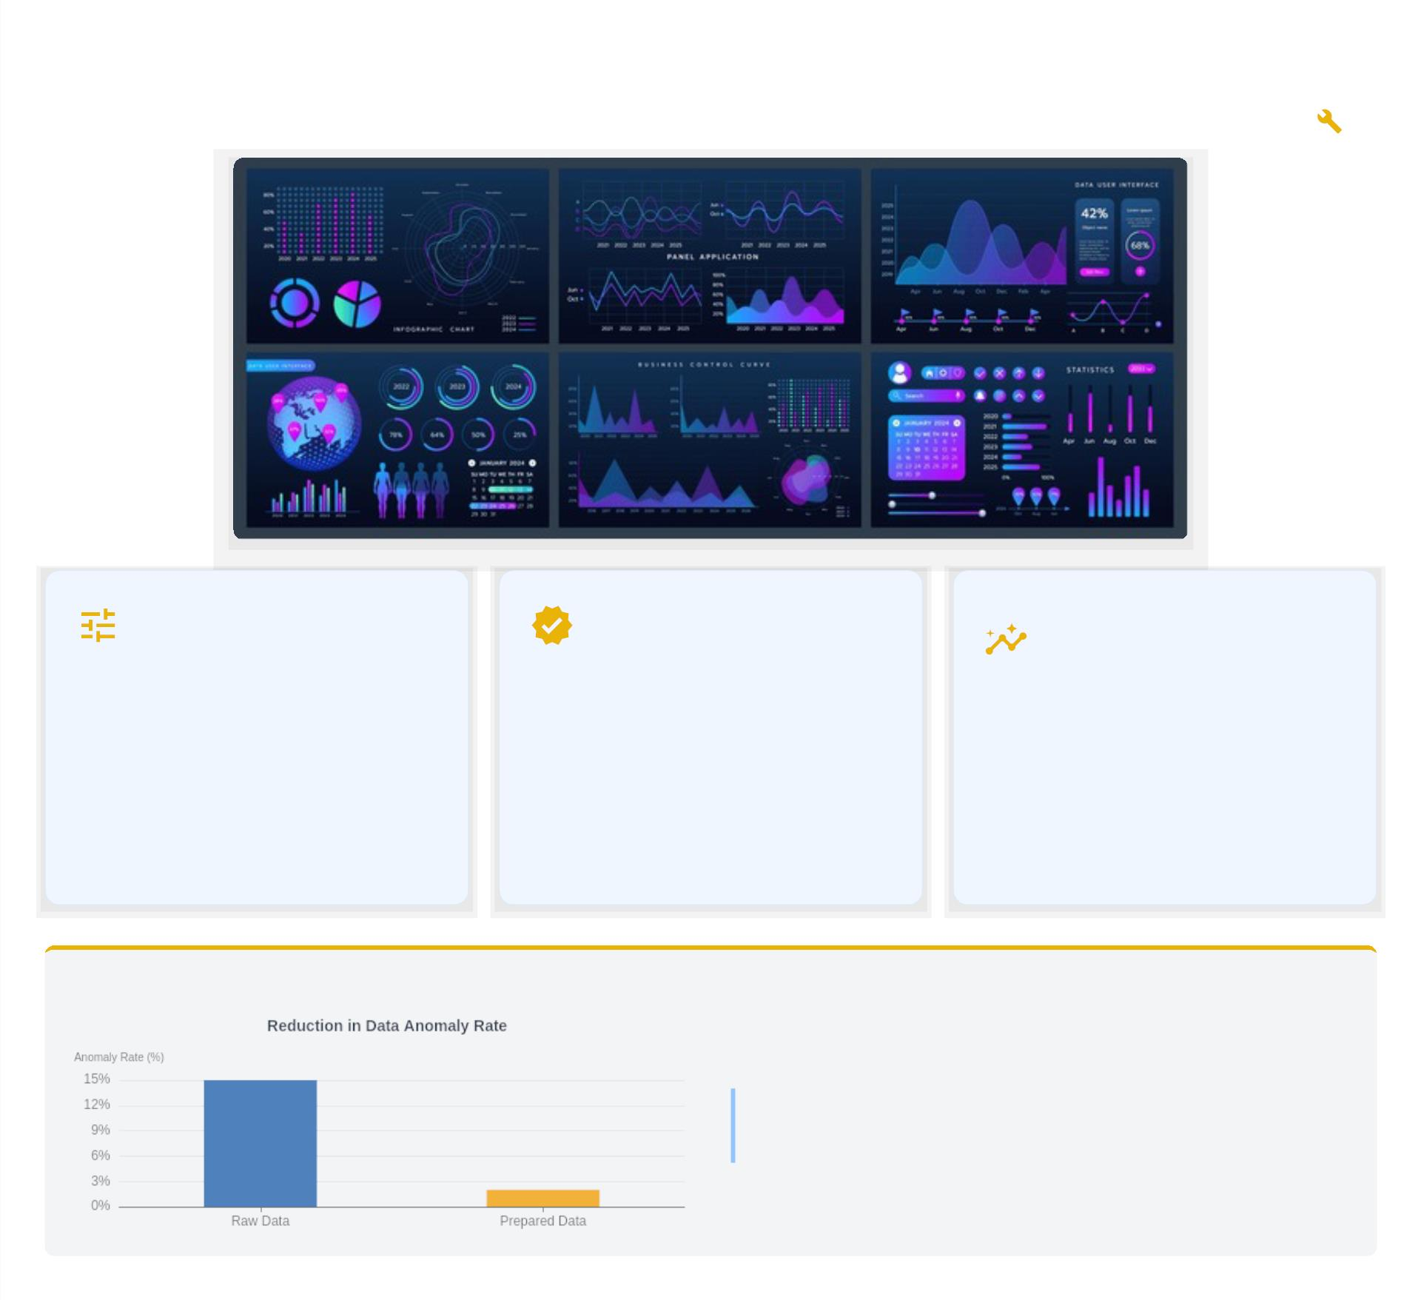

Project Methodology: Data Preparation
Our approach to data preparation was structured and modular, ensuring robustness and clarity.
Import & Cleanse
Ensure Integrity
Ready for
Insights
We meticulously imported and
cleaned the dataset. This
involved handling missing values,
standardizing formats, and
removing duplicates to ensure
paramount consistency and
accuracy.
Rigorous validation processes were
employed to ensure data
The thoroughly prepared data was
structured and optimized, making it
ready for eﬀective analysis and
visualization, paving the way for
actionable insights.
integrity. This was vital to
establish a reliable foundation for
all subsequent analytical phases,
guaranteeing trust in our insights.
D ATA PREPARATION: THE FOUNDATION FOR RELIABLE INSIGHTS!
"By analyzing data from (Forage), I created a comprehensive report
that helps businesses make data-driven decisions to improve
customer experience and reduce churn."
Image Source: Analytics Illustration Royalty-Free Images, Stock... | Quote Source: LinkedIn post by Purna Duggirala

Slide 7
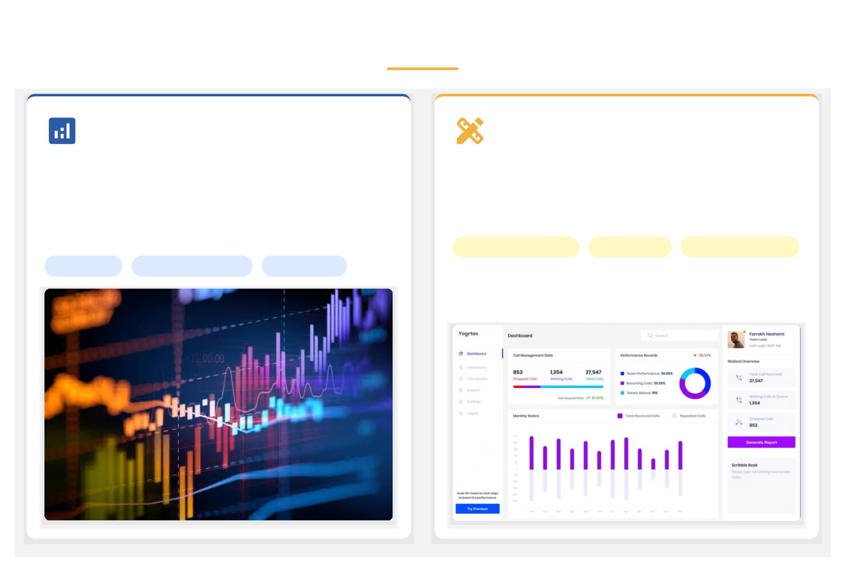
Project Methodology: Analysis & Design
Phase 1: Analysis
Phase 2: Design
Aggregation of call statistics and KPI definition using pivot tables
and custom calculations. This foundational step ensures a
comprehensive and accurate data baseline for performance
evaluation.
Design of user-friendly dashboard layouts, with emphasis on
visual clarity for effective presentation of insights. This translates
complex data into an intuitive and interactive user experience.
User-Friendly Layouts
Visual Clarity
Interactive Elements
Pivot Tables
Custom Calculations
KPI Definition
Source: Data Analytics Abstract, Top 5 Call Center Dashboard Reporting & Analytics Tips

Slide 8
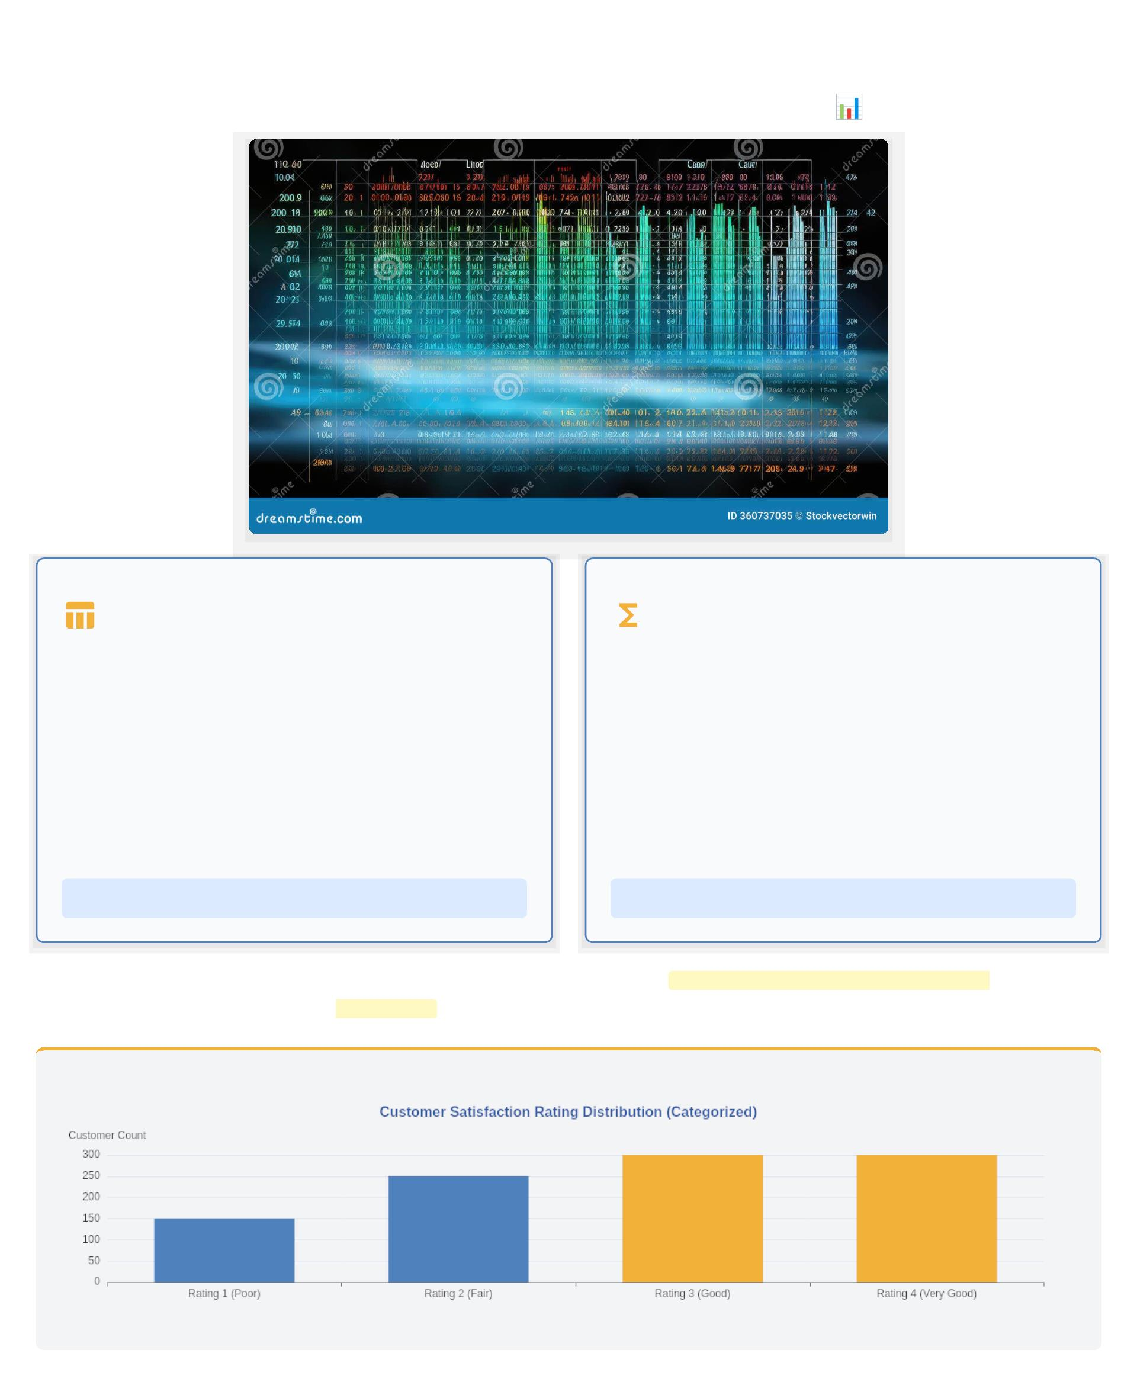
Tools & Techniques: Excel Foundations
Microsoft Excel: The Core Development Platform
Pivot Tables: Summarize &
Calculated Fields: Custom Logic &
Aggregate
Insights
Pivot Tables are an indispensable tool within Excel, allowing for
rapid and efficient data summarization and aggregation. They
transform raw, complex datasets into concise, understandable
reports.
Calculated Fields empower users to introduce custom logic
directly within Pivot Tables. This allows for the creation of new
data points and metrics not present in the original dataset.
Crucial for advanced analysis, they facilitate specialized
computations like rating rounding to standardize feedback or
segmenting data into specific time buckets.
Essential for performance analysis, these tables dynamically
organize data, providing immediate views on sales trends,
customer behavior, and operational metrics without requiring
complex formulas.
Key Benefit: Dynamic Data Reporting
Key Benefit: Enhanced Analytical Depth
This powerful combination of Excel's core functionalities provides robust and flexible data manipulation
capabilities , driving comprehensive business intelligence.
CALCULATED FIELDS: TRANSFORMING RAW D ATA INTO ACTIONABLE INSIGHTS!
"Excel helps sort, filter, and show data visually, while DAX lets me create custom calculations for deeper insights."
Source: Image from Spreadsheet Data Stock Illustrations
Source: Quote from LinkedIn post by Purna Duggirala

Slide 9
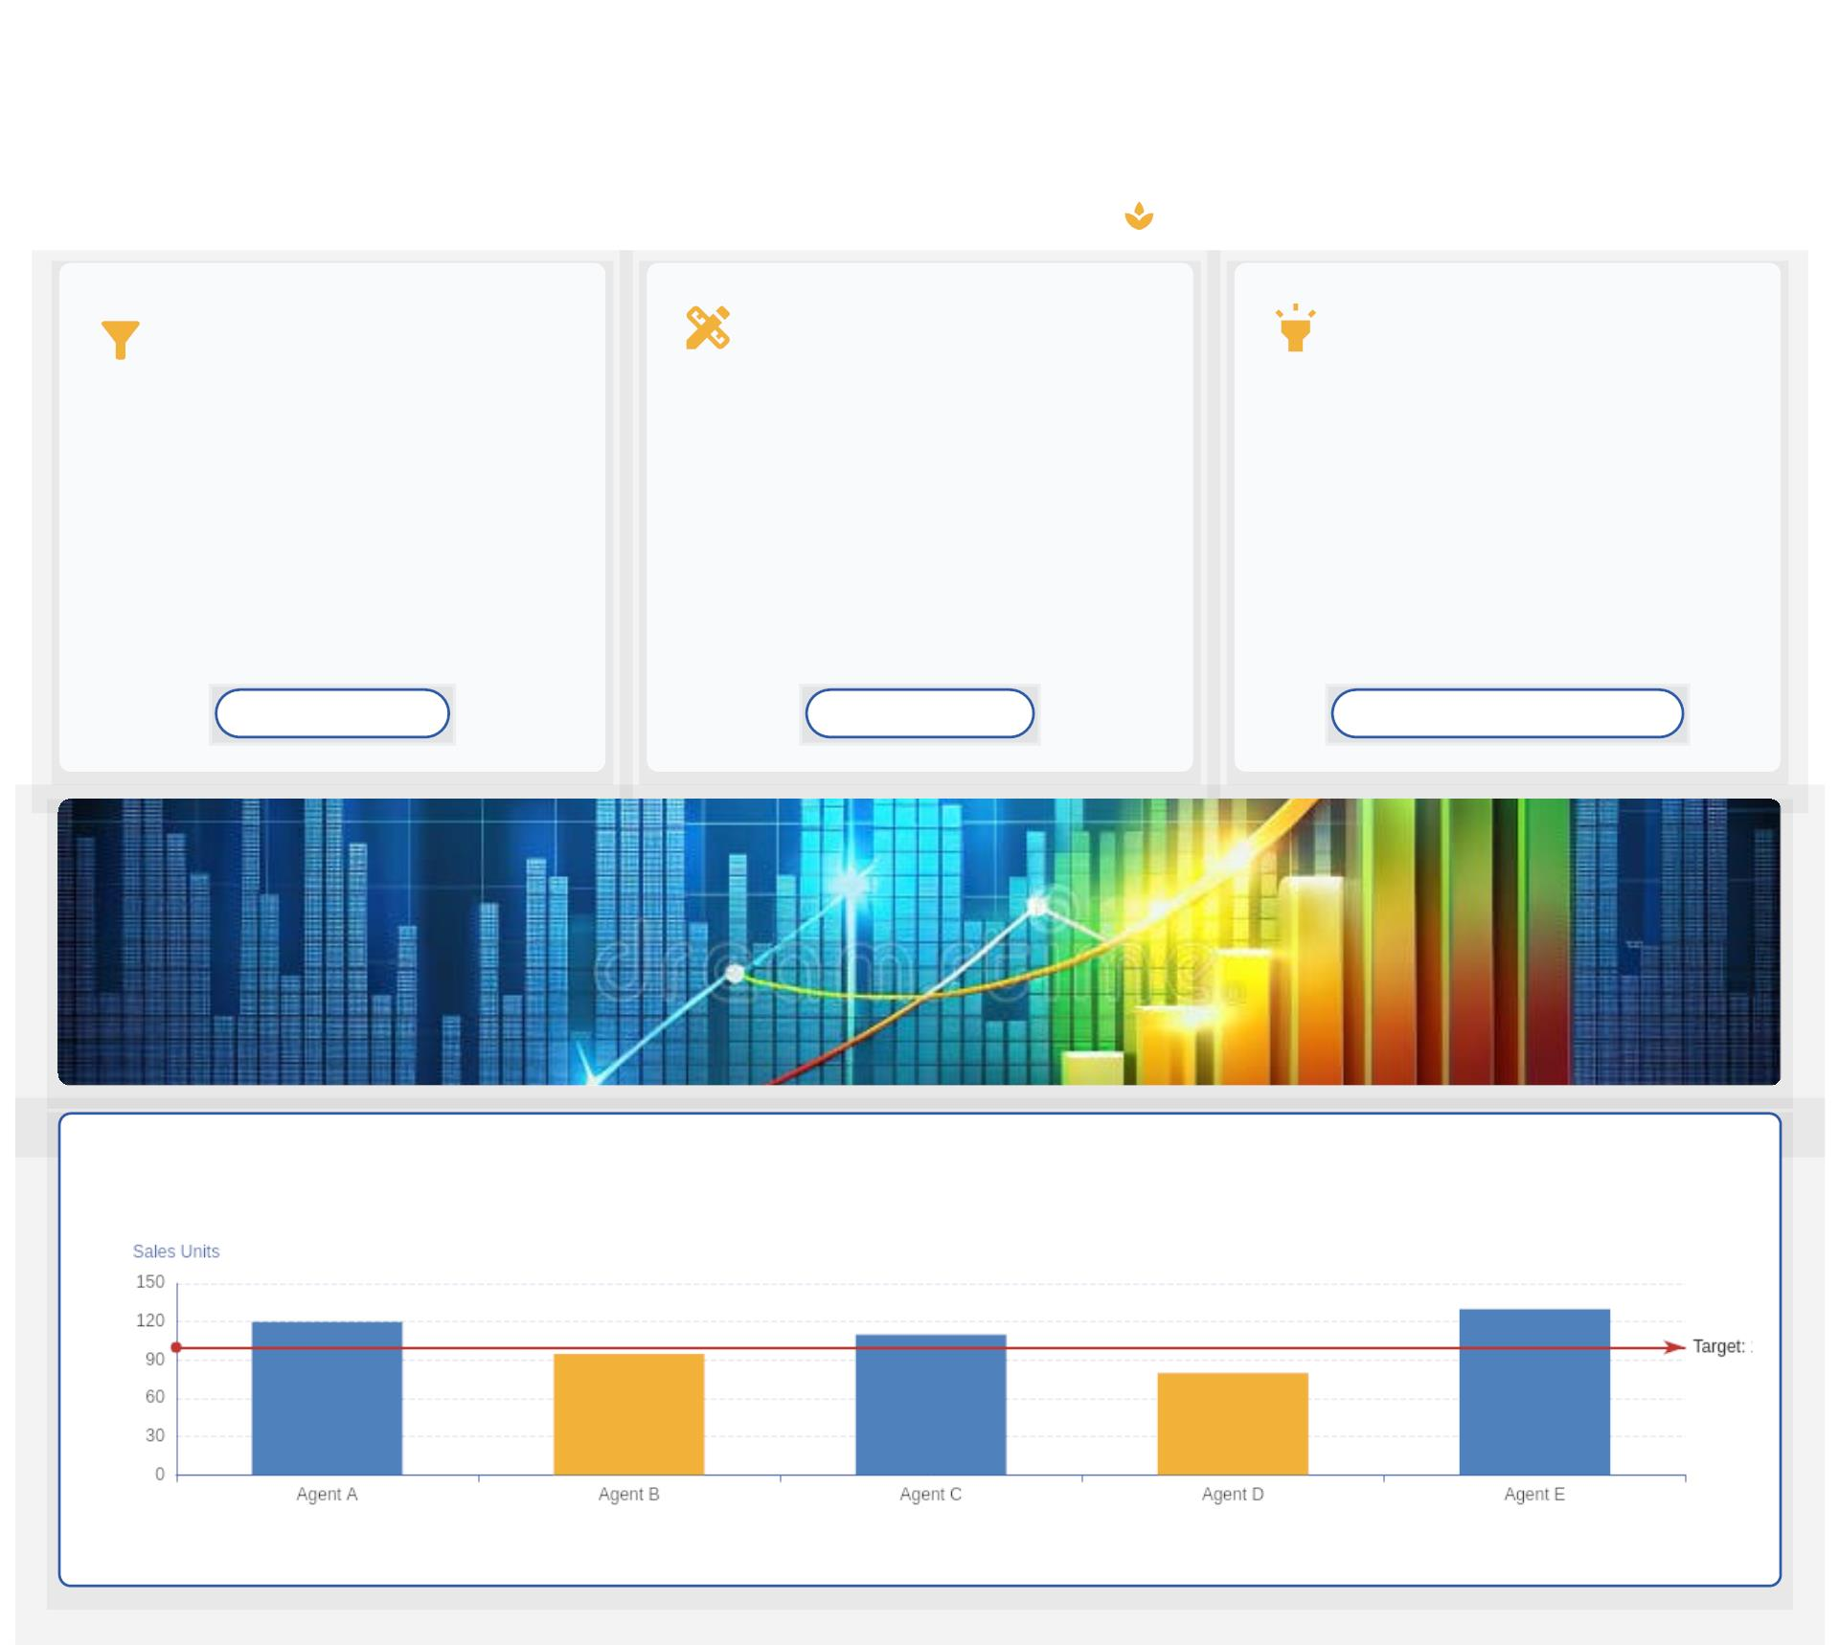
Tools & Techniques: Interactive & Visuals
Our approach focused on achieving both power and polish, enabling dynamic insights and enhanced user
experience, all built seamlessly within Excel.
Slicers & Timeline
Controls
Visual Assets & Design
Conditional Formatting
Aesthetic & Clarity: To elevate the
dashboard's appeal, we incorporated a range of
visual assets, including custom icons and
cohesive tile designs.
Dynamic Highlighting: To draw immediate
attention to critical data points, Conditional
Formatting dynamically highlights key metrics
based on predefined rules.
Dynamic Filtering: We integrated Excel's
powerful Slicers and Timeline controls to
provide intuitive, interactive filtering for dynamic
analysis.
Intuitive Interface: These elements create a
user-friendly and engaging dashboard where
information is absorbed quickly.
Instant Insights: This provides instant visual
cues, accelerating decision-making and
performance management.
On-Demand Analysis: This empowers users to
drill down into specifics, uncovering trends
without touching raw data.
Dynamic Analysis
Intuitive Interface
Instant Performance Insights
CONDITIONAL FORMATTING: TURNING D ATA INTO ACTIONABLE VISUALS!
"Having a quick view of the key performance indicators is beneficial."
Source: Visualizing Quarterly Revenue Growth, Easy Tutorial, LinkedIn, TemplateLab

Slide 10
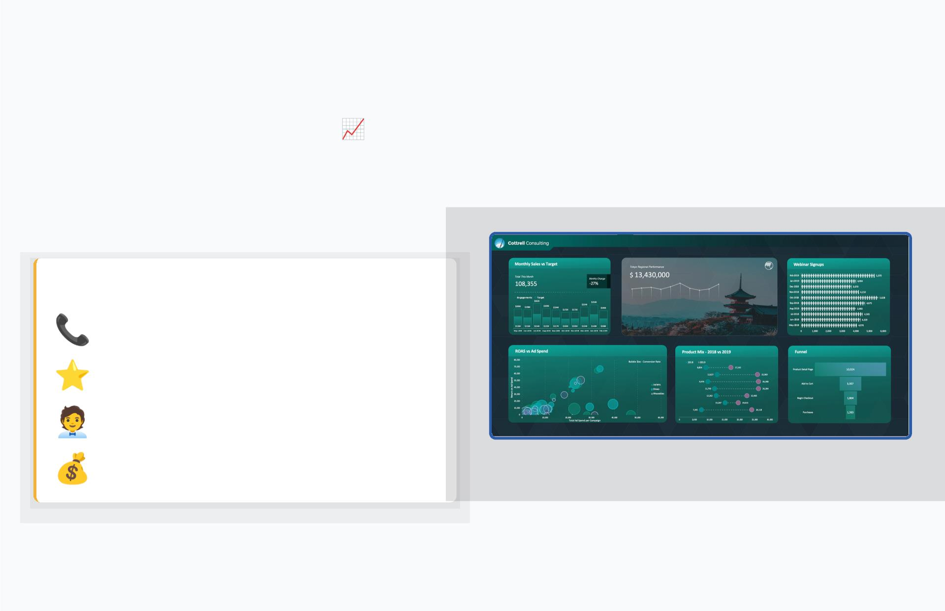
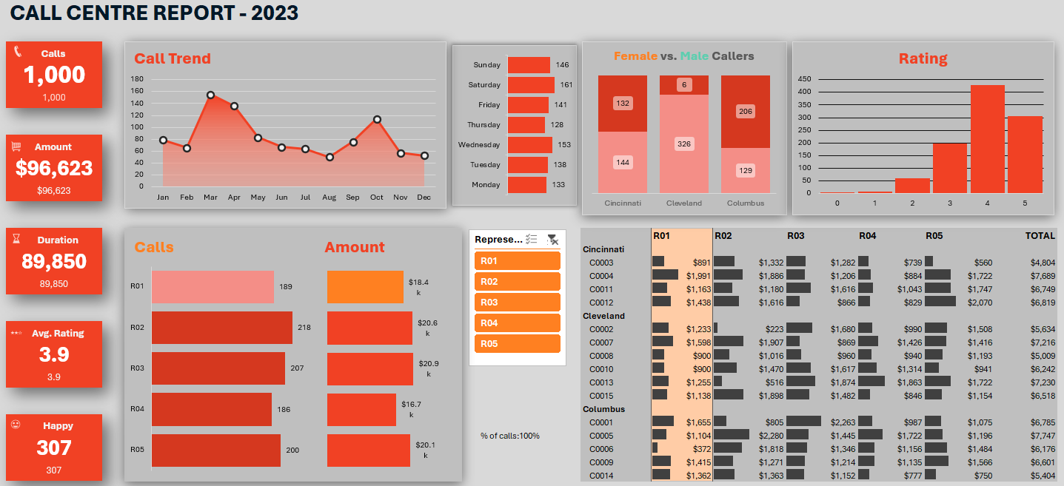
Outcome Summary
Our dynamic dashboard delivers
comprehensive, real-time insights .
It empowers users to seamlessly explore data by age,
gender, city, and representative, turning raw numbers
into a clear narrative.
Key Areas of Insight Include:
Daily call trends
Customer satisfaction patterns
Individual representative performance
Detailed revenue performance
This comprehensive view enables deep contextual
analysis and truly data-driven decisions.
Source: Image from 5 of my favorite Excel dashboard examples

Slide 11
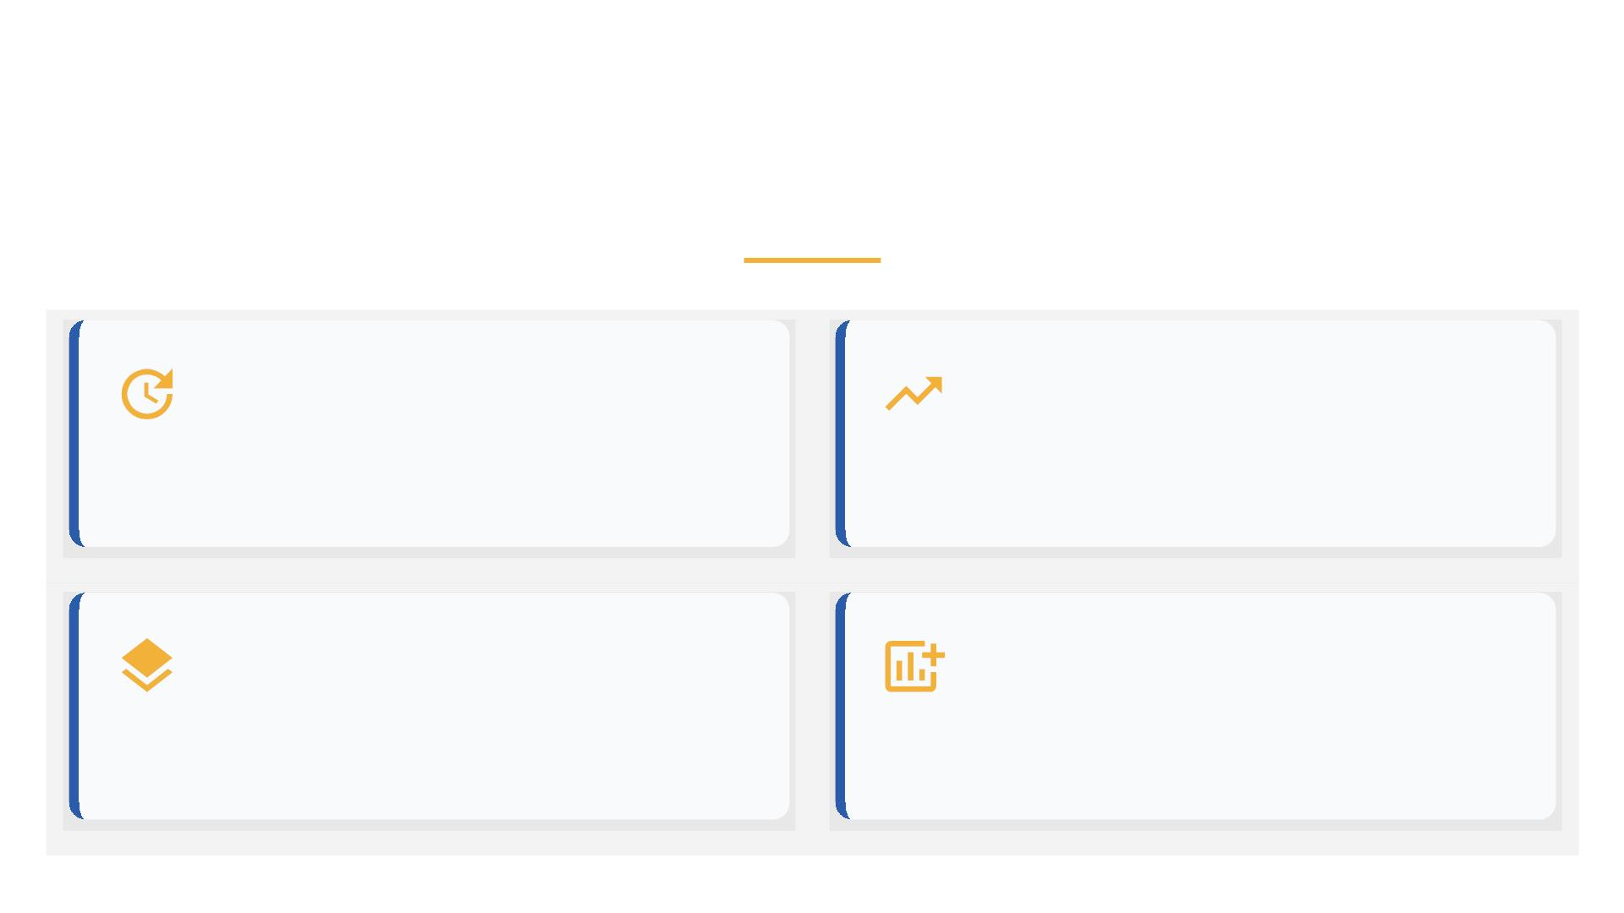
Future Roadmap
Opportunities for Growth
Real-time Data Integration
Migration to Power BI
Establish live data connections for immediate, up-to-
the-minute insights and proactive decision-making.
Port the dashboard to Power BI to enable broader
web-based accessibility and superior collaborative
features.
Advanced Analytics Layers
Expanded KPI Framework
Incorporate sophisticated analysis like sentiment
scoring from call transcripts to deepen customer
understanding.
Enrich the dashboard by adding new, critical metrics
for a more holistic and comprehensive performance
view.

Slide 12
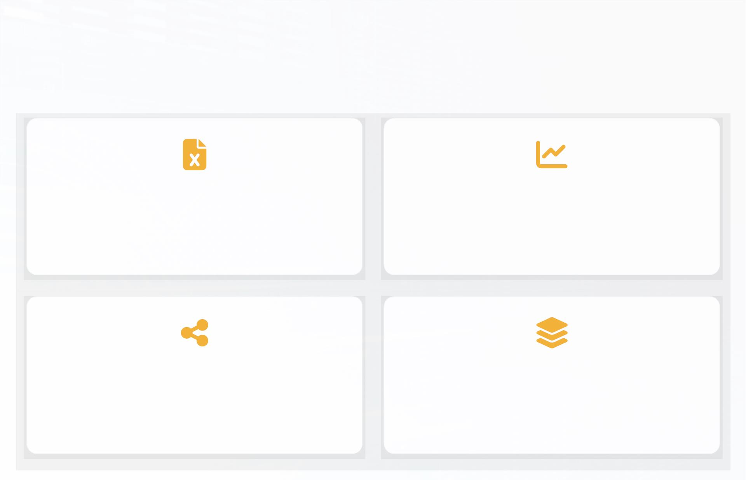
Key Takeaways
A summary of the project's core achievements and strategic value.
Excel's Advanced Capabilities
Operational Intelligence Pipeline
Demonstrated how Excel can be leveraged beyond basic
spreadsheets to create powerful, interactive business
intelligence tools.
Established a clear data-to-decision pipeline, transforming raw
call logs into actionable operational insights for management.
Cross-Departmental Utility
Scalable Analytical Foundation
Created a versatile tool valuable to HR, Operations, Sales, and
Marketing, fostering data-driven collaboration.
Built a robust and scalable model that can be expanded with
more data, advanced metrics, and new technologies like Power
BI.
Source: Image from Spreadsheet Abstract Royalty-Free Images

Slide 13
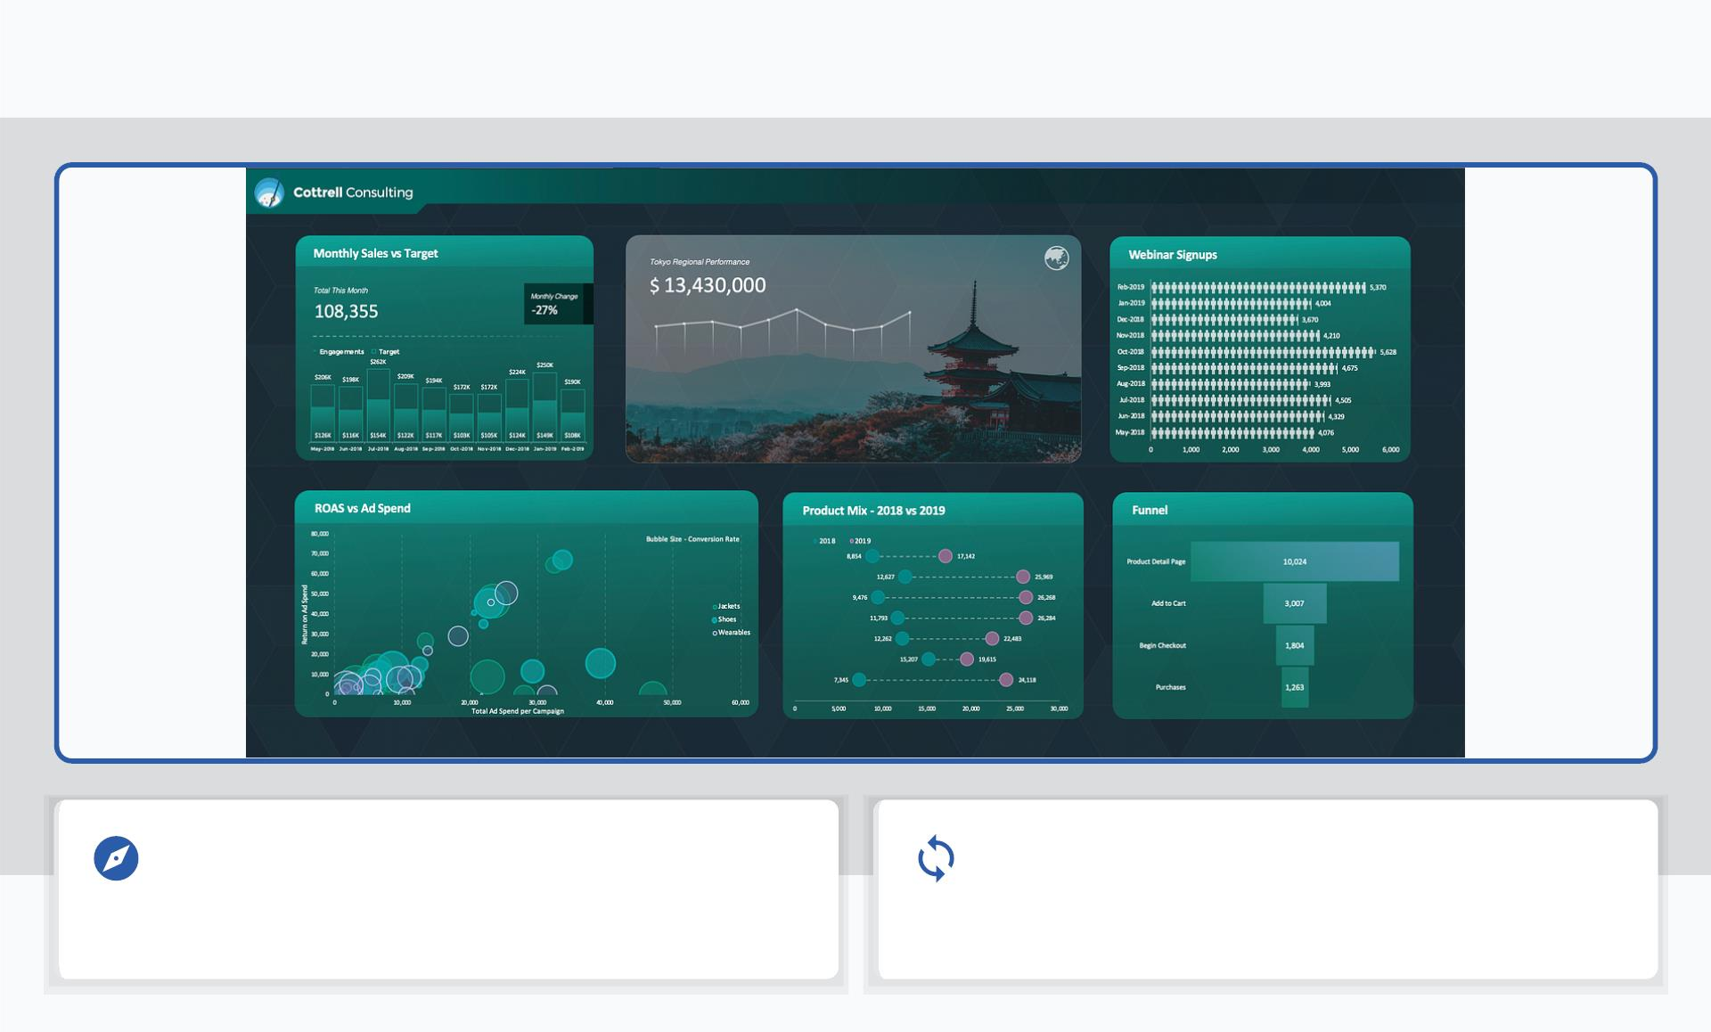
The Interactive Dashboard
Intuitive Exploration
Automatic Updates
Designed for intuitive exploration, transforming raw
data into actionable intelligence.
All dashboard elements—tiles, charts, and tables—
update automatically with selected ﬁlters.
Source: Image from 5 of my favorite Excel dashboard examples

Slide 14
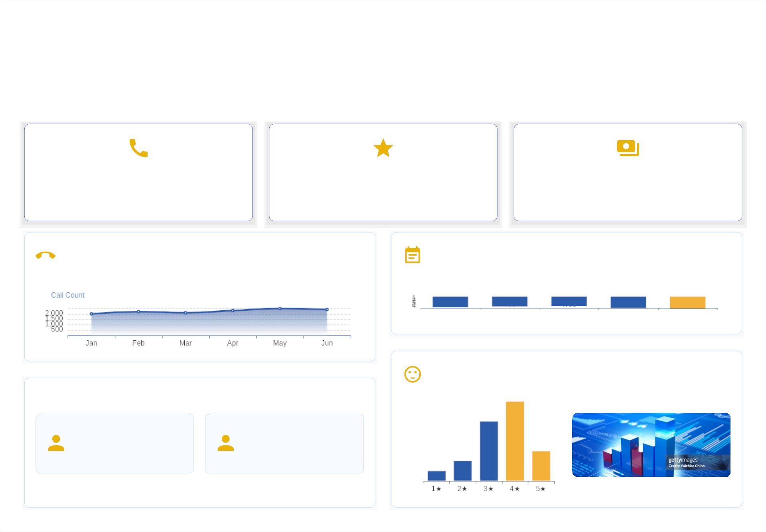
Dashboard Components: Deep Dive
Our dashboard is meticulously engineered to serve as a single 'screen of truth', seamlessly
blending critical data, dynamic visuals, and intuitive interactivity to empower informed decision-
making.
12,500
92%
$1.2M
Total Calls Handled (YTD)
Customer Satisfaction (5-Star)
Revenue Generated (YTD)
Monthly Call Volume Trend
Avg Call Duration by Weekday
Customer Rating Distribution
Representative Performance Overviews
Top Customer Revenue
Jane Doe
CS AT: 95%
FCR: 88%
John Smith
CS AT: 90%
FCR: 82%
Customer A: $15,000
Image from: Revenue Growth Chart Stock Photos
Concept from various dashboard resources (e.g., LinkedIn by Purna Duggirala, Insight7, Dialpad)

Slide 15

Thank You
Rajdeep Ray
Connect:
github.com/deadlineZeus
linkedin.com/in/rajdeep-ray-3616501b6/
+91 7076918307
rajdeepray.c48.it@gmail.com

