Slide 1
PREDICTION OF DIABETES USING DIFFERENT MACHINE LEARNING MODELS
*

Slide 2
ABSTRACT:
Diabetes has become a serious health problem in present world. About one in seven U.S adults has diabetes now, according to the Centers for Disease Control and Prevention. But by 2050, that rate could skyrocket to as many as one in three. In 2013 it was estimated that over 382 million people throughout the world had diabetes.
Diabetes could cause hypoglycemia(low BP) and hyperglycemia(high BP) which could cause bad effect on patient. There are many factors that cause diabetes for example Glucose, Blood Pressure, Skin Thickness, etc .Data sciences could help us solving these severe problem of diabetes
Here we use various Machine Learning models to predict the probability of patient being effected by Diabetes.

Slide 3
INTRODUCTION:
The evolution in data sciences has lead to huge benefits in almost every field of real-world working environment such as weather report prediction, super-market sales analysis, hospital data analysis. Packages in python like NumPy,Pandas,Sklearn,matplotlib help us in data analytics.Using those packages we can moodily the data,plot the dependencies of features,predict the outcome of certain tuple of features.
In this project, we implement a python code for predicting the probability of getting affected by diabetes using different machine learning models.

Slide 4
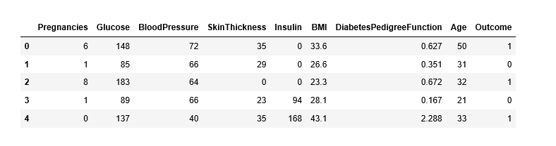
DATASET :
The diabetes data set was originated from UCI Machine Learning Repository
The diabetes data set consists of 768 data points, with 8 features each:
They are Pregnancies, Glucose, Blood Pressure, Skin Thickness, Insulin, BMI, Diabetes Pedigree Function, Age, Outcome.
Outcome” is the feature we are going to predict, 0 means No diabetes, 1 means diabetes. Of these 768 data points, 500 are labeled as 0 and 268 as 1.

Slide 5
Description of Dataset:
No.of Pregnancies: Number of births given by the patient .
Glucose level in Blood: Glucose content in blood noted through blood test.
Blood Pressure: Noted using sphygmomanometer,blood pressure monitor,etc.
Skin thickness: Noted using some ultrasonic scans.
Insulin: Insulin contain present in pancreas.
Body Mass Index: BMI is a measure of body fat based on height and weight that applies to adult men and women.
Diabetes Pedigree Function: It provides some data about diabetes mellitus history in relatives and genetic relationship of those relatives to the patient.
Age:Age of the patient at the time of data entry.

Slide 6
Procedure
Initially the data is been splited into train data and test data.
Next, the train data is used to train different machine learning models like Logistic Regression , SVC, Decision tree, Random Forest Classifier , KNeighbors Classifier .
By using those models we predict the probability of a patient getting affected by diabetes.
And we summarize the accuracy of each model and pick up the best on among them

Slide 7
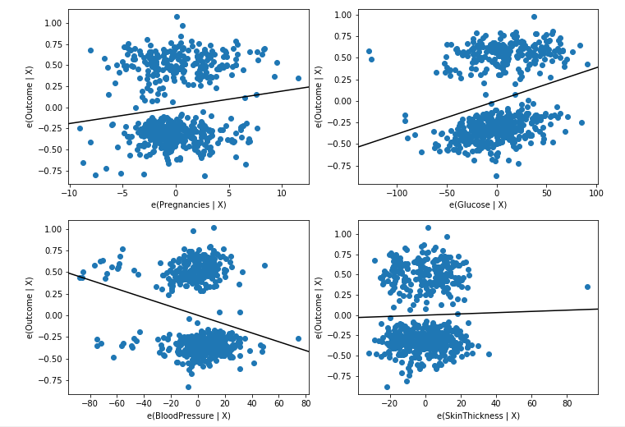
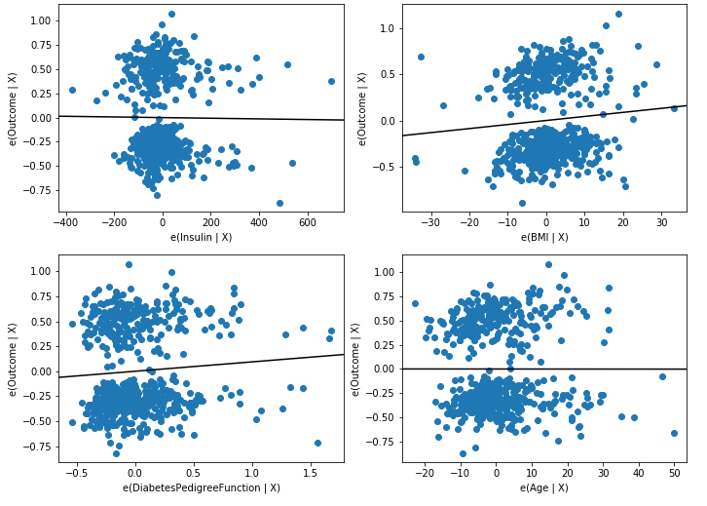
Plot of Dependencies of Features Vs Outcome:

Slide 8
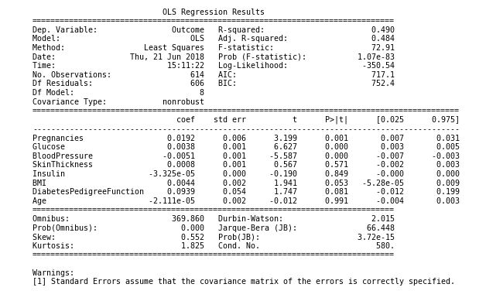
Summary of Statistical Model
Through the plot of dependencies and summary, we can say that outcome is mostly effected by Glucose and rarely affected by Age.

Slide 9
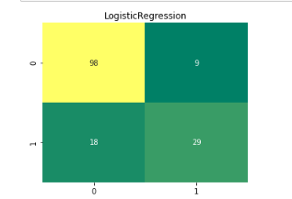
Confusion Matrix and Classification report of Different Classifiers:
============Logistic Regression==============
precision recall f1-score support
0 0.84 0.92 0.88 107
1 0.76 0.62 0.68 47
avg / total 0.82 0.82 0.82 154

Slide 10
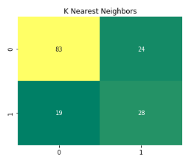
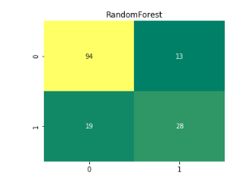
========K Nearest Neighbors========
precision recall f1-score support
0 0.81 0.78 0.79 107
1 0.54 0.60 0.57 47
avg/total 0.73 0.72 0.72 154
========random forest tree========
precision recall f1-score support
0 0.83 0.88 0.85 107
1 0.68 0.60 0.64 47
avg/total 0.79 0.79 0.79 154

Slide 11
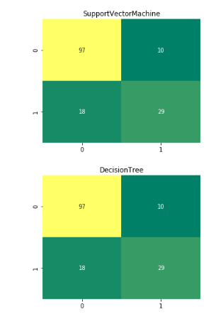
========Support Vector Machine=========
precision recall f1-score support
0 0.84 0.91 0.87 107
1 0.74 0.62 0.67 47
avg/total 0.81 0.82 0.81 154
===========Decision Tree=============
precision recall f1-score support
0 0.87 0.84 0.86 107
1 0.67 0.72 0.69 47
avg/total 0.81 0.81 0.81 154

Slide 12
Conclusion:
Through the results obtained through the dependency plot , Classification report of different Classifier, We conclude that ‘Logistic Regression’ has the highest accuracy of prediction and most effecting feature is ‘Glucose’ and the Least effecting feature is ‘Age’.

Slide 13
Project by:
S.Y.V.Manidhar
V.Pujitha
K.Veera Vidya
P.Bharathi
P.Siva Nanda Reddy

