Slide 1

Force Directed Algorithm
Adel Alshayji
4/28/2005

Slide 2

What is FD Algorithm?
Force directed algorithms used to represents graphs.
Force directed algorithms view the graph as a virtual physical system.
The nodes of the graph are bodies of the system.
These bodies have forces acting on or between them.
These forces are physics-based, and therefore have a natural analogy, such as magnetic repulsion or gravitational attraction.

Slide 3
What is for?
The force directed layout use force directed algorithms for drawing large graphs.
In any graph, the edges can be modeled as gravitational attraction and all nodes have an electrical repulsion between them.
It is also possible for the system to simulate unnatural forces acting on the bodies, which have no direct physical analogy, for example the use of a logarithmic distance measure.
Notes:
This means you can layout large graphs interactively using this algorithm, rather than waiting hours or days for the layout to compute.

Slide 4
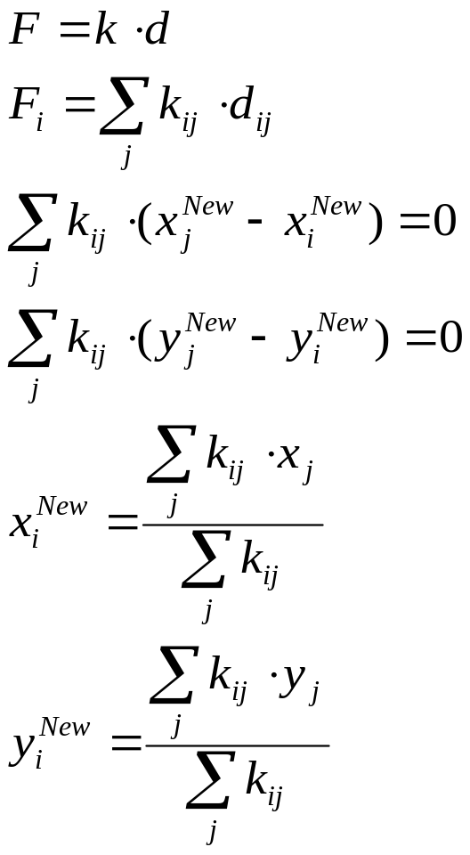
Force Calculation
1
2
i
3
4
5
6
Cells are connected by a net of forces.
The force magnitude between each two nodes is proportional to the distance separating them.
By using Hooke’s law, forces around each node is computed and then equilibrium state is sought.
New values for the node position is computed and the whole net of nodes is rearranged.

Slide 5
How this Algorithm Work?
Regardless of the exact nature of the forces in the virtual physical system, force directed algorithms.
Compute a locally minimum energy layout of the nodes.
This is usually achieved by computing the forces on each node and iterating the system in discrete time steps.
The forces are applied to each node and the positions are updated accordingly.

Slide 6
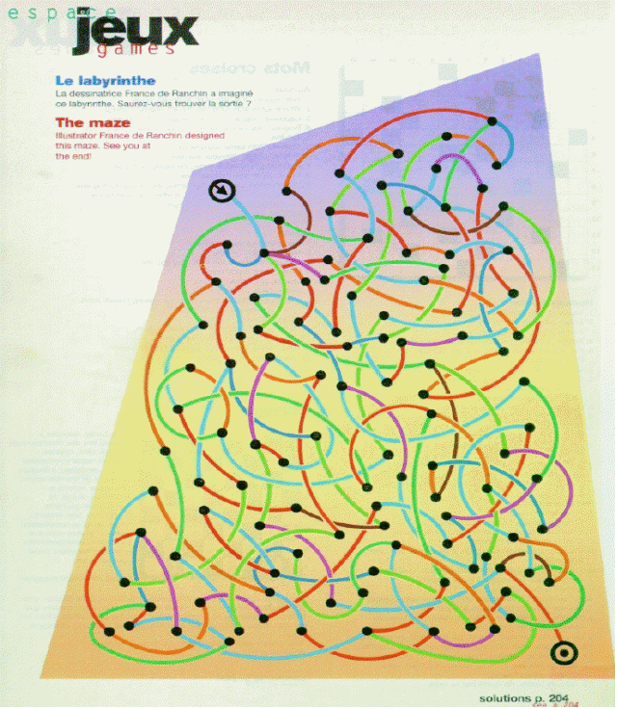
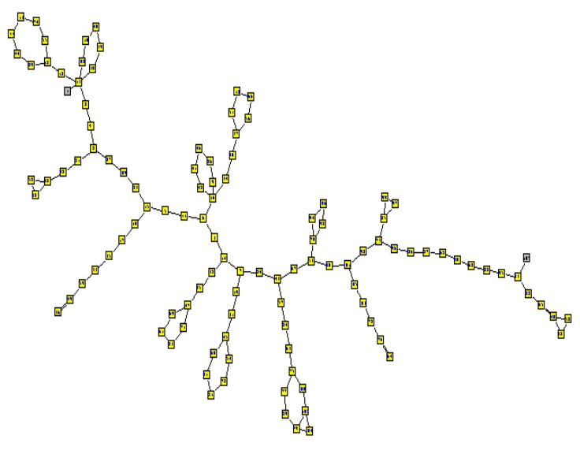
FD Graph Drawing
Which layout is nicer?
An energy model is associated with the graph layouts.
Low energy states correspond to nice layouts.
Energy: 1.77x10³²¹
Energy: 2.23x10⁶
By [Yehuda Koren]

Slide 7
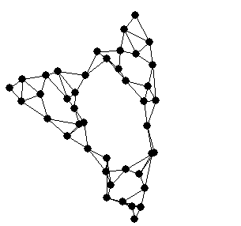
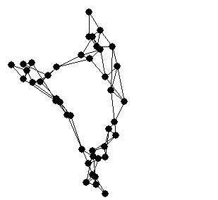
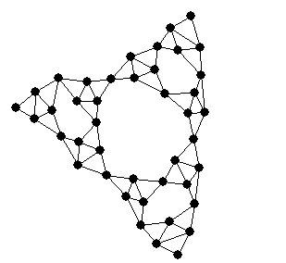
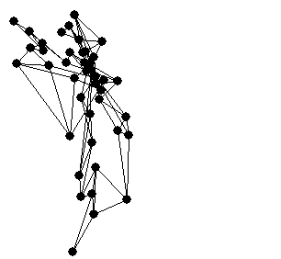
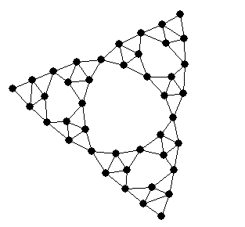
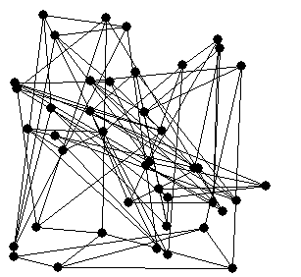
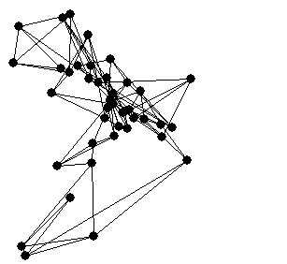
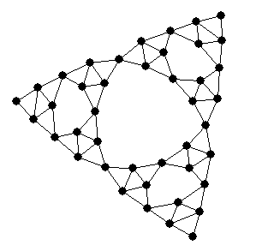
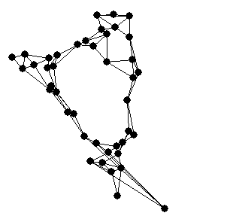
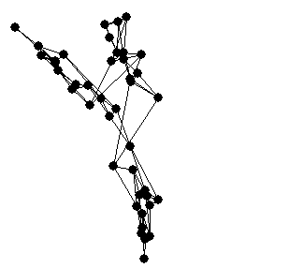
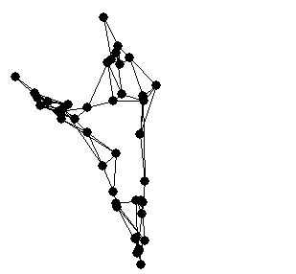
FD Graph Drawing (cont.)
Convergence to global minimum is not guaranteed!
Graph drawing = Energy minimization
Hence, the drawing algorithm is an iterative optimization process
Initial (random) layout
Final (nice) layout
Iteration 1:
Iteration 2:
Iteration 4:
Iteration 5:
Iteration 6:
Iteration 7:
Iteration 8:
Iteration 9:
Iteration 3:
Energy
Layout

Slide 8
FD Graph Drawing (cont.)
This graph has Aesthetical properties
Proximity preservation:
similar nodes are drawn closely
Symmetry preservation:
isomorphic sub-graphs
are drawn identically
No external influences:
“Let the graph speak for itself”

Slide 9
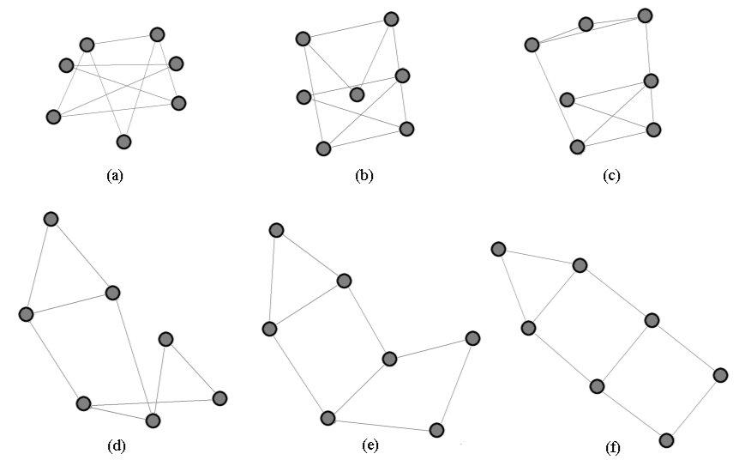
Example 1
A graph drawing through a number of iterations of a force directed algorithm.

Slide 10
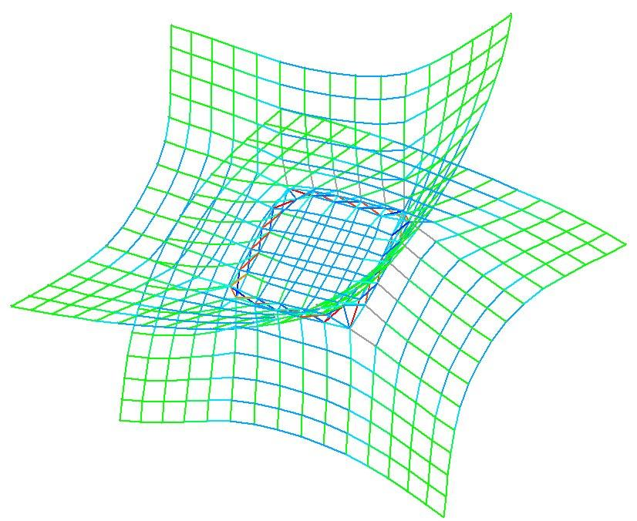
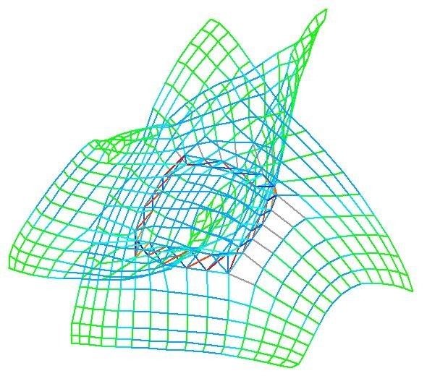
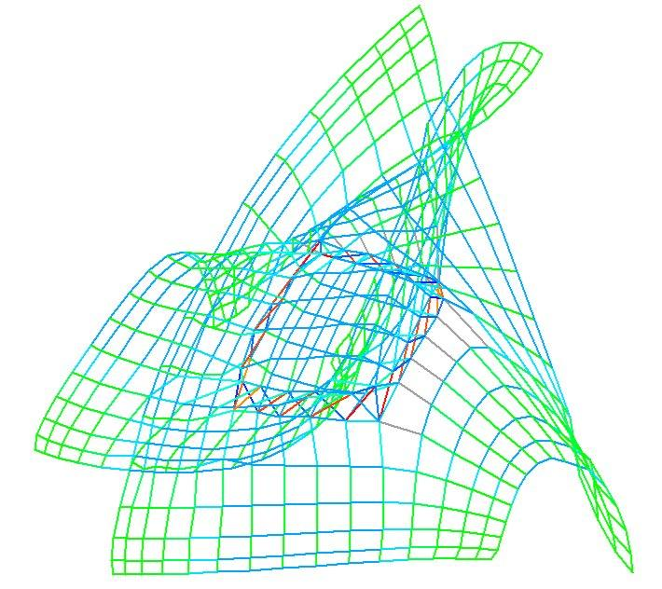
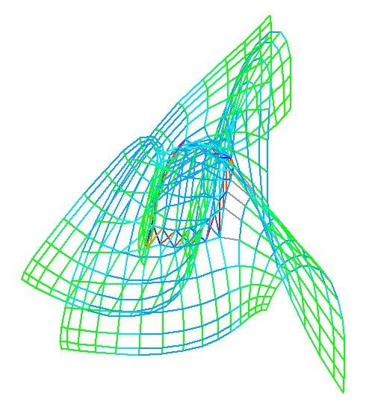
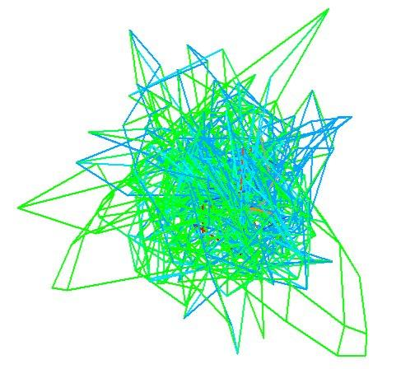
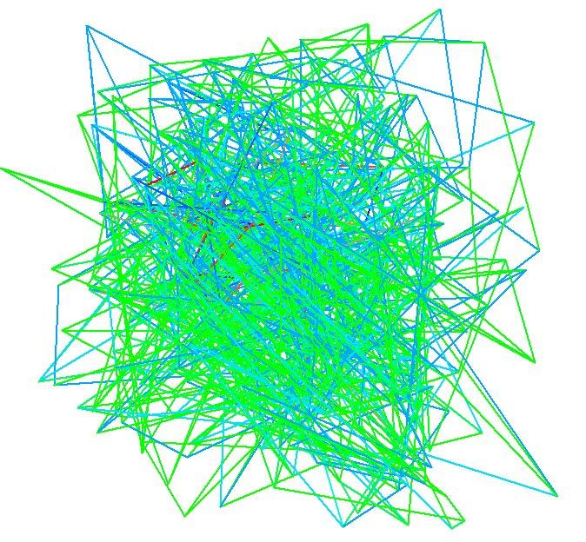
Example 2
This series of images show a graph drawing from a random layout to the final aesthetically pleasant drawing of the graph.

Slide 11
Scaling with Large Graphs
Traditional force-directed methods are limited to a few hundred nodes
Problems when drawing large graphs:
  Visualization issue: not enough drawing area
    Cures: dynamic navigation, clustering, fish-eye view, hyperbolic space,…
  Algorithmic issue: convergence to a nice layout is too slow
We concentrate on the algorithmic issue, i.e., the computational complexity (mainly time).

Slide 12
Complexity
Complexity per single iteration is O(n2)
  Energy contains at least one term for each node pair (repulsive forces)
Estimated number of iterations to convergence is O(n)
Overall time complexity is ~ O(n3)
Force directed methods do not scale up well to large graphs!

Slide 13
Limitation
Force-directed algorithms are often used in graph drawing due to their flexibility, ease of implementation, and the aesthetically pleasant drawings they produce.
However, classical force directed algorithms are unable to handle larger graphs due the inherent N squared cost at each time step.
Where N is the number of bodies in the system.
The FADE layout paradigm, overcomes this computational limitation to allow large graphs to be drawn and abstractly represented.

Slide 14
What is FADE Paradigm?
In the FADE paradigm, we take the graph layout and perform a geometric clustering (typically by recursive space decomposition) of the locations of the nodes. This process, along with implied edge creation, forms a hierarchical compound graph.

Slide 15
How it is Work?
Compute Initial Layout
REPEAT
  Compute Edge Forces
  Construct Geometric Clustering
  FOR each node V
    Compute Approximate Non-edga Forces on V
END FOR
Move Nodes
Update Bounding Area/Volume
UNTIL Stopping Condition
END

Slide 16
Performance Improvement
The performance improvement in the FADE paradigm comes from :
Compute forces using recursive decomposition for the locations of the nodes, rather than using all the nodes directly.
Different decompositions generate recursive geometric clustering of the nodes of the graph.
The recursive clustering does facilitate a dramatic improvement in the performance of force directed algorithms.

Slide 17
Performance Improvement (cont.)
It allows for multi-level viewing of huge graphs at various levels of abstraction.
As the quality of the drawing improves, the quality of clustering, exhibited by the decomposition tree, improves to a reasonable amount.
This clustering helps in visual abstraction, when it has sufficient quality.

Slide 18
Spring Embedder
Example of F.D. Method
Replace edges with springs (zero rest length) ---
attractive forces
Replace vertices with electrically charged particles, repelling each other --- repulsive forces
Start with a random placement of the vertices, then just let the system go until it reaches equilibrium.

Slide 19
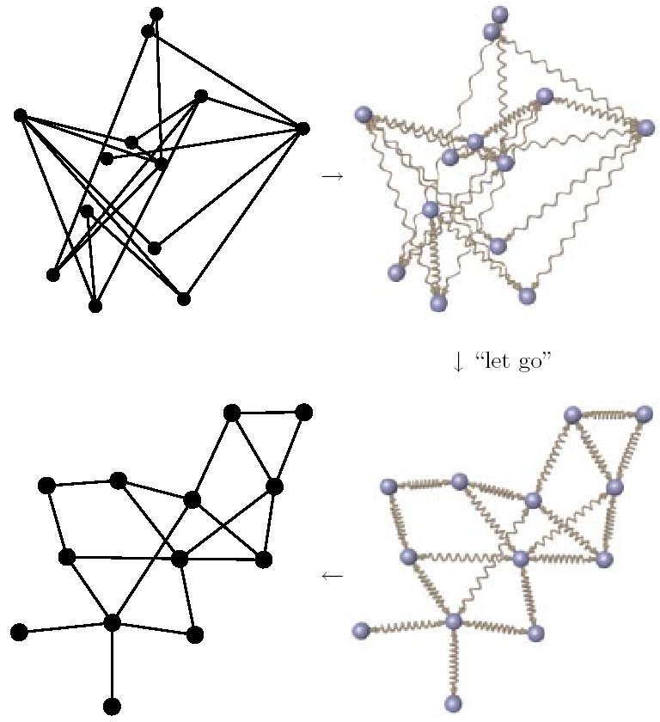
Example of Spring Method
[Kaufmann and Wagner, 2001]

Slide 20
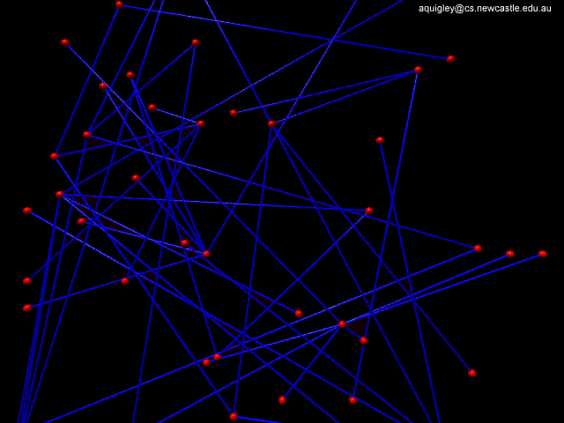
Animated Example
By, [Aaron J. Quigley]

Slide 21
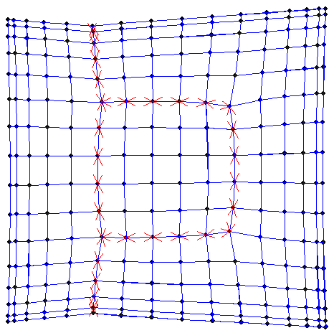
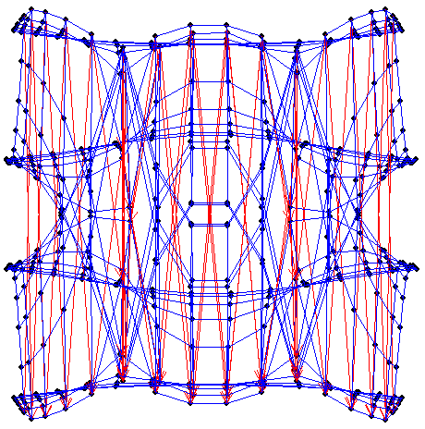
Example in 3D
[Carmel,Harel,Koren’02]
ACE

Slide 22
Where FD Algorithm Fit?
Force directed methods and large graphs
Multi-scale acceleration of force directed methods
Hall’s graph drawing method
(a particular force-directed method)
ACE: a multi-scale acceleration of Hall’s method
High dimensional embedding: a new approach to graph drawing
Hall
High Embedding
Force directed
Multi-scale
ACE
10⁰
10¹
10²
10³
10⁴
10⁵
10⁶
No. of nodes drawn in a minute.
By [Yehuda Koren]

Slide 23
Conclusion
Force-directed algorithms are used in graph drawing with limited number of nodes.
It simplifies graph layout so the graph become simple to understand and use.
It is unable to handle larger graphs due the inherent O(N ²) cost at each time step.
FADE Paradigm, works better with graph drawing and improve algorithm performance.
For higher number of nodes, Multi-scale, Hall, High Embedding, and ACE algorithm work better than Force Directed Algorithm.

Slide 24
References
Dr. Aaron John Quigley, College Lecturer,Department of Computer Science, University College Dublin, Ireland.
Yehuda Koren, The Weizmann Institute of Science.
Andrew Kennings, Electrical and Computer Engineering, University of Waterloo.
Sait, Sadiq M., VLSI physical design automation: theory and practice.

Slide 25
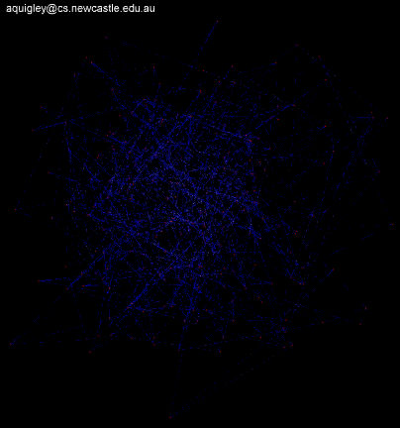
Thank You
This animation produced by, [Aaron J. Quigley] `

