Slide 1
Force directed graph drawing
Thomas van Dijk

Slide 2
The problem
Given a set of vertices and edges,
compute positions for the vertices.
If the edges don’t have to be straight (e.g. curved), compute something about them too.
  Probably control points for a parametric curve

Slide 3
Drawing general undirected graphs
Some problems are hard because there are a lot of constraints
This one is hard because there are very little constraints

Slide 4
Overview
The concept of force directed drawing
Aspects of force directed drawing

Slide 5
Metaphor
Vertices are metal rings
Exert a repulsive force
This way, vertices don’t come too close together.

Slide 6
Metaphor
Edges are springs that connect the rings
An attractive force between connected vertices.
This way, vertices with edges between them don’t go too far apart

Slide 7
Metaphor
Will probably give a good looking drawing
Define an ‘energy’ function on drawings
Minimize this energy

Slide 8
Forces

Slide 9
Forces

Slide 10
Forces

Slide 11
Forces

Slide 12
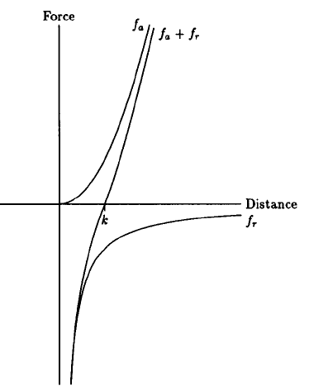
Example magnitude of forces
Fruchterman & Reingold (‘91)
Attraction quadratic
Repulsion hyperbolic
Parameterized for the
distance we try to
achieve
f_{a} = d² / k
f_{r} = -k² / d

Slide 13
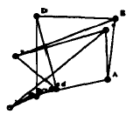
Fruchterman & Reingold

Slide 14
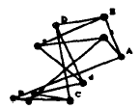

Slide 15
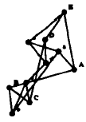

Slide 16
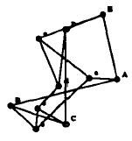

Slide 17
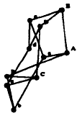

Slide 18


Slide 19
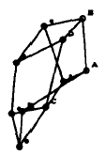

Slide 20
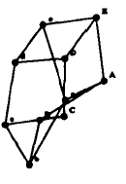

Slide 21
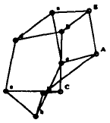

Slide 22
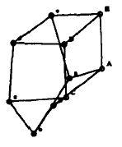

Slide 23
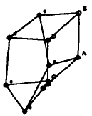

Slide 24
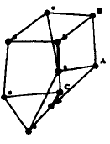

Slide 25
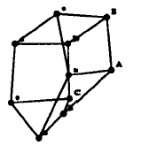

Slide 26
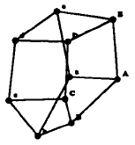

Slide 27
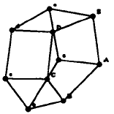

Slide 28
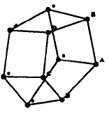

Slide 29
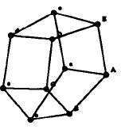
“Final”

Slide 30
“Final”

Slide 31
“Final”

Slide 32
Termination
Well …
  50 iterations?
  Energy threshold?
  Local minimum reached?
  User input?

Slide 33
Oft-cited papers
(E) Eades (’84)
A heuristic for graph drawing
(K&K) Kamada & Kawai (’89)
An algorithm for drawing general undirected graphs.
(F&R) Fruchterman & Reingold (’91):
Graph Drawing by Force-directed Placement
(D&H) Davidson & Harel (’96)
Drawing Graphs Nicely Using Simulated Annealing

Slide 34
Aspects of force directed algos
Very flexible concept
Many aspects
  Can be mixed and matched

Slide 35
What are good drawings?
K&K: “The graph structure encompasses so many kinds of structures, from trees to complete graphs, that it is difficult to find out the common criteria of nice drawings.”

Slide 36
What are good drawings?
K&K, D&H, F&R
  Distribute the vertices and edges uniformly
  Symmetry whenever possible
D&H, F&R
  Conform to the shape of the frame
  Reduce the number of edge crossings
D&H
  Keep vertices from coming too close to edges
F&R
  Uniform edge length

Slide 37
What are good drawings?
D&H: be able to weigh which aesthetic criteria are important
Then it will also be possible to tweak it

Slide 38
What are good drawings?
versus

Slide 39
What are good drawings?
K&K: edge crossing per se is not a good criterion.
  “Balance” is more important
versus

Slide 40
Initial configuration
D&H, F&R: random.
K&K: on a circle.
Both ‘just work’
In all the implementations, can also specify start positions

Slide 41
Edge length
K&K: Try to make uniform
F&R: Pairs of vertices should have distance in the plane equal to their distance in the graph
D&H: As short as possible

Slide 42
Moving vertices
Typically one at a time (K&K, D&H)
Susceptible to local minima
All at once for better results (F&R)
Limit the distance moved in one step
Big steps at first, small ones later

Slide 43
Moving vertices
Gansner and North (’98)
Improved Force-Directed Layouts
Construct Voronoi diagram
Move vertices to their Voronoi cell centroid

Slide 46
Moving vertices
Gansner, Koren & North (’04) again
Graph Drawing by Stress Majorization
Different optimization technique, known as majorization.
  Existing technique from a different field
  Reportedly works great here
Both improved running time and stability

Slide 47
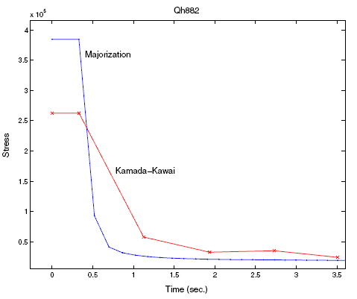
Majorization runtime

Slide 48
What to do about edge-crossings
Again, K&K: edge crossings aren’t bad
at all.
D&H: trying to make edges short tends to give little crossings.
  Algorithms for drawing plane graphs exist, but don’t always give nice pictures.
  Better to have a few crossings in an otherwise good looking drawing.

Slide 49
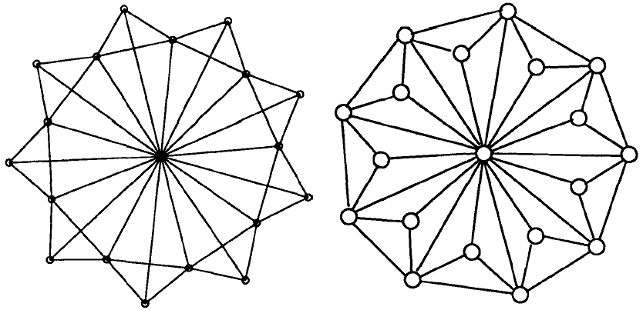
What to do about edge-crossings
F&R
D&H

Slide 50
What to do about edge-crossings
François Bertault (’00)
A force-directed algorithm that preserves edge-crossing properties
(Find a drawing of the graph with minimal edge crossings using some algorithm)
Beautify it using force directed methods
  Don’t introduce edge crossings!

Slide 51
Conclusion
Force directed methods give good results
Other methods give unsatisfactory results
E.g. GraphViz uses it.
Lots of opportunities to tweak

Slide 52
After the break
Curves instead of straight line segments as edges.

Slide 53

Questions?

Slide 54
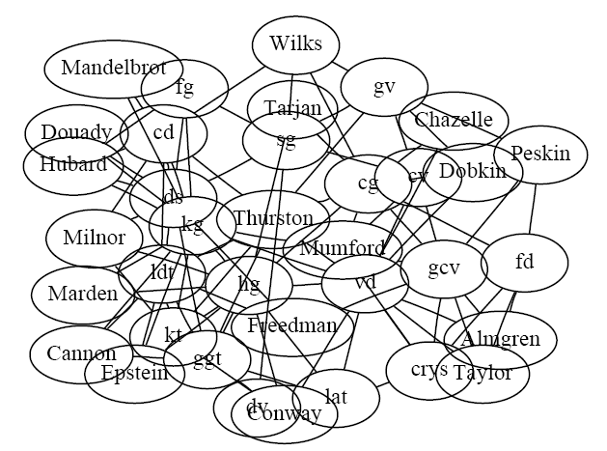
Non-point vertices
Again, Gansner and North (’98)
Improved Force-Directed Layouts

Slide 55
