Slide 1
Data Analysis and Mining
Weixiong Rao 饶卫雄
Tongji University 同济大学软件学院
2017 Spring
wxrao@tongji.edu.cn
  *Some of the slides are from Dr Jure Leskovec’s and Prof. Zachary G. Ives

Slide 2

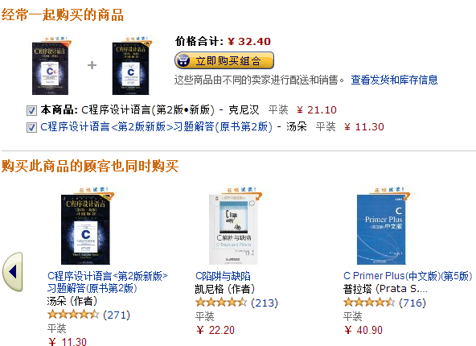


DAM is here!
Product Recommendation

Slide 3
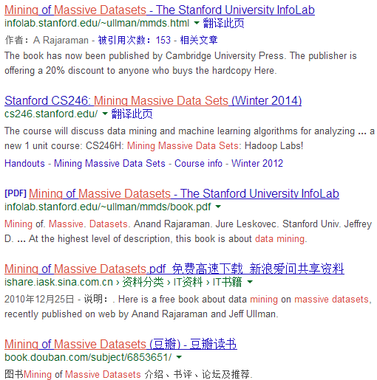

Web Search Ranking

Slide 4
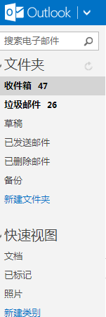
Spam e-Mail Detection

Slide 5


阿尔法围棋
一款围棋人工智能程序
由谷歌（Google）旗下DeepMind团队开发
其主要工作原理是“深度学习”
2016年3月与李世石进行人机大战, 4:1获胜
2016年末2017年初，该程序在中国棋类网站上以”大师Master”为注册帐号与中日韩数十位围棋高手进行快棋对决，连续60局无一败绩。
其等级分曾经超过排名人类第一的棋手柯洁。

Slide 6
DeepMind公司
由人工智能程序师兼神经科学家Demis Hassabis等人联合创立 (2010年创建)
2014年1月谷歌计划斥资4亿美元收购人工智能初创企业DeepMind
是前沿的人工智能AI企业, 其将机器学习和系统神经科学的最先进技术结合起来, 建立强大的通用学习算法
最初成果主要应用于模拟、电子商务、游戏开发等商业领域。
DeepMind 欲将其算法应用到医疗保健行业，包括计划在 5年 内使用机器学习处理英国国家医疗服务体系(以下简称：NHS) 的数据
DeepMind希望开发一种人工智能软件, 使之可以在面对任何问题时完成自学。
哈萨比斯认为: 这有助于解决一些全世界最棘手的问题。
“人工智能很有可能令人类震惊”“它可以加速疾病治疗速度，还能加速各种目前进展较慢的事情。”

Slide 7
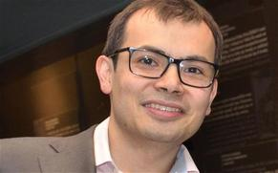
Demis Hassabis
4岁开始下象棋, 很快成为天才少年
8岁时在棋盘上的成功促使他开始思考两个至今令他困扰的问题：
  第一，人脑是如何学会完成复杂任务的？
  第二，电脑能否做到这一点？
17岁时，哈萨比斯就负责了经典模拟游戏《主题公园》的开发，并在1994年发布, 随后读完了剑桥大学计算机科学学位, 在1998年创办了自己的游戏公司
2005年进入伦敦大学学院, 攻读神经科学博士学位, 希望了解真正的大脑究竟是如何工作的, 以此促进人工智能的发展
展示了一款软件, 可以自学经典视频游戏, 甚至能达到一流人类选手的水平
2014年早些时候Google收购名不见经传的伦敦创业公司DeepMind, 价格据说高达4亿英镑
在2014年的温哥华TED大会上, 谷歌CEO拉里·佩奇专门谈到了哈萨比斯, 还将他公司的技术称作“我很久以来见过的最惊人的技术之一”

Slide 8
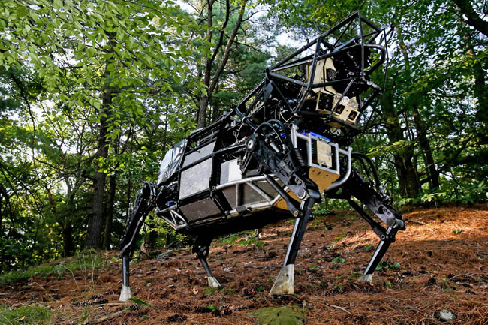
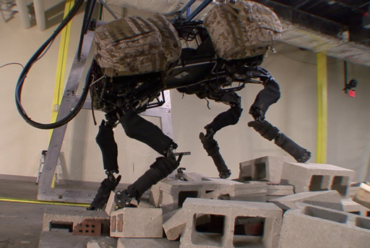
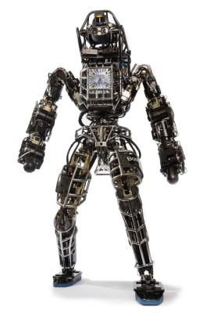

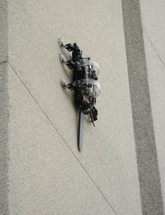
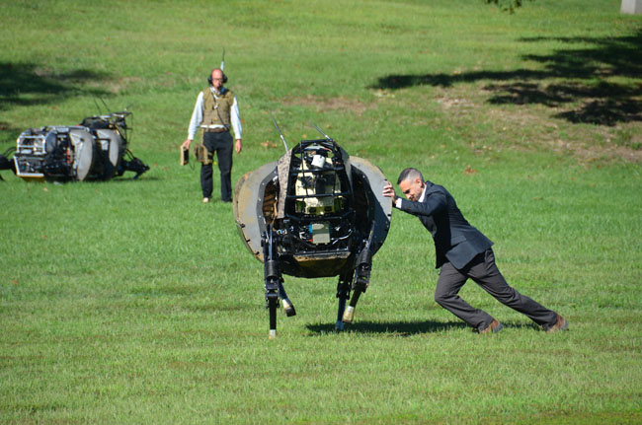
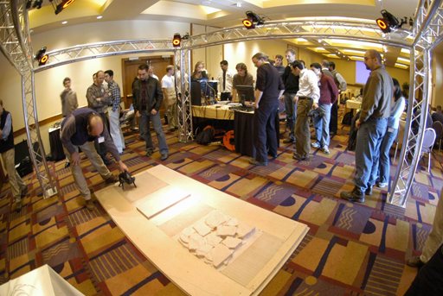
波士顿动力公司

Slide 9
Big Data
Typical large enterprise:
  5,000-50,000 servers, Terabytes of data, millions of Txn per day.
In contrast, many Internet companies
  Millions of servers, petabytes of data
  Google:
    Lots and lots of Web pages
    Billions of Google queries per day
  Facebook:
    A billion Facebook users
    Billion+ Facebook pages
  Twitter:
    Hundreds of million Twitter accounts
    Hundreds of million Tweets per day

Slide 10
What’s DAM?
Analysis of data is a process of inspecting, cleaning, transforming, and modeling data with the goal of discovering useful information, suggesting conclusions, and supporting decision making.
Data mining is a particular data analysis technique that focuses on modeling and knowledge discovery for predictive rather than purely descriptive purposes.

Slide 11
What’s big DAM?
Big data is the term for a collection of data sets so large and complex that it becomes difficult to process using on-hand database management tools or traditional data processing applications.
  The challenges include capture, curation, storage search, sharing, transfer, analysis and visualization
Our course: How to do DAM in the Big data context
  Data Mining ≈ Predictive Analytics ≈Data Science ≈ Business Intelligence
  Big data mining ≈ Massive data analysis

Slide 12
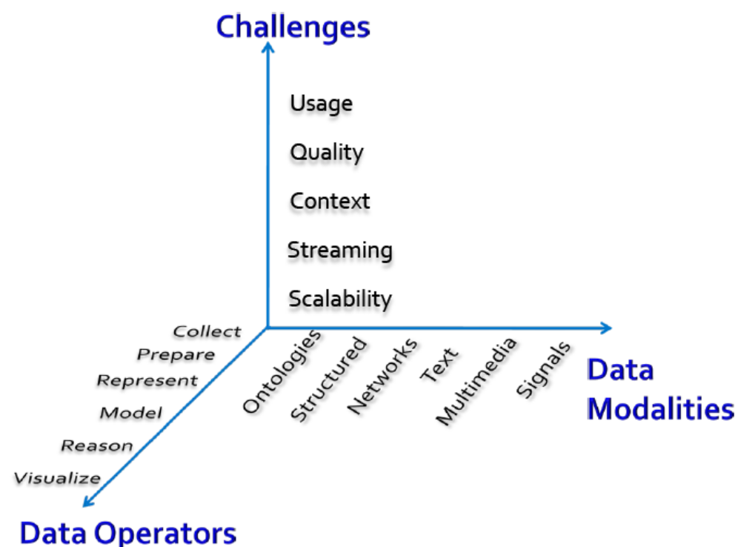
Let’s focus on big DAM
-what matters when dealing with data?

Slide 13
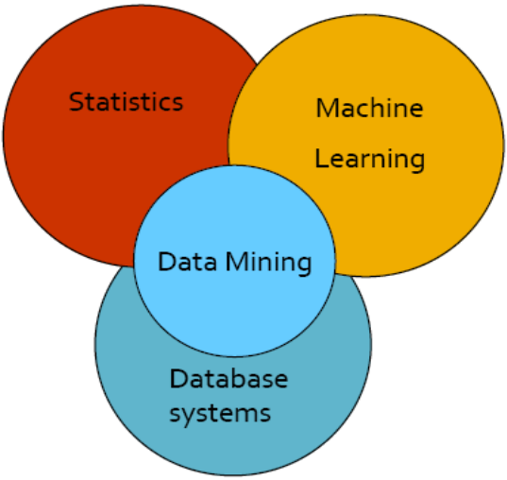
Let’s focus on big DAM
- cultures of data minging?
Data mining overlaps with: ▪
  Databases: Large-scale data, simple queries
  Machine learning: Small data, Complex models
  AI: artificial Intelligence
  CS Theory: (Randomized) Algorithms
Different cultures: ▪
  To a DB person, data mining is an extreme form of analytic processing – queries that examine large amounts of data
    Result is the query answer
  To a ML person, data-mining is the inference of models
    Result is the parameters of the model
AI

Slide 14
Let’s focus on big data mining
This class overlaps with machine learning, statistics, artificial intelligence, databases but more stress on
  Scalability (big data)
  Algorithms
  Computing architectures
  Automation for handling real big data
The required background
  Data structure and Algorithm design
  Probability and Linear algebra
  Operating System
  Java program design
AI

Slide 15

What will we learn?
We will learn to mine different types of data:
  Data is high dimensional
  Data is a graph
  Data is infinite/never-ending
  Data is labeled
We will learn to use different models of computation:
  Python
  Streams and online algorithms
  Single machine in-memory

Slide 16
What will we learn?
We will learn to solve real-world problems:
  Recommender systems
  Market Basket Analysis
  Spam detection
  Duplicate document detection
We will learn various “tools”: ▪
  Optimization (stochastic gradient descent)
  Dynamic programming (frequent itemsets)
  Hashing (LSH, Bloom filters)
  *From Dr Jure Leskovec’s slides.

Slide 17
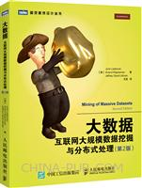

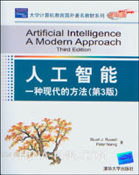
About the course
Teaching Assistants (TAs)
  Yige Zhang, 张奕格
Course Website:
  soon
Textbook:
大数据：互联网大规模数据挖掘与分布式处理（第2版）
作者：莱斯科夫Leskovec,J., 拉贾拉曼Rajaraman,A., 厄尔曼 Ullman,J.D.
译者： 王斌
丛书名： 图灵程序设计丛书
出版社：人民邮电出版社
机器学习
作者： 周志华
出版社：清华大学出版社
ISBN：9787302423287
人工智能:一种现代的方法(第3版)(影印版)
Artificial Intelligence: A Modern Approach (3rd Edition)
原出版社： Prentice Hall

Slide 18
课程内容安排-1
Week 1 | 大数据: 第三章 | Week 6
2/28 | Lect0-overview |  | Lect3-classification (Bayes)
 | Lect1-Find Similar Items | Week 7 | Lect3-classification (SVM)
3/2 | HW1 Intro |  | HW3 Upt
Week 2 | 大数据：第7章； 机器学习：第9章 | Week 7 | 大数据：第9章
 | Lect2-Clustering (basic) |  | Lect4-Recommendation
 | Lect2-Clustering (Hierarchy-KM) |  | HW4 Intro
Week 3 |  | Week 8 | 大数据：6章; Frequent pattern mining: current status and future directions
 | Lect2-Clustering(KM-EM-Density) |  | Lect5-Frequent Pattern
Week 4 |  |  | Lect5-Apriori
 | Lect2-Clustering (Evaluation-Validation) | Week 9
 | HW2 Intro |  | Lect5-FP-growth
Week 5 | 大数据：9.2.7； 机器学习：4,6,7 |  | Lect5-eclat
 | Lect3-classification (overview) |  | HW5 Intro
 | Lect3-classification (DT, RF, Bayes)
 | HW3 Intro

Slide 19
课程内容安排-2
Week 10 | AI –第3-6章 | Week 14 | AI-第13-15章, 机器：14章
 | Lect6-AI-overview |  | Lect8-Probabilistic Reasoning
 | Lect6-AI-Search | Wee15
 | Lect6-AI-Shorest Distance |  | Lect8-Reasoning over time
Week 11 |  |  | HMM
 | Lect7-AI-CSP |  | Karlman Filter
 | HW6 Intro |  | HW8 Intro
Week 12 | AI-第7-11章 | Week 16 | NN-机器：5章
 | Lect8-AI-Reason |  | Lect9-NN
 | Lect8-First-Order Logic | Week 17
 | Lect8-Inference in First-Order Logic |  | Final Project
Week 13 |  | Week18
 | Lect8-Classical Planning |  | Course Review
 | Lect8-Planning&Acting in Real World
 | HW7 Intro

Slide 20
课程主页
https://piazza.com/tongji.edu.cn/spring2017/ssedam/home

