Slide 1
Big Data Analysis and Mining
Clustering Basics
Weixiong Rao 饶卫雄
wxrao@tongji.edu.cn
2017 Fall
Some slides are borrowed from Qinpei Zhao’s lecture notes

Slide 2
Outline
Cluster Basics
Clustering algorithms
Hierarchical clustering
k-means
Expectation-Maximization (EM)
Cluster Validity
determining the number of clusters
clustering evaluation
Notes:
2

Slide 3
Clustering Analysis
Definition:
物以类聚，人以群居
Grouping the data with similar features
It’s a method of data exploration, a way of looking for patterns or structure in the data that are of interest.
Properties: unsupervised, parameter needed
Application field: Machine learning, pattern recognition, image analysis, data mining, information retrieval and bioinformatics etc.
K-means animation

Slide 4
Factors of Clustering
What data could be used in clustering?
Large or small, Gaussian or non-Gaussian, etc.
Which clustering algorithm? (cost function)
Partition-based (e.g. k-means)
Model-based (e.g. EM algorithm)
Density-based (e.g. DBSCAN)
Genetic, spectral ……
Choosing (dis)similarity measures – a critical step in clustering
Euclidean distance,…
Pearson Linear Correlation,…
How to evaluate the clustering result? (cluster validity)

Slide 5
Quality: What Is Good Clustering?
A good clustering method will produce high quality clusters with
high intra-class similarity
low inter-class similarity
The quality of a clustering result depends on both the similarity measure used by the method and its implementation
The quality of a clustering method is also measured by its ability to discover some or all of the hidden patterns

Slide 6
Requirements of clustering in data mining (1)
Scalability
Ability to deal with different types of attributes
Discovery of clusters with arbitrary shape
Minimal requirements for domain knowledge to determine input parameters

Slide 7
Requirements of clustering in data mining (2)
Ability to deal with noise and outliers
Insensitivity to order of input records
High dimensionality
Incorporation of user-specified constraints
Interpretability and usability

Slide 8
Similarity and dissimilarity
There is no single definition of similarity or dissimilarity between data objects
The definition of similarity or dissimilarity between objects depends on
the type of the data considered
what kind of similarity we are looking for

Slide 9
Similarity and dissimilarity
Similarity/dissimilarity between objects is often expressed in terms of a distance measure d(x,y)
Ideally, every distance measure should be a metric, i.e., it should satisfy the following conditions:

Slide 10
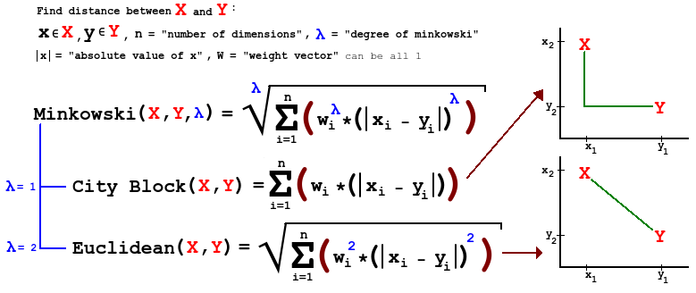
Euclidean distance
Here D is the number of dimensions in the data vector. For instance:
RGB color channel in images
Logitude and latitude in GPS data

Slide 11
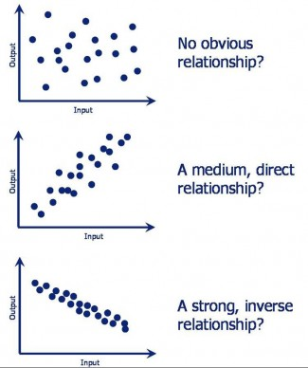
Pearson Linear Correlation
We’re shifting the expression profiles down (subtracting the means) and scaling by the standard deviations (i.e., making the data have mean = 0 and std = 1)
Always between –1 and +1 (perfectly anti-correlated and perfectly correlated)

Slide 12
Hierarchical Clustering
Produces a set of nested clusters organized as a hierarchical tree.
Can be visualized as a dendrogram
A tree-like diagram that records the sequences of merges or splits

Slide 13
Strengths of Hierarchical Clustering
No assumptions on the number of clusters
Any desired number of clusters can be obtained by ‘cutting’ the dendogram at the proper level
Hierarchical clustering may correspond to meaningful taxonomies
Example in biological sciences (e.g., phylogeny reconstruction, etc), web (e.g., product catalogs) etc.

Slide 14
Hierarchical Clustering
Two main types of hierarchical clustering
Agglomerative:
Start with the points as individual clusters
At each step, merge the closest pair of clusters until only one cluster (or k clusters) left
Divisive:
Start with one, all-inclusive cluster
At each step, split a cluster until each cluster contains a point (or there are k clusters)
Traditional hierarchical algorithms use a similarity or distance matrix
Merge or split one cluster at a time

Slide 15
Hierarchical Clustering: two types
Step 0
Step 1
Step 2
Step 3
Step 4
agglomerative
a
a b
b
a b c d e
c
c d e
d
d e
e
divisive
Step 4
Step 3
Step 2
Step 1
Step 0

Slide 16
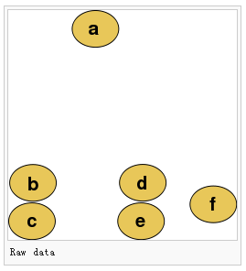
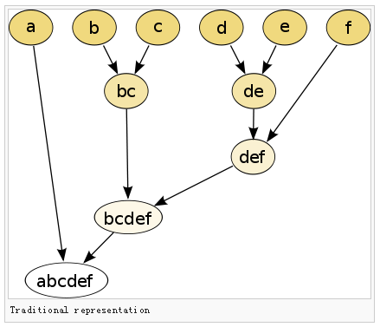
Practice?

Slide 17
Agglomerative clustering algorithm
Most popular hierarchical clustering technique
Basic algorithm
Compute the distance matrix between the input data points
Let each data point be a cluster
Repeat
Merge the two closest clusters
Update the distance matrix
Until only a single cluster remains
Key operation is the computation of the distance between two clusters
Different definitions of the distance between clusters lead to different algorithms

Slide 18
Input/ Initial setting
Start with clusters of individual points and a distance/proximity matrix
p1
p2
p3
p4
p5
. . .
p1
p2
p3
p4
p5
.
.
.
Distance/Proximity Matrix

Slide 19
Intermediate State
After some merging steps, we have some clusters
C1
C2
C3
C4
C5
C1
C2
C3
C3
C4
C4
C5
C1
Distance/Proximity Matrix
C2
C5

Slide 20
Intermediate State
Merge the two closest clusters (C2 and C5) and update the distance matrix.
C1
C2
C3
C4
C5
C1
C3
C2
C4
C3
C4
C5
C1
Distance/Proximity Matrix
C2
C5

Slide 21
After Merging
“How do we update the distance matrix?”
C2 U C5
C1
C3
C4
C3
C1
?
C4
C2 U C5
? ? ? ?
C3
?
C1
C4
?
C2 U C5

Slide 22
Distance between two clusters
Each cluster is a set of points
How do we define distance between two sets of points
Lots of alternatives
Not an easy task

Slide 23
Inter-cluster distances
Three widely used ways of defining the inter-cluster distance, i.e., the distance between two separate clusters, are
single linkage method (nearest neighbor):
complete linkage method (furthest neighbor):
average linkage method (unweighted pair-group average):

Slide 24
Distance between two clusters
Single-link distance between clusters C_{i} and C_{j} is the minimum distance between any object in C_{i} and any object in C_{j}
The distance is defined by the two most similar objects

Slide 25
Single-link clustering: example
Determined by one pair of points, i.e., by one link in the proximity graph.
1
2
3
4
5

Slide 26
Single-link clustering: example
5
1
3
5
2
1
2
3
6
4
4
Nested Clusters
Dendrogram

Slide 27
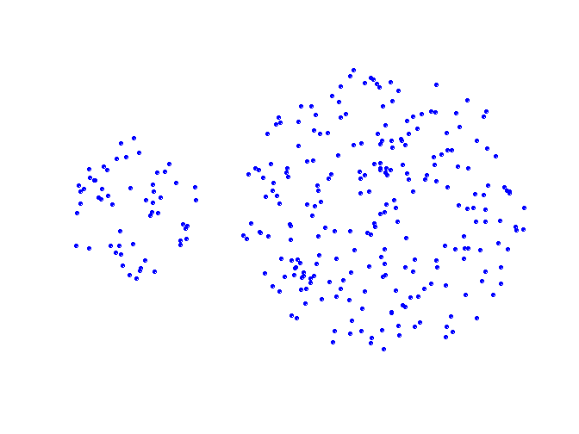
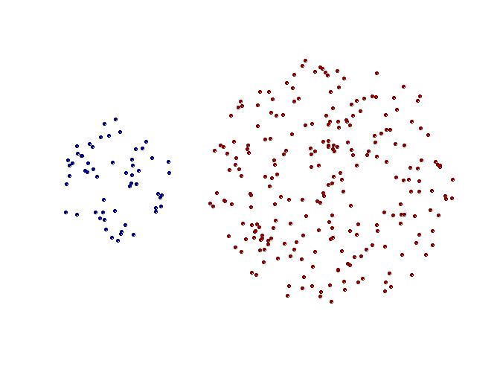
Strengths of single-link clustering
Original Points
Two Clusters
Can handle non-elliptical shapes

Slide 28
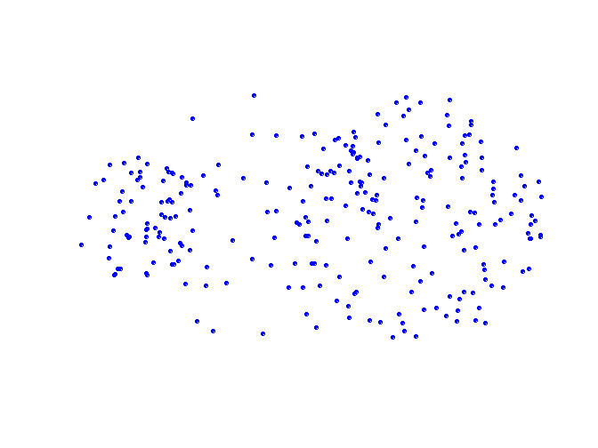
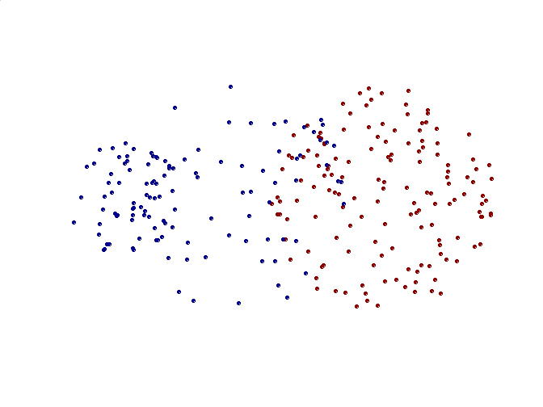
Limitations of single-link clustering
Original Points
Two Clusters
Sensitive to noise and outliers
It produces long, elongated clusters

Slide 29
Distance between two clusters
Complete-link distance between clusters C_{i} and C_{j} is the maximum distance between any object in C_{i} and any object in C_{j}
The distance is defined by the two most dissimilar objects

Slide 30
Complete-link clustering: example
Distance between clusters is determined by the two most distant points in the different clusters
1
2
3
4
5

Slide 31
Complete-link clustering: example
4
1
2
5
5
2
3
6
3
1
4
Nested Clusters
Dendrogram

Slide 32
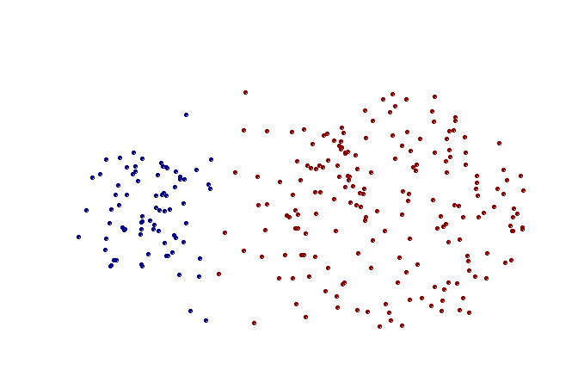
Strengths of complete-link clustering
Original Points
Two Clusters
More balanced clusters (with equal diameter)
Less susceptible to noise

Slide 33
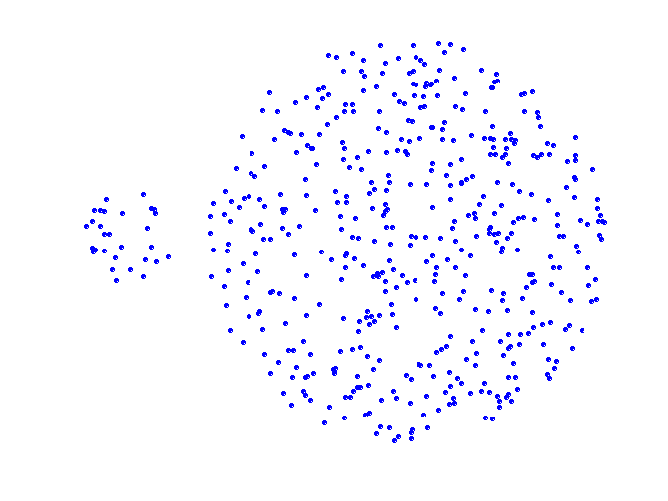
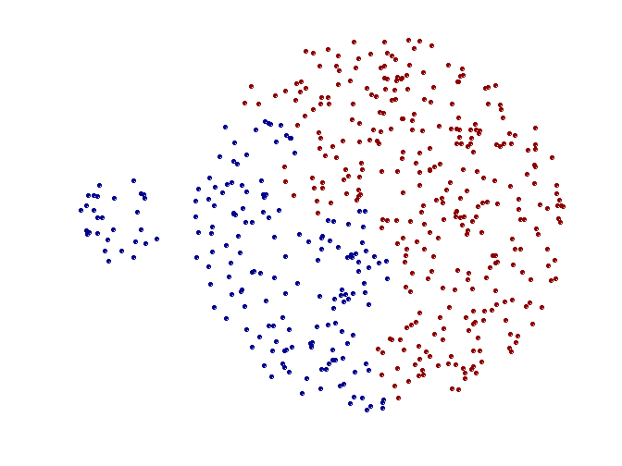
Limitations of complete-link clustering
Original Points
Two Clusters
Tends to break large clusters
All clusters tend to have the same diameter – small clusters are merged with larger ones

Slide 34
Distance between two clusters
Group average distance between clusters C_{i} and C_{j} is the average distance between any object in C_{i} and any object in C_{j}

Slide 35
Average-link clustering: example
Proximity of two clusters is the average of pairwise proximity between points in the two clusters.
1
2
3
4
5

Slide 36
Average-link clustering: example
5
4
1
2
5
2
3
6
1
4
3
Nested Clusters
Dendrogram

Slide 37
Average-link clustering: discussion
Compromise between Single and Complete Link
Strengths
Less susceptible to noise and outliers
Limitations
Biased towards globular clusters

Slide 38
Distance between two clusters
Centroid distance between clusters C_{i} and C_{j} is the distance between the centroid r_{i} of C_{i} and the centroid r_{j} of C_{j}

Slide 39
Distance between two clusters
Ward’s distance between clusters C_{i} and C_{j} is the difference between the total within cluster sum of squares for the two clusters separately, and the within cluster sum of squares resulting from merging the two clusters in cluster C_{ij}
r_{i}: centroid of C_{i}
r_{j}: centroid of C_{j}
r_{ij}: centroid of C_{ij}

Slide 40
Ward’s distance for clusters
Similar to group average and centroid distance
Less susceptible to noise and outliers
Biased towards globular clusters
Hierarchical analogue of k-means
Can be used to initialize k-means

Slide 41
Hierarchical Clustering: Comparison
5
1
4
1
3
2
5
5
5
2
1
MIN
2
MAX
2
3
6
3
3
6
1
4
4
4
5
5
1
4
1
2
2
5
2
Ward’s Method
5
2
3
6
Group Average
3
3
6
4
1
1
4
4
3

Slide 42
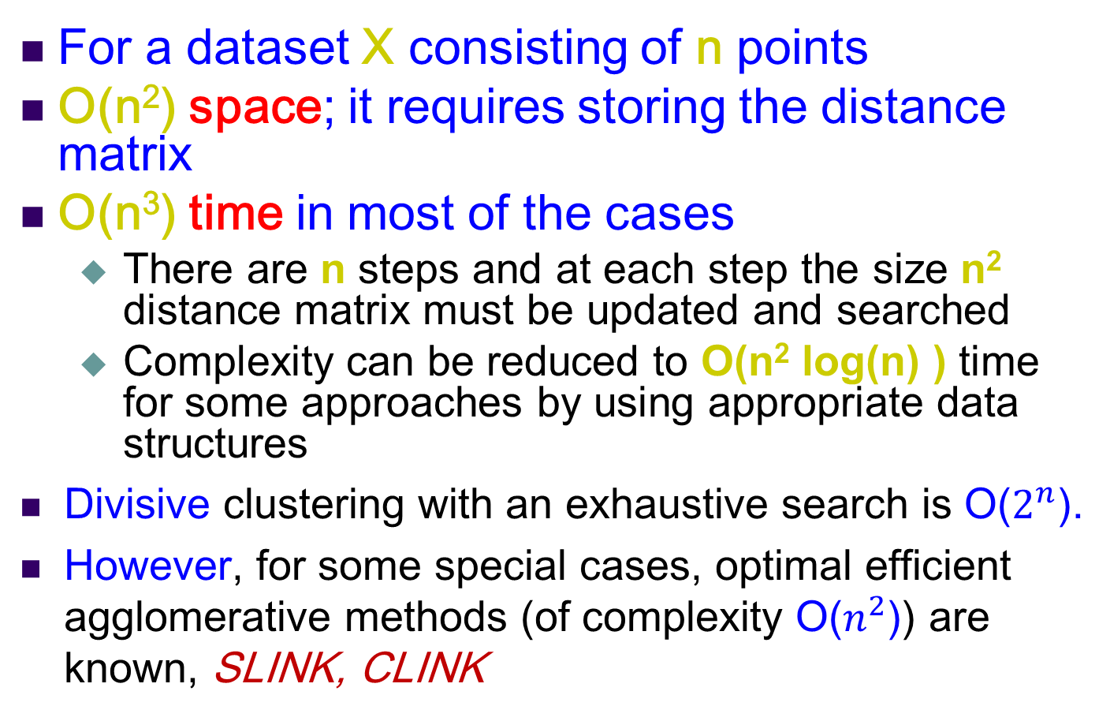
Hierarchical Clustering: Time and Space requirements
For a dataset X consisting of n points
O(n²) space; it requires storing the distance matrix
O(n³) time in most of the cases
There are n steps and at each step the size n² distance matrix must be updated and searched
Complexity can be reduced to O(n² log(n) ) time for some approaches by using appropriate data structures
Divisive clustering with an exhaustive search is O($2^{n}$).
However, for some special cases, optimal efficient agglomerative methods (of complexity O($n^{2}$)) are known, SLINK, CLINK

Slide 43
Divisive hierarchical clustering
Start with a single cluster composed of all data points
Split this into components
Continue recursively
Monothetic divisive methods split clusters using one variable/dimension at a time
Polythetic divisive methods make splits on the basis of all variables together
Any intercluster distance measure can be used
Computationally intensive, less widely used than agglomerative methods

Slide 44
Strengths of hierarchical clustering
Conceptually simple
Theoretical properties are well understood
When clusters are merged/split, the decision is permanent => the number of different alternatives that need to be examined is reduced

Slide 45
Weakness of hierarchical clustering
Merging/splitting of clusters is permanent => erroneous decisions are impossible to correct later
Divisive methods can be computational hard
Methods are not (necessarily) scalable for large data sets

Slide 46
Partitioning Algorithms
Partitioning method: Construct a partition of n documents into a set of K clusters
Given: a set of documents and the number K
Find: a partition of K clusters that optimizes the chosen partitioning criterion
Globally optimal
Intractable for many objective functions
Ergo, exhaustively enumerate all partitions
Effective heuristic methods: K-means and K-medoids algorithms

Slide 47
K-Means
Assumes documents are real-valued vectors.
Clusters based on centroids (aka the center of gravity or mean) of points in a cluster, c:
Reassignment of instances to clusters is based on distance to the current cluster centroids.
(Or one can equivalently phrase it in terms of similarities)

Slide 48
K-Means Algorithm
Select K random data {c₁, c₂ ,… c_{K}} from data {x₁, x₂ ,… x_{N}} as seeds.
Until clustering converges (or other stopping criterion):
//partitioning
For each point x_{i}:
Assign x_{i} to the cluster c_{j} such that dist(x_{i}, c_{j}) is minimal.
//Next, update the centroid of each cluster
For each cluster c_{j}
c_{j} = μ(c_{j})

Slide 49
K Means Example (K=2)
Pick seeds
Reassign clusters
Compute centroids
Reassign clusters
x
x
x
Compute centroids
x
x
x
Reassign clusters
Converged!

Slide 50
Termination conditions
Several possibilities, e.g.,
A fixed number of iterations.
data partition unchanged.
Centroid positions don’t change.
Does this mean that the data in a cluster are unchanged?

Slide 51
Convergence
Why should the K-means algorithm ever reach a fixed point?
A state in which clusters don’t change.
K-means is a special case of a general procedure known as the Expectation Maximization (EM) algorithm.
EM is known to converge.
Number of iterations could be large.
But in practice usually isn’t

Slide 52
Time Complexity
Computing distance between two data points is O(D) where D is the dimensionality of the vectors.
Reassigning clusters: O(KN) distance computations, or O(KNM).
Computing centroids: Each doc gets added once to some centroid: O(NM).
Assume these two steps are each done once for I iterations: O(IKNM).

Slide 53
Reference
Software for clustering: http://bonsai.hgc.jp/~mdehoon/software/cluster/
Wikipedia: https://en.wikipedia.org/wiki/Hierarchical_clustering

