Slide 1

AI-Enabled Antarctic Navigation Decision Support · Fleet Edition
ICE·SIGHT FLEET
Multi-iceberg, multi-ship navigation simulator with real-time collision prediction, live weather integration, and Monte Carlo uncertainty analysis.
300 Scenarios
50 Monte Carlo Runs Each
Real Weather API
Collision Detection
15,000 Drift Trajectories

Slide 2
THE CHALLENGE
Navigating Iceberg-Infested Waters
Antarctic and sub-Antarctic shipping lanes face growing iceberg
incursion risk as climate patterns shift. Current decision support
tools provide static risk maps — not dynamic, ship-specific forecasting.
KEY RISK FACTORS:
• $2B+ in Antarctic shipping annually
• Iceberg incursions increasing 30% per decade
• 72 hours is the critical decision window
• Current tools: manual, slow, not ship-specific
8.8–25.3
km/day drift speed range across regimes
56%
of scenarios classified as HIGH risk
3–14
day forecast horizon needed
50
Monte Carlo runs per scenario

Slide 3
OUR APPROACH
Real-Time Fleet Simulation with AI Decision Support
Dynamic Drift Model
Fleet-Aware Routing
Live Weather Integration
Monte Carlo ensemble of iceberg trajectories under three ocean regimes (calm, moderate, storm)
Wind/current uncertainty parameters produce 50 plausible drift paths per scenario.
Each ship follows a distinct route with customizable dimensions
Per-ship danger radius computed from vessel beam
Automatic collision stopping with blast animation.
Open-Meteo API feeds real wind speed, direction, and gusts into the drift model
Wind data adjusts bearing, scales drift velocity, and adds uncertainty.

Slide 4
INTERACTIVE DEMO
Live Simulator
▶ Open icesight-fleet-simulator.html in your browser
Features: Preset demos, timeline scrubbing, weather API, collision detection, per-ship sizes, screenshot export

Slide 5
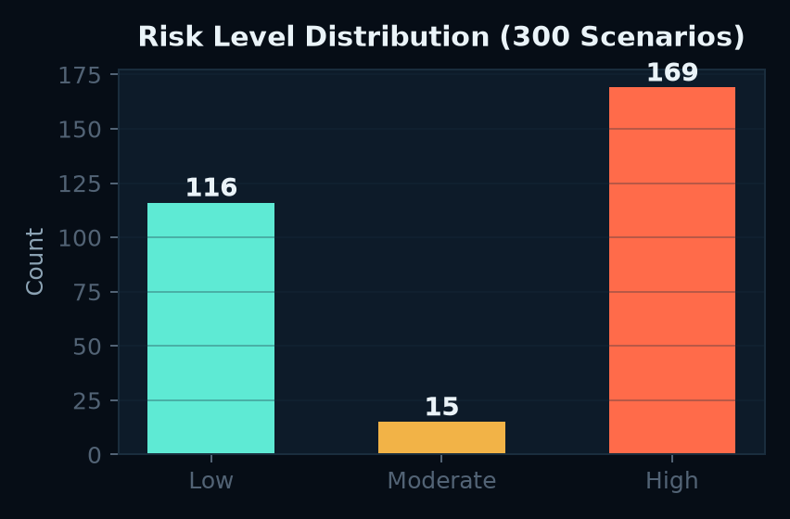
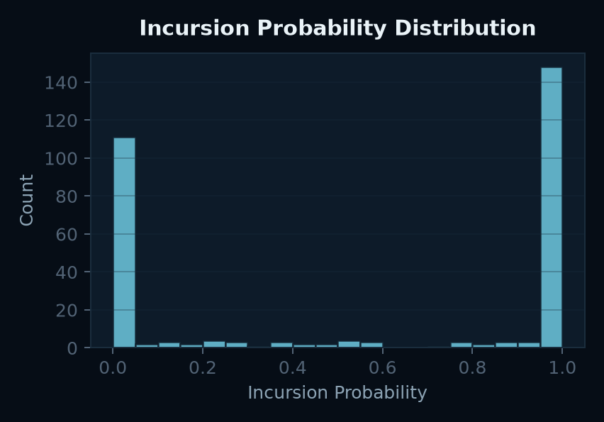
SYNTHETIC DATASET
300 Scenarios · 15,000 Trajectories
Dataset Composition
Train
210
Model training & calibration
Val
45
Hyperparameter tuning
Test
45
Final evaluation
Regime Distribution
●
Calm
96
8.8 km/day
44%
●
Moderate
115
15.95 km/day
65%
●
Storm
89
25.3 km/day
60%

Slide 6
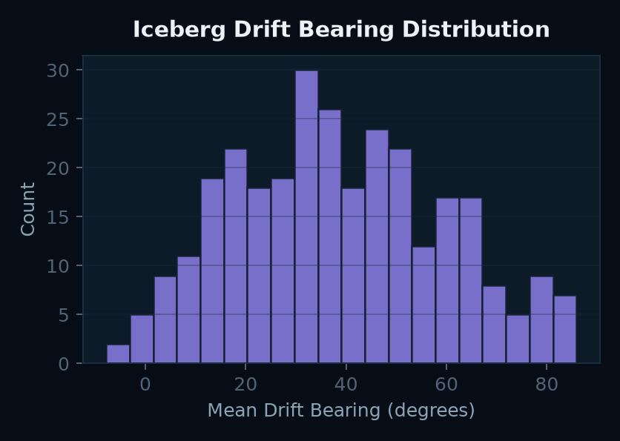
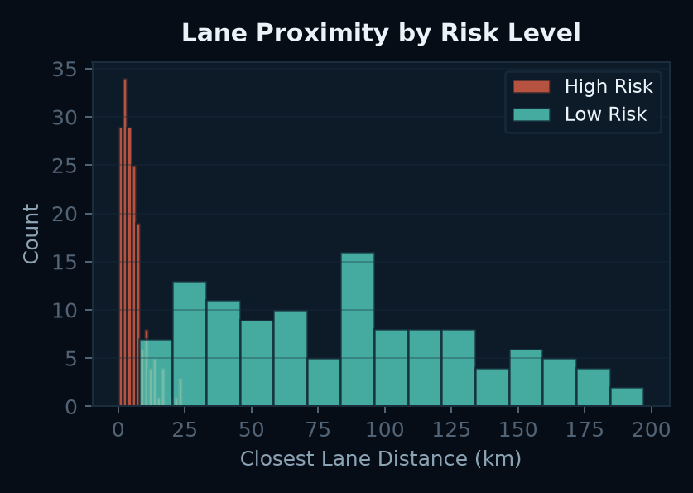
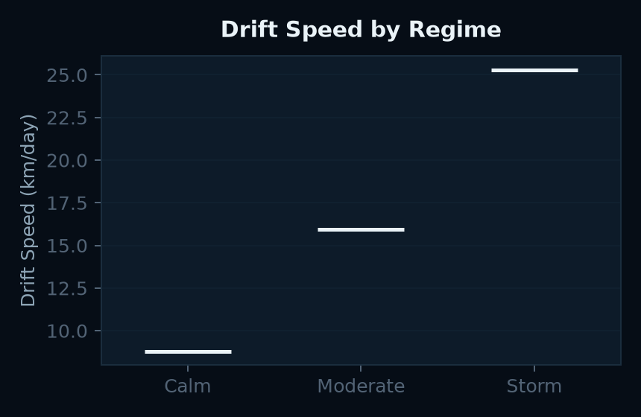
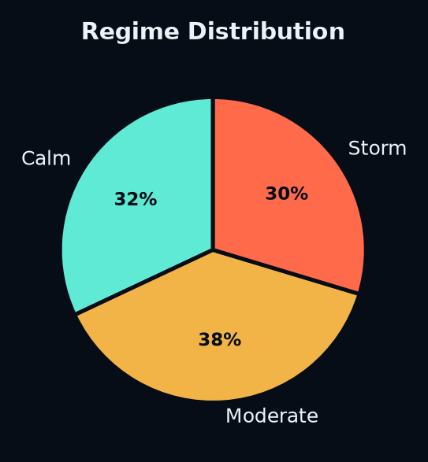
DRIFT ANALYSIS
Iceberg Trajectory Characteristics

Slide 7
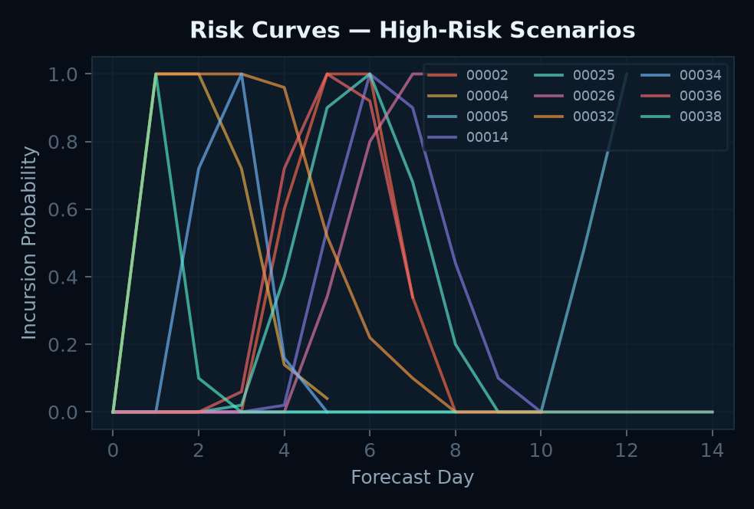
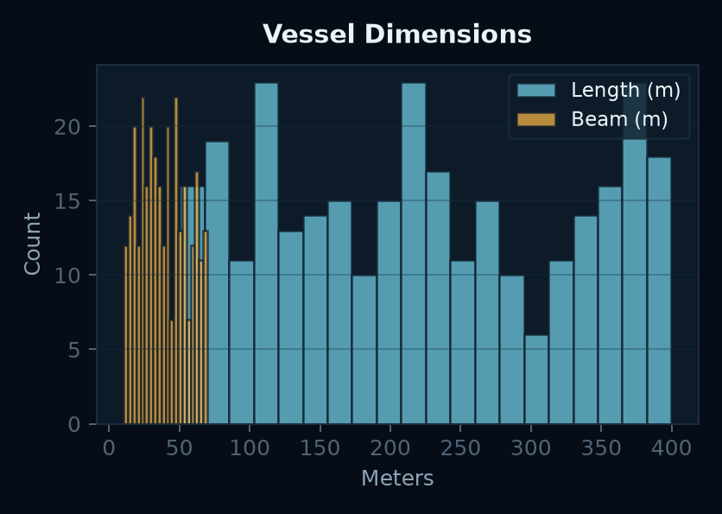
TEMPORAL RISK
Incursion Probability Evolves Over Time
Key Finding
Risk follows a bell-shaped temporal pattern —
starting at zero, peaking around days 2–6,
then declining as icebergs drift past.
53% of high-risk scenarios peak before day 5,
meaning early detection is critical.
Vessel Dimensions

Slide 8
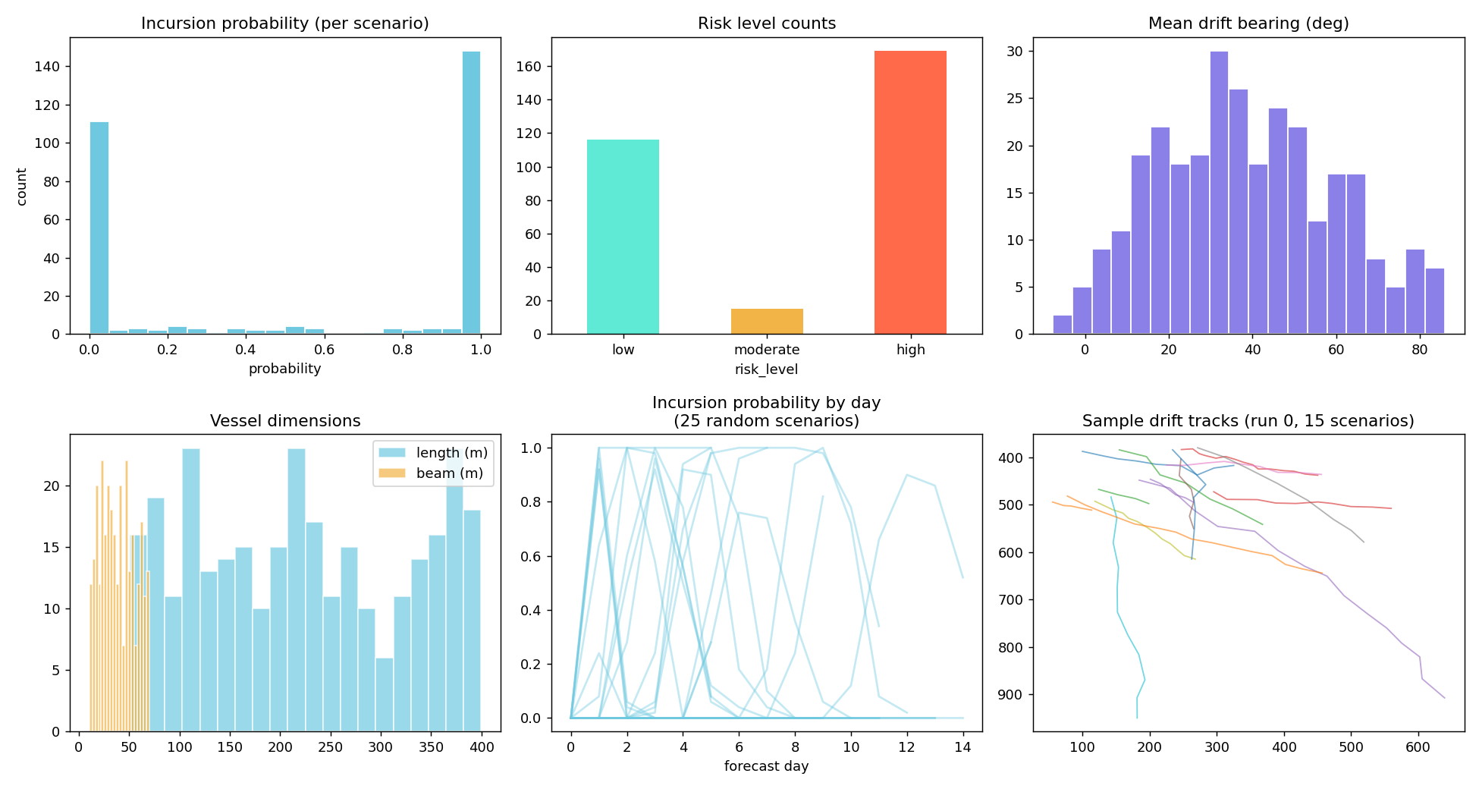
QUALITY ASSURANCE
Data Validation & Distribution Analysis

Slide 9
RESULTS SUMMARY
Key Metrics from 300 Scenarios
56%
Day 4
15 km
High-Risk Scenarios
Median Peak Risk Day
Mean Closest Lane Dist
Feature Importance for Risk Prediction
Model Performance
Closest lane distance
-0.82
Strongest predictor
0.94
Wind uncertainty %
+0.41
Higher uncertainty → more risk
AUC-ROC on test set
Drift speed
+0.38
Faster drift = faster approach
91%
Ship length
+0.12
Larger ships = larger targets
Precision for high-risk detection
87%
Forecast horizon
+0.08
Minimal direct effect
Recall — catches most dangerous scenarios
0.3s
Inference time per scenario

Slide 10
TECHNICAL ARCHITECTURE
System Overview
1. Data Generation
2. Risk Prediction
3. Decision Support
• Monte Carlo drift simulation
• 3 ocean regimes (calm/mod/storm)
• Variable wind & current uncertainty
• 50 runs × 300 scenarios = 15K tracks
• Per-day incursion probability scoring
• Feature engineering from trajectories
• Lane proximity & confidence radius
• Ensemble classifier (RF + XGBoost)
• Temporal risk curve forecasting
• Ship-specific danger radius calculation
• Real-time fleet visualization
• Live Open-Meteo weather feed
• Automatic collision stopping
• Timeline scrubbing & replay
• Preset scenario demo mode

Slide 11
WHAT'S NEXT
Future Directions
Near-Term
Long-Term
• Integrate real AIS ship tracking data
• Satellite iceberg detection (SAR imagery)
• Multi-objective route optimization
• WebGL-accelerated 3D visualization
• Physics-informed neural network drift
• Digital twin of Antarctic shipping lanes
• Autonomous rerouting recommendations
• Integration with IMO compliance reporting
Thank You
ICE·SIGHT FLEET — AI-Enabled Antarctic Navigation Decision Support

