Slide 1

WELCOME
TOPIC
End
Points
Example
Types
Definition
CONSTRUCTOR

Slide 2

Example
Definition
End
Types
Points
CONSTRUCTOR
is a special method
whose main purpose
is to initialize object

Slide 3



POINT
POINT
POINT
1
2
3
Constructor
Constructor
Constructor
End
Example
Types
Definition
will be executed automatically whenever we create an object
Points
name should be same as the class name
does not have any return type

Slide 4
POINT
POINT
POINT
4
5
6
Default constructor
Multiple Constructor
End
Constructors
Definition
Example
Types
Points
is created implicitly when there is no constructor in class
will be executed only once for one object
with the same number and same type of parameters are invalid

Slide 5
POINT
POINT
POINT
7
8
9
Constructor
We can define
Constructor
End
Example
Types
Definition
can have access modifiers but not non access modifiers
can be overloaded but can not be overridden
Points
Any number of constructers in a class

Slide 6
End
Definition
Example
Types
Points
NO-ARG
CONSTRUCTOR
PARAMETERIZED
CONSTRUCTOR
constructer
constructor
that does not have any parameter
that has a specific number of parameters

Slide 7
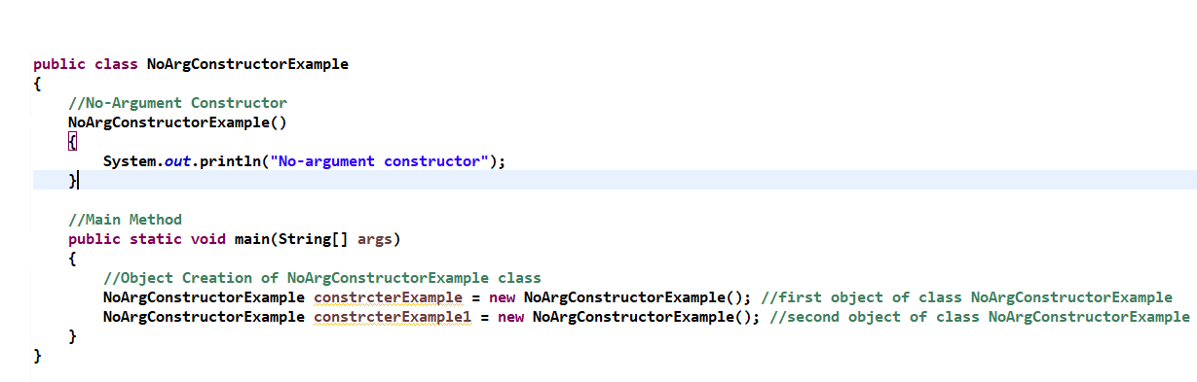
Points
End
Example
Definition
Types

Slide 8
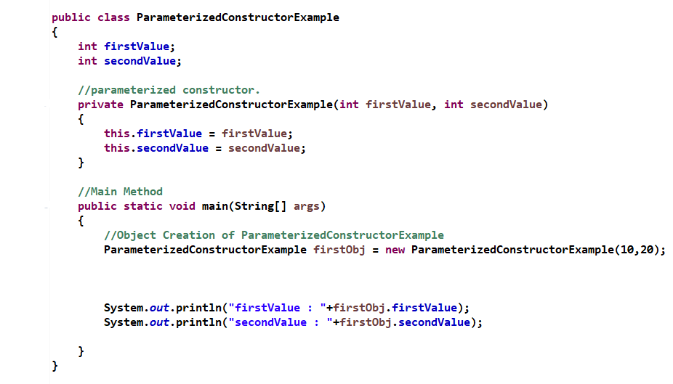
End
Example
Types
Points
Definition

Slide 9

End
Definition
Example
Types
Points

