Slide 1
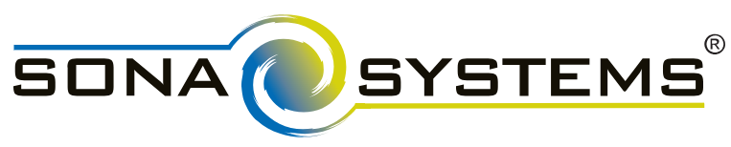
Psychology 101
SONA Research requirements
& access
John D. Medaglia, Ph.D.
Associate Professor
Applied Cognitive & Brain Sciences
Department of Psychology
Drexel University www.johnmedaglia.com
E-Mail: John.D.Medaglia@Drexel.edu

Slide 2
Course & Policy Requirements
Part of understanding Psychology can only occur via firsthand experience in experiments!
Required: to obtain full credit for participation (10% of your course score), you must be enrolled in 6 Sona credits (3 participation hours total) during the quarter.
I will allow up to 4 additional Sona credits for extra credit 2 participation hours total).

Slide 3
Accessing SONA Systems
Direct link to instructions for accessing the SONA system.
General policies and procedures.

