Slide 1

Engineering Excellence Cycle VIII Team EETeamJ1 – Hadoop Data Lake
Final Presentation
Notes:
Movie Lens Data description

Slide 2
Team
Shirish Bhale (Owner)
Devendra Singh Parmar (Evaluator)
Mohammed Sadique Khan (Mentor)
Preeti Jain (Mentor)
Shashwat Sharma (Ops/Dev)
Ravi Bhardwaj (QA/Ops)
Rupika Mahajan (Dev/Ops)
Pradeep Chand Nailwal (Dev/Ops)
Sudesh Shettigar (Ops/Dev)
Santosh Kumar Jha (Dev/Ops)
Deepti Agrawal (Dev/Ops)
Om Prakash Soni (Dev/Ops)
Sanchita Mishra (Dev/Ops)
Gagandeep Singh Panesar (Dev/Ops)
Abhishek Parihar (QA/Ops)
Dilip Dave (QA/Ops)

Slide 3
Agenda
Case Study Highlights
Deliverables
Hadoop Data Lake Capabilities
Movie Lens Use Cases
Tools & Technologies
Architecture View
Cluster Demonstration
Use Case Walkthrough
QA Highlights
Project Metrics
Scrum Tool
Challenges
Processes
Collective Learning

Slide 4
Case Study Highlights
As part of this case study, team has set up a hadoop data lake and implemented hadoop, hive and spark use cases. The team developed reference use cases using below technologies:
Apache Hadoop/YARN
PIG
Hive
Apache Spark
Ranger
Nagios
ELK

Slide 5
Deliverables
Solution architecture for setting up cluster
Reference use case source code
Use case document with queries
Hive document
Azkaban document
Oozie document
Notes:
Monitoring reports to be looked into

Slide 6
Deliverables
Monitoring configurations and reports
Installation documents
Enable HA
Nagios
Scrum sheet
Test plan
Test cases doc
Monitoring reports
Benchmarking reports

Slide 7
Tools & Technologies
Context | Tools | Technology
Cluster Deployment | Ambari (2.2.2.0) | HDP (2.4.2.0), Spark (1.6.x.2.4), Hive (1.2.1.2.4), PIG (0.15.0.2.4), JAVA (1.8)
SCRUM | Agile Scrum Sheet
Repository Management | Git
Document Designing | Microsoft Word, PowerPoint, www.draw.io
Security Management |  | Kerberos(1.10.3-10), Ranger(0.5.0.2.4)
Workflow Management | Oozie (4.2.0.2.4), Azkaban (2.5.0)
Monitoring | Nagios (4.1.1)
Logging | ELK Stack (Elastic search 2.2, Logstash 2.2 and Kibana 4.4 )

Slide 8
Hadoop Data Lake Capabilities
Facilitates the data management in various structural forms, usually object blobs or files.
Process raw data & push refined or transformed data for further analytics.
Publish analysed data back into the data lake to share with the larger community.
Offers the necessary interface, manage and monitor hadoop clusters using Ambari & Nagios.
Provides authentication, authorization, accounting and data protection.
Capable of handling job scheduler and job tracker to keep the jobs running smoothly.
Dynamically scales processing capabilities to meet business goals.

Slide 9
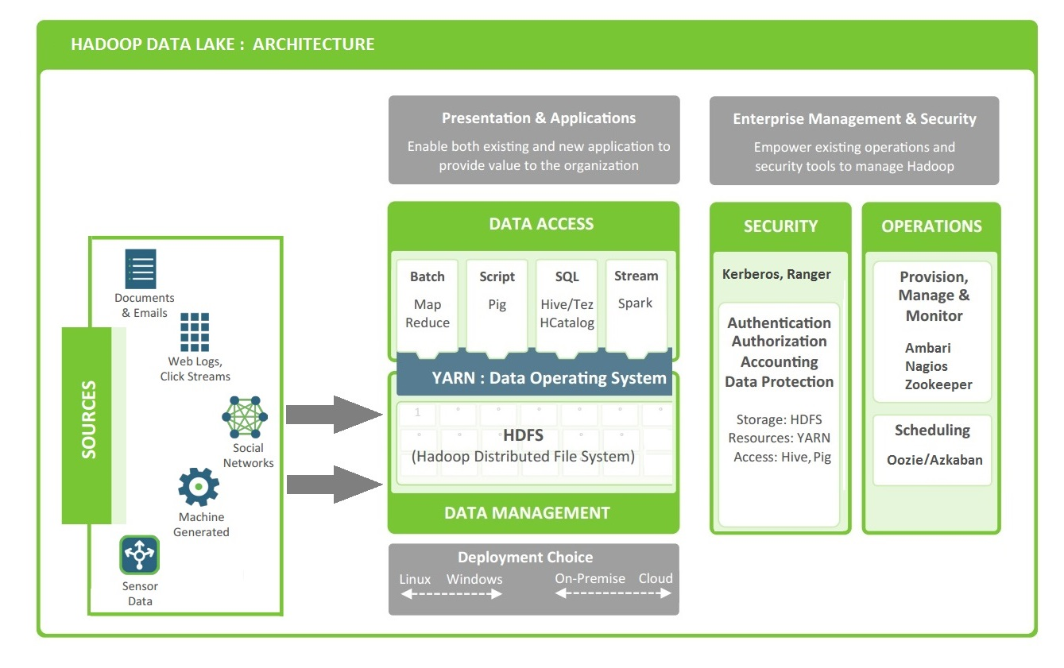
Architecture View

Slide 10
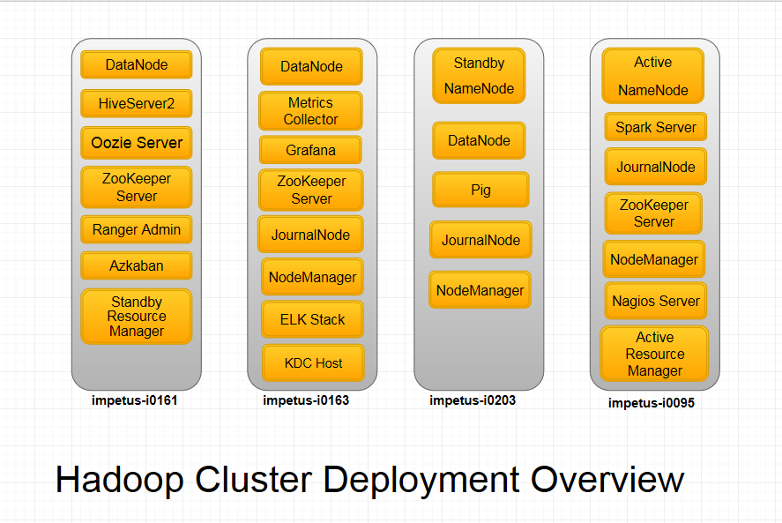
Deployment Diagram (Host and Components in cluster)

Slide 11
Cluster Demonstration
Dashboard

Slide 12
Movie Lens Use Cases
As part of this case study we have implemented below use cases on Movie lens data
List all the movies and the number of ratings.
List all the users and the number of ratings they have done for a movie.
List all the movie IDs which have been rated (movie ID with at least one user rating it).
List all the users who have rated the movies (users who have rated at least one movie).
List of all the user with the max, min, average ratings they have given against any movie.
List all the movies with the max, min, average ratings given by any user.

Slide 13
Use Cases Walkthrough

Slide 14
QA Highlights
QA Highlights
QA was part of requirement understanding discussions, application flow creation.
Setting up of cluster and various components within the cluster
Creating test cases for all use cases
Test Plan
Covering major type of testing
Strategy for every testing type
Defined Entry/Exit criteria
QA policy and test schedule

Slide 15
QA Highlights
Total test cases : 156
Total defects/issues found : 05

Slide 16
Test Cases Execution Summary (All Sprints)

Slide 17
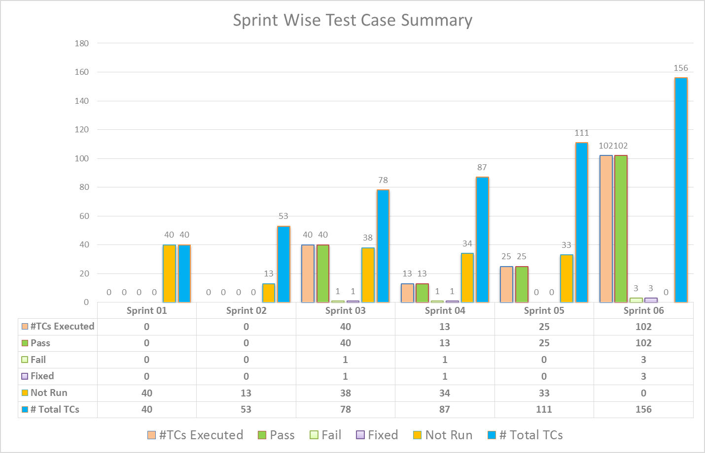
Test Cases Execution Summary (All Sprints)

Slide 18
Project Metrics
Total sprints = 06
User stories = 60
Average sprint velocity =40

Slide 19
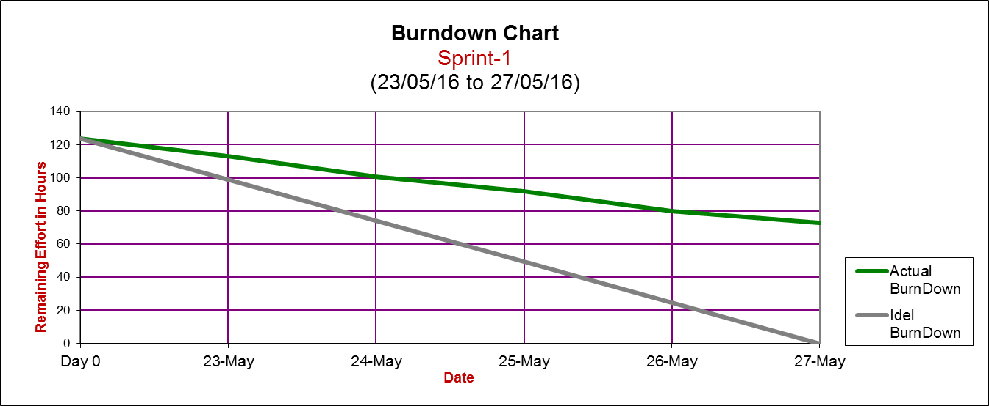
Agile Scrum Sheet- Sprint-1

Slide 20
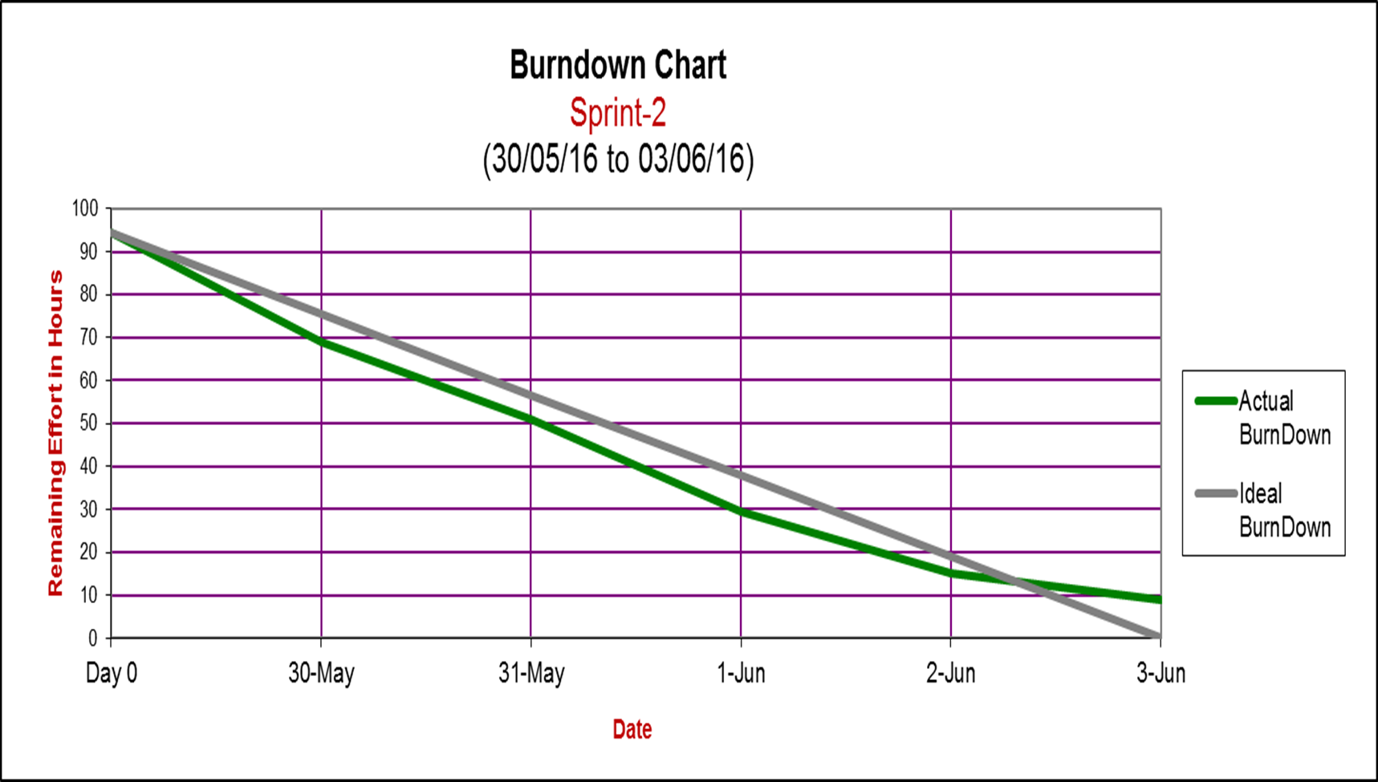
Agile Scrum Sheet- Sprint-2

Slide 21
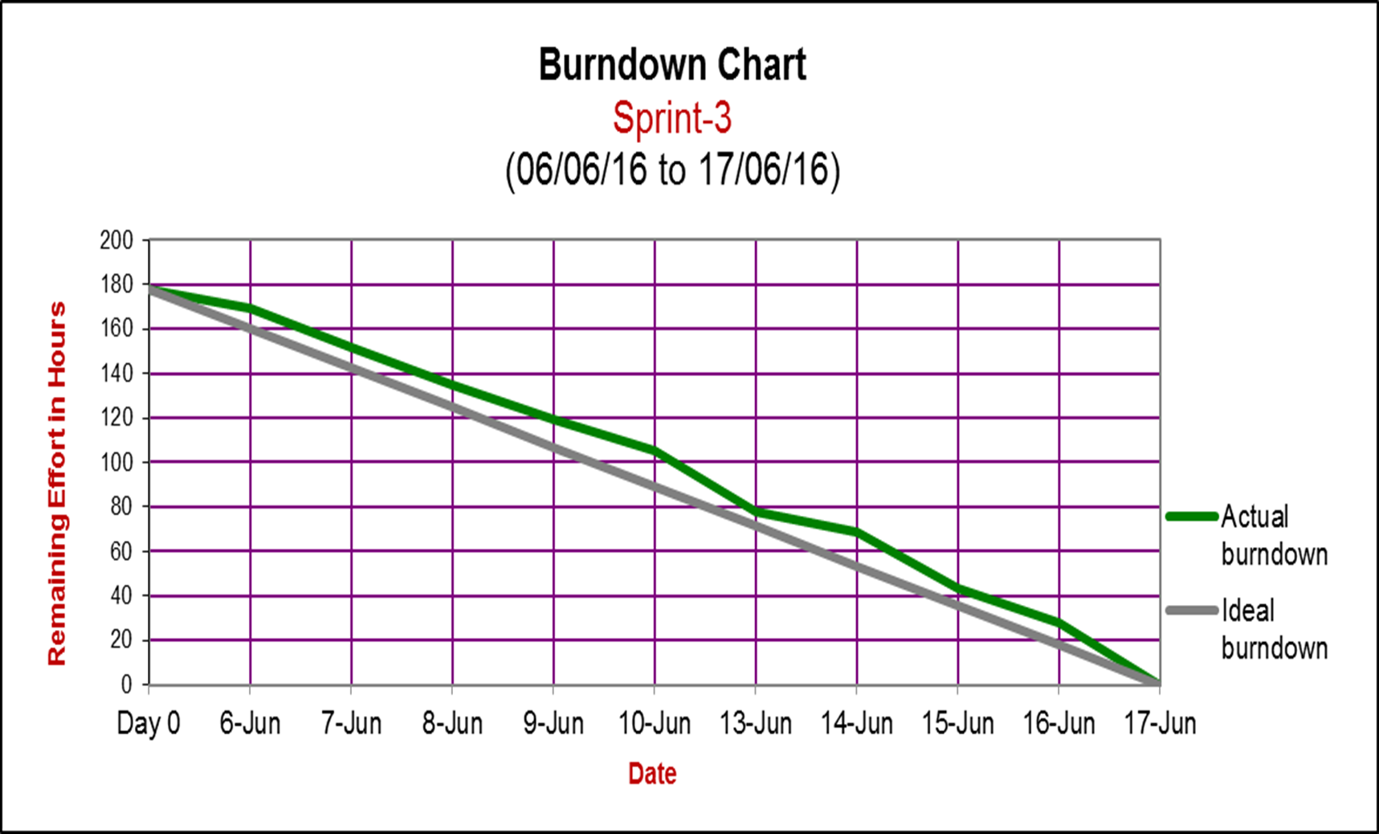
Agile Scrum Sheet- Sprint-3

Slide 22
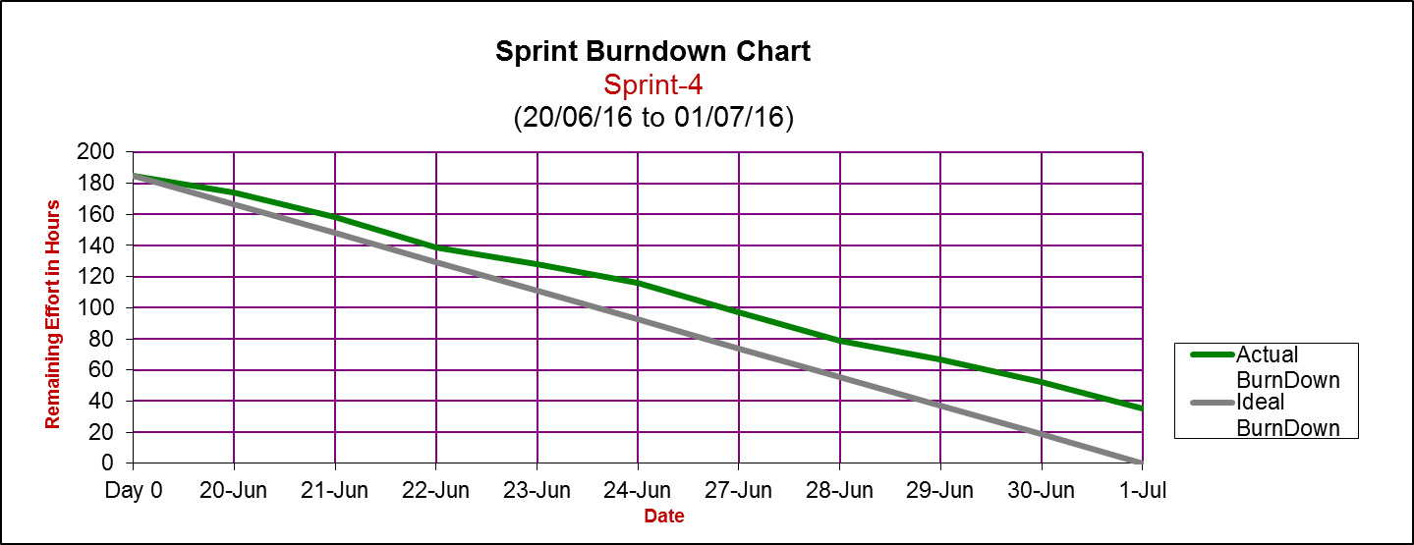
Agile Scrum Sheet- Sprint-4

Slide 23
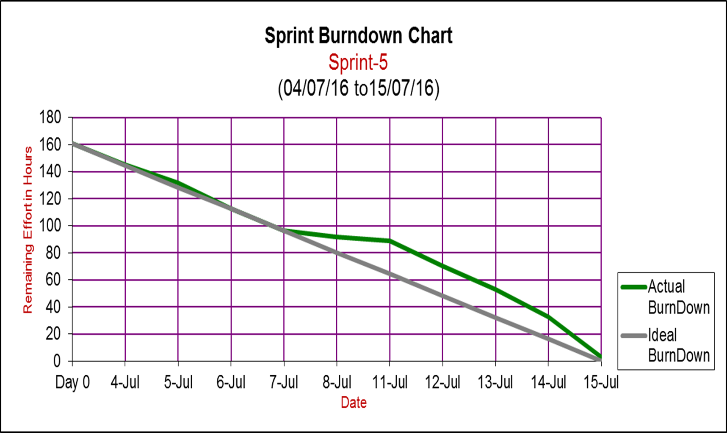
Agile Scrum Sheet- Sprint-5

Slide 24
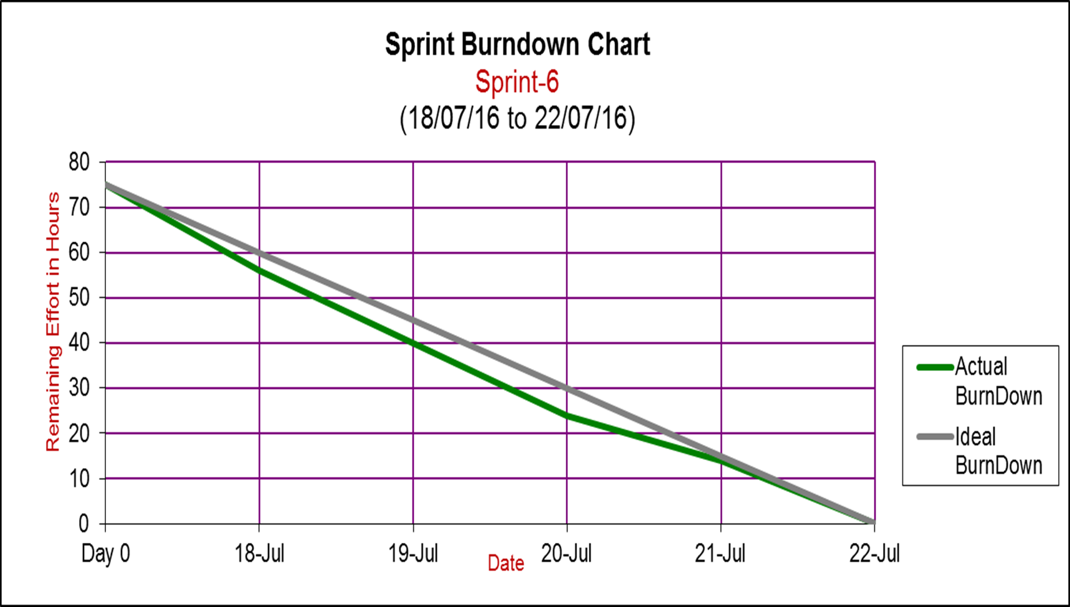
Agile Scrum Sheet- Sprint-6

Slide 25
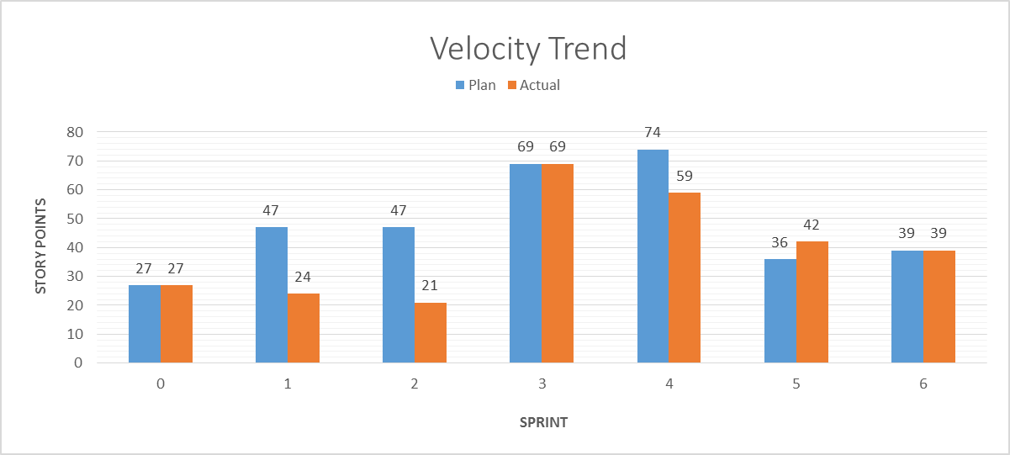
Velocity Trend

Slide 26
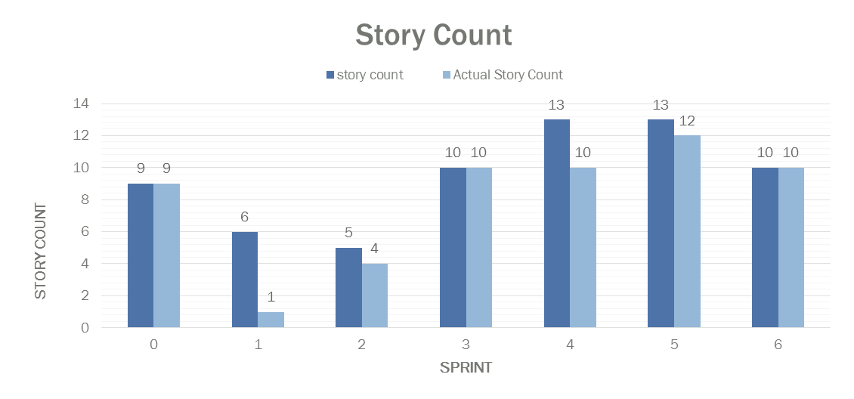
User Stories Worked v/s Completed Per Sprint

Slide 27
Challenges
Coordinating with team members from different locations.
In understanding the agile process rules and scrum sheet filling.
Estimation, story sizing and requirement analysis
Could not estimate properly due to lack of domain understanding.
New Technologies like
Big Data, Hadoop
Hive, Spark , PIG etc.
User story spill over problems
Time Management and setting priority accordingly between Project work & Case study.
Resource management

Slide 28
Challenges contd..
Environment issues
Disk failures
Configuration challenges
Enabling/Disabling Kerberos on cluster
Data challenges
Version compatibility issue between various components
Effective cluster resource management

Slide 29
Processes
Daily stand up calls
Daily update of scrum sheet
Internal demos with team and mentors
Weekly evaluations
Sprint planning & Retrospective meetings
Review demo with owner
Acceptance demo with owner

Slide 30
Collective Learning
Working with members from different locations
Learning new set of technologies
Followed agile methodology
Using SCRUM process– scrum tracker sheet
Significance of updating the scrum sheet regularly
Big data testing
Managing tasks while working on multiple projects

Slide 31
Gratitude
We would like to thank Preeti Jain and Mohammad Sadique Khan for their continuous guidance, taking out time every day to attend our calls, closely examining and providing feedback
We would also like to thank Devendra Singh Parmar and Shirish Bhale for keeping close eye on the progress of our case study by weekly evaluations and providing valuable feedbacks.
Thank you Mustufa Batterywala for helping us for final evaluation in the absence of Shirish Bhale.
Thank you all for letting us know where we lacked and for keeping us aligned in right direction.

Slide 32
Thank You

