Slide 1


Slide 2
Engineering Excellence – J1
Hadoop Cluster Setup
08: Sprint Review meeting : 07/15/2016
SPRINT 5 (July 04– July 15)

Slide 3
Last Week’s Action Items
MOM Point | Status (Done/In progress)
Follow up with Ravi for the test strategy demo | Done
Be ready to take the ownership if Ravi is not available for the test case demo | In progress (Ravi to demo on Wednesday)
Prepare bench marking test cases document | Done
QA need to prepare additional queries for the testing of data | In progress (Ravi to demo on Wednesday)

Slide 4
Team Status (Sprint 5)
Sprint 5 (Task status)
Sprint 5 (Burn down chart)
Sprint 5 (Velocity)
Sprint 5 (Goals/Demos)

Slide 5
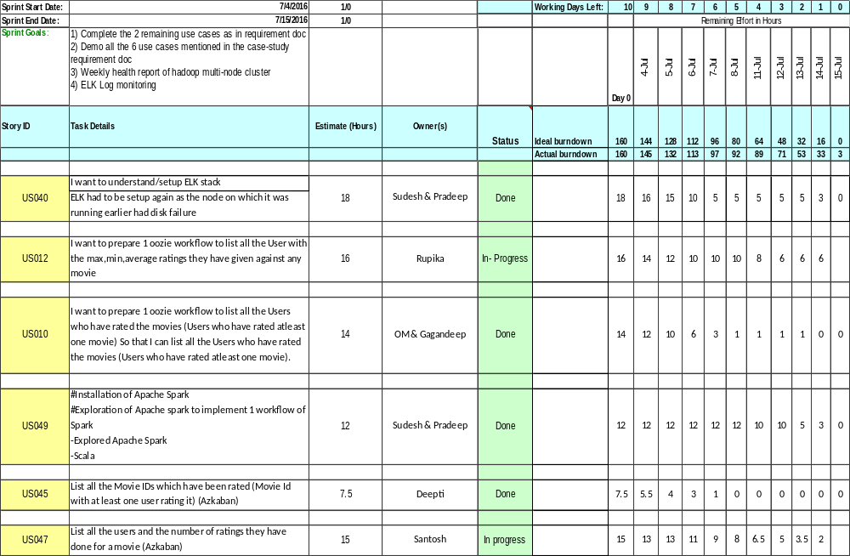
Task Status

Slide 6
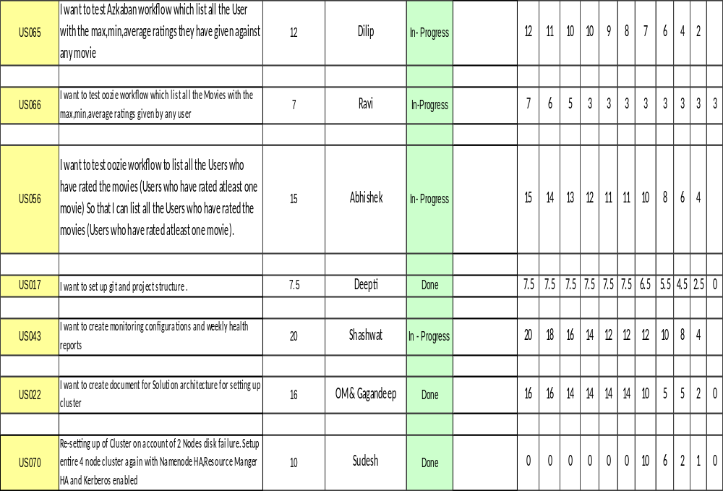

Slide 7
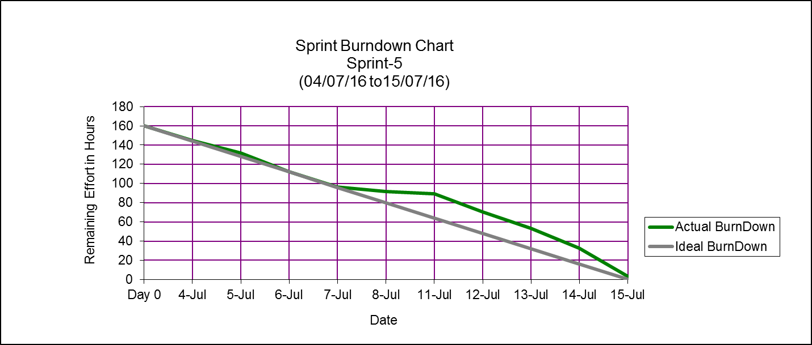
Burn Down Chart

Slide 8
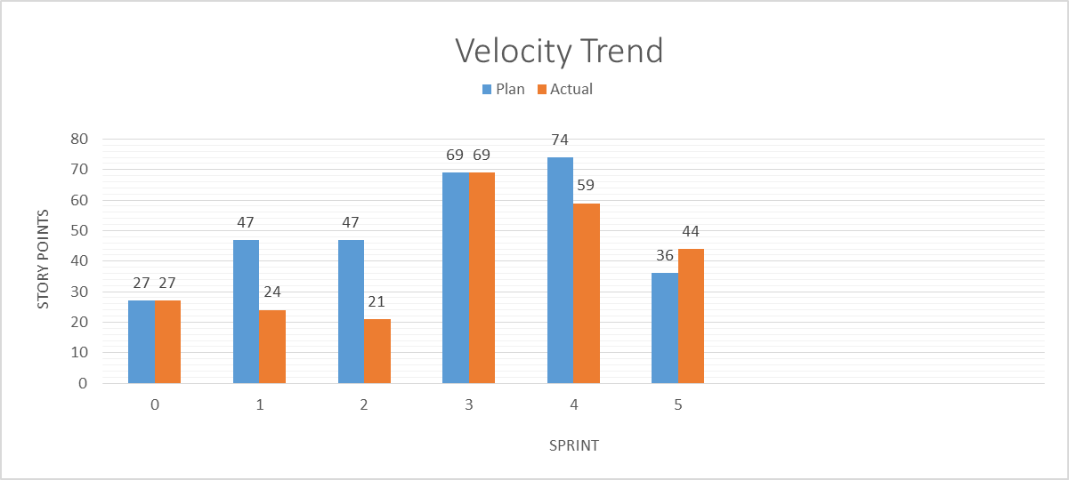
Team Velocity

Slide 9
Thanks

