Slide 1

Silicon Valley Failure and What should Banks Do to prevent this

Slide 2
Agenda
Silicon Bank Information
Stock Performance of SV
Unrelized Gains of SV
Assets of SV
Liabilities
Deposits
Simulation
Conclusion

Slide 3


Silicon Bank Information

Slide 4
Silicon Bank Information
Silicon Valley Bank (SVB) is a commercial bank division of First Citizens BancShares. The bank was previously the primary subsidiary of SVB Financial Group, a publicly traded bank holding company that had offices in 15 U.S. states and over a dozen international jurisdictions.^{[7][8][9]}
As a regional bank in the San Francisco Bay Area, SVB offers services specifically designed to meet the needs of the tech industry, and soon became the largest bank by deposits in Silicon Valley and the preferred bank of almost half of all venture-backed tech startups.^{[10][11]} In March 2023, after central bank–endorsed interest rate hikes during the 2021–2023 inflation surge,^{[12][13][14][15]} there was a bank run on its deposits, which led to its collapse and seizure on March 10, 2023 by the California Department of Financial Protection and Innovation (DFPI), its regulator.[
Source: Wikipedia

Slide 5
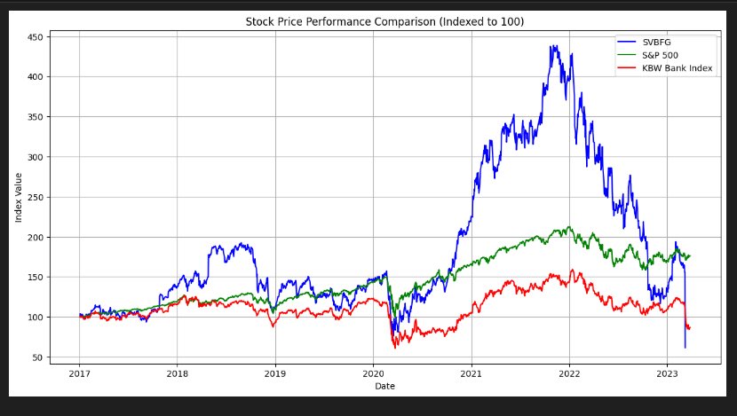
Stock Performance of SV
Not much as a Valley right ?
Source: The Fed - Evolution of Silicon Valley Bank (federalreserve.gov).

Slide 6
Stock Performance of SV
Rapid Growth and High Volatility: SVBFG's stock shows a pronounced upward trajectory, especially noticeable in the middle of the graph where it significantly outperforms both the S&P 500 and the KBW Bank Index. This indicates a period of robust growth.
Relative Performance: Post its peak, SVBFG's stock shows substantial volatility and a steep decline towards the end of the graph. This suggests that the bank faced significant challenges which negatively impacted its stock performance.
Market Comparison: Throughout most of the timeline, SVBFG performed better than the KBW Bank Index and even the broader S&P 500, until the decline. This decline could be pivotal in understanding specific risk factors or events that led to underperformance.
Broader Context
The visualization suggests that while SVB had periods of exceptional growth, it also experienced significant volatility and risk, which ultimately led to sharp declines. The outperformance followed by a rapid downfall could indicate exposure to high-risk assets or strategies, sensitivity to market or interest rate changes, or sector-specific downturns affecting its primary customer base

Slide 7
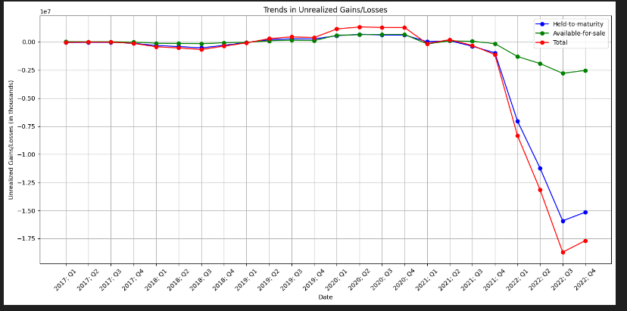
Unrelized Gains of SV
Observation
Significant Losses
Volatility in Available-for-Sale
Total Unrealized Gains/Losses
Implications
Risk Exposure
Asset Management
Source: The Fed - Evolution of Silicon Valley Bank (federalreserve.gov)

Slide 8
Significant Losses: There are periods of significant losses, especially in the "Held-to-maturity" securities, which show very large drops. These are likely due to depreciations in the market values of these investments, possibly exacerbated by rising interest rates or adverse market conditions.
Volatility in Available-for-Sale: The "Available-for-sale" category shows more variability, with both gains and losses, reflecting active management and the ability to respond to market conditions more flexibly.
Total Unrealized Gains/Losses: The total unrealized gains and losses fluctuate significantly, indicating periods of financial stress. The deepest declines align with major downturns in the "Held-to-maturity" investments.
Implications:
Risk Exposure: The data suggests that SVB was significantly exposed to risks associated with interest rate changes or market downturns, particularly through its held-to-maturity investments. This could have impacted liquidity, as these losses would affect the overall balance sheet health.
Asset Management: While the "Available-for-sale" category provided some buffer through its gains, it wasn’t sufficient to offset the losses from the held-to-maturity securities.

Slide 9
Conclusions for Unreliazed Gains
The severe unrealized losses in the held-to-maturity category highlight a critical vulnerability in SVB's asset management strategy, especially concerning interest rate sensitivity and market volatility. These findings suggest that managing such risks through diversified investments and hedging strategies might be crucial for other banks to avoid similar pitfalls.

Slide 10
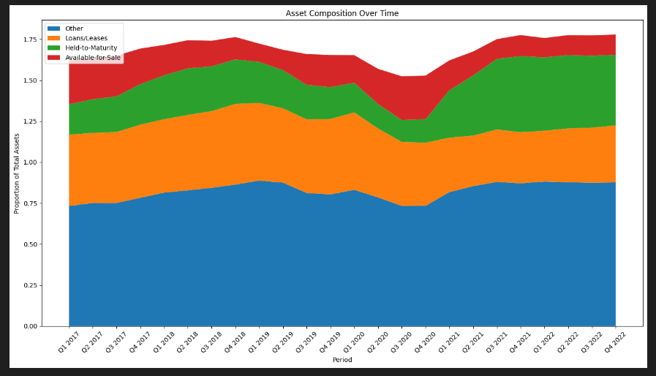
Assets of SV
Source: The Fed - Evolution of Silicon Valley Bank (federalreserve.gov)

Slide 11
Assets of SV
Asset Composition Over Time
The stacked area plot above illustrates how SVB's asset distribution changed over time across different categories relative to total assets. Here are the key observations:
Other: This category, although not specifically defined, consistently represents a significant portion of the total assets, growing over time. Its large size could include a variety of assets, whose characteristics and risks are not detailed.
Loans/Leases: There's a noticeable increase in the proportion of loans and leases over time, suggesting a growing focus on these as core assets. Given the nature of SVB's clientele (often technology and startup companies), these loans may carry higher risks.
Held-to-Maturity Securities: This category also grows significantly, which correlates with the substantial unrealized losses we saw earlier. If these securities were adversely impacted by market conditions or interest rate changes, they could represent a considerable vulnerability.
Available-for-Sale Securities: The proportion of these assets is smaller and shows some variability. This category offers more liquidity and could be adjusted to meet short-term needs or respond to market conditions.
Implications:
Risk Concentration: The growth in loans/leases and held-to-maturity securities indicates a concentration of assets that might be less liquid and more sensitive to economic changes. This concentration can be risky if not properly managed, particularly in volatile markets or during economic downturns.
Asset Management Strategy: The data suggests that SVB might have lacked sufficient diversification in asset types that could withstand sudden shifts in market conditions. This could have contributed to the challenges faced by the bank during periods of financial stress.

Slide 12
Conclusion for Assets of SV
SVB's asset composition over the quarters highlights potential strategic missteps in managing risk, particularly through the accumulation of large positions in potentially volatile or illiquid assets. This insight underscores the importance of balanced asset management strategies for banks, especially those serving niche markets with specific risks.

Slide 13
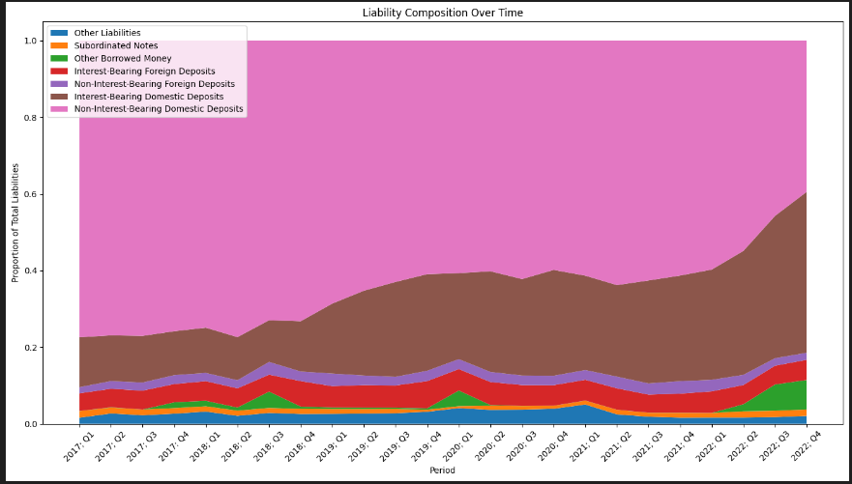
Liabilities
Source: The Fed - Evolution of Silicon Valley Bank (federalreserve.gov)

Slide 14
Dominance of Deposits: Non-interest-bearing domestic deposits constitute the largest proportion of the total liabilities throughout the observed periods. This indicates a significant reliance on deposit funding, which can be volatile, especially in a banking crisis or when customer confidence wanes.
Substantial Proportional Shifts: There are visible changes in the proportions of other types of liabilities, such as subordinated notes and other borrowed money. Such fluctuations can impact the bank's financial stability, especially if they coincide with financial stress periods.
Foreign Deposits: Both interest-bearing and non-interest-bearing foreign deposits make up a notable portion of the liabilities. These can introduce additional risks related to foreign exchange fluctuations and economic conditions outside the domestic market.
Implications:
Risk of Run on Deposits: The high proportion of non-interest-bearing domestic deposits could have posed a significant liquidity risk if a large number of depositors decided to withdraw their funds simultaneously, which is often a concern for banks during times of financial uncertainty.
Leverage and Stability: The presence of subordinated notes and other borrowed money as significant components of the liabilities suggests reliance on potentially costly debt financing, which can affect financial stability during interest rate hikes or economic downturns.

Slide 15
Conclusion for Liabilities
SVB's liability composition shows potential vulnerabilities in its funding structure, primarily the heavy reliance on deposit funding and significant proportions of other borrowed money. These factors likely contributed to the bank's liquidity issues and overall financial instability during the crisis.

Slide 16
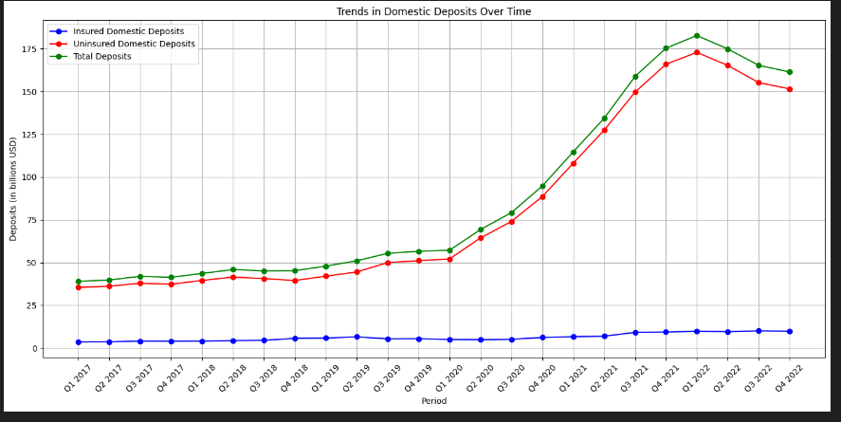
Deposit Trends
Source: The Fed - Evolution of Silicon Valley Bank (federalreserve.gov)

Slide 17
Deposit Trends
Growth in Uninsured Deposits: There is a notable increase in uninsured domestic deposits over time. This suggests that a significant portion of the bank's deposit base consisted of large balances above the FDIC insured limit. High volumes of uninsured deposits can be a risk factor during financial distress as these depositors are more likely to quickly withdraw funds.
Steady Increase in Insured Deposits: Insured domestic deposits also show growth, but at a slower rate than uninsured deposits. This indicates a broadening customer base but does not necessarily mitigate the risk associated with large uninsured balances.
Total Deposits Growth: The overall growth in total deposits seems robust, indicating that the bank was successful in attracting more deposits over time. However, the high proportion of uninsured deposits remained a persistent risk.
Implications:
Risk of Bank Runs: The significant amount of uninsured deposits could have contributed to the liquidity crisis at SVB. In times of uncertainty or negative news, holders of large uninsured deposits might move their funds more swiftly than smaller, insured depositors.
Financial Stability Concerns: The rapid increase in both types of deposits could strain the bank's liquidity management if not matched by equally robust growth in stable, diversified assets.

Slide 18
Conclusion for Deposit Trends
Conclusion:
The deposit data illustrates a potential vulnerability in SVB's financial structure — the high level of uninsured deposits, which can lead to rapid withdrawals. This underscores the importance of maintaining a balance between deposit growth, particularly uninsured deposits, and robust risk and liquidity management practices.

Slide 19
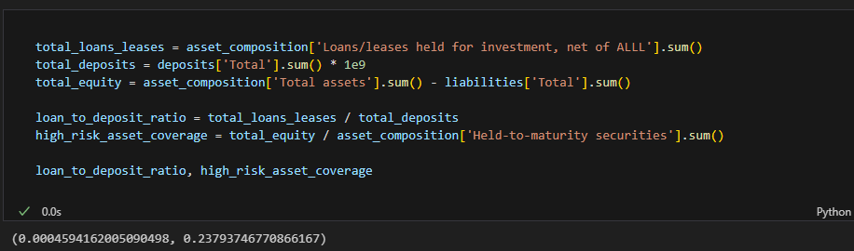
Simulation And Further Analysis
Loan to Depoit Ratio
High Risk Asset Coverage

Slide 20
Simulation and Further Analysis
Loan to Deposit Ratio: The ratio is 46% . Normally, a healthy loan-to-deposit ratio is around 80-90%, indicating that the bank is lending effectively while maintaining sufficient liquidity.
High-Risk Asset Coverage: The ratio of 0.2380.238 indicates that high-risk assets (held-to-maturity securities) are covered by equity by about 23.8%. This is a critical metric, as a lower ratio can signal potential undercapitalization against risky assets, leading to vulnerabilities during adverse market conditions.

Slide 21
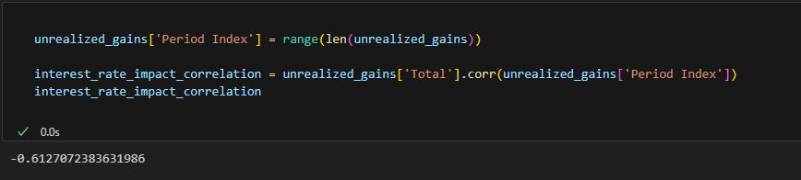
Simulation and Further Analysis
Interest Rate Impact on Assets
The correlation coefficient of −0.613−0.613 between the period index and total unrealized gains/losses suggests a moderate to strong negative correlation. This indicates that as time progressed (which could correspond with periods of rising interest rates), the total unrealized gains and losses became more negative. This trend demonstrates SVB's sensitivity to interest rate fluctuations, particularly for its held-to-maturity securities. The negative impact increases with rising rates, which likely depreciated the value of these long-duration assets.

Slide 22
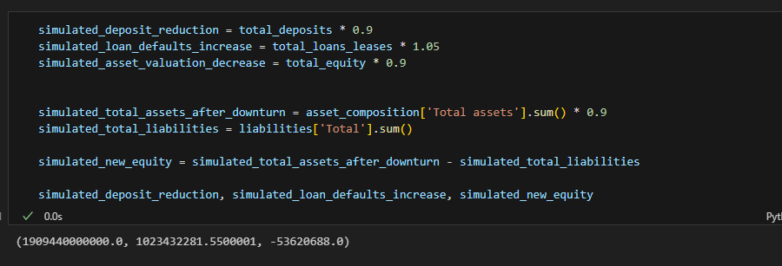
Scenario
Deposits decrease by 10% due to a loss of confidence.(March 2023, SVB announced it needed to raise capital to shore up its balance sheet. This announcement triggered a crisis of confidence among its customers, leading to a bank run.
Loan defaults increase by 5%.
Asset valuations decrease by 10%.

Slide 23
Scenario Coclusion
Deposit Reduction: The deposits decreased to approximately $1.91 trillion, reflecting a 10% reduction. This decrease could strain liquidity, especially if a large portion of these deposits are uninsured and prone to rapid withdrawals.
Increase in Loan Defaults: Loan defaults increased to about $1.02 billion, highlighting potential losses that could further stress the bank's financial health.
Decrease in Asset Valuations and Equity: The total equity, after a 10% reduction in asset valuations, turned negative (−$53.62−$53.62 million). This indicates that the bank would become undercapitalized, exacerbating its vulnerability in the face of economic stress.

Slide 24
Conclusion
Interest Rate Environment: The rapid increase in interest rates by the Federal Reserve to combat inflation had a significant impact on SVB. As rates rose, the value of the bank's bond portfolio, which contained long-term fixed-rate securities, declined sharply.
Large, Uninsured Deposits: A substantial portion of SVB's deposits were uninsured, as they exceeded the FDIC's insurance limit of $250,000. This factor heightened the risk of a bank run, as larger depositors are more likely to withdraw funds quickly in times of perceived financial instability.
Asset-Liability Mismatch: The bank faced challenges due to mismatches in the maturities of its assets and liabilities. Its assets (long-term investments) could not be liquidated quickly enough without incurring losses that exceeded the value of its immediate liabilities (short-term deposits).
Economic Conditions: The broader economic downturn, particularly in the tech sector, exacerbated SVB's challenges. As tech companies faced funding issues and reduced valuations, their banking needs and deposit levels also declined, putting additional pressure on the bank.

Slide 25
Recomandation for other banks
Diversification of Client Base and Asset Classes
Robust Risk Management
Maintaining Adequate Liquidity
Monitoring Large, Uninsured Deposits:

