Slide 1
Penetration Testing
Tool
By: Robert Deal

Slide 2
Group Members:
Robert Deal
dealre@mail.uc.edu
937-760-7719
No assigned Advisor

Slide 3
Project Abstract
The goal of the project is to create a software tool that can be used to penetrate a system with known or otherwise identified vulnerabilities. The goal is also to have a number of systems in place to manage the target machine’s logs, set up/manage backdoors, and maintain connections. The Idea is to demonstrate the way in which bad actors can use relatively simple exploits on what is considered modern machinery. The tool is also a good chance to learn about the specific real world application of how ideas of computer security in a formal learning institution are applied in real world examples.

Slide 4
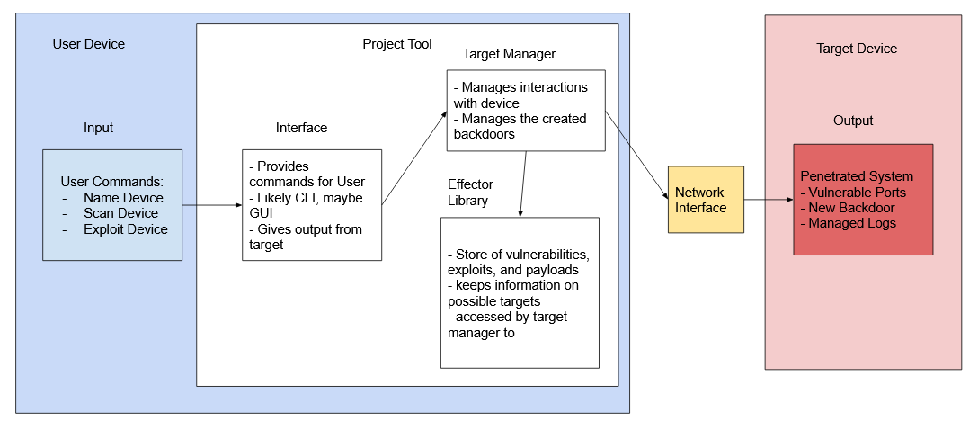
User Stories and Design Diagrams
As someone who performs penetration testing, I need to be able to scan target devices and get a comprehensible output
As someone who performs penetration testing, I need to be able to identify what vulnerabilities are exploitable on the target device
As someone who performs penetration testing, I need to be able to send a payload to a target and have it perform whatever task i desire
As someone who performs penetration testing, I need to be able to manage any connections or backdoors that the payload opens up
As someone who performs penetration testing, I need to be able to keep all actions on a target device relatively hidden from any adversaries

Slide 5
Major Project Constraints
Economics: Using personal computers already owned, or cheap example equipment
Professional: This would look great on a resume for cyber defense companies
Ethical: Useful for learning how to defend, isn’t all too valuable to use for nefarious purposes
Legal: Personal equipment, personal networks, no legal concerns
Security: Hopefully the project will result in finding security vulnerabilities, could submit them to cve.org
Social: Will result in learning more about such systems to better protect them in a profession career
Environmental: Personal or used equipment, no additional waste generated

Slide 6
Review of Project Progress
Acquired used router and old computer for use as a target
Setup the equipment and tested networking
Created a basic script for loading and managing planned exploits
Identified possible public vulnerabilities on the router for exploitation

Slide 7
Expected Accomplishments
Provide a semi-functioning prototype code that shows basic functionality of the device on limited systems, to be added to and improved later down the line.

Slide 8
Division of Work
To be done by Robert Deal

Slide 9
Expected Demo
Demo setup will likely consist of a personal laptop with the code on it, sending to a router and used desktop computer, with plans for other IOT devices that can allow for more “ostentatious” effects like having the script print unauthorized materials on a printer, or set off other such equipment.

Slide 10
Thank you

