Slide 1
Customer Advocate Group Remote Imaging System (CAGRIS)

Slide 2
Overview
Field Quality reports are vital to DaimlerChrysler to improve overall quality of vehicles made
Accurate, complete, and detailed Field Quality reports are required to ensure transfer of information to the right people

Slide 3

Overview
Appropriate report information must be provided
Need higher quality and more complete CAGRIS reports

Slide 4
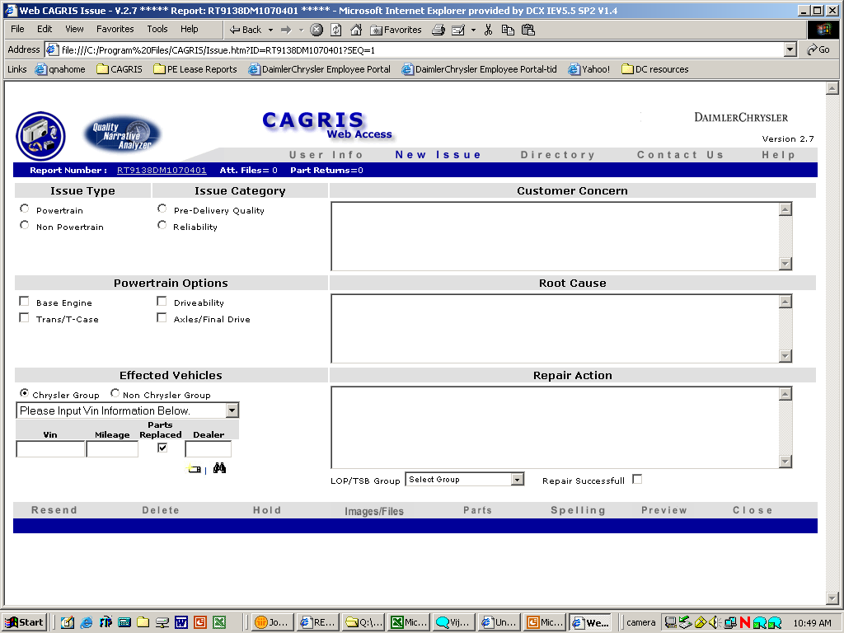
Standalone Web Version

Slide 5
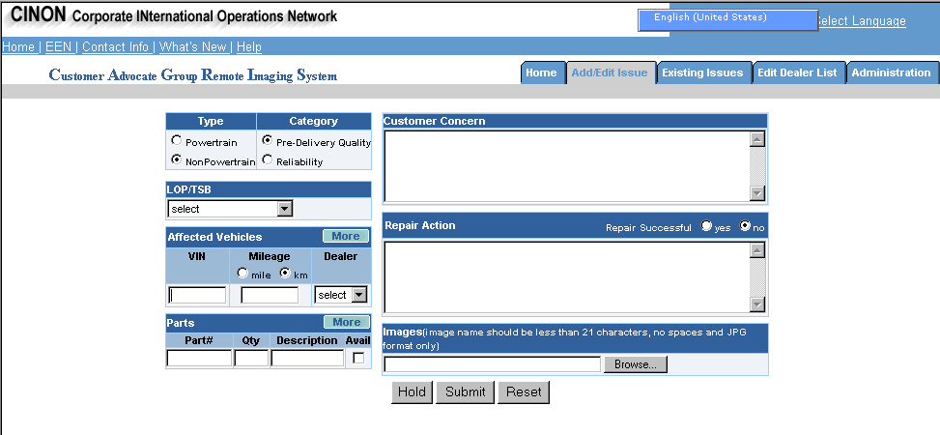
International Web Version

Slide 6
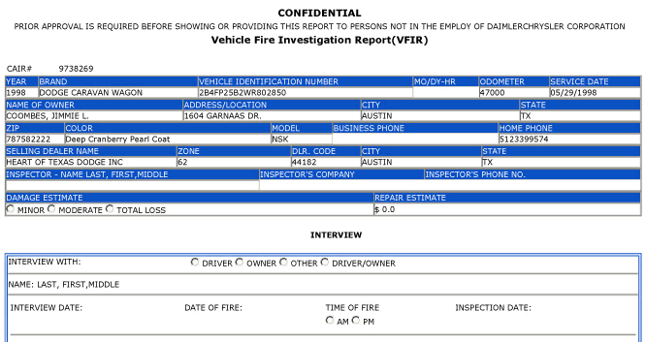
Special Investigations
Only SI investigators use this version of CAGRIS

Slide 7
When to Report Issues
Product issues: Significant vehicle or part issues
  Especially a "come back" repair
Parts cataloging errors: Part listed in MOPAR parts catalog is not right part for the application

Slide 8
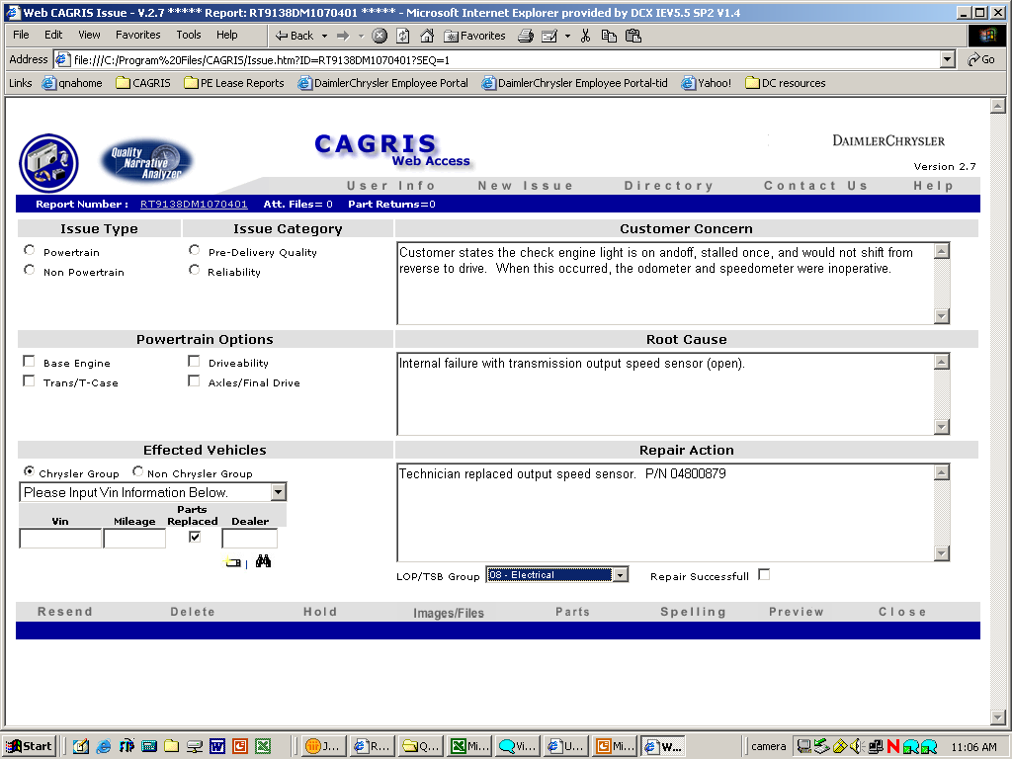
When to Report Issues
Parts packaging issues: New part received broken or damaged
Service manual errors: Errors in diagnostic flow charts or system operation descriptions
Technical Service Bulletins (TSBs): TSBs that did not fix issue as described in bulletin

Slide 9
When to Report Issues
If customer claims vehicle was involved in accident, open flame fire due to alleged product defect, or airbag deployed inappropriately, a "Legal Type" CAIR must be submitted
This type of contact will be recorded and assigned to Special Investigations

Slide 10
When to Report Issues
Any information in CAGRIS report may be reviewed by National Highway Traffic Safety Administration (NHTSA) via Transportation Recall Enhancement, Accountability, and Documentation (TREAD) Act
A CAGRIS report could be used as an exhibit in any courtroom in the United States
  It is important to be factually correct, non-judgmental, and use proper grammar and spelling

Slide 11
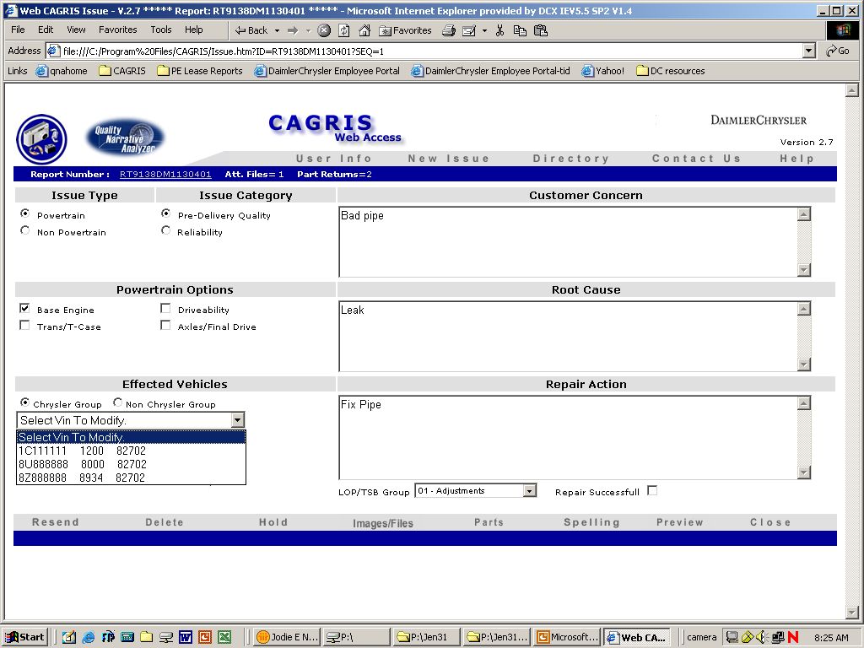
When to Report Issues
When there are multiple VINs for one issue
  Update or edit existing report
  Do not generate a new report number for a different vehicle with the same issue as a previously reported vehicle

Slide 12
When to Report Issues
When there are multiple issues for one VIN:
  It's important that separate reports be created for each issue
    Factors such as category and type selections determine who receives a copy of each report

Slide 13
Initial Report Information
Important information must be included prior to reporting on the Customer Concern or Repair Action details
Remember, this initial reporting information could be submitted using different layouts, depending upon which version of CAGRIS you use to report the issue

Slide 14
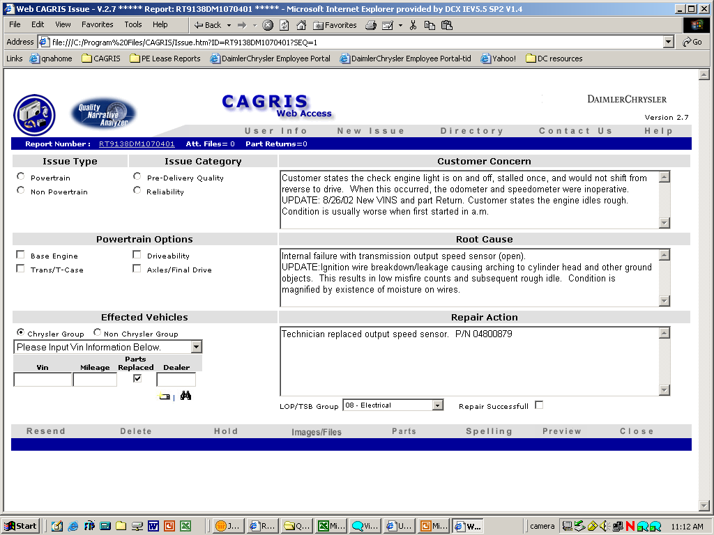
Initial Report Information
Determine if issue pertains to Powertrain or Non-Powertrain
Determine if issue was Pre-Delivery Quality or Reliability
Indicate Labor Operations (LOP) and/or Technical Service Bulletin (TSB) number

Slide 15

Initial Report Information
  For affected vehicles, report the:
    VIN
    Mileage
    Parts Replaced
    Dealer

Slide 16
Customer Concern
Write what customer said using short, concise descriptions
Include statements that communicate customer empathy
Bad Example - Customer Concern:
Customer stated that the check engine light was on.
Good Example - Customer Concern:
Vehicle towed in with customer complaining of vehicle running rough, then stalled. After stalling, vehicle would restart, but stall when accelerating. Check engine lamp on. Dealer just replaced cam and crank sensors for same complaint.

Slide 17
Customer Concern
Never exaggerate or stretch the truth
  Only write what the customer says
Bad Example - Customer Concern:
Customer stated that the check engine light was on.
Good Example - Customer Concern:
Vehicle towed in with customer complaining of vehicle running rough, then stalled. After stalling, vehicle would restart, but stall when accelerating. Check engine lamp on. Dealer just replaced cam and crank sensors for same complaint.

Slide 18
Repair Action - Root Cause
Observe technician during repair process
Take pictures with digital camera, capturing details of repair process
Check service history on vehicle to verify previous complaints
Bad Example – Root Cause:
I think the wiring harness shorted out causing a #6 misfire.
Good Example – Root Cause:
Engine harness chaffed against transmission solenoid pack resulting in a short to ground on the crank sensor signal wire and the #6 injector driver wire.

Slide 19
Repair Action - Root Cause
Verify if current issue was caused by previous repair
Search for same issue on Quality Narrative Analyzer (QNA) system
Check for TSBs on issue
Check Customer Advocate Group (CAG) Bulletin board for issue
Bad Example – Root Cause:
I think the wiring harness shorted out causing a #6 misfire.
Good Example – Root Cause:
Engine harness chaffed against transmission solenoid pack resulting in a short to ground on the crank sensor signal wire and the #6 injector driver wire.

Slide 20
Repair Action - Root Cause
Call advocates
Check part sales history
Ask technicians if they have seen the issue before
Bad Example – Root Cause:
I think the wiring harness shorted out causing a #6 misfire.
Good Example – Root Cause:
Engine harness chaffed against transmission solenoid pack resulting in a short to ground on the crank sensor signal wire and the #6 injector driver wire.

Slide 21
Repair Action – Issue Repair
Describe how vehicle was fixed
Report Part Number (P/N) and Labor Operation (LOP) warranty manager submitted on claim
Bad Example – Root Cause:
I think the wiring harness shorted out causing a #6 misfire.
Repair:
Moved the harness and insulated it.
Good Example – Root Cause:
Engine harness chaffed against transmission solenoid pack resulting in a short to ground on the crank sensor signal wire and the #6 injector driver wire.
Repair:
Technician repaired wires and installed braided sleeve over harness. P/N 05086614AA LOP 0894TKL3

Slide 22
Repair Action – Additional Details
Bad Example – Repair:
Explain process that led to root cause explanation
Verify customer complaint
Moved the harness and insulated it.
Details:
None
Good Example – Repair:
Technician repaired wires and installed braided sleeve over harness. P/N 05086614AA LOP 0894TKL3
Details:
Upon our inspection, technician (Mark Smith) found that the vehicle started, but ran rough. With the DRB III code P 0206 Injector #6 control circuit was active with 0 global good trips. A one-trip failure was also stored for P 0306 - cylinder misfire. We followed diagnostic chart in manual, which lead to…

Slide 23
Repair Action – Additional Details
Bad Example – Repair:
Quantify the issue
Determine how the part can be identified
  Record any numbers or markings found on the part and take pictures of them
Moved the harness and insulated it.
Details:
None
Good Example – Repair:
Technician repaired wires and installed braided sleeve over harness. P/N 05086614AA LOP 0894TKL3
Details:
Upon our inspection, technician (Mark Smith) found that the vehicle started, but ran rough. With the DRB III code P 0206 Injector #6 control circuit was active with 0 global good trips. A one-trip failure was also stored for P 0306 - cylinder misfire. We followed diagnostic chart in manual, which lead to…

Slide 24
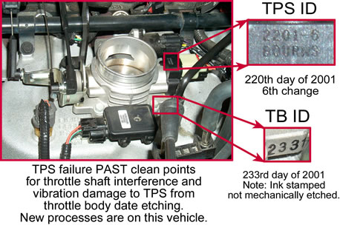
Repair Action – Additional Details
If a part has a colored paint dot on it, take a picture of it
Even if numbers, markings, or paint dots do not seem significant, they are usually very significant to supplier

Slide 25
Repair Action – Additional Details
Include any trouble codes and/or DRB III data that was identified - take a picture of DRB III screen
Discuss difficulties with diagnostic process
Document parts that were changed that did not repair the condition

Slide 26
Image Types
Macro view of component being photographed
Also include close-up view "calling out" location of paint markings, dots, or failure location and failure detail

Slide 27
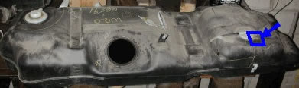
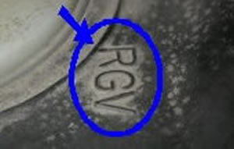
Image Types
MACRO view (RS Fuel Tank)
Close up of a molded in marking
Location of close-up is identified in the MACRO view

Slide 28
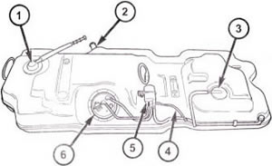
Image Types
Sometimes line art can be used in place of MACRO view
These images may also provide call-outs that can be used in descriptive text of report, or to refer to detail images

Slide 29
Uploading Images from a Digital Camera
ALWAYS include an image with your CAGRIS issue report, even if it's just a picture of part that was changed
Take digital pictures at the highest possible resolution your camera will allow

Slide 30
Uploading Images from a Digital Camera
There are a few different ways to upload digital pictures, depending upon which type of camera you're using
  If using a camera with a removable memory storage card, you can use a memory card reader, such as a Smart Media reader

Slide 31
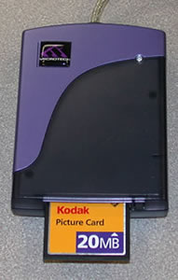
Uploading Images from a Digital Camera
When using memory storage card
  Insert card into reader
  Browse for drive for your reader
  Copy or move pictures from reader drive into a desired folder or directory on your computer

Slide 32
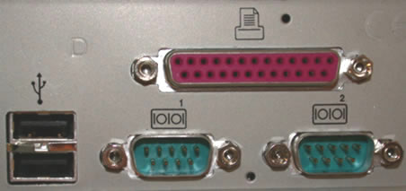
Uploading Images from a Digital Camera
You can also upload pictures by connecting a cable from your camera to a Universal Serial Bus (USB) port
  You must load software on to your computer in order to upload pictures
  Not all computers have a USB port
  Check the back of your computer for a USB port before loading software

Slide 33
Uploading Images from a Digital Camera
If your camera does not have a USB connector cable, establish cable link from camera to serial port
Load software on your computer to upload pictures
Refer to camera's user manual for detailed uploading information

Slide 34
Modifying Images
Browse for or import images to any version of CAGRIS
After finding and importing an image, use mark-up tools to emphasize a particular area on the image
Use mark-up tools to allow your images to tell a story and illustrate details of issue and repair process

Slide 35
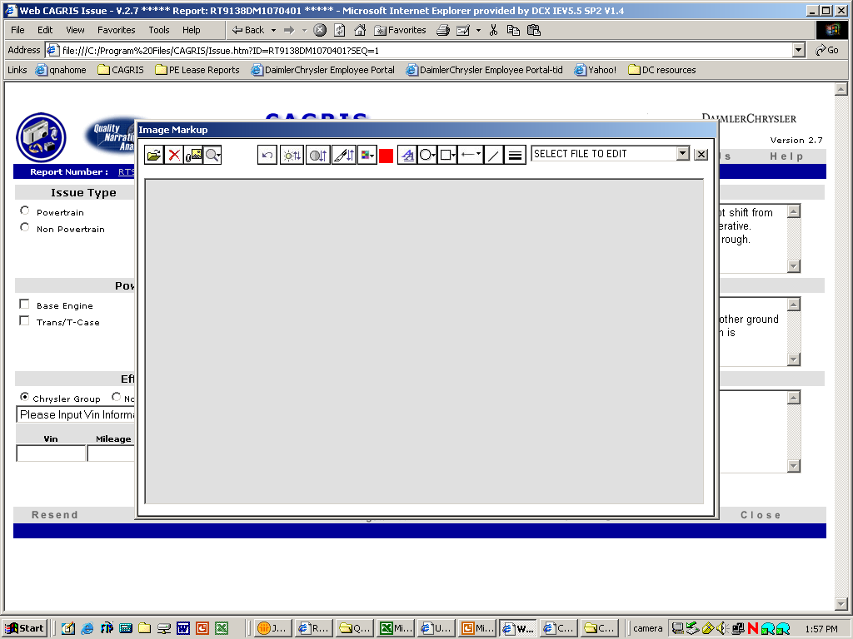
Attaching Images to an Issue Report
Click on the third button from the left to browse for and attach an image

Slide 36
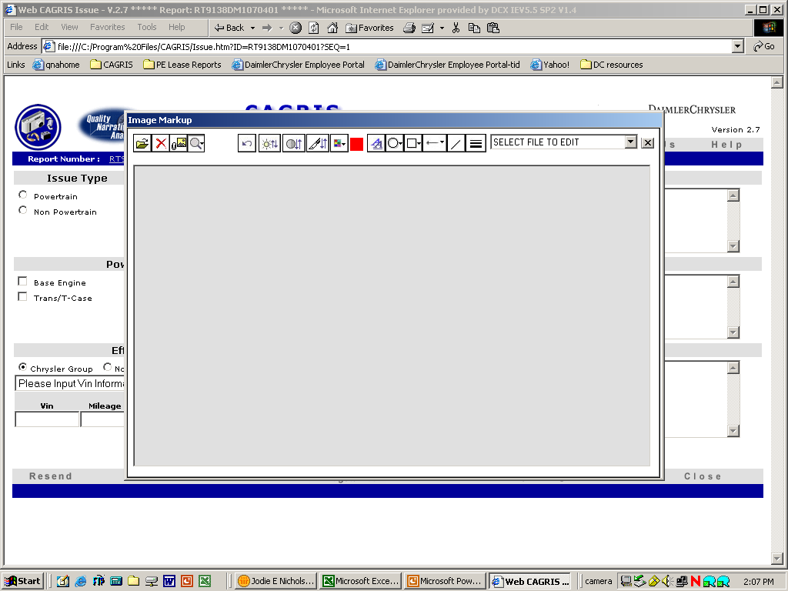
Modifying Images
CAGRIS provides mark-up tools within the application
  There are a variety of icon buttons that have specific functions
  Draw circles, squares, lines, and arrows on image and even type important comments or numbers on top of the image

Slide 37
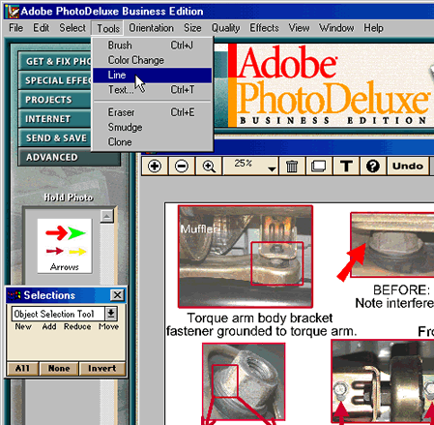
Modifying Images
You can also modify image using another software application prior to attaching image to report

Slide 38
Modifying Images
Software that comes with digital camera may have mark-up capabilities
Other graphics programs
  Image Composer
  PaintShop Pro
  Photoshop

Slide 39
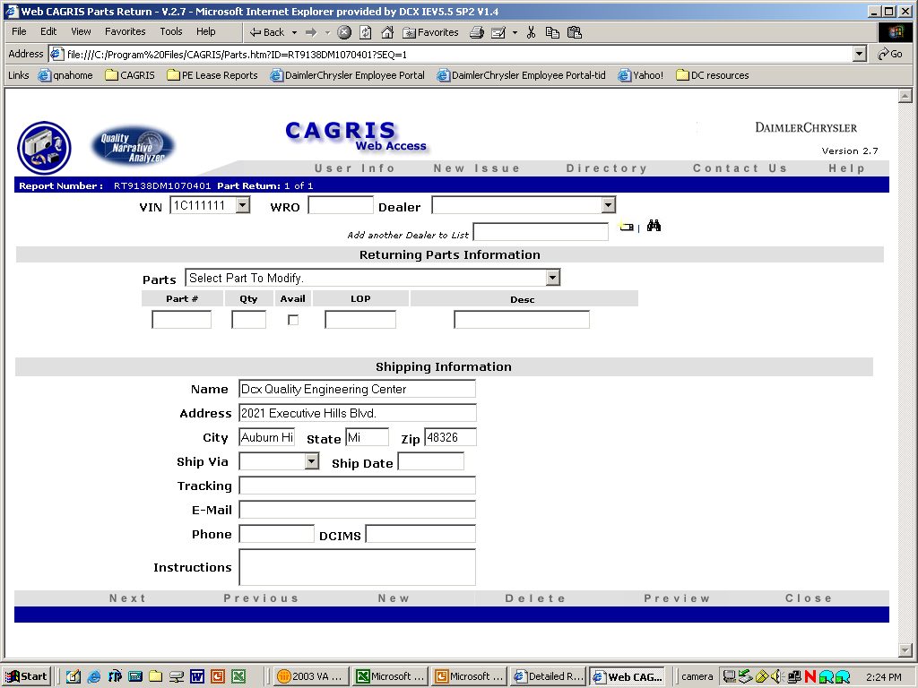
Parts Return Form
All available parts from Field Quality Reports should be returned to the Quality Engineering Center (QEC) in Auburn Hills, Michigan
If a part is not replaced or not available for return, indicate this on your report with a description of why part was not returned

Slide 40
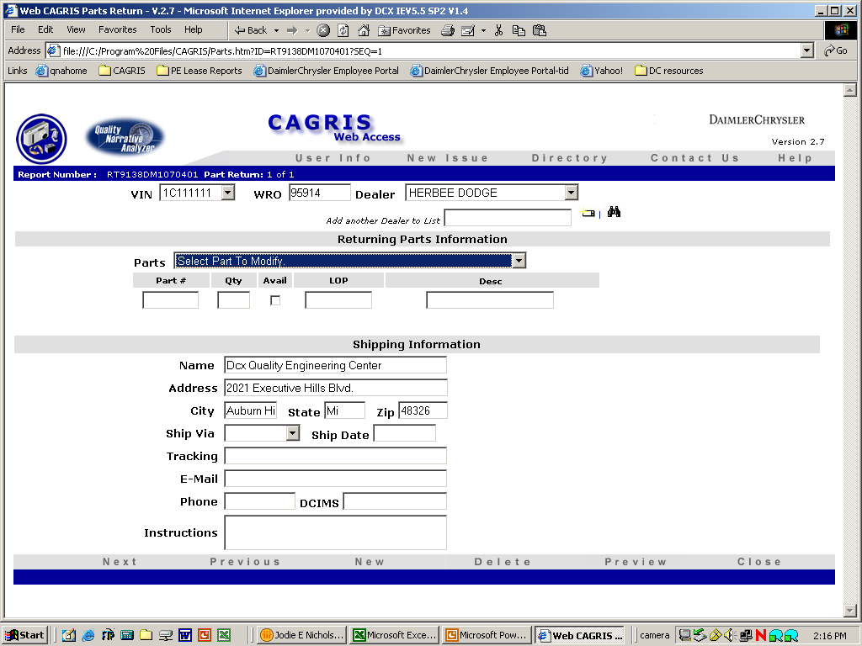
Parts Return Form
Input VIN, Warranty Repair Order (WRO) number, and Dealer
Indicate part number, quantity, availability, and description for each part
Complete shipping information
Enter shipping method, date, and tracking number
In Instructions field, specify person the parts returned should be delivered to

Slide 41
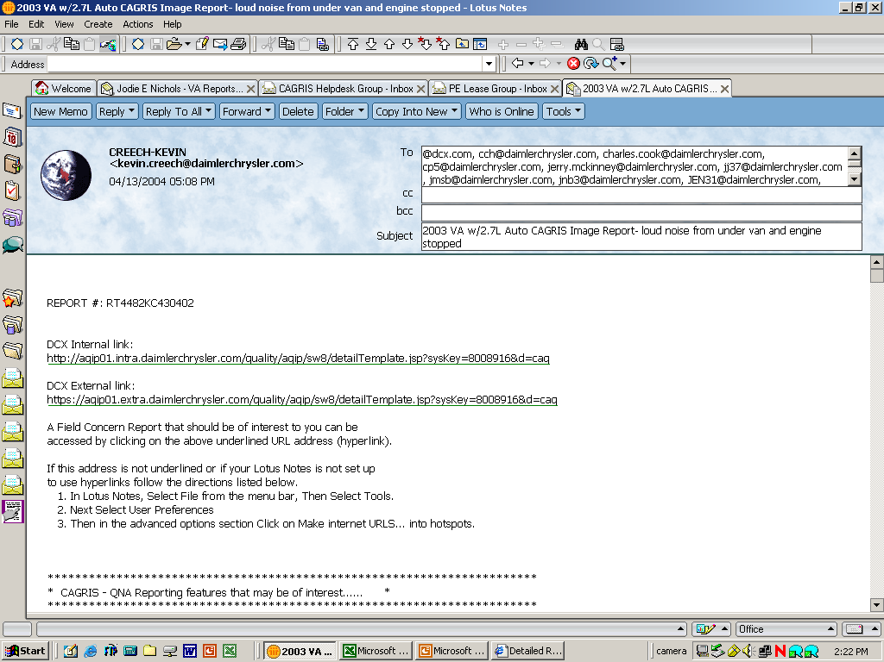
Distribution of the Report
After submitting Field Quality Report, it is distributed by Quality Narrative Analyzer (QNA) system
QNA system automatically emails a link to individuals that need to view your report

Slide 42
Searching for Reports on QNA
Use QNA to research any field quality issue
Search for CAGRIS reports by keyword, report number, date, vehicle information, LOP, part number, dealer, etc.
Find similar CAGRIS reports: what happened, what was done, and how problem was fixed
Save and group your searches and even email search results or groups to your colleagues

Slide 43
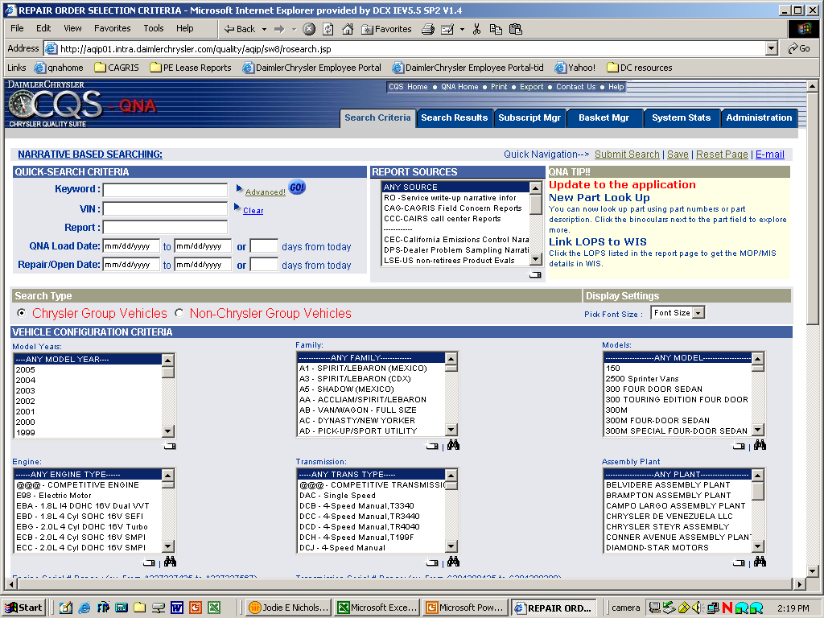
Searching for Reports on QNA

Slide 44
Parts Return Analysis System (PRAS)
Provides reports and summaries on all returned parts after they are analyzed by Suppliers and DCX Engineering
Engineers analyze and disassemble parts returned and try to determine what caused them to fail or malfunction
Information on specific parts and warranty review summaries is available for returned parts in PRAS

Slide 45
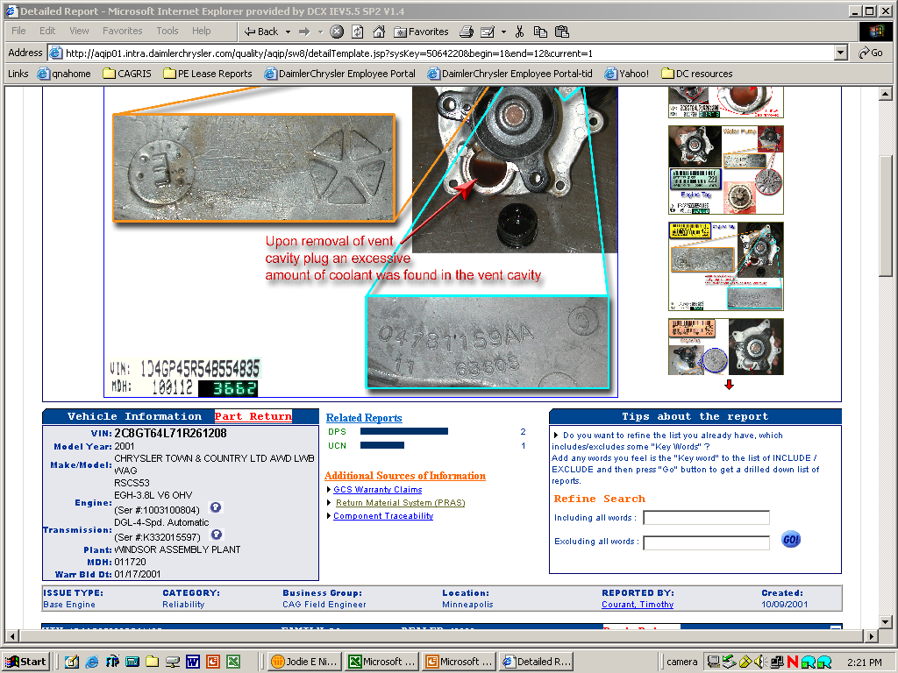
Parts Return Analysis System (PRAS)

Slide 46
Questions?
The CAGRIS Web-Based Training Course is now available

