Slide 1
INFO 101 Social Networking Technologies
Modeling Facebook

Slide 2
Class Discussion
What’s a database?

Slide 3
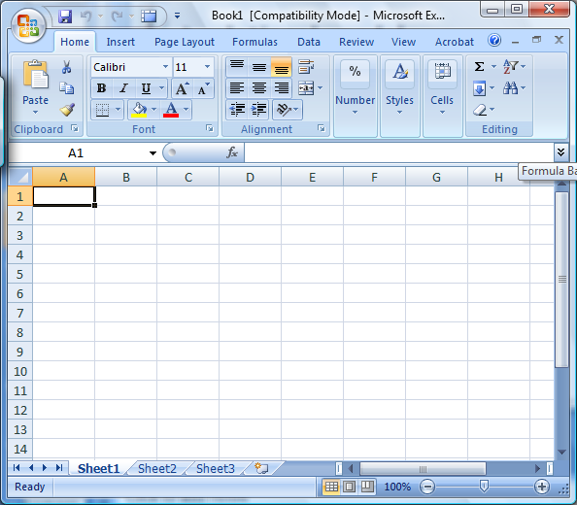
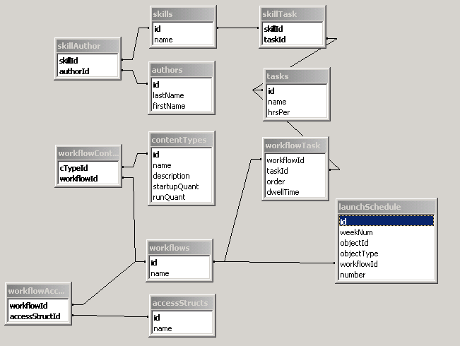
What’s a database?
Notes:
Start with Excel
Shows rows columns and tables
Good for basic stuff
When you need to go further, you need a database
Lots of different tables
All interrelated

Slide 4
Class Discussion
Suggest a site on the net and say what would be in its database.

Slide 5
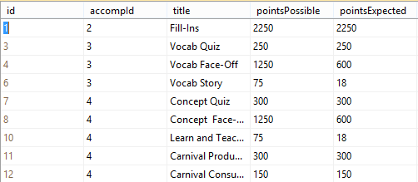
Databases have Tables
The major structure
Hold related info about one “type” of info
The Task table from gClass

Slide 6
Class Discussion
Bring up Facebook
What would some of the tables in the Facebook system be?

Slide 7
Tables have Rows and Columns
The Task table from gClass

Slide 8
Class Discussion
Suppose there is a Person table in Facebook.
What might some of the columns be?

Slide 9
Tables have ids
Each row is like you, an entity
To identify entities (like you) we use ids
So each row has an id

Slide 10
Bump for the person who can produce the most unique id’s from their pocket or purse

Slide 11
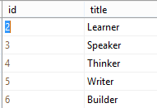
Tables have relationships
The Task table from gClass
The accomplishment table

Slide 12
Class Discussion
What would be some relationships between tables in Facebook?

Slide 13
Let’ model Facebook posts
Use a spreadsheet
Or
https://www.lucidchart.com/pages/er-diagram-tool
Click Conceptual models

Slide 14


Model this!
Do it in a single table

Slide 15

Possible Answers
Person table

Slide 16
Model this!
Do it two tables
Person table
Break the name into two or more columns
Post table
Give each person and post an id

Slide 17


Possible Answers
Person table
Post table

Slide 18
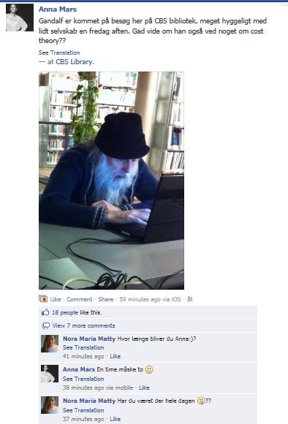
Model this
Start from the two table approach
Need add only one table

Slide 19
Model this
Start from the two table approach
Need add only one table
Call it comment

Slide 20
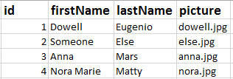


Possible answer
Person table
Post table
Comment table

Slide 21
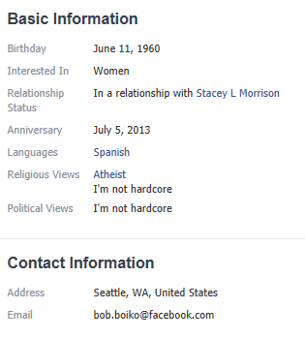
Original Work: Newbie
Do it in a Spreadsheet or Lucid Chart if you can
One table is fine
https://www.lucidchart.com/pages/er-diagram-tool
Click Conceptual models

Slide 22
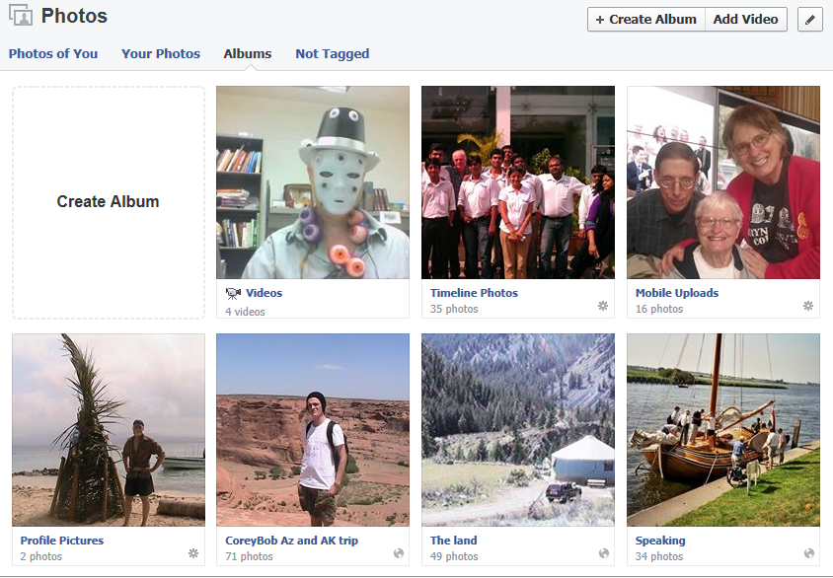
Original Work: Apprentice
Do it in a spreadsheet, Lucid Chart or another tool
At least two tables
Account for
albums vs . photos
Videos vs. photos
Timeline, profile and mobile uploads albums that are automatically created.
Don’t worry about
Create album, photos of you, your photos, add video, not tagged, gears
https://www.lucidchart.com/pages/er-diagram-tool
Click Conceptual models

Slide 23
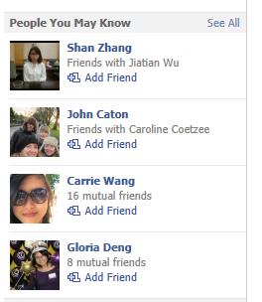
Original Work: Master
Do it in just two tables
Must use Lucid Chart or other ER modeling tool
https://www.lucidchart.com/pages/er-diagram-tool
Click Conceptual models

