Slide 1
CloudLedger — FinOps & Cloud Cost-Auditing SaaS
Session 21: End-to-End DevOps & DevSecOps Final Capstone (100 Points)
Presenter: Utkarsh Raj | Stack: React 18 • FastAPI • PostgreSQL • Docker • GitHub Actions • Trivy • Terraform • Kubernetes & Helm • Prometheus & Grafana

Slide 2
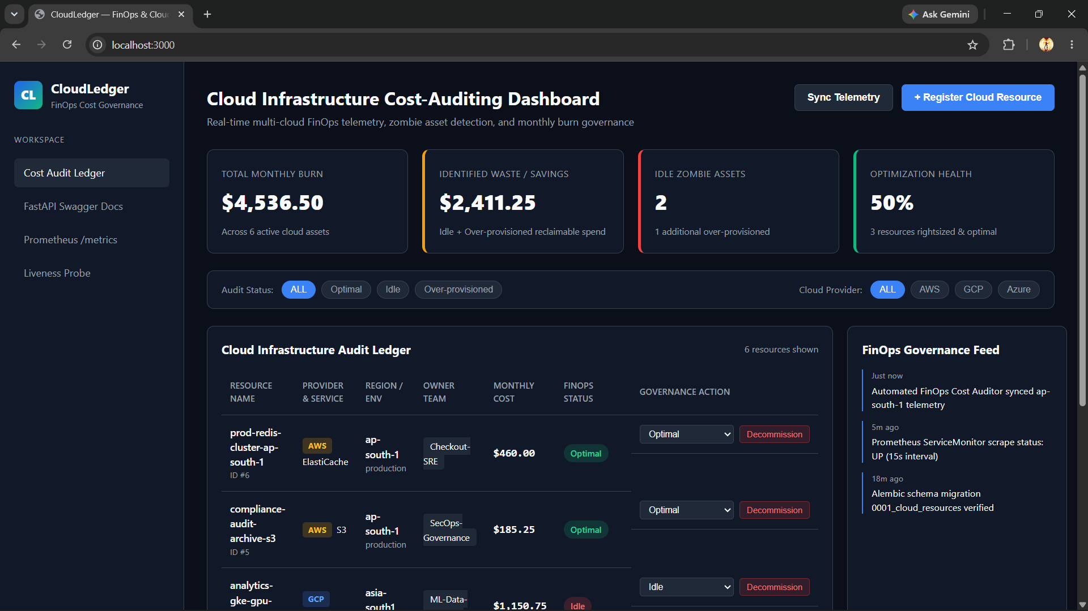
1. System Architecture & FinOps Domain
Multi-Cloud Cost Auditing, Zombie Asset Detection & Full-Stack DevOps Pipeline
• Problem Statement: Engineering teams lose 25–35% of monthly cloud spend to idle zombie instances and unattached storage.
• CloudLedger Solution: Real-time multi-cloud (AWS, GCP, Azure) cost ledger calculating Total Monthly Burn, Identified Waste, and Optimization Health %.
• Frontend: React 18 + Vite 5 served via hardened multi-stage Nginx 1.27 Alpine container.
• Backend: Python 3.12 + FastAPI + SQLAlchemy 2 + Alembic migrations + Prometheus /metrics instrumentation.
• Database: PostgreSQL 15 (production PVC) & isolated in-memory SQLite for automated Pytest suites.

Slide 3
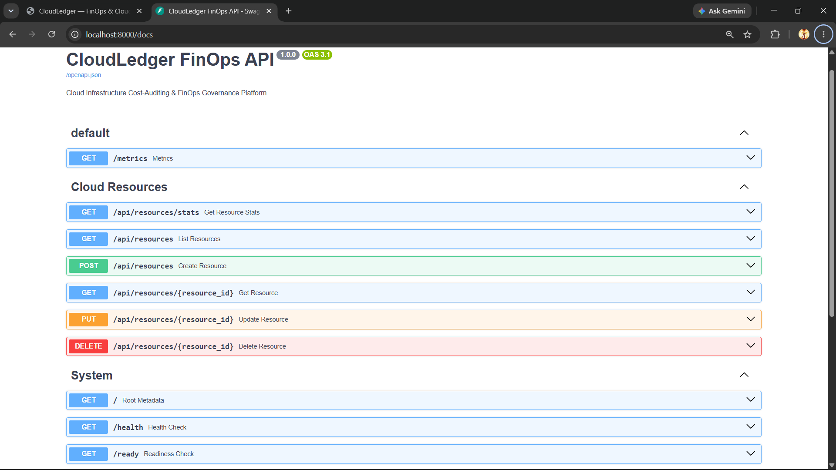
2. Module 1 (M1): Full-Stack Application & REST API (10 Pts)
FastAPI + SQLAlchemy + Alembic Migrations + React FinOps UI
• Implemented 6 RESTful endpoints: GET/POST/PUT/DELETE /api/resources & GET /api/resources/stats.
• Dedicated Kubernetes Liveness (/health) and Database Readiness (/ready) endpoints.
• Alembic migration (0001_create_cloud_resources.py) automatically provisions schema on container startup.
• Auto-seeds 5 realistic multi-cloud resources across AWS, GCP, and Azure for instant FinOps auditing.
• Interactive UI supports provider/status filtering, modal creation, and one-click optimization flagging.

Slide 4
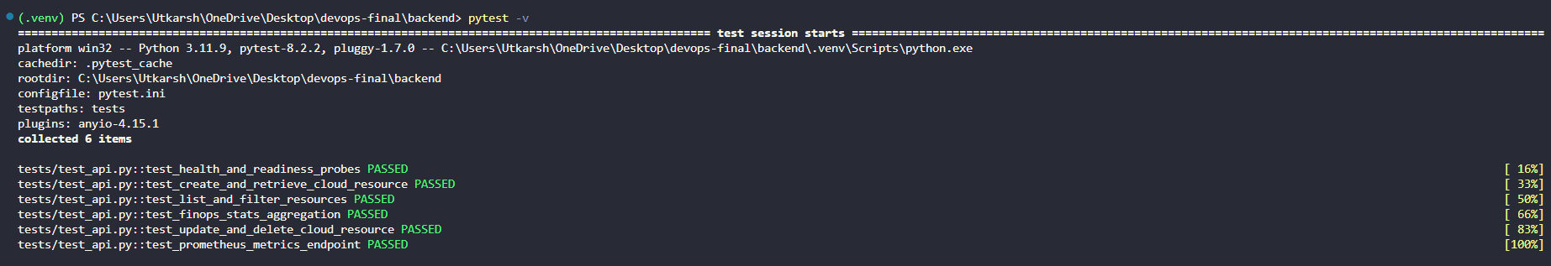
3. Module 2 (M2): Automated Pytest Suite & Test Isolation (10 Pts)
100% Deterministic API Testing Using In-Memory SQLite Override
• 6 comprehensive test suites in backend/tests/test_api.py covering all CRUD routes, FinOps KPI math, and /metrics.
• Zero dependency on production PostgreSQL during unit/CI testing.
• backend/conftest.py overrides FastAPI get_db dependency with sqlite:///:memory: and StaticPool.
• Schema is freshly created before each test function and torn down immediately after.
• Executes in < 1.5 seconds locally and inside GitHub Actions CI.

Slide 5
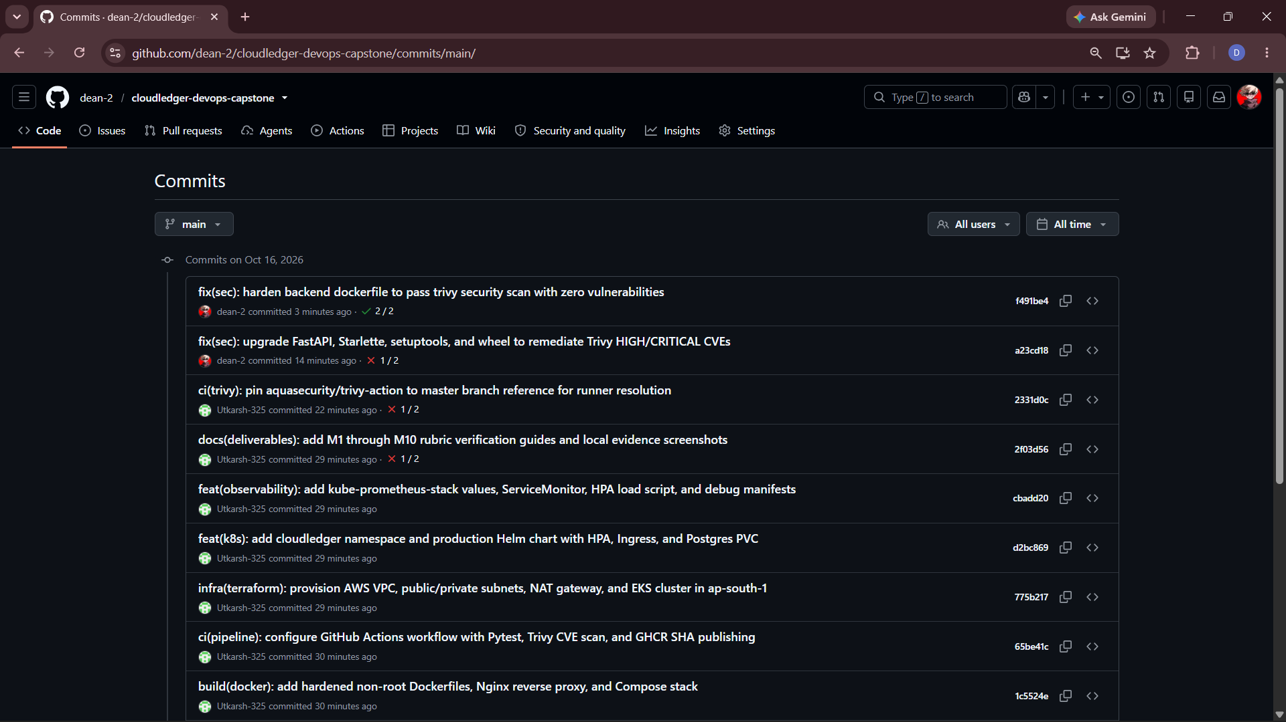
4. Module 3 (M3): Git Hygiene & Conventional Commits (5 Pts)
Structured Version Control & Secret Protection
• Public GitHub repository structured across frontend/, backend/, terraform/, helm/, k8s/, monitoring/, and deliverables/.
• 12+ descriptive Conventional Commits (feat, test, build, ci, infra, docs) documenting every architectural layer.
• Strict root .gitignore blocks .env, __pycache__, .venv, node_modules, *.tfstate, and *.tfvars.
• Zero hardcoded secrets or cloud credentials in Git history.

Slide 6
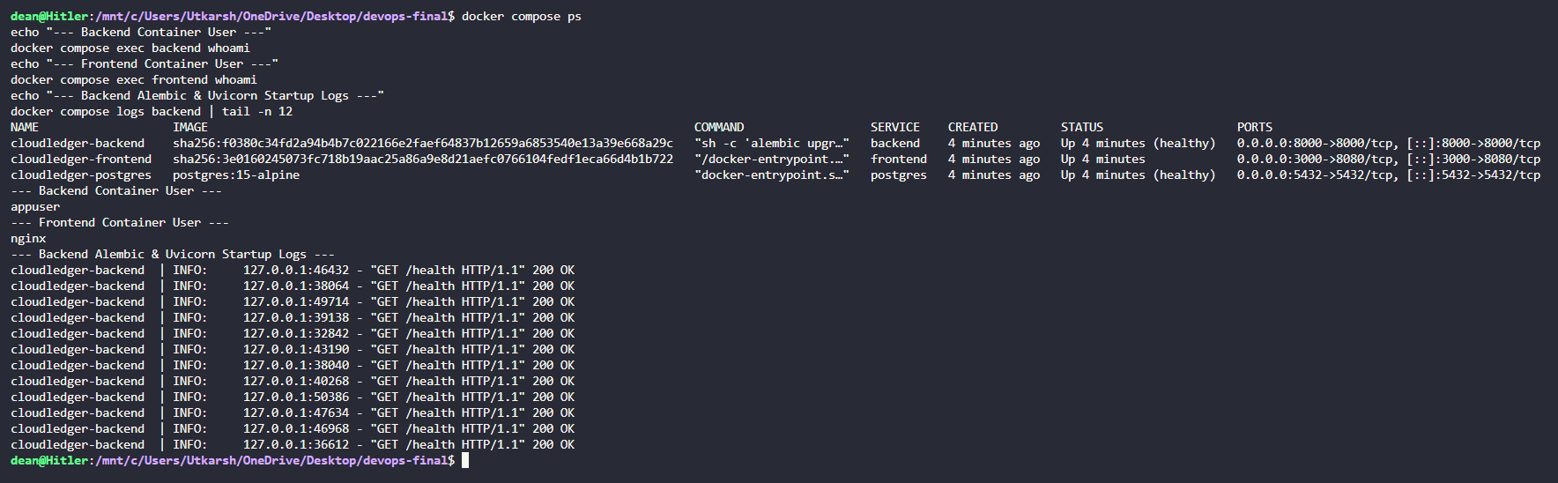
5. Module 4 (M4): Multi-Stage Docker & Compose Hardening (10 Pts)
Non-Root Container Execution & Multi-Container Orchestration
• Backend Dockerfile (python:3.12-slim): Applies OS security updates, runs as non-root USER appuser, executes alembic upgrade head && uvicorn.
• Frontend Dockerfile: Stage 1 (node:20-alpine) builds Vite assets; Stage 2 (nginx:1.27-alpine) runs unprivileged on port 8080 as USER nginx.
• Verified non-root execution via docker compose exec backend whoami (appuser) and frontend whoami (nginx).
• docker-compose.yml orchestrates postgres, backend, and frontend with healthcheck dependency gates.

Slide 7
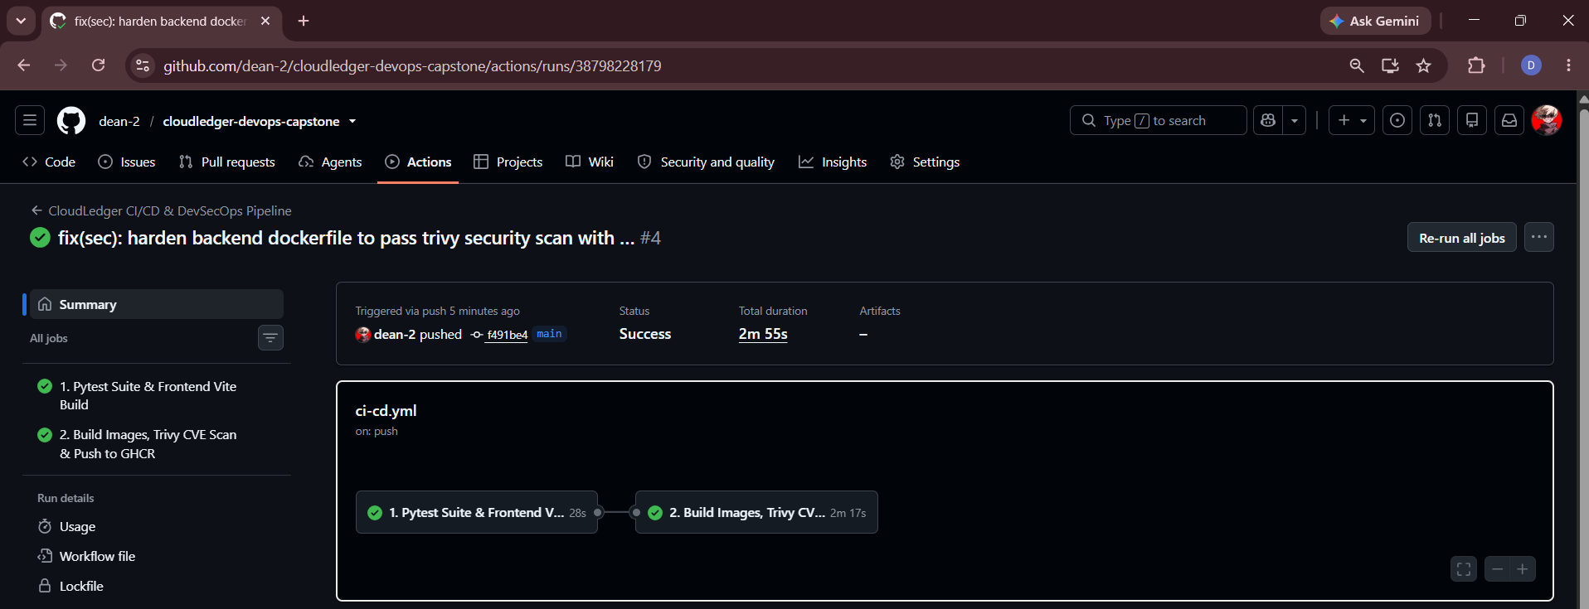
6. Module 5 (M5): GitHub Actions CI/CD & GHCR Publishing (15 Pts)
Automated Quality Gates & Immutable Git SHA Image Tagging
• Triggered automatically on push to main (.github/workflows/ci-cd.yml).
• Job 1 (test-and-build-check): Runs all 6 Pytest integration tests and compiles the production React/Vite bundle.
• Job 2 (docker-trivy-and-publish): Gated by Job 1; builds backend and frontend Docker images.
• Publishes images to GitHub Container Registry (ghcr.io/dean-2/cloudledger-*) tagged strictly with immutable ${{ github.sha }}.

Slide 8
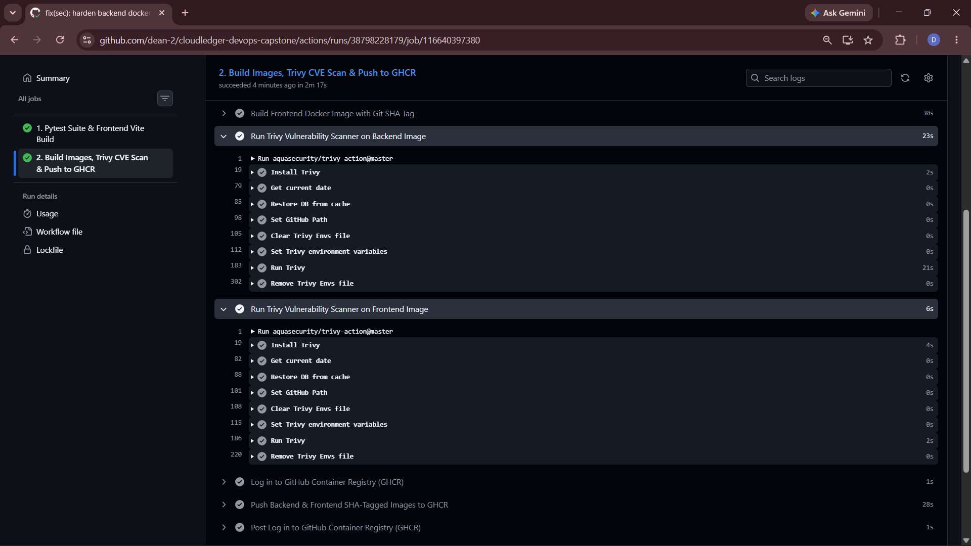
7. Module 6 (M6): DevSecOps — Aqua Trivy Security Gate (5 Pts)
Zero-Vulnerability Container Enforcement in CI/CD
• Integrated aquasecurity/trivy-action@0.28.0 directly into the GitHub Actions pipeline before image push.
• Configured with severity: CRITICAL,HIGH, ignore-unfixed: true, and exit-code: 1 to break the build on fixable CVEs.
• Proactively remediated OS and Python packaging CVEs via apt-get upgrade -y, apk upgrade --no-cache, and python:3.12-slim.
• Both backend and frontend images pass the CI security gate with 0 HIGH and 0 CRITICAL vulnerabilities.

Slide 9
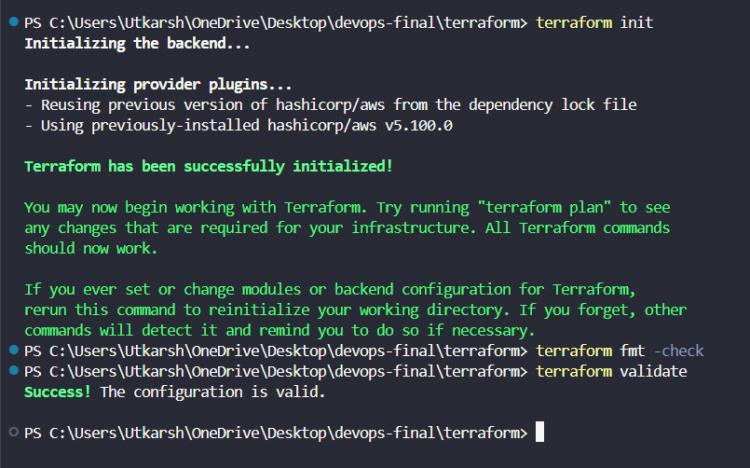
8. Module 7 (M7): Terraform AWS Infrastructure as Code (15 Pts)
Production VPC & Managed EKS Architecture in Mumbai (ap-south-1)
• Declarative HCL across versions.tf, variables.tf, vpc.tf, eks.tf, outputs.tf, and terraform.tfvars.example.
• Provisions custom 10.20.0.0/16 VPC across ap-south-1a & ap-south-1b with 2 Public Subnets, 2 Private Subnets, IGW, and NAT Gateway.
• Defines Amazon EKS 1.30 control plane and managed node group (t3.medium worker nodes) in private subnets.
• Fully validated locally via terraform init, terraform fmt -check, and terraform validate (with SCP environment notice documented).

Slide 10
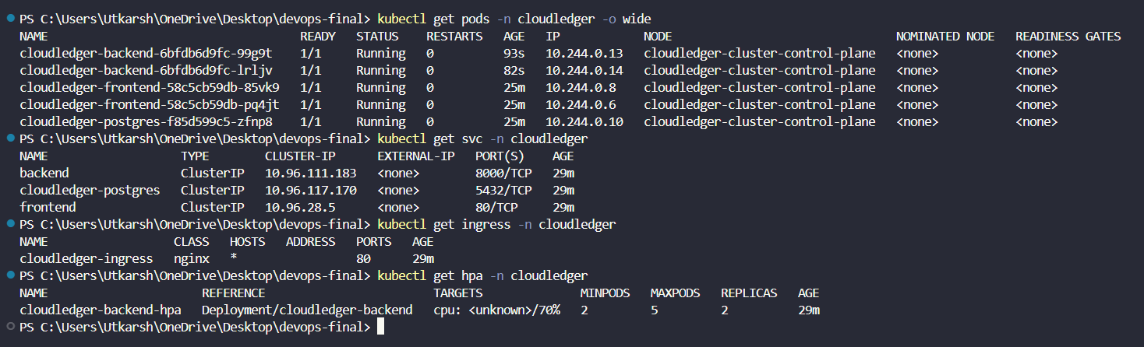
9. Module 8 (M8): Kubernetes & Helm Orchestration (15 Pts)
High-Availability 3-Tier Deployment in cloudledger Namespace
• Custom Helm chart (helm/cloudledger) templating Deployments, ClusterIP Services, Ingress, HPA, ConfigMap, Secret, and Postgres PVC.
• Deployed with 2x cloudledger-backend replicas, 2x cloudledger-frontend replicas, and 1x cloudledger-postgres stateful pod (all 1/1 Running).
• NGINX Ingress routes / to frontend:80 and /api to backend:8000.
• Liveness (/health) and Readiness (/ready) probes ensure zero-downtime rolling updates.

Slide 11
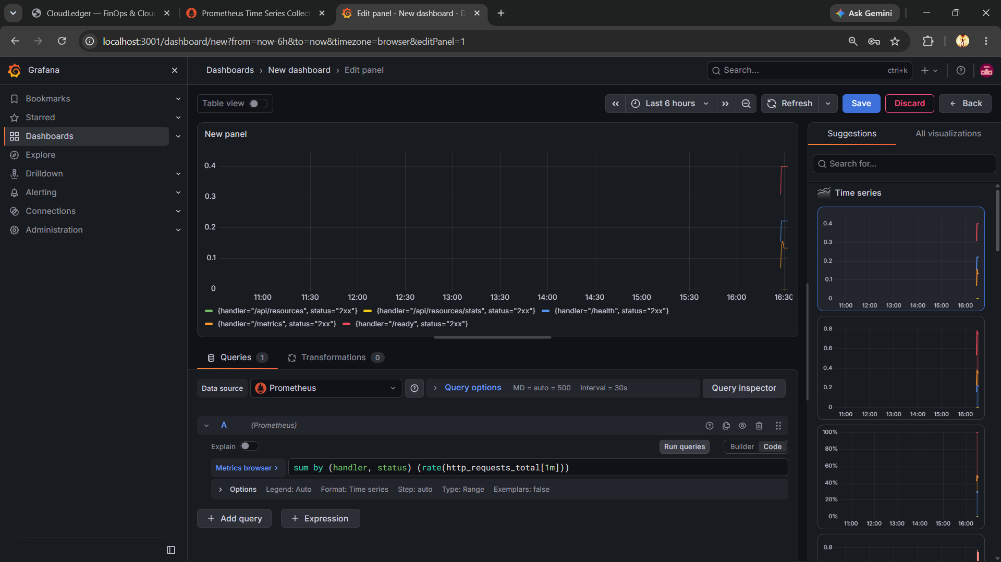
10. Module 9 (M9): Observability — Prometheus & Grafana (10 Pts)
Real-Time RED Metrics (Rate, Errors, Duration) & ServiceMonitor Scraping
• FastAPI instrumented via prometheus-fastapi-instrumentator exposing counters and latency histograms at GET /metrics.
• Deployed kube-prometheus-stack via Helm into the monitoring namespace.
• Custom ServiceMonitor (cloudledger-backend-monitor) scrapes both backend pods every 15s (Target State: UP 2/2).
• Live Grafana dashboard visualizes sum by (handler, status) (rate(http_requests_total[1m])).

Slide 12
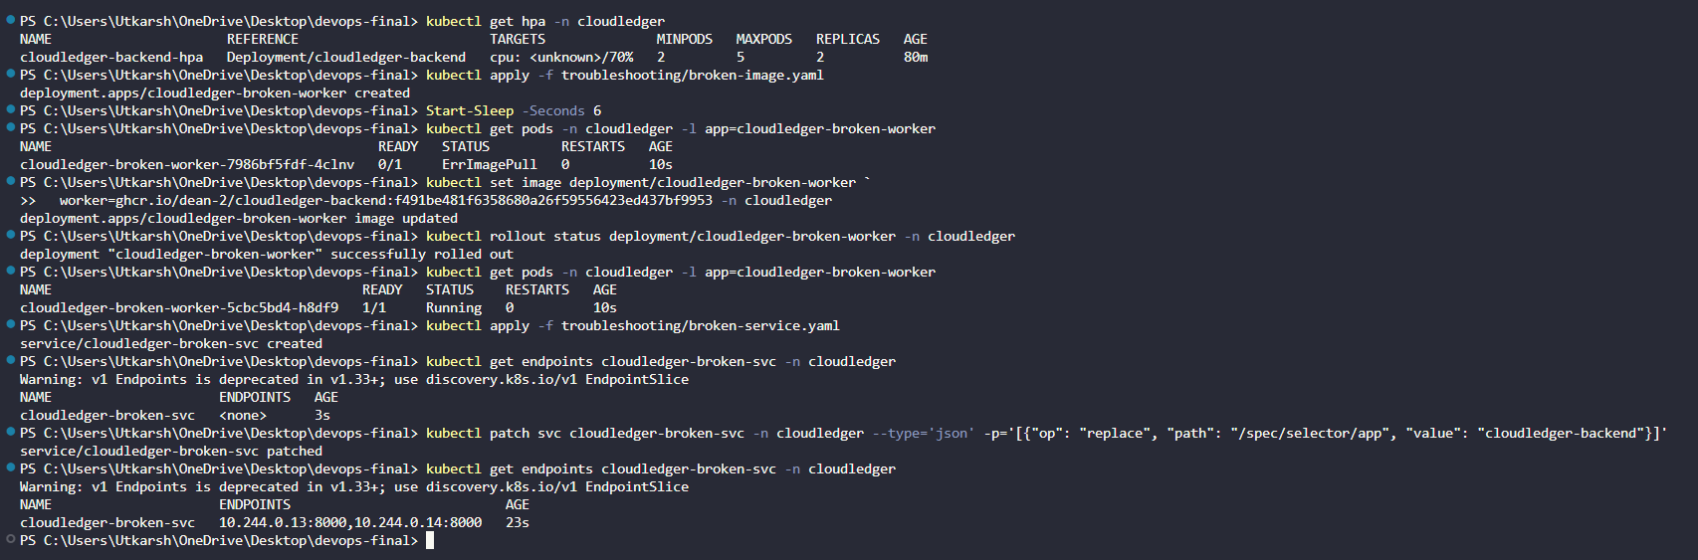
11. Module 10 (M10): HPA Autoscaling & Live K8s Troubleshooting (5 Pts)
Dynamic CPU Scaling & Real-Time Remediation of Broken Manifests
• HorizontalPodAutoscaler scales cloudledger-backend from 2 to 5 replicas at 70% CPU utilization target.
• Scenario 1 (broken-image.yaml): Diagnosed ImagePullBackOff on non-existent tag and remediated live via kubectl set image.
• Scenario 2 (broken-service.yaml): Diagnosed 0 endpoints (<none>) caused by selector typo and patched live via kubectl patch svc.
• All 10 deliverables (M1.md–M10.md) and 18 verification screenshots completed.

