Slide 1
Predicting World Cup 2026 Results with Linear Regression
HIT140 Foundations of Data Science · Assessment 3 (Objective 2)
Sydney Group 07 · [Member names and student IDs]
Notes:
Introduce the group and the two regression tasks from Objective 2.

Slide 2
Two questions, one tournament
Linear Regression 2.1
Linear Regression 2.2
How big will the winning margin be?
How many goals will a team score?
104
GD
208
Goals
matches (rows)
target: team1 − team2 goals
team-match rows
target: goals scored
Both models use exactly 8 explanatory variables, all known before kick-off. 48 teams · 308 goals · champions Spain.
Notes:
Explain the two targets and the 104/208 row requirement from the brief.

Slide 3
From raw results to leak-free features
1
2
3
4
Collect
Validate
Engineer
Model
Scores for 104 matches, FIFA ranking (11 Jun), Transfermarkt values, ages, WC history
Group scores rebuild all 12 official tables; knockout scores confirmed by ≥2 sources
Form uses only matches played earlier; team1 − team2 differences for 2.1
OLS, backward elimination, 80/20 split + 20× repeated 10-fold CV
Notes:
Stress the brief's rule: only information available before the match. Form features use cumulative sums minus the current match.

Slide 4
The 8 explanatory variables
Concept | LR 2.1 (team1 − team2) | LR 2.2 (team view)
Strength ranking | fifa_rank_diff | fifa_rank, opp_fifa_rank
Squad value | log_value_ratio | log_market_value, opp_log_market_value
Squad age | avg_age_diff | —
Home continent | host_diff | is_host
Experience / pedigree | wc_experience_diff, elite_conf_diff | —
Fatigue / stage | rest_days_diff | is_knockout
Tournament form so far | form_gd_pg_diff | form_gf_pg, opp_form_ga_pg
Notes:
Explain why each variable should matter before a match.

Slide 5
2.1: squad value and ranking move with goal difference
7.4
VIF of log_value_ratio: overlaps with FIFA rank (r = −0.79)
Several variables carry the same 'team strength' signal, so not all can stay significant together.
Notes:
Correlations are strong for value, ranking and experience; collinearity explains later results.

Slide 6
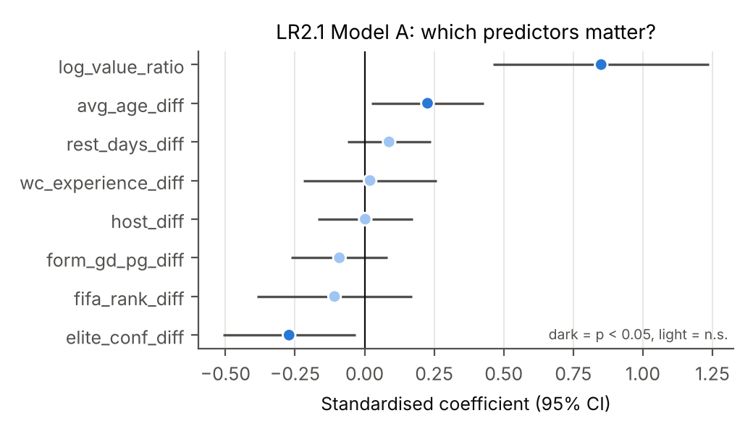
2.1: three variables survive elimination
+1.09
log_value_ratio
per ln-unit (≈2.7× squad value)
+0.32
avg_age_diff
per year older on average
−0.71
elite_conf_diff
UEFA/CONMEBOL vs. others, given value
Model B: adjusted R² 0.480 (Model A, all 8 variables: 0.469). All p < 0.01.
Notes:
Interpret coefficients holding others fixed; the negative confederation effect is not causal.

Slide 7
2.1: the simpler model predicts unseen matches better
0.50
Model B test R² (Model A: 0.28)
−27%
error vs. predicting the average
Residuals look normal (Shapiro–Wilk p = 0.60) with constant spread (Breusch–Pagan p = 0.15).
Notes:
Model A overfits: train R² 0.53 vs test 0.28. Model B generalises better.

Slide 8
2.2: goals are a small, skewed count
1.48
mean goals per team per match
0.40
strongest correlation (own squad value)
61% of rows are 0 or 1 goals, so one team's tally is much noisier than a match's margin.
Notes:
Right-skewed integer target: a challenge for linear regression assumptions.

Slide 9
2.2: own value and opponent rank drive goals
+0.45
goals per ln-unit of own squad value
+1.0
goal vs. an opponent ranked 50 places lower
Model B keeps 2 of 8 variables (adj. R² 0.261 vs. 0.267 for A) and is best in cross-validation.
Notes:
Model C = log(1+goals) target, back-transformed. Best on the single split (test R² 0.25) but not in CV.

Slide 10
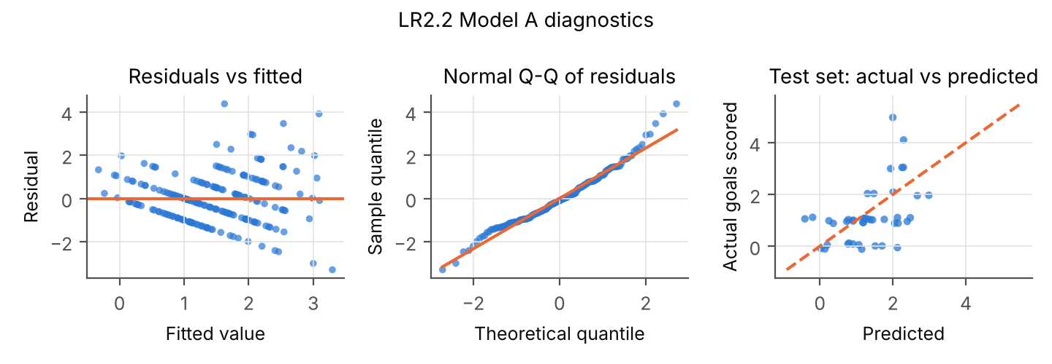
2.2: the residuals reveal the model's limits
Striped residuals and failed checks (Shapiro–Wilk p = 0.001, Breusch–Pagan p < 0.001) come from an integer target.
The log(1 + goals) Model C improves normality (p = 0.021) but not cross-validated error.
Next step beyond this unit: Poisson regression for count data.
Notes:
Discuss assumptions and the improvement attempt honestly.

Slide 11
What we learned
Squad value wins
Margins beat tallies
Simpler generalises
The most consistent pre-match predictor in both models.
2.1 explains ~48% of variance; 2.2 only ~26%.
Backward elimination cut error on unseen data in both tasks.
Limitations
Small samples (104 / 208 rows); single test split varies, so CV is reported too
Form = 0 before each team's first match; squad values snapshot from 18 June
Paired rows in 2.2 are not independent; FIFA rank is ordinal
Notes:
Close with the three takeaways and limitations; invite questions.

