Slide 1
Review and Introduction to Biostatistics
Advanced Biostatistics
Dean C. Adams
Lecture 1
EEOB 590C

Slide 2
The Particulars
Lectures: Mondays 10:00 – 11:30, 203 Bessey Hall
Lab: Mondays 11:30 – 12:30, 203 Bessey Hall
Readings: no assigned readings, but 3 references are useful
Legendre, P., and L. Legendre. 1998. Numerical Ecology. 2nd Edition. Elsevier Science, Amsterdam.
Manly, B. F. J. 1994. Multivariate Statistical Methods: A Primer. Second Edition. Chapman & Hall, London.
Sokal, R. R. and F. J. Rohlf. 2012. Biometry. 4th Edition. Freeman Associates, San Francisco.
NOTE: THIS SEMINAR IS NOT A SUBSTITUTE FOR STATISTICS COURSES, BUT SERVES AS AN OVERVIEW (or roadmap of what is out there)

Slide 3
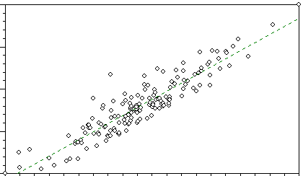
Dean’s Biased View of Statistics
All data are dots in space
Axes of the space change depending on data type (e.g., categorical vs. continuous data)
Statistical methods represent a set of tools for visualizing and describing patterns of dots in data space
Secret of statistics: knowing which method to use for which data type (choice is combination of hypotheses and data types)

Slide 4
Inferential vs. Exploratory Statistics
Independent Variable: specifies the hypothesis; a predictor for other variables (e.g., sex, age). (X-matrix)
Dependent Variable: the response variable; its variation depends other variables. This is the ‘data’ (Y-matrix)
MANY ways of classifying statistical methods, I prefer…
Inferential Statistics: test for specific patterns in data using independent variables to generate hypotheses (Y vs. X)
Exploratory Statistics: describe patterns in data without independent variables or specific hypotheses (patterns in Y)

Slide 5
Inferential vs. Exploratory Statistics
Some examples:
Inferential Methods
Exploratory Methods
T-test
Principal Components (PCA)
F-test
Principal Coordinates (PCoA)
ANOVA/MANOVA
Multi-Dimensional Scaling (MDS)
Chi-square
UPGMA
Regression
K-Means clustering
Some methods are ‘hybrids’ (e.g., CVA and Correspondence Analysis)

Slide 6
Inferential Statistics: Approaches
Parametric Methods: Use parameters estimated from data to test hypotheses. Parameters compared to theoretical distributions to assess significance (powerful approaches)
Nonparametric Methods: Depend on the distribution of the variates (the data); some use ranks, others generate their own distribution from data (e.g., randomization). Used when data don’t meet parametric assumptions
Bayesian Methods: use prior knowledge & data to assess hypotheses. Powerful approach, but can be context dependent (e.g., if two researchers have different ‘priors’)

Slide 7
Basic Concepts: Inferential Statistics
Test for specific patterns in data using independent variables to generate hypotheses (Y vs. X)
Procedure:
Obtain an observed value
Compare observed value to expected values under the null hypothesis (or from the likelihood under the null hypothesis)
Determine whether observed value is something interesting (i.e., it is unexpected relative to expected under the null hypothesis? Typically P < 0.05)
Where do the expected values come from?

Slide 8
Inferential Statistics: Expected Values
Obtained by:
1: The type of data examined
2: A model of how the process works
Often a theoretical distribution can be derived
Example 1: How likely is it that you get 5 heads in a row?
Type of data: Binary: head/tail (1/0)
Model: a ‘fair’ coin (i.e., chance of heads = 0.5). Also, each event independent (flipping a head the 1st toss does not alter chance of heads on 2nd toss)
Likelihood of 5 tails in a row is: 0.5*0.5*0.5*0.5*0.5 = 0.03125
Value is small, so result of 5 heads in a row is not likely

Slide 9
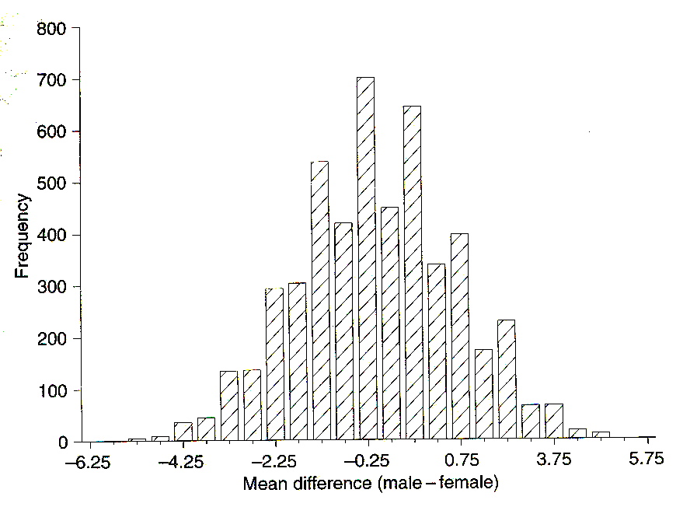
Inferential Statistics: Expected Values
Example 2: Are male and female mandible lengths the same?
Type of data: Continuous
Model: Assess trend in male vs. female jackal mandible length (i.e., compare average values). Assume independence of individuals measured.
Calculate test value and generate expected values under the null hypothesis of no difference between males and females (i.e., no pattern)*
Shuffle specimens among M/F groups, calculate D_{rand} and repeat many times, compare D_{obs} to distribution of D_{rand}
Males: 120,107,110,116, 114, 111, 113, 117, 114, 112
Females: 110, 111, 107, 108, 110, 105, 107, 106, 111, 111
D_{obs} = 4.8
This is a randomization test
*The null hypothesis and expected values derived from it are
extremely important for designing proper permutation tests

Slide 10
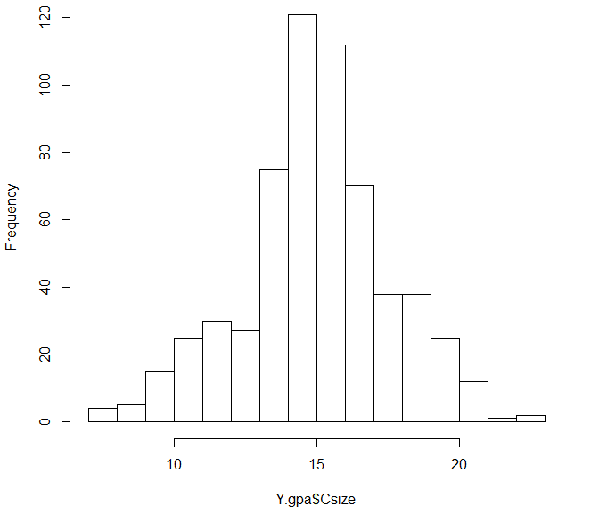
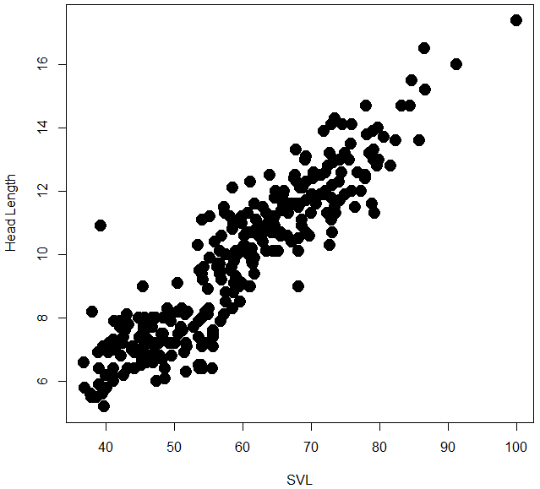
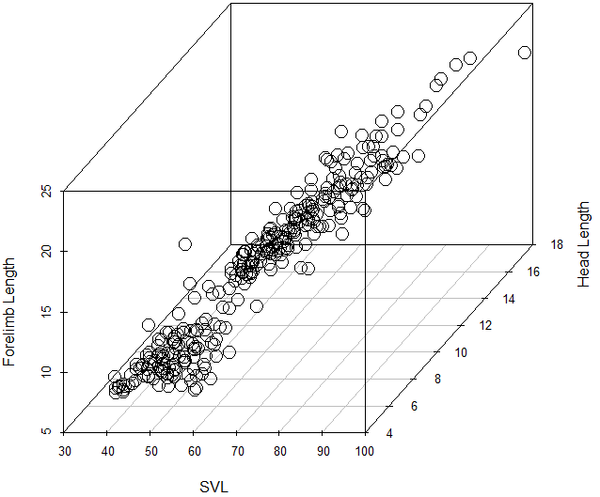
Univariate Versus Multivariate Analyses
Univariate statistics: Assess variation in single Y (obtain scalar result)
Multivariate statistics: Assess variation in multiple Y simultaneously
Multivariate methods are mathematical generalizations of univariate (ACTUALLY, univariate methods are special cases of multivariate!)

Slide 11
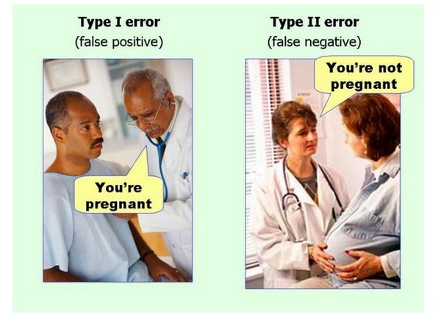
Type I & Type II Error
Type I error (α): reject H₀ when true (false positives)
Type II error (β): not rejecting H₀ when false (false negatives)

Slide 12
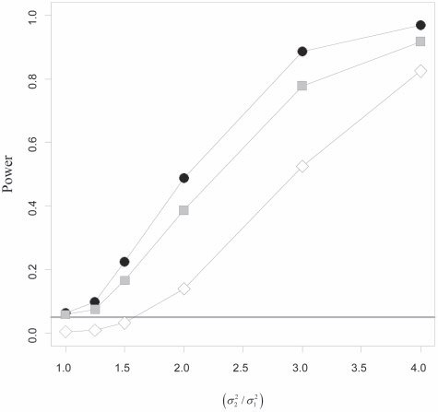
Power
Power (1-β): ability to detect significant effect (function of effect, N, σ²)
Power of test can be empirically determined
Type I error and power for several evolutionary test statistics.
(Adams. 2013. Syst. Biol.)

Slide 13
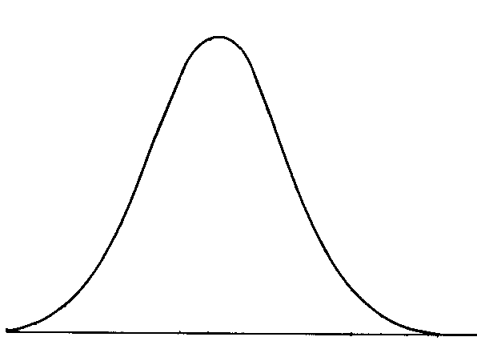
Basic Concepts: Distributional Tests
Parametric statistics: estimate statistical parameters from data, and compare to a theoretical distribution of these parameters
Significance based upon how ‘extreme’ the observed value is relative to the distribution of values (under the null hypothesis of no pattern)
Different distributions used for different statistical parameters and tests
NOTE: theoretical aspects and general properties of these distributions is a HUGE and interesting area of statistical research (consult Stats. Dept. for details)
Observed value
probability

Slide 14
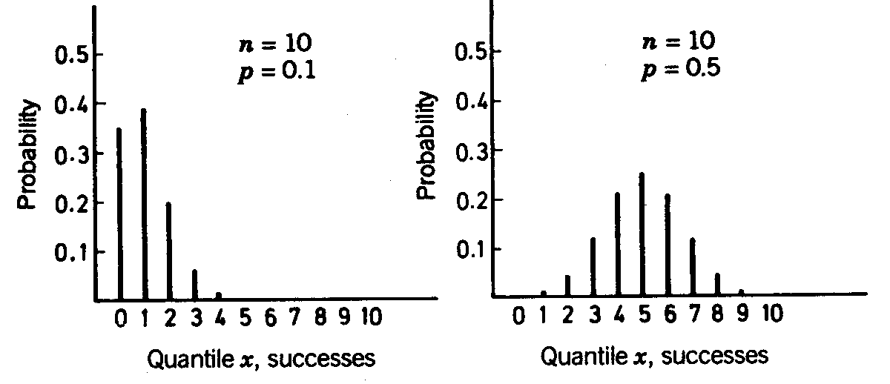
Distributions: Binomial
Distribution for binary events, calculate probabilities directly
Determine probability of obtaining x outcomes in n total tries
Example: prob. of obtaining 7 heads in 10 tries
The ‘coin-toss’ distribution
n is the total # events, x is the # successes, and p & q are the probability of success and failure.

Slide 15
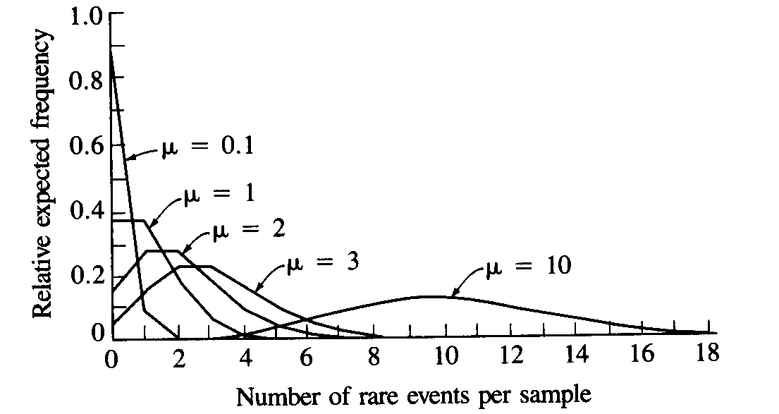
Distributions: Poisson
Models probability of rare, and independent events
For Poisson:
Multiple Poisson distributions exist (for different means)
Molecular mutations are typically modeled as Poisson

Slide 16
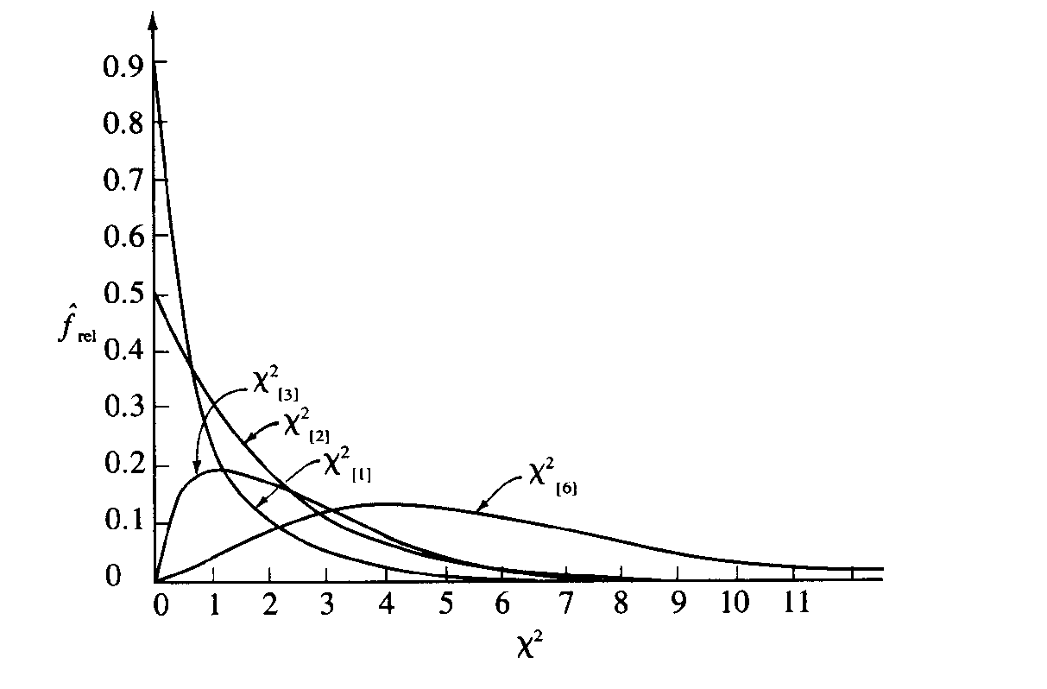
Distributions: Chi-Square χ²
Ranges from 0 to +∞: Multiple χ² distributions exist (for different df)
Many statistics (particularly for categorical data) are compared to χ² distributions (χ², G-test, Fisher’s exact test, etc.)

Slide 17
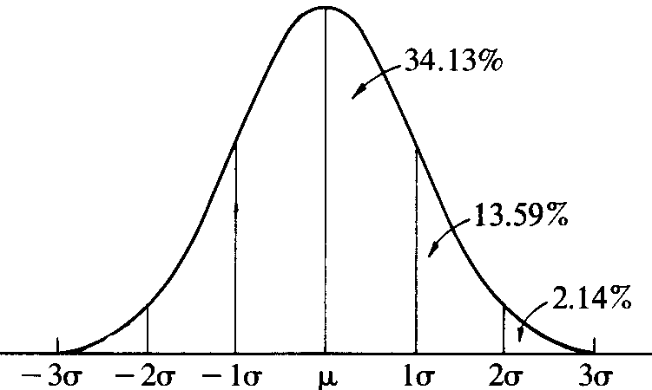
Distributions: Normal
The ‘bell curve’: data are symmetrical about the mean
Range: -∞ to +∞: ±1σ = 68% of data, ±2σ = 95% of data, ±3σ = 99% of data
T-distribution is a set of approximate normal distributions for finite sample sizes (used to compare to groups)

Slide 18
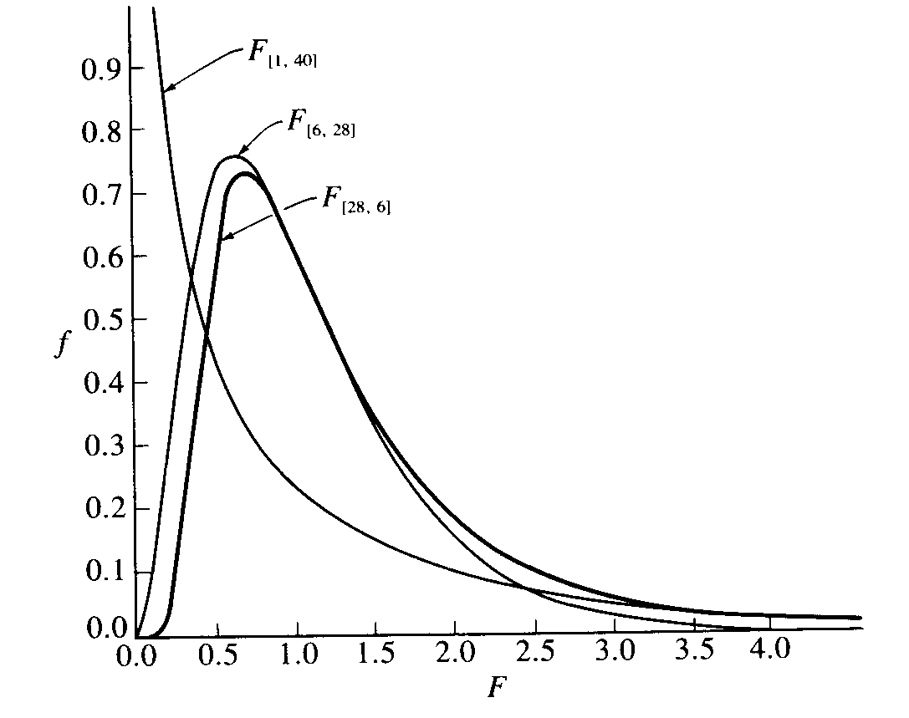
Distributions: F
Models the ratio of variances: range: 0 to +∞
One of the most commonly used distributions (used for GLM)
Is the combination of 2 T-distributions (and has 2 df)
Multiple F-distributions for various df

Slide 19
Data Transformations
Sometimes, our data and hypotheses match a type of analysis (e.g., ANOVA), but violate the assumptions (e.g., normality)
One solution: transform the data so that they more closely match the assumptions of the test (meeting the test assumptions is important, so that results can be attributed to true differences in the data vs. violations of the properties of the test)
Some common transformations for biological data are:
Log transformation: when mean is positively correlated with variance (e.g., linear morphological measurements)
Square-root transformation: used for frequency counts (note: need to add 0.5 to ALL counts if zeros exist in data)
Arcsine transformation: used for percentage/proportion data
There are MANY other possible transformations

Slide 20
Basic Concepts: Central Tendency
Summarize a sample of data points using parameters, and the measure of central tendency is one VERY important concept
Arithmetic Mean: average of the values:
Geometric Mean: used for log-data:
also calculated as:
Harmonic Mean: used for rates/speed:
Median: value having an equal number of lower and higher-valued items (the ‘middle’ or 50th percentile value)
Mode: value found in highest frequency in the data

Slide 21
Basic Concepts: Moment Statistics
Moment Statistics: deviations around the mean, raised to powers
1st moment: sum of deviates (equals zero)
2nd moment (variance)*: sum of squared deviates, measures dispersion around mean
3rd moment (skewness): describes the direction (skew) of the distribution
4th moment (kurtosis): describes overabundance of deviates at tails or at center of distribution
Skewed left Skewed right
Platykurtic Leptokurtic
*Note: for most statistical analyses, variance is calculated using (n-1)

Slide 22
Basic Concepts Cont.
Standard deviation: another measure of dispersion around the mean: square-root of variance (note that n-1 used)
Degrees of Freedom (df): describes the number of parameters in data that are free to vary after we’ve calculated some parameter (e.g., if you know the mean and all but 1 value from the data, you can figure out the remaining variate)
Becomes important when determining whether your sample size is sufficient for a particular test (each test has associated df based on how many parameters are estimated)

Slide 23
Roadmap of Inferential Statistics
Basic roadmap depends on type of X & Y variables
The vast majority of biological analyses lie somewhere in this simple roadmap
 | Categorical X | Continuous X
Categorical Y | Contingency tables | Logistic Regression
Continuous Y | ANOVA | Regression (correlation)
Log-Linear Models
General Linear Models (GLM)

Slide 24
Inferential Statistics: Calculations
Main categories of inferential models: General Linear Models (GLM) and Log-linear models
Maximum likelihood (ML) used to calculate all parameters
GLM (ANOVA, regression): Used when Y is continuous. Fitting procedure is Least Squares (minimize the sum of squares deviations). This is equivalent to ML when error is normally distributed
Log-Linear Models (logistic regression, contingency tables): Used when Y is categorical. Called log-linear because ML estimate of logs of variables is linear

Slide 25
Brief Explanations: ANOVA
ANOVA (Analysis of Variance): Y~X
X is categorical (groups), Y is continuous
H_{o}: no relationship between X & Y (i.e., no difference among groups)
Compare variation between groups to variation within groups (e.g., are males & female different in height?)
Model: (μ is grand mean, α_{i} is i^{th} group mean, and ε_{ij} is error)
Multiple factors can be tested simultaneously (e.g., sex & species)
Assumptions: independent ε_{ij}, normally distributed ε_{ij}, & homoscedastic (equal) variance

Slide 26
Brief Explanations: Regression
Regression: Y~X
X & Y are continuous
H_{o}: no relationship between X & Y
Fit a line or curve to data that maximally describes variation in the bivariate plot (e.g., relationship of age vs. height)
Model: (β₀ is intercept, β_{i} is slope, and ε_{i} is error )
Multiple linear and/or curvilinear X-variables may be included
Assumptions: independent X_{i} (measured without error), independent and normally distributed e_{ij}, & homoscedastic variance along regression line

Slide 27
Brief Explanations: Logistic Regression
Logistic Regression: Y~X
X is continuous, Y is binary
H_{o}: no relationship between X & Y
Y is derived from a categorical variable (e.g., % males)
Best regression line fit using ML
Logistic regression can sometimes be performed as linear regression using the logit transformation of the proportions

Slide 28
Brief Explanations: Contingency Tables
R x C Tests: Y~X
X is categorical, Y is categorical
H_{o}: no frequency differences among groups (rows & cols independent)
Chi-square tests and G-tests fit this type of model
Common in medical studies: Is smoking associated with cancer rates?
 | Cancer | No Cancer
Smokers | #A | #B
Non-Smokers | #C | #D

Slide 29
Expanded Roadmap of Inferential Statistics
Include more X & Y variables
ALL GLM models are derived from SAME equation, so conceptual leap to multivariate statistics is minimal
Note: ‘multivariate’ log-linear models exist, but are infrequently used in biology
 | 1 Categorical X | >1 Categorical X | 1 Continuous X | >1 Continuous X | Both
1 Categorical Y | R x C Tests | Multi-way tables | Logistic Regression | ‘multi-factor’ logistic regression
1 Continuous Y | ANOVA | Factorial ANOVA | Regression | Multiple Regression | ANCOVA
>1 Continuous Y | MANOVA | Factorial MANOVA | Multivariate Regression | Multivariate Multiple Regression | MANCOVA

Slide 30
Basic Univariate Statistics: Student’s T-Test
Compare single sample to a known value, or compare 2 samples
Determine whether means are significantly different
H_{o}: no difference in means
For a single sample calculate:
For two samples calculate:
Other variations exist (e.g., for paired data)
*Note: 2-sample t-test (n₁=n₂) yields equivalent results to 2-sample ANOVA
compare to t-distribution with pooled df (or do resampling)

Slide 31
T-Test: Example
Compare male and female class loads (# course credits)
Obtain t-statistic:
> t.test(y~x)
data: y by x
t = 4.4721, df = 8, p-value = 0.002077
alternative hypothesis: true difference in means is not equal to 0
95 percent confidence interval:
0.9687236 3.0312764
sample estimates:
mean in group f mean in group m
6 4

Slide 32
Basic Univariate Statistics: Correlation
Determine amount of association (covariation) between two variables (H_{o}: no association)
Range: -1 to +1 (more extreme values = higher correlation)
Measures ‘tightness’ of scatter of one variable relative to the other
Assess significance by converting r to t (or resampling)

Slide 33
Correlation Cont.
Numerator of r_{ij} is covariance: describes deviations in 1 variable as they change with deviations in another variable (similar to variance, but for 2 variables)
Very important concept*
Can also think of correlation as angle between vectors i and j in variable space: the tighter the angle, the higher the correlation
Thus, r = cos θ (1 of MANY ways to visualize correlations)
*NOTE: N-1 drops out of numerator and denominator of r
vs.

Slide 34
Basic Univariate Statistics: Chi-Square
Often used to summarize categorical data from contingency tables
Tests for independence of values in cells (i.e. between rows and columns)
For 2 x 2 table calculate:
Compare X² to X² distribution with (n-1) df =(r-1)(c-1)
Other derivations exist for particular data types, but this is general concept
O = observed data in each cell, & E = expected data

