Slide 1
Resampling Methods
Advanced Biostatistics
Dean C. Adams
Lecture 2
EEOB 590C

Slide 2
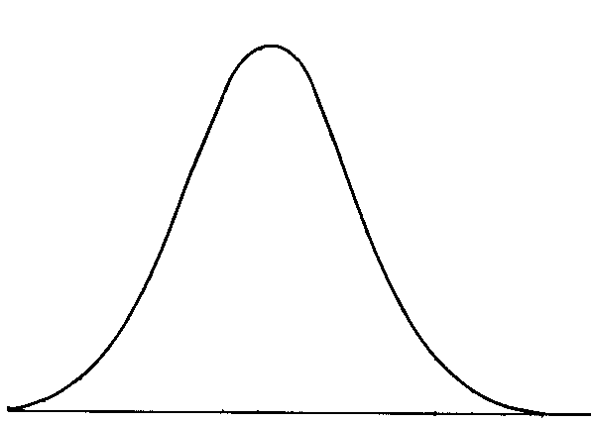
Inferential Statistics: Expected Distributions
Distribution of ‘expected’ values from H₀
Compare observed to expected to assess significance
“How ‘extreme’ is my observed value?”
Frequentist statistics: Distributions from theory
Resampling methods: Generate expected distributions from data
Observed value
probability

Slide 3
Resampling Methods
Take many samples from original data set
Evaluate significance of the original based on these samples
Nonparametric (no theoretical distribution)
Very flexible (easy to assess complex designs)
Major variants: randomization, bootstrap, jackknife, Monte Carlo
Useful for testing:
Standard designs
Non-standard designs
High-dimensional data (small N; large p)

Slide 4
Randomization (Permutation)
First true randomization: Fisher’s exact test (1935)
Complete enumeration of possible pairings of data (for t-test)
Calculate observed statistic (e.g., T-statistic): E_{obs}
Reorder data set (i.e. randomly shuffle data) and recalculate statistic E_{rand}
Repeat for all possible combinations and generate distribution of possible statistics
Percentage of E_{rand} more extreme than E_{obs} is significance level
Note: E_{obs} is treated as an iteration
Randomization can be used to determine most any test statistic
3
4
2
5
6
9
8
7
6
8
5
2
3
4
9
7
3
4
9
6
5
2
8
7
E_{obs}

Slide 5
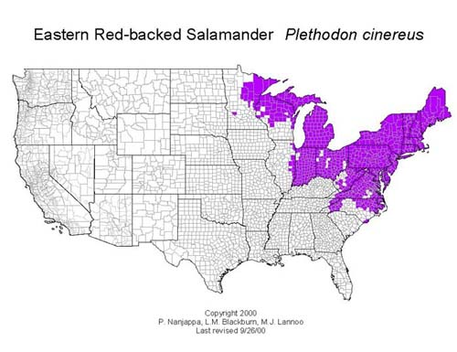
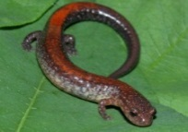
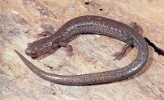
Randomization: Example
P. cinereus & P. hoffmani: compete when sympatric
What happens to jaw morphology?
Compare squamosal/dentary ratios
Plethodon cinereus
dent
sq
Plethodon hoffmani
F = 15.47,
P = 7.76 x 10⁻⁹
P_{rand} = 0.00001
(99,999 iterations)
Data From Adams and Rohlf (2000). PNAS 97:4106-4111.

Slide 6
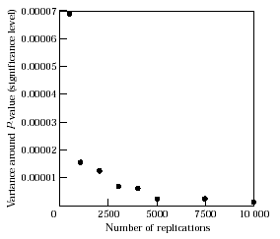
General Permutation Test
All possible permutations not feasible for most cases
Use large number of iterations instead (4,999, 9,999, etc.)
↑ # iterations improves precision of estimated significance
from Adams and Anthony (1996). Anim. Behav. 51:733-738.

Slide 7
Randomization: Comments
EXTREMELY useful and flexible technique
Critical issue: What and How to resample
General procedure: shuffle dependent (Y) variables relative to X
Works for:
Standard designs (ANOVA, regression, factorial ANOVA)
Non-standard designs
Small p, large N

Slide 8
Exchangeable Units
What one shuffles matters
Designing a proper resampling test requires
1: Identifying the null hypothesis (H₀)
2: Having a known expected value under H₀
3: Identifying what values may be shuffled to estimate distribution under H₀
Not all things that can be shuffled should be shuffled!

Slide 9
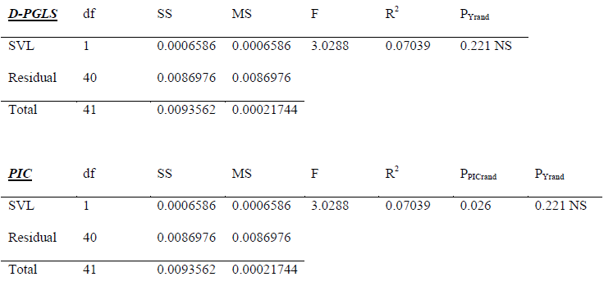
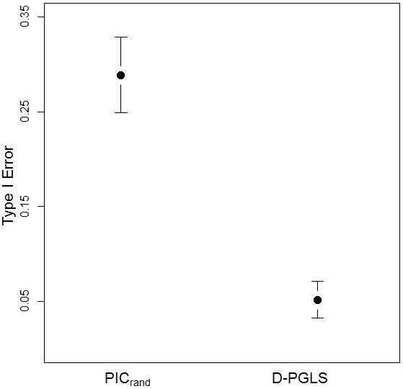
Exchangeable Units: Example
High-dimensional PCM (phylogenetic comparative method)
1: Shuffle Y-data and re-calculate things each time (D-PGLS)
2: Calculate PICs then shuffle these (PIC_{rand})
PIC_{rand} has high type I error rates (PICs are NOT the exchangeable units under the null hypothesis)
Adams and Collyer 2015. Evol.

Slide 10
Standard Designs: T-Test / ANOVA
Assess association of X & Y
Shuffle Y relative to X: models expectations of H₀ (no relationship)
Example 1: Comparison of groups (T-test or ANOVA)
Identify column representing independent variable (X)
Identify column representing dependent variables (Y): calculate F or T
Shuffle Y on X and recalculate statistic (F or T)
Works for multivariate Y data (shuffle ROWS of Y)
X
Y
X
Y
M
M
E_{obs}
E_{obs}
E_{rand}
F
F

Slide 11
Standard Designs: Regression/Correlation
Example 2: Tests of Association (correlation and regression)
Identify column representing independent variable (X)
Identify column representing dependent variables (Y); calculate F or r
Shuffle Y on X and recalculate statistic (F, r, etc.)
Works for multivariate Y data (shuffle ROWS of Y)
X
Y
X
Y
E_{obs}
E_{obs}
E_{rand}

Slide 12
Restricted Randomization
Restrict permutation of values to sub-set of data
Useful for hypotheses where some combinations don’t make sense (or for where specific hypotheses are of interest)
Example: Two species with males and females
Compare species but preserve sexual dimorphism: Shuffle within each sex
Compare sexes but preserve species: Shuffle only within each species
 | ♂ | ♀
Spp. 1
Spp. 2

Slide 13
Factorial Models
Model: Y~A+B+A*B
Assessing factors via resampling is challenging (requires estimates of EMS for each)
1: Unrestricted Randomization: Permute Y vs. (A+B+A*B)
Can test all terms (MS_{A}, MS_{B}, & MS_{A*B})
Often the wrong H₀! Conflates MS across terms (can yield uninterpretable results)
2: Restricted Randomization: Permute Y (within A; then within B)
Can test MS_{A} & MS_{B}, but not MS_{A*B} (could use unrestricted randomization for A*B)
3: Residual Randomization: Permute Y_{resid} from sequential H_{o} models
Can test all terms (MS_{A}, MS_{B}, & MS_{A*B})
Proper H₀ for each
See Edgington 1995
Manly 1998

Slide 14
Factorial Models: Understanding the Null
Factorial models are sets of sequential hypothesis tests
Model: Y~ A + B + A*B
Y~A: Tests MS_{A} vs. H_{0.r} Y~1 (Does A explain more variation than the mean?)
Y~ A + B: Tests MS_{B} vs. vs. H_{0.r1} Y~A (Does B|A explain > variation than A?)
Y~ A + B + A*B: Tests MS_{A*B} vs. vs. H_{0.r2} Y~A+B (as above for A*B)
Develop resampling procedures that appropriately test each H₀
Residual randomization most appropriate for factorial models
See Gonzalez and Manly 1998
Andersson and TerBraak 2003
Collyer, Sekora, and Adams 2015

Slide 15
Residual Randomization
Permute Y_{resid} from reduced model (H_{0.r}) with fewer terms
Holds constant SS terms in H_{0.r} while testing SS terms not in H_{0.r}
Protocol
Calculate parameters and observed test statistic (E_{obs}) from full model (e.g., 2-factor ANOVA: , where X contains factors A, B, and A×B)
Remove term (e.g., A×B) from X, calculate predicted values ( ) and residuals (ε)
Shuffle residuals (ε), add to predicted values, and calculate E_{rand}
Repeat many times and percentage of E_{rand} more extreme than E_{obs} is significance level
Higher statistical power for factorial designs (Andersson and TerBraak 2003)
Extremely powerful for many E&E hypotheses
See Gonzalez and Manly 1998. Environmetrics.
Collyer and Adams 2007. Ecology.
Collyer, Sekora, and Adams 2015. Heredity.

Slide 16
Permutation For Non-Standard Designs
Permutation useful when no theoretical distribution exists for H₀
VERY COMMON in biology, as biologists frequently have specific hypotheses not ‘covered’ by current distribution theory
Protocol
Collect data and generate hypothesis
Identify dependent and independent variables; calculate appropriate T_{obs}
Shuffle data to generate distribution of T_{rand}

Slide 17
Non-Standard Permutation: Example
P. cinereus & P. hoffmani: compete in sympatry
Is there evidence of character displacement?
H₀: Sympatric differences > allopatric differences
Data: Head shape (multivariate)
H₀: D_{symp}> D_{allo} (non-standard design)
Conclusion: evidence for character displacement
Plethodon cinereus
Plethodon hoffmani
D_{symp} = 0.0753
D_{allo} = 0.0444
T = 0.0308
P_{rand} = 0.0001
sympatric P. cinereus (green) and sympatric P. hoffmani (red)
Data From Adams and Rohlf (2000). PNAS.

Slide 18
The ‘Small N to Large p’ Problem
High-dimensional multivariate data increasingly common
If p>N, standard approaches can fail
Example: MANOVA design with p>N
|SSCP_{F}|=0
SSCP_{F}⁻¹ does not work (divide by zero)
MANOVA can’t be computed
Solution: Use resampling-based methods
1: Assess significance from other model parameters
2: Distance-based statistical approaches

Slide 19
Resample Parameters for Hypothesis Testing
Test significance of some parameter using randomization
Obtain original test-statistics (T_{obs}): tr(SSPC_{model}), D_{gp1,gp2}, etc.
Shuffle data & calculate T_{rand}
Compare T_{obs} vs. T_{rand}
Repeat
Doesn’t require inverting covariance matrix, so general solution

Slide 20
Distance-Based Approaches
Test significance based on distances between objects
Relies on covariance matrix - distance matrix equivalency (Gower, 1966)
MANOVA is covariance based
Its ‘dual’ (permutational-MANOVA) is distance-based
PCoA
Dist
Y
PCA
VCV
Gower 1966. Biometrika.
Adams 2014. Evol. & Syst. Biol.
* Method will be discussed in more detail later this semester

Slide 21
Permutational-MANOVA*: Computations
Permutational-MANOVA partitions variation in distances
SS_{Btwn} and SS_{Err} found from Distances
Obtain SS_{B}, SS_{W}: estimate F_{obs}
Shuffle data; estimate F_{rand}
Compare F_{obs} vs. F_{rand}
Repeat
Doesn’t require inverting covariance matrix, so general solution
Same group: e_{ij}=1
Different group: e_{ij}=0
*Method identical to Procrustes ANOVA and AMOVA

Slide 22
Bootstrap
Permutation: resamping without replacement
Each observation present, just shuffles order
Bootstrap: resampling with replacement
Some observations chosen more than once, others not at all
Useful for estimating confidence intervals (CI) (though other uses as well)
Several approaches exist

Slide 23
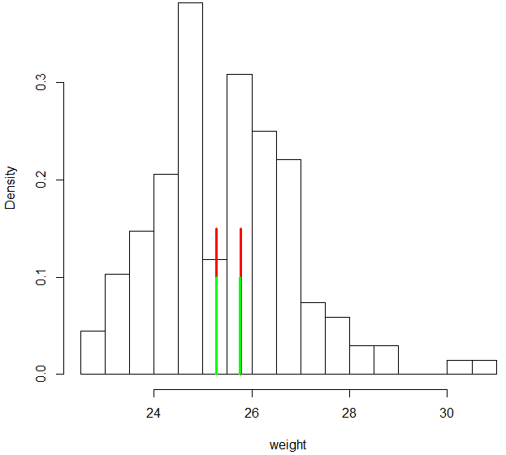
Standard Bootstrap CI
Proposed to alleviate bias in estimating σ
Protocol
Generate many bootstrap data sets
Estimate test statistic for each
Find σ from bootstrap test statistics
CI calculated as:
Traditional CI: red
Bootstrap CI: green

Slide 24
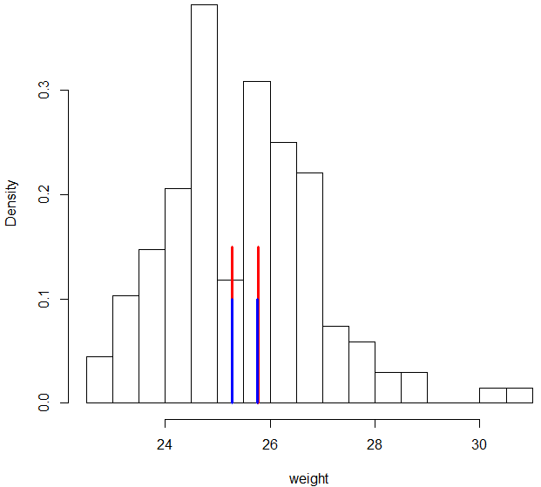
Percentile Bootstrap CI
Proposed to alleviate use of normal distribution
Protocol
Generate many bootstrap data sets
Estimate test statistic for each
Bootstrap CI: upper and lower
α/2 percent (usually: 0.025 & 0.975)
Note: assumes the distribution of bootstrap test statistics is centered on observed test statistic
Traditional CI: red
Bootstrap CI: blue

Slide 25
Bias-Corrected Percentile Bootstrap CI
Accounts for when > 50% of bootstrap test statistics are above or below observed value (‘Slides’ the percentiles a bit)
Protocol
Generate many bootstrap data sets
Estimate test statistic for each
Find fraction (Fr) of bootstrap values above/below observed statistic
Upper and lower CI: (Φ is cumulative normal distribution, and α is desired type I error: usually 0.05)

Slide 26
Bootstrapping and Phylogenetics
Felsenstein (1985) proposed bootstrapping to assess confidence in phylogenetic trees
Calculate phylogenetic tree from data (e.g., parsimony or UPGMA)
Bootstrap data set large # times and recalculate tree
Proportion of nodes in bootstrapped trees is ‘support’ for that node in the observed tree
Logic: measured characters are representative of true character set
Bootstrap generates alternative character matrices
CAREFUL IN INTERPRETATION!
Bootstrap estimates on nodes are NOT independent
Bootstrap values often follow particular pattern: large at base and tips, smaller in middle (result of combinatoric branching theory)

Slide 27
Jackknife
Jackknifing resamples by systematically eliminating 1 sample
Each iterated data set thus contains n-1 observations
Asks how precise is the observed estimate (or how sensitive it is to particular values)
Typically used to estimate bias, standard errors, and CI of test statistics

Slide 28
Jackknife Protocol for Bias
Calculate observed test statistic E_{obs}
Remove one observation and calculate estimate of statistic E_{jack}
Repeat above step, removing a different object each iteration
Calculate mean of estimates
Note: the jackknife is less frequently used due to greater computer power (full permutations and bootstraps are more computationally feasible)

Slide 29
Monte Carlo Simulations
Use parameterized model to simulate data, from which distribution of E_{rand} is generated
NOT a permutation or bootstrap, because values in each iteration are not from the original set of data
However, parameters for the model are estimated from the original data
Assumes that the observed data is a representative sample, so other such samples are generated, and used to compare patterns in original sample to those of randomly generated samples

Slide 30
Monte Carlo Simulations
Example applications:
Are plants distributed randomly in forest?
Calculate point-pattern statistic of actual plants
Simulate random plant locations (using RandUnif, or other model) and compare patterns
Are species ‘evenly’ distributed among communities?
Calculate evenness measure (E) for actual communities
Simulate random communities from a community-assembly model and compare E_{rand} to E_{obs}
In E&E, one often hears of ‘parametric bootstrap’ for hypothesis testing and generation of confidence intervals. This is a Monte Carlo procedure

Slide 31
Resampling: Comments
Resampling approaches extremely useful and flexible
Much more powerful than rank-based nonparametric approaches, and can be as powerful as parametric tests in some circumstances
Can be used to assess significance when data don’t meet certain assumptions of test (e.g., data not normal but in ANOVA format)
Useful when no theoretical distribution exists (CCorA &2B-PLS)
Also useful when data design or hypothesis is ‘non-standard’
Can implement resampling methods in:
R
SAS
Any computer programming language (Perl, Python, C, Pascal, etc.)
Excel with Pop-tools add-in (intuitive, but limited in capabilities)
Permute (Legendre)

