Slide 1
Matrix Algebra Review & GLM: General Linear Models
Advanced Biostatistics
Dean C. Adams
Lecture 5
EEOB 590C

Slide 2
Matrices: The Algebra of Statistics
Grasping matrix algebra is the KEY for understanding statistics
Compact method of expressing mathematical operations
Generalize from one to many variables (i.e. vectors to matrices)
Matrix operations have geometric interpretations in data spaces
Much of our data (e.g., shape) cannot be measured with a single variable, so multivariate methods are required to properly address our hypotheses (e.g., can evaluate covariance)

Slide 3
Scalars, Vectors, and Matrices
Scalar: a number
Vector: an ordered list (array) of scalars (n_{rows} x 1_{cols})
Matrix: a rectangular array of scalars (n_{rows} x p_{cols})

Slide 4
Matrix Transpose
Reverse rows and columns
Represent by A^{t} or A’
Vector transpose works identically

Slide 5
Matrix Addition and Subtraction
Matrices must have same dimensions
Add/subtract element-wise
Vector addition/subtraction works identically
Addition
Subtraction

Slide 6
Scalar Multiplication
When multiplying a vector/matrix by a scalar, simply multiply all elements by the scalar

Slide 7
Vector Multiplication
Multiply 2 vectors:
Right?
Wrong!
*Actually, not always wrong, but not general. The above is known as the ‘Hadamard’ product (element-wise multiplication), which is a special multiplication procedure that is only possible for vectors/matrices of the same dimension (and only done when specified as Hadamard product).

Slide 8
Vector Multiplication: Inner Product
Combines multiplication and addition, and is performed in specified order
Why inner product? In order for vector multiplication to work, dimensions have to match in a special way.
Inner product(or dot product) is a product that returns a scalar.
Outer dimensions define resultant matrix
Inner dimensions must match

Slide 9
Vector Multiplication: Outer Product
Inner Product
Outer Product
This is a “square matrix”
rows = columns
*Note the trace of ba^{t} (the sum of diagonal elements) is equal to the inner product of a^{t}b

Slide 10
Matrix Multiplication
Simply the joint multiplication of vectors within matrices
Matrix multiplication is solving a series of inner products

Slide 11
Matrix Multiplication
Order of matrices makes a difference: AB ≠BA
Also, matrix product will not always work in both directions:

Slide 12
Review: Multiplication
Scalar multiplication:
Matrix multiplication:
Inner dimensions MUST AGREE!!!

Slide 13
Special Matrices

Slide 14
Special Matrices Cont.

Slide 15
Matrix Multiplication: Geometric Interpretation
Multiplying data and other matrices has geometric interpretations
YI=Y: No change to Y
YcI=Y: Change of scale (e.g, enlargement)
YD=Y: Stretching if D is diagonal
YT=Y: Rigid rotation if T is pxp orthogonal
YT=Y: Shear if T is not orthogonal
(T can be decomposed into rotation, dilation, rotation)
Y = data matrix

Slide 16
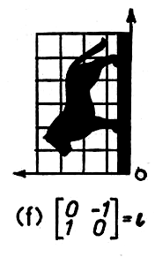
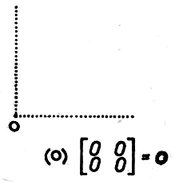
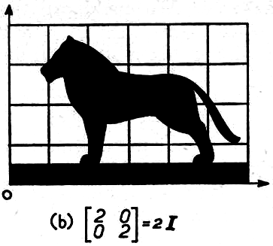
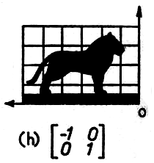
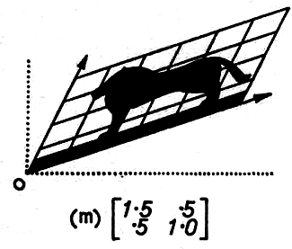
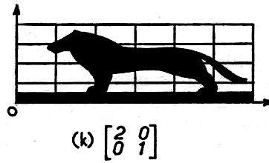
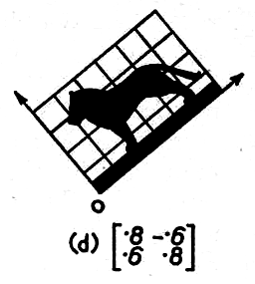
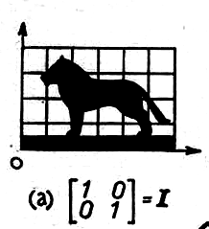
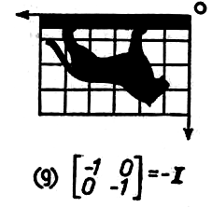
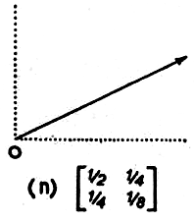
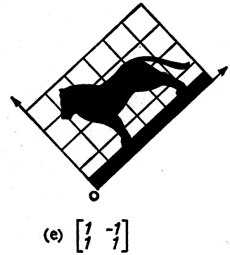

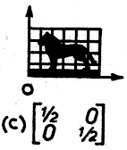
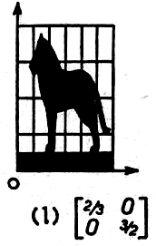
Matrix Multiplication: Visual Examples
Original
Scalar (1/2)
Scalar (2)
Rotations
Shears and Projections
(images from C.A.B. Smith, 1969)

Slide 17
Matrix Inversion
Can’t divide matrices, but can find the inverse (reciprocal) and then multiply by reciprocal (much like: )
Inverses have property that:
Matrix must be square and non-singular (i.e., determinant  0)

Slide 18
Matrix Inversion: Example
Example:
Inverse:
Confirm:

Slide 19
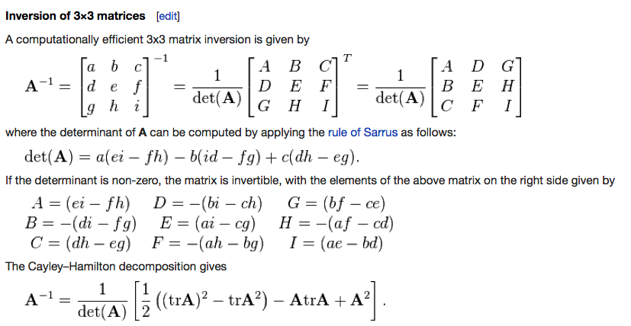
Matrix Inversion: Larger matrices
Inversion of 3 x 3 matrices or larger is not trivial computationally.
Plagiarized from Wikipedia…
Computer programs like R use LAPACK – a system of numerical linear equations and decompositions – to estimate matrix inverse.

Slide 20
Matrix Inversion: Uses
While inversion seems useful in only rare circumstances, we use it frequently as an analytical tool in statistical estimation.
Consider:
This is the matrix equivalent to squaring!

Slide 21
From Matrix Algebra to Linear Models
Here, X contains a dummy variable, and a second variable
X is a linear model design matrix. It allows calculation of statistics for variables

Slide 22
A Simple Linear Model
The linear model and its coefficients

Slide 23
The General Linear Model
Data = Design × Coefficients + Error
(Prediction )
Matrix of p dependent values
Matrix of unexplained values (residuals)
Model design matrix n subjects and k parameters
Model coefficients for k parameters, p times

Slide 24
The General Linear Model
Need to solve this
Why?
Make ‘X’ a square matrix:
Multiply by inverse:

Slide 25
General Linear Models
Assess variation in Y as explained by models of the form:
ANOVA: Categorical X
H_{o}: no difference among groups
Regression: Continuous X
H_{o}: no relationship between X & Y
ANCOVA: Combination of the two
H_{o}: no difference among groups while
accounting for covariation
4
3
2
1
0.29
0.39
0.48
0.58
0.68
squamosal/dentary ratio
5.85
5.14
headwdth
4.44
3.73
3.03
19.58
27.65
35.73
43.80
51.88
SVL
5.85
5.14
1
1
2
headwdth
4.44
2
3
3
4
3.73
4
3.03
19.58
27.65
35.73
43.80
51.88
SVL

Slide 26
Estimating Parameters
Typically expressed using SS equations (see e.g., Biometry)
Linear models simply partition SS and s²
ANOVA (single-factor)
Parameters then found using SS-type equations
Parameters more easily found using matrix form of GLM
Regression

Slide 27
Deriving Univariate Regression
where:
and:
1. Expand matrixes:
2. Begin rewrite:

Slide 28
Deriving Univariate Regression (Cont. 1)
2. From before:
3. Calculate inverse:
4. Multiply

Slide 29
Deriving Univariate Regression (Cont. 2)
Rearrange to:
Denominator:
1:
2: (expand multiplication)
3: (separate sum, extract constant)
4: (since: )
NOTE: lots of work
To get to solution
from matrices!
5: (multiply by n)

Slide 30
Calculating Sums of Squares
F-ratio is: SSM/SSE (with df corrections)
Need to calculate full and reduced model SS
Full model (contains all terms)
Reduced model (X# has 1 less term in it)
Significance based on:
General formula for SS of a model effect (say, A):
Works for multivariate as well
See Rencher, 1995: p. 359

Slide 31
SSΩ & SSω: Some Comments
SSω > SSΩ (SSΩ: more terms = lower SS; ‘explains’ more)
q & q’ are df for SSω & SSΩ (how many parameters are estimated for each model vs. sample size)
(SSω - SSΩ) estimates effect of the term of interest
For bivariate regression: SSω = SST
For bivariate regression: (SSω - SSΩ) = [SST – SSE] = SSM

Slide 32
Regression Example
The Data: (for matrix form):
> lm(yreg~xreg)
Coefficients:
(Intercept) xreg
0.3152 0.5163
> anova(lm(yreg~xreg))
Df Sum Sq Mean Sq F value Pr(>F)
xreg 1 9.8098 9.8098 154.71 0.00112 **
Residuals 3 0.1902 0.0634
> solve(t(xnewreg)%*%xnewreg)%*%t(xnewreg)%*%yreg
[,1]
[1,] 0.3152174
[2,] 0.5163043
From full model:
t(yreg-yhatreg)%*%(yreg-yhatreg)
[,1]
[1,] 0.1902174

Slide 33
ANOVA using GLM
Same idea, but must use special X-matrix coding
Recode k groups in k-1 dummy variables columns) of X
Generally, column 1 yields , column 2 yields deviation from for mean of group 1, etc. (if set up as orthogonal contrasts)
Dummy variables can be constructed as orthogonal contrasts of various groups

Slide 34
Orthogonal Contrasts
Group columns only represent , , etc. if they are set up as orthogonal contrasts
Orthogonal contrasts are columns of 1, 0, -1 that sum to ZERO
One approach: code group of interest as 1, last group as –1, and others as 0
If groups have different sample sizes, this can get complicated
Need to do weighted contrasts (i.e. scale –1 by sample size)
To get mean for group, multiply deviation by this weight

Slide 35
GLM ANOVA: The Meaning of β
For GLM ANOVA, value in β represent the overall mean ( ) and deviations from the grand mean ( )
For 2 groups, think of β₁ as the ‘slope’ between group means
Example:
-1 1

Slide 36
ANOVA Example 1: Equal Sample Sizes
The Data:
> summary(lm(y~x2))
Coefficients:
(Intercept) 5.0000 0.2236 22.361 1.69e-08
x2 -1.0000 0.2236 -4.472 0.00208
n₁=5
n₂=5
> solve(t(xnew)%*%xnew)%*%t(xnew)%*%y
[,1]
[1,] 5
[2,] -1
> anova(lm(y~x2))
Df Sum Sq Mean Sq F value Pr(>F)
x2 1 10 10.0 20 0.002077 **
Residuals 8 4 0.5
From full model:
> t(y-yhat)%*%(y-yhat)
[,1]
[1,] 4

Slide 37
ANOVA Example 2: Unequal Sample Sizes
The Data:
> solve(t(xnew)%*%xnew)%*%t(xnew)%*%y
[,1]
ones 5.00
xnew -0.75
> summary(lm(y~x))
Coefficients:
Estimate Std. Error t value Pr(>|t|)
(Intercept) 5.5000 0.4621 11.902 2.28e-06 ***
xm -1.2500 0.7307 -1.711 0.125
> anova(lm(y~x))
Df Sum Sq Mean Sq F value Pr(>F)
factor(x) 1 3.75 3.7500 2.9268 0.1255
Residuals 8 10.25 1.2812

Slide 38
GLM Comments
GLM is the fitting of models
Fit null model (e.g., Y~1) and then more complicated models
Assess fit of different models via SS (i.e,. LRT)
All of this is accomplished using matrix algebra

Slide 39
Conclusions
ANOVA and regression all the same model (GLM)
(key difference is what is used in X)
GLM can be expressed in matrix algebra
Question: What about multivariate-Y?

