Slide 1
Multivariate Data & GLM
Advanced Biostatistics
Dean C. Adams
Lecture 6
EEOB 590C

Slide 2
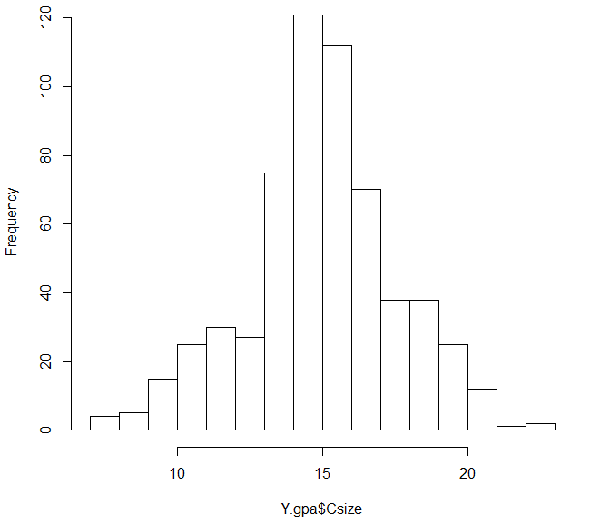
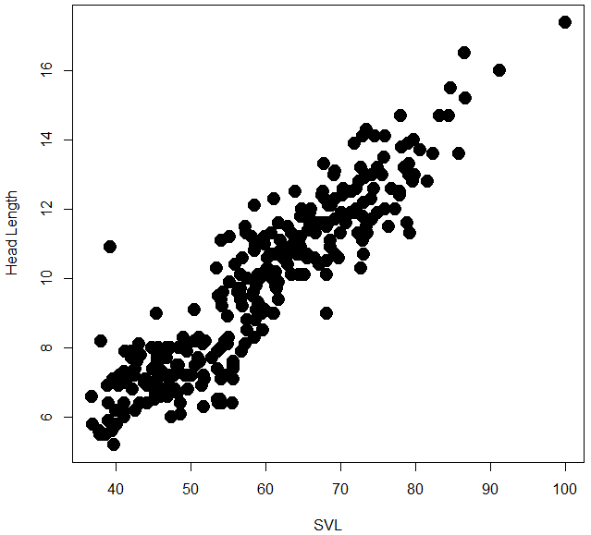
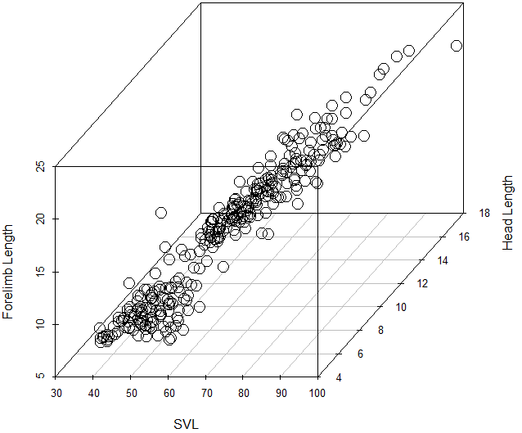
Univariate Versus Multivariate Analyses
Univariate statistics: Assess variation in single Y (obtain scalar result)
Multivariate statistics: Assess variation in multiple Y simultaneously
Multivariate methods are mathematical generalizations of univariate (ACTUALLY, univariate methods are special cases of multivariate!)

Slide 3
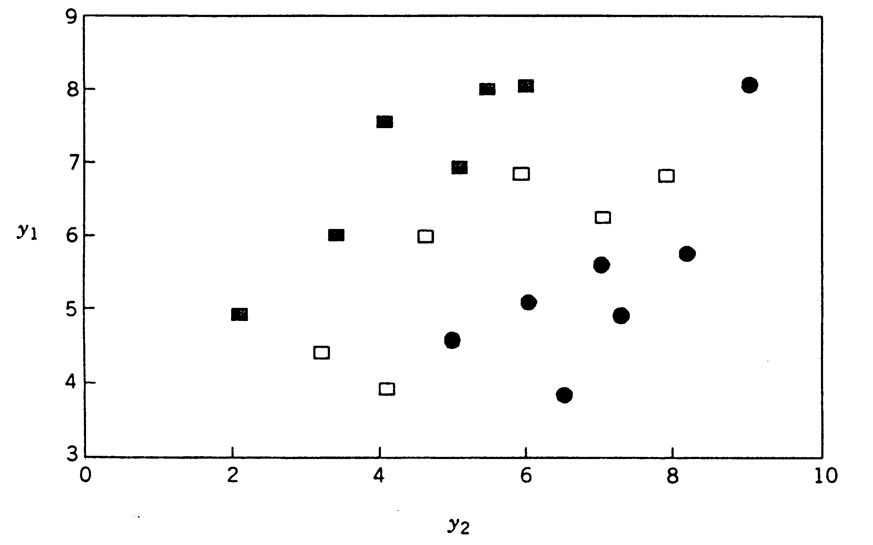
Why Jump to Multivariate?
More complete description of pattern
Biological data are often multivariate, so treat as such
Separate univariate analyses misses location differences or covariation in the data*
*Note: While covariation and location are related, they are not the same, and different multivariate methods utilize one or the other (e.g., PCA for covariaton, MANOVA for multivariate location)
ANOVAs on y₁ and y₂ separately would fail to identify group differences found in MANOVA

Slide 4
Rao’s Paradox (Curse of Dimensionality)
Increasing # dimensions of data (Y) means more information
However, for a given n the statistical power decreases
Eventually, too few n for # variables in Y
How large should sample size be?
Many suggestions:
n = 2*#vars
n = 4*#vars
n = #vars²
n_{gp} = 2*#vars
n_{gp} = 4*#vars

Slide 5
Identifying Patterns from the Y-Matrix
Several ways to identify patterns in Y_{n×p} (Y-matrix of n objects × p variables)
1: Linear models: MANOVA/regression to assess patterns
2: R-mode analyses: Summarize by columns (VCV matrix of variables)
3: Q-mode analyses: Summarize by rows (distance matrix for objects)*
First one needs to DESCRIBE the multivariate data!
*Many Q-mode & R-mode methods yield identical results: PCA (R-mode) vs. PCoA_{DEuclid} (Q-mode)

Slide 6

Descriptors of Multivariate Data
Describing multivariate data = understanding it
Data are dots in space, so goal is to describe point cloud
VCV (S): Covariance matrix of variances and covariances (‘multivariate variance’)
Correlation matrix: matrix of pairwise variable correlations (standardized covariance matrix)
Bivariate correlation plots are also useful

Slide 7
Multivariate Distances
Data are ‘dots’ in multivariate data space
Distances between objects describe similarity (or difference)
Distance (or similarity) measure used depends on the type of data
NOTE: Distances (D) can be converted to similarities (S) and vice-versa
When scaled to 0→1, relationship is: or or
Large distance = less similar
Small distance = similar

Slide 8
Similarity/Distance From Binary Data
Data are 0/1
Generate 2×2 frequency table for each pair of specimens
Similarity/distance based on a,b,c,d (# traits in each category)
Simple matching coefficient:
Jaccard’s coefficient:
Hamming distance: (#differences)
Choice depends on data and assumptions (e.g., are shared absences (0,0) meaningful?)
 | Specimen 2
Specimen 1 |  |  | 1 |  | 0
 | 1 |  | a |  | b
 | 0 |  | c |  | d
For S→ D conversions see Legendre & Legendre 1998

Slide 9
Similarity/Distance From Multi-State Data
Multi-state data requires different S/D measures
Percent matching:
Note: can extend all binary descriptors in this fashion
Gower’s general similarity:
Contribution of each trait (s_{j}) is: 0/1 for binary OR multi-state
Spec 1 |  | 9 | 3 | 4 | 6 | 2 | 1 | 6 | 8 | 7 | 8
Spec 2 |  | 5 | 3 | 3 | 4 | 3 | 1 | 6 | 4 | 6 | 8
X_{Agreements} |  | 0 | 1 | 0 | 0 | 0 | 1 | 1 | 0 |  | 1
For S→ D conversions see Legendre & Legendre 1998

Slide 10
Similarity/Distance From Continuous Data
Continuous data common in morphometrics
MANY possible distance measures
Euclidean distance:
Manhattan distance:
Canberra distance: Note double 0 must be removed
Mahalanobis distance:
Some distances (e.g., D_{euclid}) generate a METRIC space

Slide 11
Combining Data Types
All distance measures require data in commensurate units
D_{euclid} requires all Y are continuous
D_{hamming} requires all Y are 0/1
Researchers sometimes combine data types
Y=SVL, #bristles, presence of nose (0/1)
Y=elevation, #individuals/km, presence of competitor (0/1)
THIS IS GIGO!!!
A program may calculate the distance, but it has no meaning (variables in incommensurate units, not weighted properly, etc.)
Could convert characters to common unit & combine, but still have the weighting problem
Generally not advisable to combine data types for obtaining distances

Slide 12
Metrics vs. Measures
Not all distance measures are the same: they fall into different classes
Metric: A distance is a metric IFF:
1: minimal: min(d₁₁=0)
2: symmetry: (d₁₂=d₂₁)
3: Triangle inequality: (d₁₂+d₁₃ ≥ d₂₃)
Semimetric (pseudometric): Triangle inequality not satisfied
(e.g., Bray-Curtis distance & Sørenson’s similarity)
Nonmetric: min(d₁₁<0): i.e. has negative distances
(e.g.,Kulczynski’s coefficient)
Some distance measures are metric (e.g., D_{Euclid}, D_{Manhat}), others not (see above)
For discussion of common ecological distance/similarity coefficients, see Legendre & Legendre, 1998 Numerical Ecology

Slide 13
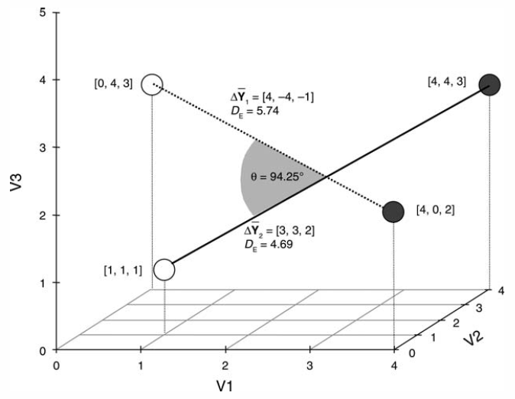
Euclidean (Metric) Spaces
Euclidean spaces are defined by the Euclidean metric (D_{euclid})
Euclidean spaces satisfy:
3 metric space conditions: 1: min(d₁₁=0); 2: d₁₂=d₂₁; 3: d₁₂+d₁₃ ≥ d₂₃
Axis Perpendicularity: if x & y are perpendicular (orthogonal)
In Euclidean spaces, distances, directions, and angles can be defined
Thus they can be examined and compared for biological interpretation
NOTE: most multivariate studies assume a metric (typically Euclidean) geometry

Slide 14
Jump to Multivariate GLM
ALL previous models (ANCOVA, factorial, nested, multiple regression, etc.) can be done as GLM in matrix form
Thus, GLM with matrices is extremely general, and covers much of our roadmap of inferential statistics
Since univariate GLM is 1 equation, jumping to MULTIVARIATE is easily accomplished (add columns to Y)
 | 1 Categorical X | >1 Categorical X | 1 Continuous X | >1 Continuous X | Both
1 Continuous Y | ANOVA | Factorial ANOVA | Regression | Multiple Regression | ANCOVA
>1 Continuous Y | MANOVA | Factorial MANOVA | Multivariate Regression | Multivariate Multiple Regression | MANCOVA
}
GLM

Slide 15
Multivariate GLM
Multivariate GLM easy, add columns to Y-matrix
β found the same way, but is a matrix
Problem: SSω & SSΩ are now matrices, so univariate no F-ratio
Need to summarize variation explained by SSω & SSΩ matrices
Several solutions:
Wilks’ lambda:
Pillai’s Trace:
Roy’s largest root:
Hotelling’s Trace:
Test statistics can be converted to F-ratio:
Pillai’s more robust to unbalanced designs and violations of model
N = total sample size, s = # X variables in reduced model, and p = # Y variables (Wilks’ Λ: lower is more significant)

Slide 16
Testing Group Differences: MANOVA
Compares variation within groups to variation between groups
X = independent variable (group labels)
Y = dependent variables
Solve for β (components of means)
Significance from multivariate test-statistic
Wilks’ lambda:
Pillai’s Trace:
Pillai’s more robust to unbalanced designs and moderate violations of model

Slide 17
Post Hoc Tests I: D_{Mahal}
Pairwise comparisons using Generalized Mahalanobis Distance (D² or D)
Convert D² T² F to test
For experiment-wise error rate, adjust using Bonferroni:
df1 = p, df2 = (N-g-p-1)
N = total sample size, g = # groups
p = # response vars.

Slide 18
Post Hoc Tests II: Randomization
Resampling method for pairwise comparisons
Estimate group means
Calculate matrix of D_{euclid}
Shuffle specimens into groups
Estimate means and D_{rand}
Assess D_{obs} vs. D_{rand}
Repeat
D_{Euclid}

Slide 19
MANOVA Example: Bumpus Sparrow Data
After a bad winter storm (Feb. 1, 1898), Bumpus retrieved 136 sparrows in Rhode Island (about ½ died)
Collected the following measurements on each:
To investigate natural selection, examined whether there was a difference in alive vs. dead birds
1) Alive/dead 2) Weight 3) Total length
4) Wing extent 5) Beak-head length 6) Humerus
7) Femur 8) Tibiotarsal 9) Skull
10) Keel-sternum 11) male/female
Bumpus, H. C. 1898. Woods Hole Mar. Biol. Sta. 6:209-226.

Slide 20
Bumpus Data: MANOVA
Single-factor MANOVA
>summary(manova(bumpus.data~sex))
Df Pillai approx F num Df den Df Pr(>F)
sex 1 0.46652 12.243 9 126 9.166e-14 ***
Factorial MANOVA
>summary(manova(bumpus.data~sex*surv))
Df Pillai approx F num Df den Df Pr(>F)
sex 1 0.47143 12.2882 9 124 9.520e-14 ***
surv 1 0.34256 7.1788 9 124 2.442e-08 ***
sex:surv 1 0.09718 1.4831 9 124 0.1613
Dead appear to be slightly larger, as do males

Slide 21
MANOVA: Post-Hoc Tests
Group comparisons with Euclidean Distance (D_{Euclid} below & P_{rand} above)
Conclusions from MANOVA:
Significant sexual dimorphism (males slightly larger)
Significant survival status (nonsurvivors slightly larger)
All pairwise comparisons significant, except within females
 | Fem Dead | Fem Surv | Male Dead | Male Surv
Fem Dead | 0 | 0.300 NS | 0.013 | 0.001
Fem Surv | 0.0319 | 0 | 0.008 | 0.005
Male Dead | 0.0576 | 0.0831 | 0 | 0.026
Male Surv | 0.0542 | 0.0649 | 0.0423 | 0

Slide 22
Describing The Data
S (VCV matrix)
Humerus, femur, tibiotarsal, & skull have most variation (in log-units)
R
Trait-by-trait group comparisons (NOTE: plots miss covariation)
2
♂
♀
2
1
1
0
0
5.02
5.05
5.07
5.09
5.12
5.44
5.46
5.49
5.52
5.55
ln(totlen)
ln(wingext)

Slide 23
Visualizing Group Differences: PCA*
Female: red
Male: blue
Alive: circle
Dead: triangle
*Will learn this next time

Slide 24
Testing for Covariation: Regression
Relates variation in shape to variation in covariate
X = independent variable (continuous)
Y = dependent variables
Solve for β (components of means)
Significance from multivariate test-statistic
Wilks’ lambda:
Pillai’s Trace:
Pillai’s more robust to unbalanced designs and moderate violations of model

Slide 25
Bumpus Data: Regression
Allometry
> summary(manova(Y~TotalLength))
Df Pillai approx F num Df den Df Pr(>F)
TotalLength 1 0.55629 19.903 8 127 < 2.2e-16 ***
Significant allometry (relative to total length)
Note: challenging to visualize patterns

Slide 26
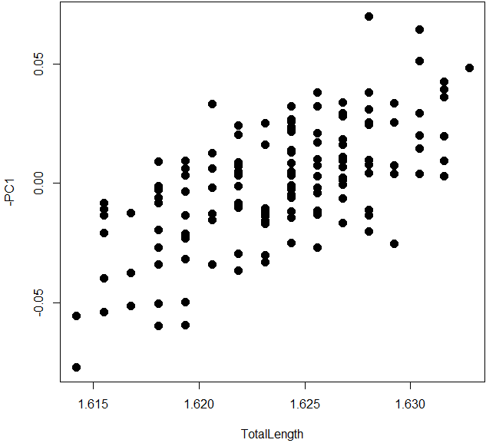
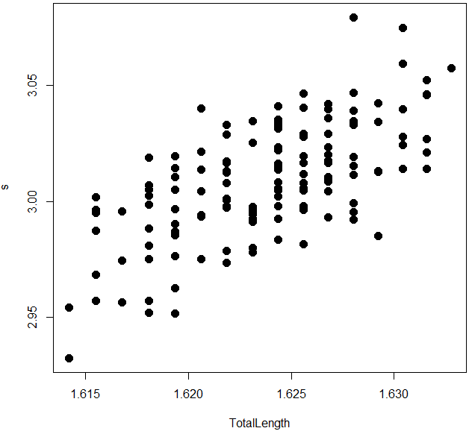
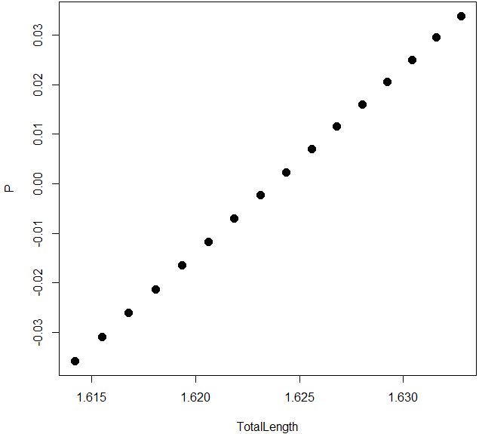
Visualizing Multivariate Regressions
Represent Y by some summary axis
PC1 vs. X
PC1 may not align with
direction of covariation
Regression Score vs. X
Drake and Klingenberg (2008)
Evolution
Predicted Values vs. X
Adams and Nistri (2010)
BMC Evol Biol

Slide 27
Testing Groups and Covariates: MANCOVA
Relates variation in shape to variation in covariate
X = independent variables (groups & continuous)
Y = dependent variables
Solve for β (components of means)
NOTE: MANCOVA is sequential procedure
Test interactions first (group-specific slopes)
If NS, remove and compare groups (while accounting for covariate)
** Implementation point: covariate must be first variable in X-matrix, as R uses Type I SS for H

Slide 28
Bumpus Data: MANCOVA
Full MANCOVA
> summary(manova(lm(Y~TotalLength*sex*surv)))
Df Pillai approx F num Df den Df Pr(>F)
TotalLength 1 0.63862 26.7287 8 121 < 2.2e-16 ***
sex 1 0.41791 10.8590 8 121 1.924e-11 ***
surv 1 0.26227 5.3771 8 121 8.593e-06 ***
TotalLength:sex 1 0.09667 1.6186 8 121 0.1263
TotalLength:surv 1 0.02795 0.4348 8 121 0.8981
sex:surv 1 0.09295 1.5499 8 121 0.1471
Compare groups while accounting for allometry
> summary(manova(lm(Y~TotalLength+sex*surv)))
Df Pillai approx F num Df den Df Pr(>F)
TotalLength 1 0.62878 26.2545 8 124 < 2.2e-16 ***
sex 1 0.40635 10.6098 8 124 2.859e-11 ***
surv 1 0.26117 5.4791 8 124 6.315e-06 ***
sex:surv 1 0.08125 1.3708 8 124 0.2157

Slide 29
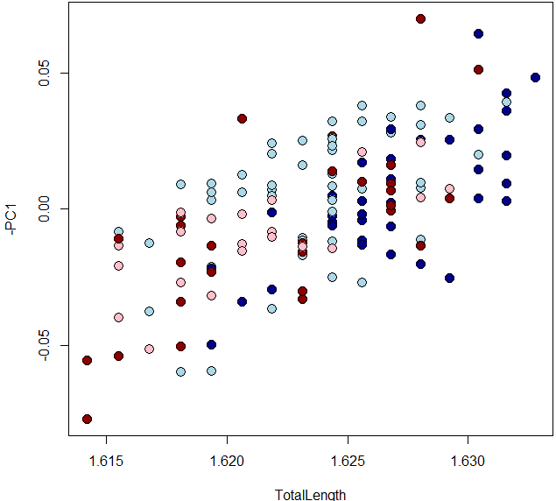
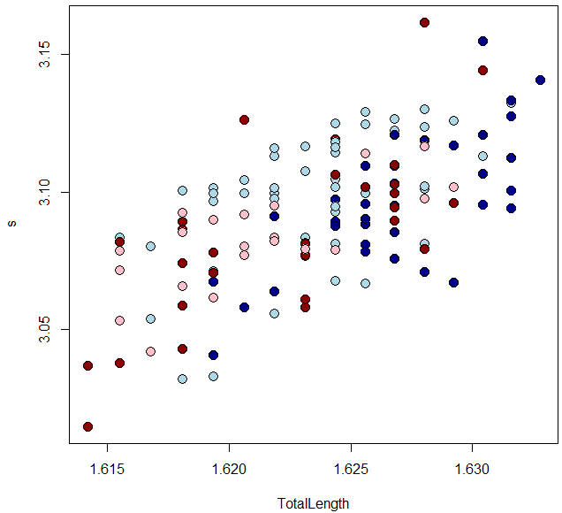
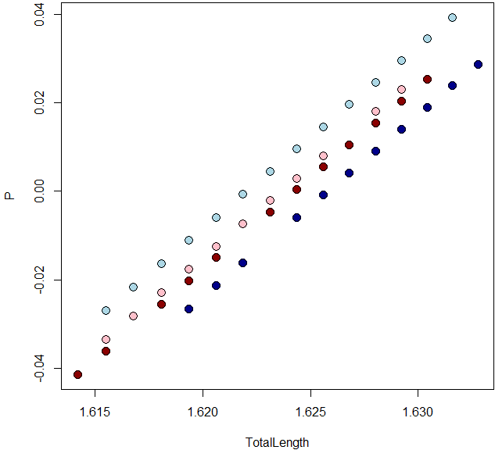
Visualizing MANCOVA
Represent Y by some summary axis (by group)
PC1 vs. X
red = female
blue = male
circles = alive
triangles = dead
Regression Score vs. X
Drake and Klingenberg (2008)
Evolution
NOTE: X = cov+gps: see MorphoJ help file
Predicted Values vs. X
Adams and Nistri (2010)
BMC Evol Biol
Note: X = cov+gps

Slide 30
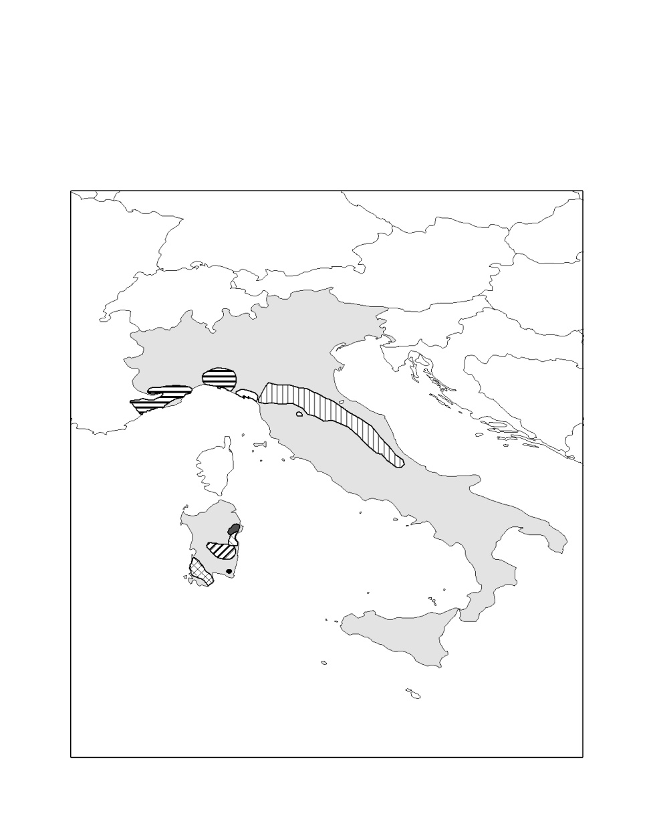
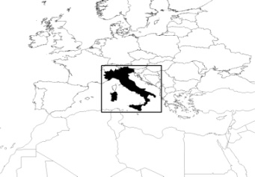
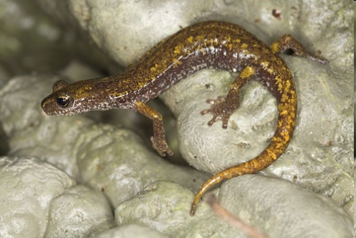
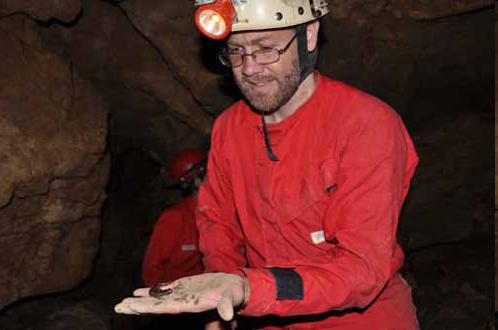
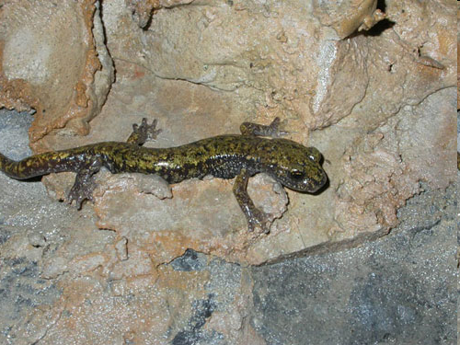
Example II: Salamander Foot Ontogeny
Italian Hydromantes inhabit caves
Climb walls & ceilings (strong ecological selection)
H_{o}: Adult foot morphology adapted for climbing (e.g,. Lanza, 1991)
a) never tested empirically, b) ignores developmental influences
Is there evidence for this hypothesis?
Adams & Nistri (2010) BMC Evol. Biol.

Slide 31
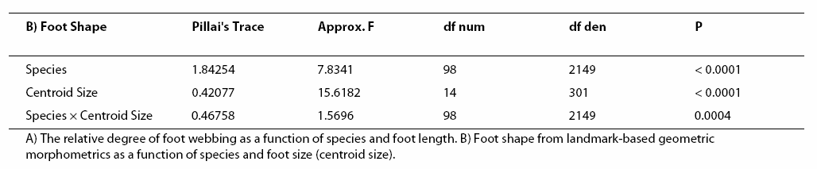
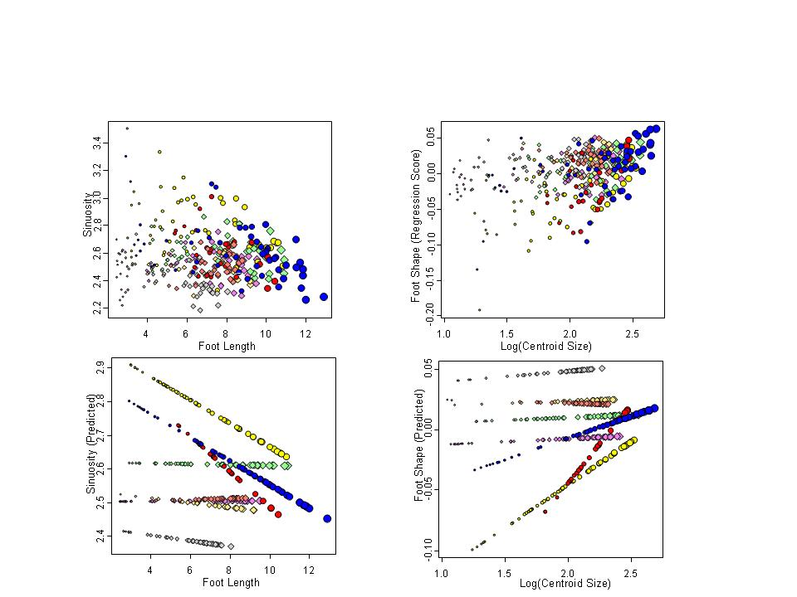
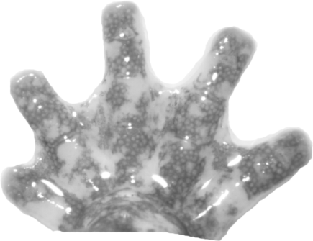
Foot Shape Ontogeny Results
Significant foot shape allometry (and convergence)
5
7
3
6
p
4
2
8
9
1
A
d
Adams & Nistri (2010) BMC Evol. Biol.

Slide 32
Multivariate GLM: Challenges I
As p ↑, power ↓
Recommendations:
Increase N (when possible)
Use distance-based MANOVA
1.0
N=10
1.0
p = 2
p = 10
p = 15
0.8
p = 20
0.8
p = 30
0.6
0.6
Power: Parametric GLM regression
Power: PGLS=PIC
0.4
Increasing
Dimensionality
0.4
Increasing
Dimensionality
p = 2
0.2
p = 4
p = 6
0.2
Power = 0.0
p = 8
p = 10
p = 15
0.0
p = 20
p = 30
0.0
0.0
0.2
0.4
0.6
0.8
0.0
0.2
0.4
0.6
0.8
Effect
Adams (unpublished).
Input Covariation
Adams (2014) Evolution.

Slide 33
Multivariate GLM: Challenges II
The ‘large P to small N’ problem
When P ≥ N, covariance matrices singular |SSCP|=0
SSCP⁻¹ can’t be computed (divide by zero)
GLM statistics undefined and cannot be completed
Can be a common problem for high-dimensional data
1.0
N=10
1.0
0.8
0.8
p = 30
0.6
Power: Parametric GLM regression
0.6
0.4
Power: PGLS=PIC
0.4
0.2
p = 10
0.2
Power = 0.0
p = 15
0.0
p = 20
p = 30
0.0
0.0
0.2
0.4
0.6
0.8
0.0
0.2
0.4
0.6
0.8
Effect
Adams (unpublished).
Input Covariation
Adams (2014) Evolution.

Slide 34
Large P to Small N: Solutions
Evaluate significance via generalized inverse (SSCP⁻ instead of SSCP⁻¹)
-Generalized inverse is called the Moore-Penrose inverse
Conceptually simple, but not all software allows this (must ‘code’ solution)
Evaluate significance via randomization
Use test-statistic that does not require inverse: tr(SSCP_{model}), D_{gp1,gp2}, etc.
Conceptually simple, but requires programming to implement
Use distance-based permutational-MANOVA

Slide 35
Solution 3: Distance-Based Approaches
Test significance based on distances between objects
Relies on covariance matrix - distance matrix equivalency (Gower, 1966)
GLM is covariance based
Its ‘dual’ (permutational-MANOVA) is distance-based
*NOTE: ANY distance measure can be used for this!!!
PCoA
Dist
Y
PCA
VCV
Gower (1966). Biometrika.

Slide 36
Permutational-MANOVA: Computations
Permutational-MANOVA partitions variation in distances
SS_{Btwn} and SS_{Err} found from distances
Obtain SS_{B}, SS_{W}: estimate F_{obs}
Shuffle data; estimate F_{rand}
Compare F_{obs} vs. F_{rand}
Repeat
Doesn’t require inverting covariance matrix, so general solution
Same group: e_{ij}=1
Different group: e_{ij}=0

Slide 37
Examples: Permutational-MANOVA
Factorial MANOVA
>summary(manova(bumpus.data~sex*surv))
Df Pillai approx F num Df den Df Pr(>F)
sex 1 0.47143 12.2882 9 124 9.520e-14 ***
surv 1 0.34256 7.1788 9 124 2.442e-08 ***
sex:surv 1 0.09718 1.4831 9 124 0.1613
Permutational-MANOVA*
> bumpus.dist<-dist(bumpus.data) #generate distance matrix
> adonis(bumpus.dist~sex*surv)
Df SumsOfSqs MeanSqs F.Model R2 Pr(>F)
sex 1 0.10568 0.105679 10.3739 0.07043 0.001 ***
surv 1 0.04607 0.046069 4.5224 0.03070 0.013 *
sex:surv 1 0.00399 0.003985 0.3912 0.00266 0.776
* The function procD.lm in the geomorph package is preferable, as it allows residual randomization

Slide 38
Multivariate GLM: Challenges III
Multivariate data not continuous (matrix binary traits, presence/absence, counts, etc.)
Not legitimate to ‘force’ into GLM
Recommendation: Use permutational-MANOVA with appropriate distance measure for data (see Legendre and Legendre 1998 for many)

Slide 39
Summary: General Linear Models
Assess variation in Y as explained by linear models:
MANOVA: Categorical X
M-Regression: Continuous X
MANCOVA: Combination of the two
Matrix formulation is most straightforward
Think of model as univariate then ‘remember’ Y is multivariate

