Slide 1
GLM Interaction Terms and Patterns of Change
Advanced Biostatistics
Dean C. Adams
Lecture 7
EEOB 590C

Slide 2
Patterns of Variation
GLM models assess patterns of variation and covariation
Are groups different from one another?
Does Y covary with X?
Methods assess clouds of points (‘dots in space’) to look for patterns
Group differences: Are clouds separated?
Regression: Is cloud elliptical (i.e. covariation)?
Often, what we really want to know is about patterns of change, not static patterns of variation
5.85
5.14
headwdth
4.44
3.73
3.03
19.58
27.65
35.73
43.80
51.88
SVL

Slide 3
Patterns of Change
Many hypotheses in E&E are really interested in patterns of change:
How does the phenotype change across environments? (plasticity)
How do traits change through evolutionary time? (quantitative genetics)
How do traits change through development? (ontogenetics)
Are patterns of variation constant across space or time? (e.g., spatial data)
GLM method only partially address these questions because they examine static patterns of variation (though, these are the statistical tools we commonly use)

Slide 4
Factorial ANOVA: Interactions
Interactions measure the joint effect of main effects A & B
Identifies whether response to A dependent on level of B
Are VERY common in biology
Example: 2 species in 2 environments (Factors A & B), species 1 has higher growth rate in moist environment, while species 2 has higher growth rate in dry environment. This would be identified as an interaction between species & environment
Species 1
Growth rate
Species 2
Note: The study of trade-offs (reaction norms) in evolutionary ecology is based on the study of interactions
Wet Dry

Slide 5
Understanding Interaction Terms
Significant interactions identify a joint response of factors (response to Factor B depends on your level in Factor A)
Interpreting interactions for univariate data is straightforward
Species 1
Growth rate
Species 2
Wet Dry
4
4
4
4
3
3
3
3
V1
2
V2
2
V3
2
V3
2
1
1
1
1
0
0
0
0
E1
E2
E1
E2
E1
E2
E1
E2
divergence
minor crossing,
similar values
major crossing,
reversal of values
effect-no effect
Collyer and Adams. (2007). Ecology.

Slide 6
Bivariate Interaction Terms
For two traits, more complicated variants are possible
Pairwise comparisons do not fully describe pattern (they determine which groups differ, but not how)
4
4
3
3
direction change
direction change:
rank-order
V2
2
V3
2
1
1
0
V1
0
V1
4
4
3
3
V3
direction change:
crossing
effect-no effect
2
V3
2
1
1
0
0
0
1
2
3
4
0
1
2
3
4
V2
V2
Collyer and Adams. (2007). Ecology.

Slide 7
Multivariate Interaction Terms
Geometrically, concept extends to higher dimensions
5
4
3
V3
2
1
4
2
3
1
V2
0
0
Collyer and Adams. (2007). Ecology.
0
1
2
V1
3
4

Slide 8
Quantifying Patterns of Change
Magnitude: amount of change
Direction: orientation of change
Phenotypic Change Vector
Magnitude
Direction
5
4
3
V3
2
1
4
2
3
1
V2
0
0
Collyer and Adams. (2007). Ecology.
Collyer, Sekora, Adams (2015). Heredity.
0
1
2
V1
3
4

Slide 9
Change Vectors: Hypothesis Tests
Patterns of change assessed using residual randomization
Protocol
Define model
Estimate coefficients
Estimate LS means
Calculate vector attributes and statistics
Design matrix with factors A, B, and A×B
Design matrix coded to find means
Magnitude
Direction
Collyer and Adams. (2007). Ecology.

Slide 10
Change Vectors: Hypothesis Tests
Patterns of change assessed using residual randomization
Protocol
Define model
Estimate coefficients
Estimate LS means
Calculate vector attributes and statistics
Define ‘reduced’ model
Estimate coefficients
Estimate values of Y
Obtain residuals
Design matrix with factors A, B, and A×B
Design matrix coded to find means
Design matrix with factors A and B only
Collyer and Adams. (2007). Ecology.
Collyer, Sekora, Adams (2015). Heredity.

Slide 11
Change Vectors: Hypothesis Tests
Patterns of change assessed using residual randomization
Protocol
Repeat many times
9. Randomize residuals i.e., shuffle rows
10. Add randomized residuals to estimated values from reduced model
Random value preserved the main effects of the reduced model
Repeat steps 1 – 4 to obtain random statistics
By creating random (sampling) distributions of the magnitude difference and angle between vectors, P-values for the observed values are described as the percentiles in the distributions. (I.e., the P-value is the probability of finding a greater or equal value by chance)
Collyer and Adams. (2007). Ecology.

Slide 12
Change Vectors: Hypothesis Tests
Patterns of change assessed using residual randomization
Protocol
Repeat many times
9. Randomize residuals i.e., shuffle rows
10. Add randomized residuals to estimated values from reduced model
Random value preserved the main effects of the reduced model
Repeat steps 1 – 4 to obtain random statistics
|d₁-d₂| x 100
Observed
0
1.0
2.0
3.0
Observed
Angle, θ
0
4
8
12
16
20
24
Collyer and Adams. (2007). Ecology.

Slide 13
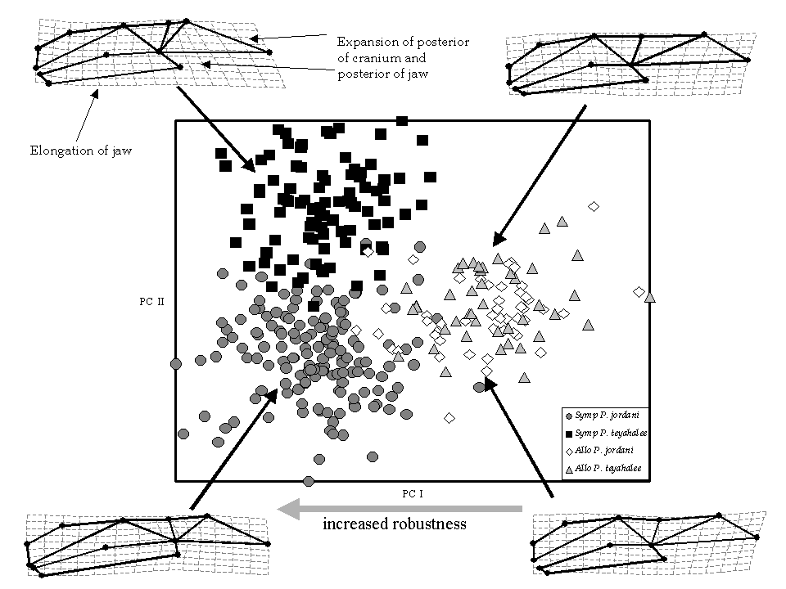
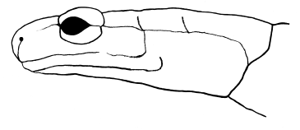
Example 1: Plethodon Salamanders
Ecological character displacement (P. jordani vs. P. teyahalee)
Significant species, site, species×site
Conclusion: species differ in way they diverge, not how much change they exhibit from allopatry to sympatry
Effect | Exact F | Df | P
Species | 4.59 | 18,315 | < 0.0001
Site | 11.46 | 18,315 | <0.0001
Species*Site | 2.15 | 18,315 | 0.0047
D_{Jord} = 0.087, D_{Teh} = 0.099, P = 0.172 NS
θ = 47.71, P < 0.0001
Data from Adams. (2004). Ecology.
Collyer and Adams. (2007). Ecology.

Slide 14
Example 2: Desert Pupfish
Sexual dimorphism in white sands pupfish (C. tularosa)
Significant population, sex, population×sex
Conclusion: populations display different amounts of sexual dimorphism and different directions of dimorphism
3
4
1
2
5
6
13
12
10
9
8
7
11
D_{SC} = 0.068, D_{MO} = 0.044, P < 0.0001
PC II
Male Salt Creek
Female. Salt Creek
Male. Mound Spring
Female. Mound Spring
θ = 23.88, P < 0.0001
Variance explained = 59.1%
PC I
Collyer and Adams. (2007). Ecology.

Slide 15
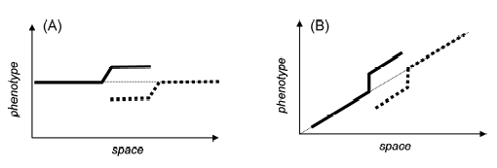
Patterns of Change with Covariates
For many hypotheses, we must account for covariate terms while assessing patterns of change
Example: Character displacement tests: Dsymp > Dallo
If phenotype varies along environmental gradient, must account for it
Incorporate covariate in X; rest of protocol remains unchanged
Adams and Collyer. (2007). Evolution.

Slide 16
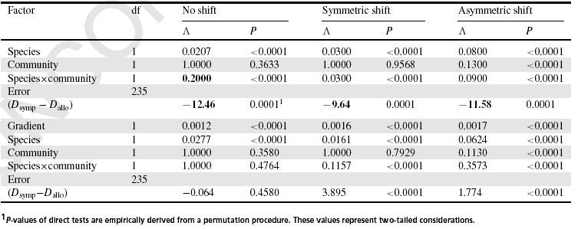
Simulated Examples
Character change along a gradient, 3 scenarios:
No character displacement (CD)
Asymmetric character displacement
Symmetric character displacement
This approach correctly identifies CD when it is present, and does not identify it when it is not present
Adams and Collyer. (2007). Evolution.

Slide 17
Generalizations
Method easily generalized for more than 2 groups
Must do in pairwise fashion (1 vs. 2, 1 vs. 3, etc.)
(e.g,. Hollander, Collyer, Adams, and Johannesson. 2006. J. Evol. Biol. 19:1861-1872.)
For > 2 states (e.g., environments) phenotypic change vector is now a TRAJECTORY (later)
Adams and Collyer (2009) Evolution.

Slide 18
Trajectories: Concept
Values represent sequential states (e.g., developmental stages, temporal points)
y₃
A data space for three variables
Trajectory of multivariate change
y₁
y₂
Adams and Collyer (2009) Evolution.

Slide 19
Attributes of Change Trajectories
Magnitude
Magnitude
(Path distance)
Difference in Magnitude
Difference in Magnitude
Difference in Direction
Difference in Direction
*p = principal eigenvector scaled to unit size
Z _{i}= matrices that have been scaled to unit size, centered, and rotated to minimize variation among them
Difference in Shape

Slide 20
Procrustes Trajectory Analysis
Scaled and Centered
Adams and Collyer (2009) Evolution.

Slide 21
Procrustes Trajectory Analysis
Shape difference = square root of summed squared differences between corresponding “landmarks”
Scaled and Centered
Rotated
Adams and Collyer (2009) Evolution.

Slide 22
Attributes of Change Trajectories
Magnitude
Magnitude
(Path distance)
Difference in Magnitude
Difference in Magnitude
Difference in Direction
Difference in Direction
*p = principal eigenvector scaled to unit size
Can Residual Randomization be used
to test null hypotheses for these statistics?
Difference in Shape
Adams and Collyer (2009) Evolution.

Slide 23
Simulated Example
20
A
B
15
D
V II
10
5
C
0
0
5
10
15
20
Adams and Collyer (2009) Evolution.
V I

Slide 24
Simulated Example
~ Same Length
20
A
B
15
Expect
PD_{A} = PD_{C} = PD_{D}
D
V II
10
5
C
0
0
5
10
15
20
Adams and Collyer (2009) Evolution.
V I

Slide 25
Simulated Example
~ Same Direction
20
A
B
15
Expect
Θ_{AB} = Θ_{AD} = Θ_{BD} = 0
D
V II
10
5
C
0
0
5
10
15
20
Adams and Collyer (2009) Evolution.
V I

Slide 26
Simulated Example
~ Same Shape
20
A
B
15
Expect
D_{AB} = D_{AC} = D_{BC}
D
V II
10
5
C
0
0
5
10
15
20
Adams and Collyer (2009) Evolution.
V I

Slide 27
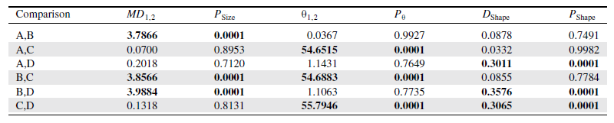
Simulated Example: Results
20
A
PTA identifies differences when present, and does not when they are not present.
B
15
10
D
V II
5
C
0
0
5
10
15
20
V I
Adams and Collyer (2009) Evolution.

Slide 28
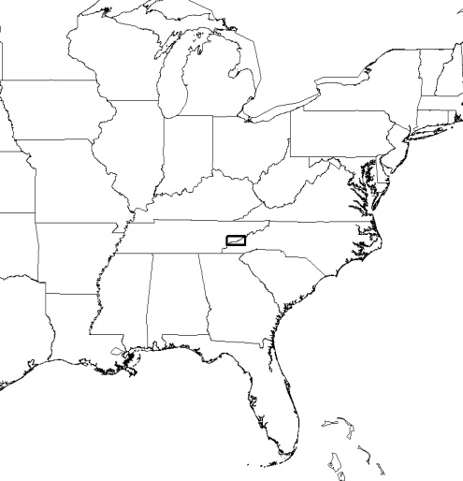
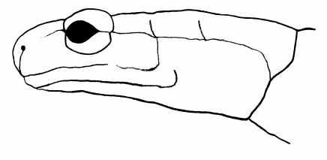
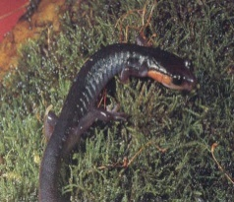
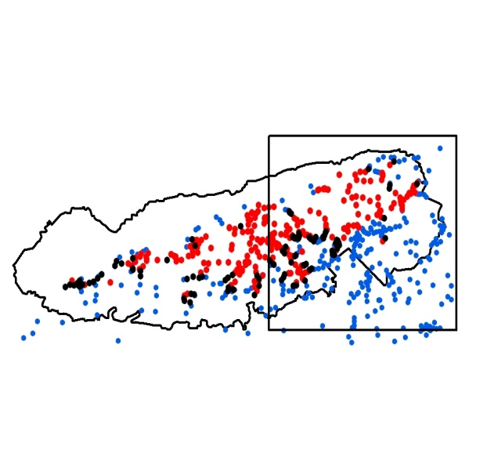
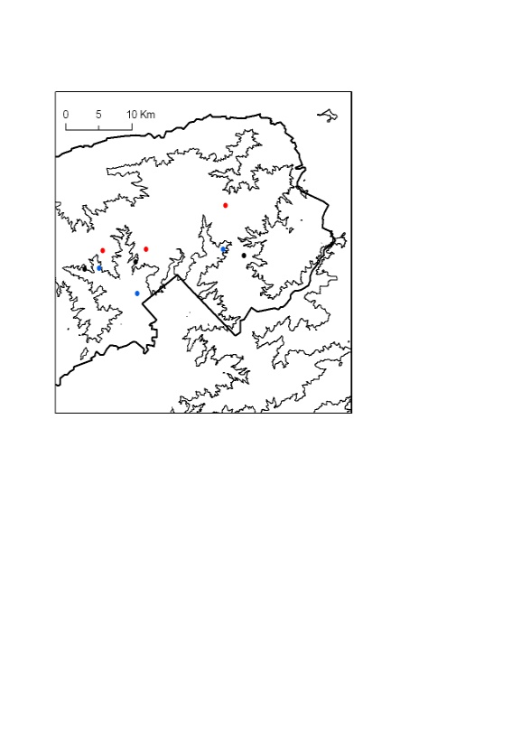
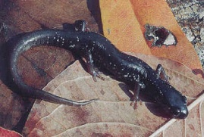
Example I: Parallel Evolution in Plethodon
Ecological work demonstrates competition prevalent
Plethodon biogeography: replicated communities across contact zones
Are microevolutionary changes repeatable?
Measured head shape from 336 specimens across three mountain transects
(allopatry→sympatry)
Plethodon jordani
Plethodon teyahalee
Adams 2010. BMC Evol. Biol.

Slide 29
Microevolution Occurs
Phenotypic evolution is present
Patterns are REPEATABLE
Factor | Df_{Factor} | Pillai’s Trace | Approx. F | df | P
Species | 1 | 0.741 | 48.874 | 18, 307 | < 0.0001
Locality Type | 1 | 0.794 | 65.612 | 18, 307 | < 0.0001
Geographic Transect | 2 | 0.783 | 11.015 | 36, 616 | < 0.0001
Species × Locality | 1 | 0.519 | 18.373 | 18, 307 | < 0.0001
Species × Transect | 2 | 0.289 | 2.888 | 36, 616 | < 0.0001
Locality × Transect | 2 | 0.338 | 3.482 | 36, 616 | < 0.0001
Species×Locality×Transect | 2 | 0.161 | 1.499 | 36, 616 | 0.0327
 | Vector Magnitude |  |  | Vector Orientation
A: P. jordani | HR | KP | TC | HR | KP | TC
HR |  | 0.1849 NS | 0.3192 NS |  | 0.6074 NS | 0.3665 NS
KP | 0.01689 |  | 0.0309 NS | 26.785 |  | 0.4071 NS
TC | 0.00871 | 0.02560 |  | 31.502 | 41.545
B: P. teyahalee | HR | KP | TC | HR | KP | TC
HR |  | 0.3363 NS | 0.8106 NS |  | 0.7965 NS | 0.5579 NS
KP | 0.00871 |  | 0.3261 NS | 19.506 |  | 0.5069 NS
TC | 0.00253 | 0.01224 |  | 25.033 | 34.136
Adams 2010. BMC Evol. Biol.

Slide 30
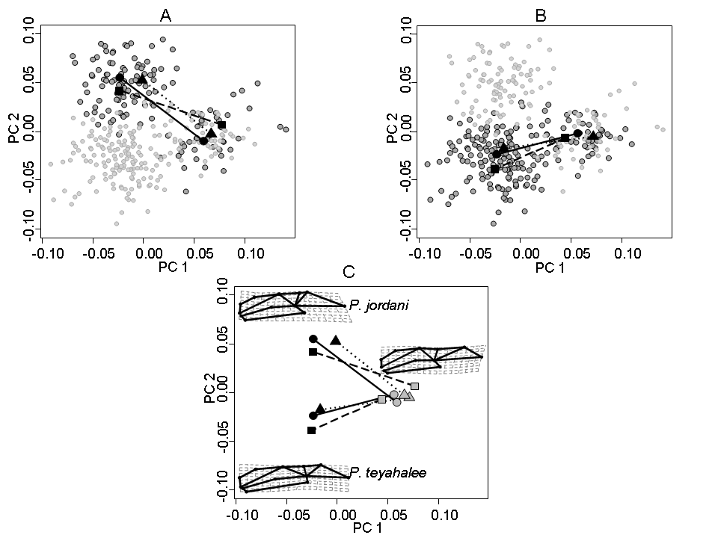
Repeatable Evolutionary Changes
NO difference in magnitude or direction of evolutionary changes among transects within species (i.e. common patterns found)
Conclusion: Evolutionary response to competition repeatable in each species: parallel evolution of character displacement
P. jordani
P. teyahalee
Adams 2010. BMC Evol. Biol.

Slide 31
Example II: Snake Ontogeny
Measured head shape from 3,107 LIVE SNAKES from 2 species (males and females
Collyer and Adams. 2103. Hystrix.
Data from Davis (2012) PhD Dissertation, University of Illinois

Slide 32
Example II: Snake Ontogeny
Measured head shape from 3,107 LIVE SNAKES from 2 species (males and females
Sexual dimorphism
MD = 0.0005 C. viridis P = 0. 0005
MD = 0.0060 C. oregnaus P = 0. 0001
Collyer and Adams. 2103. Hystrix.
Data from Davis (2012) PhD Dissertation, University of Illinois

Slide 33
Example II: Snake Ontogeny
Measured head shape from 3,107 LIVE SNAKES from 2 species (males and females
Amount of ontogenetic shape change
MD = 0.0119 Females, P = 0. 0069
MD = 0.0184 Males, P = 0. 0005
Collyer and Adams. 2103. Hystrix.
Data from Davis (2012) PhD Dissertation, University of Illinois

Slide 34
Example II: Snake Ontogeny
Measured head shape from 3,107 LIVE SNAKES from 2 species (males and females
Shape of ontogenetic shape change
D_{p} = 0.21 Females, P = 0. 0405
D_{p} = 0.21 Males, P = 0. 0048
Collyer and Adams. 2103. Hystrix.
Data from Davis (2012) PhD Dissertation, University of Illinois

Slide 35
Interaction Terms: Conclusions
Significant interactions are the most interesting result biologically
Tell us that response to factor A dependent on level of factor B
Imply that the change across levels is not consistent
Many E&E questions are really interested in change
Phenotypic plasticity, ontogenetics, species interactions, local adaptation, adaptive diversification, etc.
Significance tests of effects are not sufficient to determine how change has occurred and how patterns of change differ
Must quantify attributes of change (magnitude, orientation, shape of change trajectory) and statistically assess these
Provides more complete understanding of biological change

