Slide 1
Ordination Approaches
Advanced Biostatistics
Dean C. Adams
Lecture 8
EEOB 590C

Slide 2
Objectives of Exploratory Data Analyses
Investigate data using only Y-matrix of variables
Objects are points in high-dimensional data space
Look for patterns and distributions of points in data space
Generate summary plots of data space (ordination)
Look for relationships of points (clustering)
PC II
PC I

Slide 3
Ordination and Dimension Reduction
Visualize high dimensional data space as succinctly as possible
Describe variation in original data with new set of variables (typically orthogonal vectors)
Order new variables by variation explained (most – least)
Plot first few dimensions to summarize data
Principal Components Analysis (PCA) one approach (others include: PCoA, MDS, CA, etc.)

Slide 4
Principal Components Analysis (PCA)
Rigid rotation of the data by variables (R-mode)
Axes rank-ordered by %variation
Euclidean distances among specimens preserved (i.e,. no distortion of relationships!)
New axes (PC vectors) are linear combinations of original variables,
PC axes uncorrelated with one another
PCA accomplished via SVD (singular-value decomposition)*
*NOTE: PCA is commonly described using eigen-analysis, but in SVD computationally more efficient and more stable

Slide 5
PCA: What Does it Do?
Rigid rotation of data
PC2
humerus
PC1
femur

Slide 6
PCA: SVD Computations
Start with data matrix (Y_{nxp})
Decompose Y via SVD: Y=UDV^{t}
V_{pxp} = matrix of linear combinations of variables (rotated PC axes)
U_{nxp} = matrix of left-singular vectors
D_{pxp} = diagonal matrix of singular values
D² = % variation (λ) explained by each PC axis
UD = PCA scores for each specimen
NOTE: U also found from eigen-analysis of YY^{t}, and V found from eigen-analysis of Y^{t}Y.
The ‘classic’ implementation of PCA is using eigen-analysis: S = EΛE^{t} , where E contains the eigenvectors and Λ the eigenvalues. PCA scores are found as: P=YE

Slide 7
PCA: Comments
PCA is a rigid rotation where new axes explain % variation
Distances among objects preserved!
PC axes are loadings of each variable on PC axis (variables with values closer to -1 & +1 are more influential in that direction)
How well does a particular PC plot represent relationships among objects? Assess by:
% variation explained by PC axes
Mantel correlation and Shepard diagram (plot of distances in reduced PC space vs. distances in full data space)

Slide 8
PCA: Interpretations
PCA does NOTHING to the data, except rotate it
PCA does not find a particular factor (e.g., group differences, allometry): it identifies the direction of most variation, which may be interpretable as a ‘factor’ (but may not)
Careful interpreting ALL PC axes as biologically meaningful!! Remember they are constrained to be orthogonal, but biological variability is not
Some criteria exist for how many PC axes to interpret (broken stick model, log-ratio method, etc.): see Legendre & Legendre Num. Ecol.; also Mardia et al. 1979 Mult. Anal.; Jackson 1993, Ecol.)

Slide 9
PCA: Dimensionality
Sometimes PCA dimensions have no variation (λ > 0)
If p>N, # PC axes containing variation = N-1 (3 points always lie in a plane, etc.)
If N>p and #PC with variation < p, then some variables redundant (e.g., compositional data (A+B+C=1), or some other linear dependency)

Slide 10
PCA and the Influence of Scale
Y variables with different scale or high variation can have undue influence on PCA (akin to outliers in regression)
Scaling traits first alleviates this problem (note: this is equivalent to using the correlation matrix R in the eigen-analysis)
Obtaining R
1: cor(Y)
2: cov(scale(Y)) *
*Recall that correlations are standardized variances!

Slide 11
PCA Example: Bumpus Data
> summary(pca.bumpus)
PC1 PC2 PC3 PC4 PC5 PC6 PC7 PC8
Standard deviation 0.0699 0.0365 0.0218 0.0192 0.0162 0.0149 0.01362 0.01098
Proportion of Variance 0.6220 0.1694 0.0605 0.0469 0.0335 0.0284 0.02360 0.01534
Cumulative Proportion 0.6220 0.7915 0.8521 0.8990 0.9325 0.9610 0.98466 1.00000
> pca.bumpus$rotation
PC1 PC2 PC3
TL 0.2023231 -0.09175940 0.50893954
AE 0.2477126 -0.04677641 0.25686306
BHL 0.2336021 0.05718419 0.20256651
HL 0.4019895 0.19154460 -0.05637123
FL 0.4165135 0.35321769 -0.12498579
TTL 0.4188801 0.45911607 -0.33681530
SW 0.2218929 0.07085675 0.65504837
SKL 0.5323137 -0.78029599 -0.26951186
PC1: loadings similar and positive (size)
PC2: relative shape: SKL vs. TTL & FL

Slide 12
PCA Plot
2-D plot describes 72.5% of variation
Mantel correlation from Shepard plot: 0.96
Males (red)
Females (blue)

Slide 13
Bi-Plot
Ordination plot of objects (rows) and variables (columns)
Look for sets of vectors with small angles, and clusters of points
Can use to identify variables with high association with objects

Slide 14
Principal Coordinates Analysis (PCoA)
Ordination from distance matrix among objects (Q-mode)
Preserves object distances from any distance measure (D_{E}, Jaccard, etc. )
Useful for when PCA not appropriate (e.g,. binary data, species abundances)
If D_{Euclid} used, PCoA = PCA (Gower 1966)
Sometimes called metric multidimensional scaling (MDS) because preserves relationships among objects

Slide 15
PCoA: Protocol
Start with distance matrix among objects (zeros down diagonal) similarity converted as:
Transform the elements D_{ij} to:
Double-center matrix (subtract row and column means from each element, and add grand mean. Positions origin at centroid of scatter)
Eigen-decomposition of double-centered matrix
Eigenvectors are the COORDINATES for the ordination plot (They don’t describe aspects of the variables since there are no variables, only distances among objects)

Slide 16
PCoA: Comments
PCoA ‘embeds’ a set of objects into a Euclidean space
PCA vs. PCoA: Identical for continuous multivariate data
PCoA Strength: Enables ordination for any data type where distances are available (genetic distance, Hamming distance, geographic distance, quantitative, semi-quantitative, qualitative, or mixed data)
If PCoA yields negative eigenvalues, distances are semi-metric or nonmetric
Properties of Distances
Metric (Euclidean): (1) d₁₁ = 0, (2) d₁₂ = d₂₁, (3) triangle inequality
Semimetric (pseudometrics): no triangle inequality
Non-Metric: d₁₂ may be negative

Slide 17
PCoA Example: Bumpus Data

Slide 18
Nonmetric Multi-Dimensional Scaling (NMDS)
PCA and PCoA attempt to preserve distances among objects
NMDS preserved relative order of the objects, not their distances

Slide 19
NMDS: Protocol
Start with distance matrix
Specify number of NMDS dimensions a priori
Construct initial configuration of objects (a ‘guess’). (Important step: PCoA ordination often used)
Obtain from D_{NMDS} ~ D_{actual}
Estimate goodness of fit (stress)
Move objects in NMDS plot and repeat 4 & 5
Iterate until Δ stress is below threshold (i.e., convergence)
Note: other Stress equations exist

Slide 20
NMDS: Comments
NMDS seems arbitrary, but works rather well
Positives:
Generally yields fewer dimensions than PCA,PCoA
Does not require full distance matrix (missing values ok)
Negatives:
Arbitrary optimization
Results dependent on starting configuration (‘guess’)
Does not preserve distances among objects (though that is not the objective)

Slide 21
MDS Example: Bumpus Data
PCA Plot for comparison
Final Stress = 12.828
Males (red)
Females (blue)

Slide 22
Canonical Variates Analysis/Discriminant Analysis
Ordination that maximally discriminates among known groups (g)
Variation expressed as ratio ( C_{W} = pooled within VCV; C_{B} = between-gp VCV)
Decomposition of results in canonical vector space
Suggests which groups differ on which variables
Within-group variation in CVA plot is circular
METHOD COMMONLY MISUSED BY BIOLOGISTS
Historical note: Fisher developed DFA (1936), which was generalized to CVA by Rao (1948; 1952)

Slide 23
DFA/CVA: Protocol
Partition variation:
Obtain canonical axes of
Calculate normalized canonical axes
Obtain canonical variates (CVA scores: from Y_{c} = centered data)
U contains (g-1) eigenvectors of .
However, they are NOT orthogonal, because
is square, but not symmetric. (sometimes
Called the discriminant functions).

Slide 24
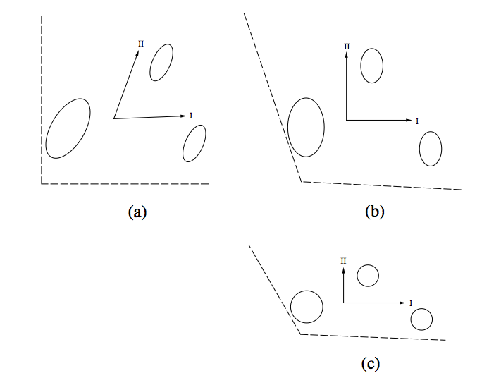
CVA: What it Does
Rotates and shears data space to space of normalized canonical axes (group variation will be circular)
Data sapce (a) → eigenvectors (b) → canonical axes (c)
From Legendre and Legendre (1998)

Slide 25
DFA/CVA: Classification
Obtain CVA scores of specimens (and group means)
Calculate Mahalanobis D² to means,
Assign objects to the group to which it is closest
Determine % misclassified
Note: ideally this is done with a second set of data NOT used to generate CVA (called cross-validation)

Slide 26
CVA Example: Bumpus Data
4-groups (male/female alive/dead)
Colored by sex
Classification:
85% correct by sex
Note how groups are MORE separated in CVA plot vs. PCA plot
PCA Plot for comparison

Slide 27
Data Space Distortion With CVA
Distances and directions among groups distorted with CVA
CVA should NOT be used to describe patterns and variation in data space, only for describing group differences
Original data:3 equidistant groups
CV1 through data space
CVA space: groups NOT equidistant
Adapted from Klingenberg and Monteiro. (2005). Syst. B iol.

Slide 28
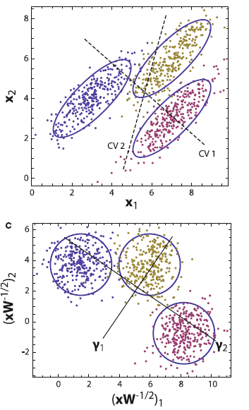
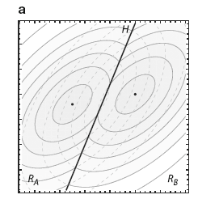
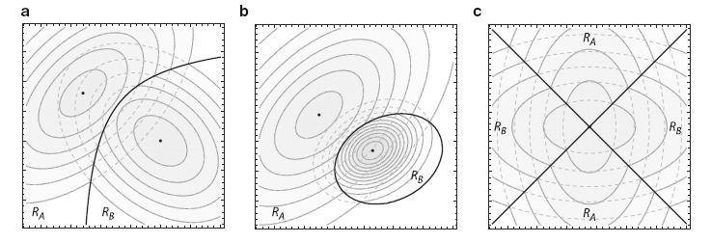
Data Space Distortion With CVA
CV axes NOT orthogonal in original data space
Linear discrimination ONLY forms linear plane IFF within-group covariances identical (shown as ‘equal probability classification lines below)
Original data space
CVA data space
Adapted from Mitteroecker and Bookstein. (2011). Evol. Biol.

Slide 29
Misleading Impression of Group Differences
Increased number of variables increases discrimination…
EVEN for IDENTICAL GROUPS!
Simulation of 50 specimens in each of 3 groups (150 variables using ‘rnorm’: identical mean & variance)
CVA with 4 variables
CVA with 50 variables
CVA with 150 variables
Adapted from Mitteroecker and Bookstein. (2011). Evol. Biol.

Slide 30
DFA/CVA: Conclusions
CVA ordination generally not useful
Distorts distances and directions in data space
Misrepresents within-group covariation and group distances
Perceived group differences increase with additional variables (even for identical groups)
Not overly useful for most applications (better to use PCA or PCA from group means for visualizing actual trends)

