Slide 1
Clustering Approaches
Advanced Biostatistics
Dean C. Adams
Lecture 9
EEOB 590C

Slide 2
Objectives of Exploratory Data Analyses
Investigate data using only Y-matrix of variables
Objects are points in high-dimensional data space
Look for patterns and distributions of points in data space
Generate summary plots of data space (ordination)
Look for relationships of points (clustering)
PC II
PC I

Slide 3
Ordination and Dimension Reduction
Visualize high dimensional data space as succinctly as possible
Describe variation in original data with new set of variables (typically orthogonal vectors)
Order new variables by variation explained (most – least)
Plot first few dimensions to summarize data
Principal Components Analysis (PCA) one approach (others include: PCoA, MDS, CA, etc.)

Slide 4
Ordination Protocols
Methods based on variables (VCV) or objects (distances)
Can view methods as flow chart of operations
PCA
PCoA
NMDS
Y
VCV
PROJ
PC
Scores
eigen
E
Λ
R
Y
S
PCo
Scores
eigen
Λ
DCntr
D
Y
S
MD
Scores
‘Guess’
D
NOTE: PCoA and NMDS can begin directly from D or S

Slide 5
Correspondence Analysis (CA)
Ordination for contingency table data (counts, frequencies)
Method VERY useful for ecological data (sites × species, individuals × prey they consumed, etc.)
CA preserves X² distance among objects (a weighted Euclidean distance of conditional probabilities)
CA provides test for the ‘independence’ of rows and columns
Where , and for rows i and j
CA also called reciprocal averaging

Slide 6
CA: Protocol
Calculate matrix (Q) of relative frequencies (proportions) from contingency table data:
Calculate elements of matrix as:
(matrix is centered by row and column means, hence ‘reciprocal averaging’)
Perform singular-value decomposition (SVD) on
Eigen-analysis NOT used because is rectangular (not square)
factors (‘eigenvectors’) for rows
factors (‘eigenvectors’) for columns
singular values (related to eigenvalues)
Ordination plot from scaled & projected row and column factors (see Legendre and Legendre, 1998 for math)

Slide 7
CA: Comments
Similarity of objects from frequency data can be viewed using ordination
Test of independence between objects and variables (significance implies some objects have higher frequencies on particular variables)
Ordination can be as a biplot (simultaneous plot of rows and columns: objects and variables)
Interesting Note: Eigenanalysis of yields , and eigenanalysis of yields
Advantage of SVD is that it decomposes rows AND columns simultaneously

Slide 8
CA Example: Buzzwords in Ecology
Use of 30 ecological terms (1982-1995) in 43 journals in 5 categories (for A) Ecologists, B) Students, C) Funding/Govt., D) Scientists, E) Biologists)
Data from Adams et al. (1997). Oikos. 80:632-636.

Slide 9
CA Plot
Buzzwords frequently used: sustainability, tragedy of commons, biodiversity
Journals for funding agencies and general public
2-D plot describes 89% of variation
Data from Adams et al. (1997). Oikos. 80:632-636.

Slide 10
Ordination Approaches: Closing Comments
Extremely useful for obtaining low-dimensional view of data
Do NOT use subset of PCs for subsequent analyses (can get into trouble)
Don’t over-interpret axes (axes may be orthogonal, biological ‘factors’ are not!)
Don’t ‘correct’ for patterns to identify ‘real’ pattern
Example: the arch effect
Common in community data, or along environmental gradients
Some have proposed ‘corrections’ (detrending) to ‘reveal’ original gradient

Slide 11
The Arch Effect
Hypothetical abundance data of 3 species for sites along an ecological gradient
Ordination (CA) of sites from above data
From Legendre and Legendre (1998). Numerical Ecology.
Note: similar curved patterns found in data in other fields (psychology: the ‘circumplex’ plot)

Slide 12
Detrended Correspondence Analysis (DCA)
‘Correct’ arch effect: two approaches
1: DCA by segments
Create DC1 segments
DC2 values are mean-centered within each segment
2: DCA by polynomials
Constrain CA so DC2 is orthogonal to DC1, DC1², DC1³, etc.

Slide 13
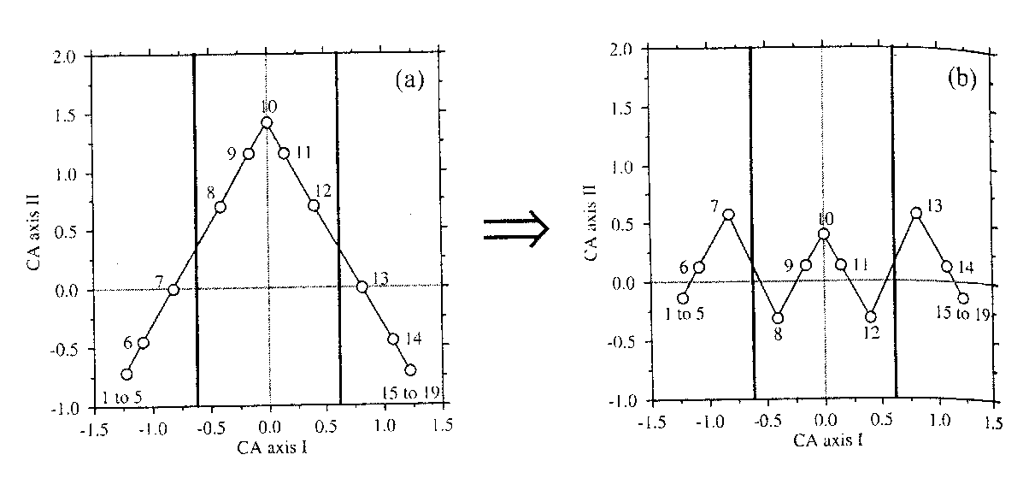
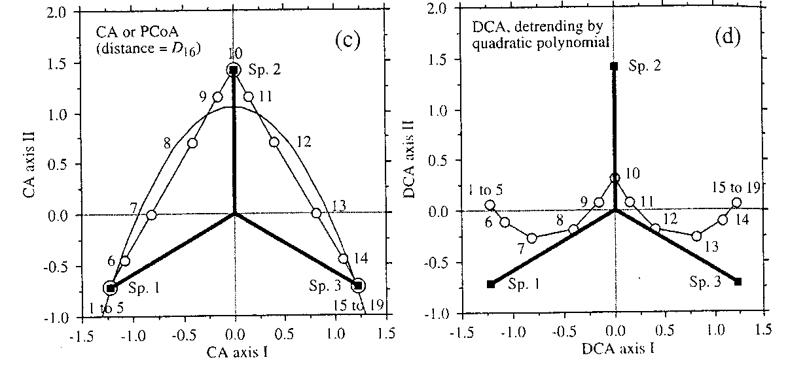
DCA: Example
DCA by Segments
DCA by polynomials
From Legendre and Legendre (1998). Numerical Ecology.

Slide 14
DCA: Comments
Methods completely arbitrary and border on absurd
How to choose segments? how many? what degree polynomial to use?
DC2 completely meaningless
Can’t interpret object locations, b/c DC2 is arbitrarily created
DCA eliminates arch, which IS the pattern!
Detrending should absolutely be avoided!
For detailed critique see Wartenberg, Ferson, and Rohlf, 1987. Am. Nat.

Slide 15
Clustering Methods
Obtain groupings (clusters) of data based on similarity
Clustering requires distances (or similarities) between points
A complementary view to ordination
Clustering is algorithmic, not algebraic (i.e., it is a procedure, or set of rules for connecting data)

Slide 16
Classifying Clustering Methods
Hierarchical: clusters are nested (higher-rank clusters contain lower-rank clusters)
Non-hierarchical: data are partitioned into clusters (no nesting)
Other classification schemes
Agglomerative vs. Divisive: start with every specimen in its own group vs. all in 1 group
Sequential vs. Simultaneous: calculate clusters all at once vs. one at a time
Monothetic vs. Polythetic (divisive methods only): single descriptor for partitions vs. multiple descriptors

Slide 17
SAHN Methods
SAHN: Sequential, agglomerative, hierarchical, nested
Cluster most similar objects first and recalculate if needed
Aggregate until all objects are part of largest cluster
Produces dendogram displaying similarities
Different criteria for determining when to join objects to clusters

Slide 18
SAHN: Single Linkage vs. Complete Linkage
Single linkage (nearest neighbor clustering): Add object when similarity to the first object is reached
Complete linkage (farthest neighbor clustering): Add object when similarity to the last object is reached
Represent extremes of SAHN clustering (& can be sensitive to noise in data)
Mostly ‘slides’ nodes towards tips (single ) or root (complete)
Cluster assignments may also change

Slide 19
Clustering Data: Example
Skull shape similarity among populations of European moles
Shape residuals for 113 superimposed specimens
Data from Rohlf et al. (1996). Syst. Biol. 45:344-362.

Slide 20
Single Linkage vs. Complete Linkage: Example
10.T_eur
9.T_eur
8.T_eur
3.M_touc
2.T_rom
1.T_rom
Single linkage
Complete linkage
6.T_stan
5.T_occ
7.T_cae
4.P_bre
Cluster change
8
6
4
2
0
10.T_eur
9.T_eur
8.T_eur
7.T_cae
Nodes shifted towards root
5.T_occ
3.M_touc
2.T_rom
1.T_rom
6.T_stan
4.P_bre
15
10
5
0
Data from Rohlf et al. (1996). Syst. Biol. 45:344-362.

Slide 21
SAHN: UPGMA
Unweighted Pair-Group Method using Arithmetic Averages
Most commonly used SAHN method
Uses averages of clusters to join additional objects
Connect closest 2 objects in a cluster
Calculate their average similarity to objects not in cluster
Replace original similarity scores with averages
Add new object to cluster when distance to average is reached
Recalculate average for cluster and continue
Method unweighted because it gives same weight to original similarity scores (e.g., when 3rd object added, new average found by dividing by 3, etc.)

Slide 22
UPGMA: Example
10.T_eur
9.T_eur
8.T_eur
3.M_touc
2.T_rom
1.T_rom
5.T_occ
6.T_stan
5.T_occ
7.T_cae
3.M_touc
4.P_bre
8
6
4
2
0
10.T_eur
Single linkage
Complete linkage
9.T_eur
8.T_eur
7.T_cae
2.T_rom
1.T_rom
6.T_stan
10.T_eur
4.P_bre
9.T_eur
8.T_eur
7.T_cae
5.T_occ
3.M_touc
10
8
6
4
2
0
2.T_rom
1.T_rom
6.T_stan
4.P_bre
15
10
5
0
Data from Rohlf et al. (1996). Syst. Biol. 45:344-362.

Slide 23
SAHN: WPGMA
Weighted Pair-Group Method using Arithmetic Averages
Same as UPGMA, but averages are weighted (always divided by 2)
Thus, gives different weights to original objects (when 3+ in cluster)

Slide 24
WPGMA: Example
5.T_occ
3.M_touc
10.T_eur
9.T_eur
8.T_eur
7.T_cae
5.T_occ
2.T_rom
1.T_rom
3.M_touc
6.T_stan
10.T_eur
4.P_bre
9.T_eur
10
8
6
4
2
0
8.T_eur
UPGMA
7.T_cae
2.T_rom
1.T_rom
6.T_stan
4.P_bre
10
8
6
4
2
0
Data from Rohlf et al. (1996). Syst. Biol. 45:344-362.

Slide 25
SAHN: UPGMC & WPGMC
Use centroids of clusters to join additional objects
Centroids obtained from similarity scores*
Centroid methods can find ‘reversals’ or negative branch lengths (e.g., when distance of 3rd object to centroid is smaller than distance between original pair)
* For details see Legendre and Legendre (1998). Numerical Ecology.

Slide 26
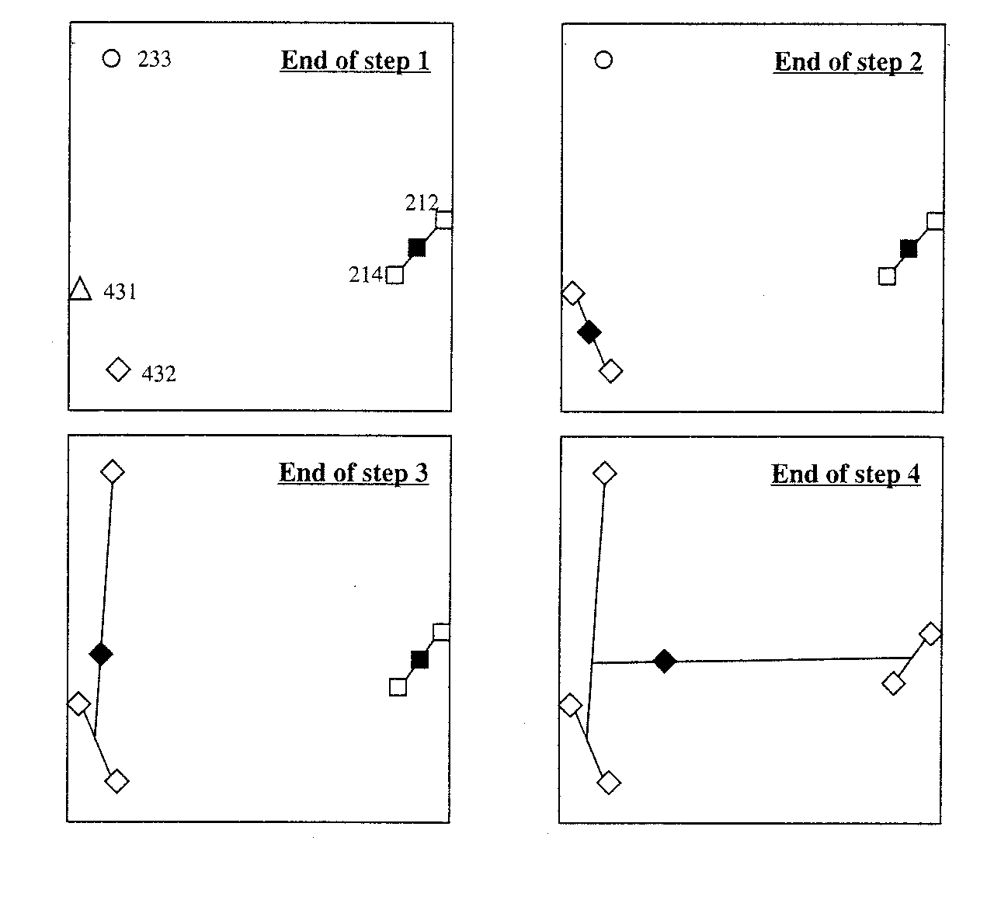
Visualizing Centroid Clustering
Can think of centroid clustering as connecting dots in ordination space
From Legendre and Legendre (1998). Numerical Ecology.

Slide 27
UPGMC & WPGMC: Examples
2.T_rom
1.T_rom
6.T_stan
5.T_occ
10.T_eur
UPGMC
WPGMC
9.T_eur
8.T_eur
7.T_cae
3.M_touc
4.P_bre
8
6
4
2
0
2.T_rom
1.T_rom
6.T_stan
5.T_occ
10.T_eur
9.T_eur
8.T_eur
7.T_cae
3.M_touc
4.P_bre
8
6
4
2
0
Data from Rohlf et al. (1996). Syst. Biol. 45:344-362.

Slide 28
Ward’s Minimum Variance Method
Use cluster variance (TESS: total error sum of squares)
Add object that increases TESS the least
2.T_rom
1.T_rom
6.T_stan
4.P_bre
5.T_occ
3.M_touc
7.T_cae
5.T_occ
10.T_eur
3.M_touc
9.T_eur
10.T_eur
8.T_eur
9.T_eur
8.T_eur
15
10
5
0
7.T_cae
2.T_rom
1.T_rom
6.T_stan
4.P_bre
10
8
6
4
2
0
UPGMA

Slide 29
Partition Methods: K-Means Clustering
Partitions data into groups that minimize TESS
Define # groups (k)
Assign specimens to groups, calculate centroid, and TESS
Repeat many times and choose solution with minimal TESS
Can iterate for k = 2,3,4 etc. to find optimal # groups
Does not yield dendogram (not hierarchical) ; only group membership

Slide 30
Clustering: Comments
Recall: these methods do NOT assume process!!
Careful in interpretation (not based on evolutionary history)
Change of metric/distance measure may alter results
Useful to combine with ordination (are complementary)
Other methods exist: minimum spanning tree (MST), neighbor-joining, flexible-link clustering, probabilistic clustering, evolutionary model-based ‘clustering’ (parsimony, ML, Bayesian, etc.)
4
2.T_rom
5.T_occ
6.T_stan
7.T_cae
3.M_touc
2
1.T_rom
10.T_eur
5.T_occ
8.T_eur
9.T_eur
0
8.T_eur
PCoA 2
10.T_eur
7.T_cae
2.T_rom
-2
9.T_eur
1.T_rom
3.M_touc
6.T_stan
-4
4.P_bre
4.P_bre
10
8
6
4
2
0
-5
0
5
UPGMA
PCoA 1

